Slide 1
(CS732)
Avatar based Architecture for a Mobile Crowd Sourcing and Resource Sharing to solve Machine Learning Problems
Presented by: Wadood Chaudhary

Slide 2
Inspiration
SETI@home is a popular volunteer distributed computing project that was launched by the University of California, Berkeley, in May 1999.
The SETI@home program itself runs signal analysis on a "work unit" of data recorded from the central 2.5 MHz wide band of the SERENDIP IV instrument.
After computation on the work unit is complete, the results are then automatically reported back to SETI@home servers at UC Berkeley.
By June 28, 2009, the SETI@home project had over 180,000 active participants volunteering a total of over 290,000 computers.
These computers give SETI@home an average computational power of 617 teraFLOPS.
SETI@home has listened to that one frequency at every point of over 67 percent of the sky observable from Arecibo which covers about 20 percent of the full celestial sphere.
CS 732: Machine Learning
5
Notes:
he search for extraterrestrial intelligence (SETI) is the collective name for a number of activities undertaken to search for intelligent extraterrestrial life. SETI projects use scientific methods in this search. For example, electromagnetic radiation is monitored for signs of transmissions from civilizations on other worlds.
Some of the most well-known projects are run by Harvard University, the University of California, Berkeley, or the SETI Institute
It was originally funded by The Planetary Society and Paramount Pictures, and later by the state of California.
Any individual can become involved with SETI research by downloading the Berkeley Open Infrastructure for Network Computing (BOINC) software program, attaching to the SETI@home project, and allowing the program to run as a background process that uses idle computer power.
In 2004 radio source SHGb02+14a was an interesting signal but was quickly shown to have a natural source.
As of 2010, after 10 years of data collection, SETI@home has listened to that one frequency at every point of over 67 percent of the sky observable from Arecibo with at least 3 scans (out of the goal of 9 scans), which covers about 20 percent of the full celestial sphere.

Slide 3
Project
Any individual can become involved with Avatar-ML research by downloading the App. allowing the App. to run as a background process that uses idle computer power of their smartphone.
Data will be downloaded and uploaded from Cloud.
A general-purpose framework based on MapReduce and GPU to add other applications as well.
CS 732: Machine Learning
5

Slide 4
Goals
Develop a Scalable General purpose framework for ML problems in the Smartphone world
Any algorithm fitting the Statistical Query Model may be written in a certain “summation form.
Most ML algorithms can be easily expressed in a map-reduce framework which is easy to program in.
Achieve linear speed-ups with the number of Smartphones.
CS 732: Machine Learning
11
Notes:
Isolated Cores.
There is little communication between cores.
Multicore mostly benefits concurrent applications
The data is subdivided and stays local to the cores

Slide 5
Apps
ML algorithm library on Smartphones
SETI style resource sharing using SmartPhones
Crowdsourcing Selfie-Generation.
Resource-sharing among Mobile Devices augment each other’s resources.
CS 732: Machine Learning

Slide 6
Section II Architecture

Slide 7
Architecture
Data set D divided into d1, d2, ... dn
Mappers running on Smart-Phones 1,SmartPhone2, … SmartPhone_n
Each mapper performs a computation over its piece of the data and emits the results s1, s2, ... sn for the Reducers which is at a central server.
CS 732: Machine Learning
CS 732: Machine Learning
SmartPhone1 – mapper of d1
SmartPhone2 – mapper of d2
SmartPhone3 – mapper of d3
Reducer Sum Mapper Outputs
5
11

Slide 8
Sum Values from a Large Data Set
Data set D divided into d1, d2, ... dn.
Mappers running on CPU 1, CPU 2, ... CPU n
Each mapper forms a sum over its piece of the dat and emits the sum s1, s2, ... sn.
CPU 1 – mapper Sum Elements of d1
CPU 1 – mapper Sum Elements of d1
CPU 1 – mapper Sum Elements of d1
CS 732: Machine Learning
Reducer Sum Mapper Outputs
11

Slide 9
Map-reduce
Batch gradient descent:
Machine 1: Use
Machine 2: Use
Machine 3: Use
Machine 4: Use
[ Jeffrey Dean and Sanjay Ghemawat]

Slide 10
Statistical Query Model
Mappers compute partial sums of the form ∑(􏰀􏰁􏰀􏰁xixiT) and ∑xiyi
Reducer aggregates the partial sums into totals and completes the calculation Θ* = A-1 b􏰀􏰁 􏰃􏰁
CPU 1 – mapper
Sum xix,T & xiyi for xi ε d1
CPU 2 - mapper
Sum xix,T & xiyi for xi ε d2
CPU - mapper
Sum xix,T & xiyi for xi ε dn
CS 732: Machine Learning
Sumxx,, Sumxy
Sumxx,, Sumxy
Sumxx,Sumxy
Reducer
Aggregate mapper outputs
A = ∑Sumxx, b = ∑Sumxy Calculate: Θ* = A-1 b
11

Slide 11
Machine Learning Algorithms
CS 732: Machine Learning
11

Slide 12
Machine Learning Algorithms
CS 732: Machine Learning
11

Slide 13
Machine Learning Algorithms
CS 732: Machine Learning
11

Slide 14
Architecture
CS 732: Machine Learning
11
Notes:
Many programming frameworks are possible for the summation form, but inspired by Google’s success in adapting a functional programming construct, map-reduce [7], for wide spread parallel programming use inside their company, we adapted this same construct for multicore use. Google’s map-reduce is specialized for use over clusters that have unreliable communication and where indi- vidual computers may go down. These are issues that multicores do not have; thus, we were able to developed a much lighter weight architecture for multicores, shown in Figure 1.
Figure 1 shows a high level view of our architecture and how it processes the data. In step 0, the map-reduce engine is responsible for splitting the data by training examples (rows). The engine then caches the split data for the subsequent map-reduce invocations. Every algorithm has its own engine instance, and every map-reduce task will be delegated to its engine (step 1). Similar to the original map-reduce architecture, the engine will run a master (step 1.1) which coordinates the mappers and the reducers. The master is responsible for assigning the split data to different mappers, and then collects the processed intermediate data from the mappers (step 1.1.1 and 1.1.2). After the intermediate data is collected, the master will in turn invoke the reducer to process it (step 1.1.3) and return final results (step 1.1.4). Note that some mapper and reducer operations require additional scalar information from the algorithms. In order to support these operations, the mapper/reducer can obtain this information through the query info interface, which can be customized for each different algorithm (step 1.1.1.1 and 1.1.3.2).

Slide 15
What is an Avatar?
App 2, User A
App 1, User A
App 2, User B
App 2, User A
App 1, User A
App 1, User A
App 1, User A
App 1, User B
App 1, User C
CS 732: Machine Learning
Avatar = All Apps by user on all devices
Avatar = All instances of a single App.
App 1
App 1
App 1
App 2
App 2
App 2
App 3
App 3
App4
Multiple Avatars per App.
A Master-Slave relationship exists between Mobile App. and its children on the cloud/cloudlets
Notes:
Avatar is an App assistant. It can be made up of all instances of Apps of a single user or all user instances of a particular App. In either cases most of the communication is between a mobile device App and its Application instance on the backend, through a process, called Avatar Manager.
A Master-Slave relationship exists between Mobile App. and its children on the cloud/cloudlets.
Multiple Avatars per App.

Slide 16
App updating data and Avatars monitoring changes to data.
Map Job
Map Job
Data processed= 08820,10036
Data processed=08820
08820
10036
10018
08820
10036
CS 732: Machine Learning
Map Job
10018
Reducer
Reducer
08820
10036
10018
App 1
App 2
Reducer
Reducer
Notes:
Scalability, failover, having Compute Node closer to and not necessarily for MapReduce or any distributed programming paradigm.

Slide 17
Mobile App as slave node of MapReduce
App2
App2
L-Z
F-K & L-Z
A-E
F-K
L-Z
A-E
F-K
CS 732: Machine Learning
App2
L-Z
Reducer
Reducer
A-E
F-K
App 1
App 2
L-Z
App Pics
App 2
Reducer
Reducer
Reducer

Slide 18
Single Server running MapReduce.
08820
Map Job
10036
08820
10018
10036
Map Job
10018
CS 732: Machine Learning
Map Job
08820
10036
App 1
10018
App 2
Reducer
Reducer

Slide 19
Possible APIs extensions for Machine Learning-Avatar
configureMaps()
configureMaps(String partitionFile)
configureMaps(List<Value> values)
configureReduce(List<Value> values)
addToMemCache(Value value)
addToMemCache(List<Value> values)
cleanMemCache()
runMapReduce()
runMapReduce(List<KeyValuePair> pairs)
runMapReduceBCast(Value value)
map(MapOutputCollector collector, Key key, Value val)
reduce(ReduceOutputCollector collector, Key key, List<Value> values)
combine(Map<Key, Value> keyValues)
sendRequestToProcessData(workItem:AvatarWorkItem)
alreadyProcessedThis(workItem:AvatarWorkItem)
assembleDataForProcessing()(Map<Key, Value> keyValues)
processResults(Map<Key, Value> keyValues)

Slide 20
Part III Project Demo
14

Slide 21
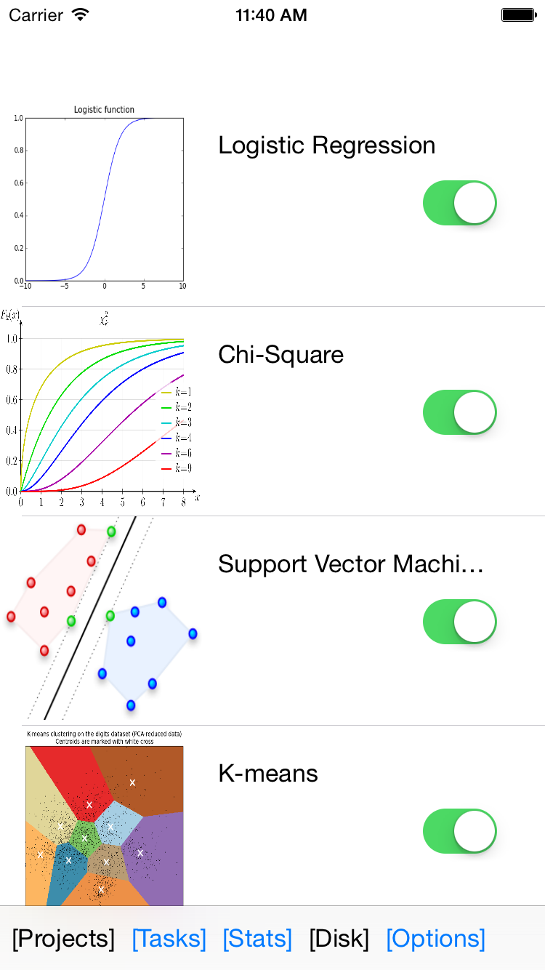
iOS App.
CS 732: Machine Learning
CS 732: Machine Learning
5
11

Slide 22
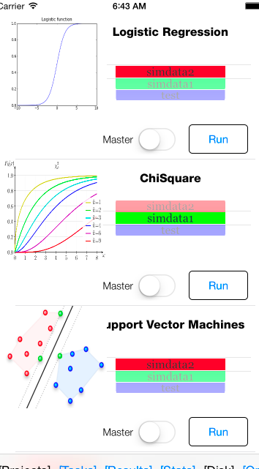
iOS App.
CS 732: Machine Learning
CS 732: Machine Learning
5
11

Slide 23
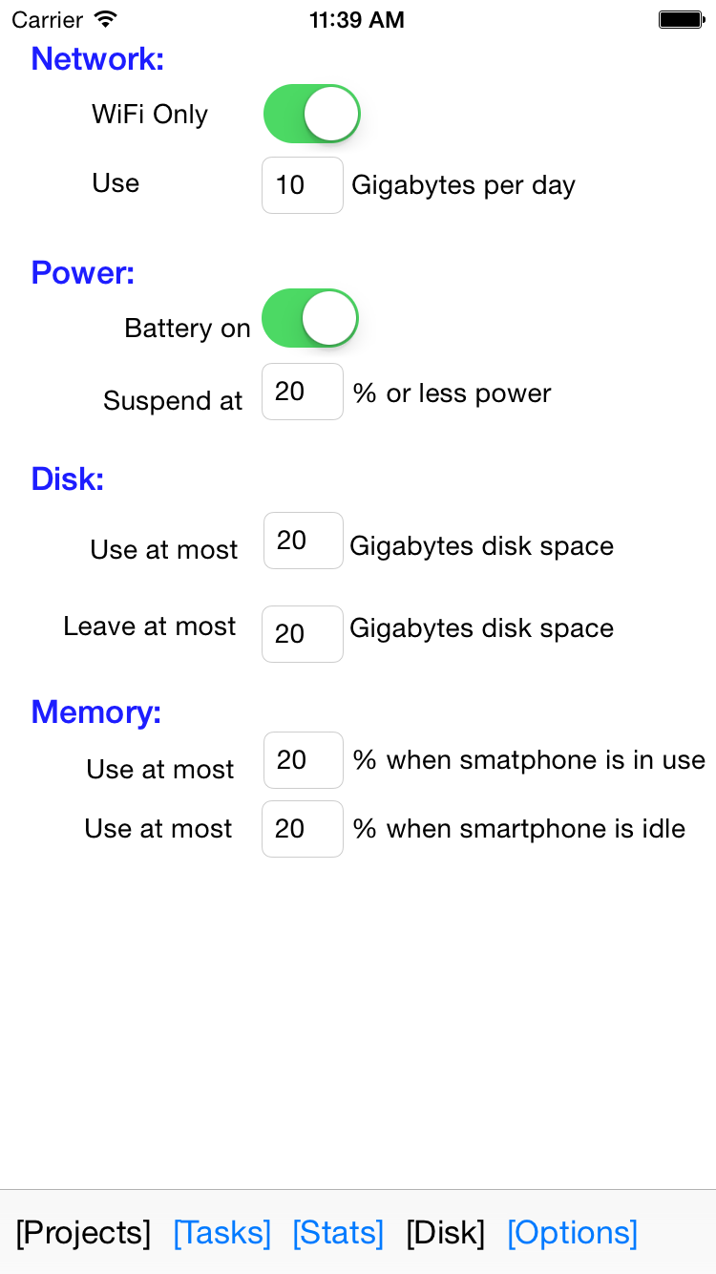
iOS App.
CS 732: Machine Learning
5
11

Slide 24
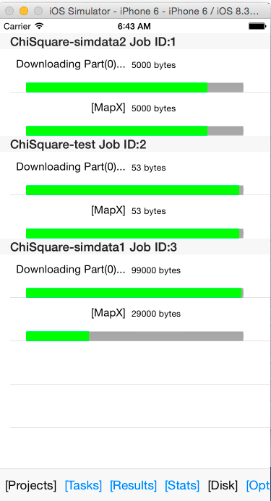
iOS App.
CS 732: Machine Learning
CS 732: Machine Learning
5
11

Slide 25
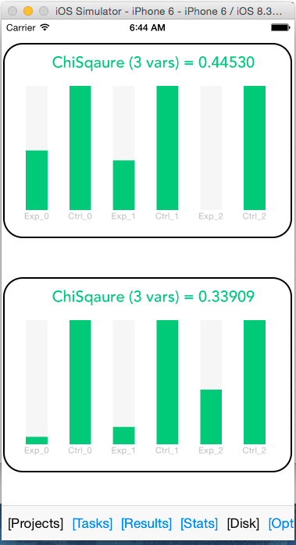
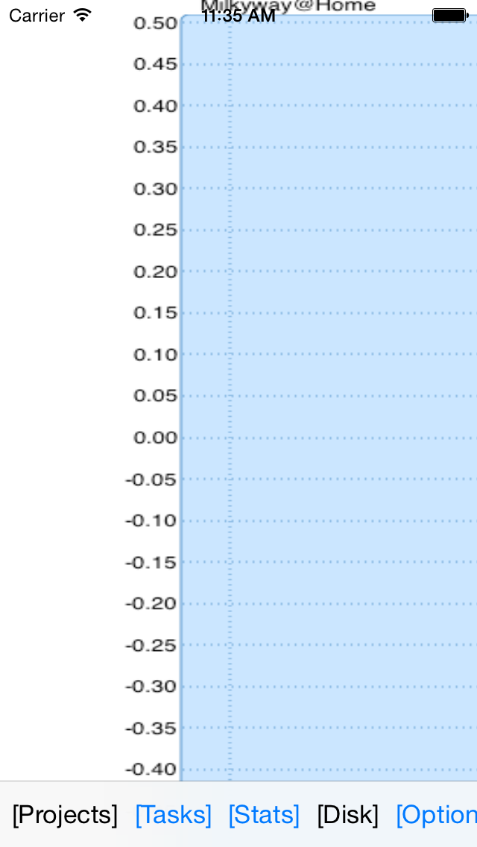
iOS App.
CS 732: Machine Learning
CS 732: Machine Learning
5
11

Slide 26
iOS App.
CS 732: Machine Learning
CS 732: Machine Learning
5
11

Slide 27
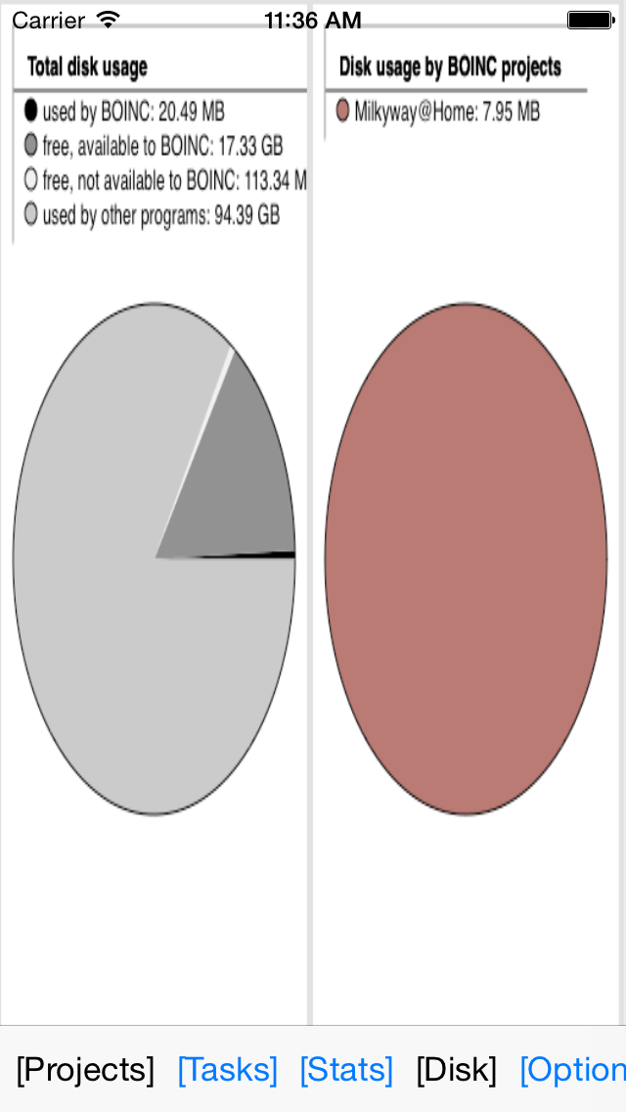
iOS App.
CS 732: Machine Learning
CS 732: Machine Learning
5
11

Slide 28
iOS App.
CS 732: Machine Learning
CS 732: Machine Learning
5
11

Slide 29
iOS App.
CS 732: Machine Learning
CS 732: Machine Learning
5
11

Slide 30
iOS App.
CS 732: Machine Learning
CS 732: Machine Learning
5
11

Slide 31
iOS App.
CS 732: Machine Learning
CS 732: Machine Learning
5
11

Slide 32
iOS App.
CS 732: Machine Learning
CS 732: Machine Learning
5
11

