Slide 1
BSP: An iterated local search heuristic for the hyperplane with minimum number of misclassifications
Usman Roshan

Slide 2
Linear classifiers
Popular methods such as the support vector machine, perceptron, and logistic regression are linear classifiers
Known to be fast and accurate (in combination with feature selection and feature learning)
Empirical comparison of linear SVM, Caruna and Niculescu-Mizil, ICML 2006
Fast SVM implementation liblinear, Hsieh et. al. ICML 2008

Slide 3
Support vector machine
Regularized hinge loss minimizer
Optimization objective:
Convex and solved with a quadratic program

Slide 4
Support vector machine
y
w
x

Slide 5
NP-hard optimization
Determining the plane with the minimum number of misclassifications is NP-hard (Ben-David, Eiron, and Long, JCSS, 2003)
Nothing known about error bounds
Objective (also known as 0/1 loss):

Slide 6
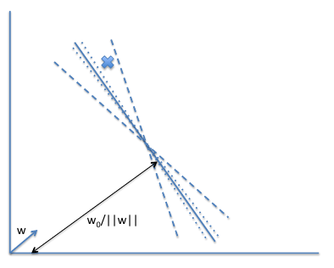
Modified objective
Difficulty in optimizing the number of misclassifications with local search

Slide 7
Modified objective
Thus we consider a modified objective by adding the hinge loss.
This guides our search and avoids getting trapped in local optima

Slide 8
Motivation for our objective
Consider the objective value of error + hingeloss of solid and dashed lines.
Now consider the objective value of just hingeloss of both lines.

Slide 9
Motivation for 0/1 loss
From Nguyen and
Sanner, ICML 2013

Slide 10
Our coordinate descent (local search)

Slide 11
Local search

Slide 12
Local minima
A major problem for optimizing NP-hard problems
How to overcome?
Random restarts
Simulated annealing
MCMC
Iterated local search

Slide 13
Iterated local search

Slide 14
Results
Data: 33 randomly selected datasets from UCI repository
Some were multi-class and converted into binary (largest class separated from the others)
We created ten random 90:10 splits for each dataset. All model parameters were learnt on the training dataset

Slide 15
Effect of iterated local search

Slide 16
Variants of BSP
BSP: optimize our objective of error + loss
BSPH: optimize hingeloss alone
BSPE: optimize error alone
BootstrapBSP: 10 bootstraps
100 iterated local search iterations

Slide 17
Effect of search parameters on BooststrapBSP (100 bootstraps)

Slide 18
Train and test error (breast cancer, 569 rows, 30 columns, PCC=0.82)

Slide 19
Train and test error (musk, 476 rows, 166 columns, PCC=0.29)

Slide 20
Train and test error (climate simulation, 540 rows, 18 columns, PCC=0.38)

Slide 21
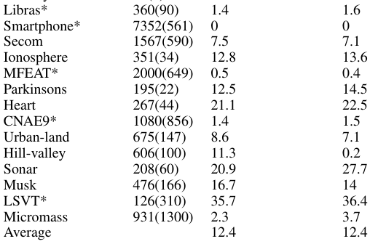
Results on 33 datasets

Slide 22
Comparison to liblinear
Average error across 33 datasets:
liblinear = 12.4%
BSP = 12.4%
Average runtime across 33 datasets
Liblinear (including time for cross-validation) = 2 mins (median = 0.5 mins)
BSP (including time for C and 100 bootstraps) = 11 mins (median = 5 mins)
Bootstrapped libsvm has 12.3% error but takes considerably longer

Slide 23
Conclusion
ICML 2013 proposes a branch and bound search for 0/1 loss
BSP: local search heuristic to optimize 0/1 loss (number of misclassifications)
Our program has comparable accuracy and runtime to liblinear – fastest and among accurate linear classifiers
Open questions:
Are there datasets where BSP would perform considerably better?
Can we add a second offset (w_0) parameter to account for hard datasets?
Is our search deep enough?

