Slide 1
Machine learning optimization
Usman Roshan

Slide 2
Machine learning
Mathematical programming optimization for convex functions
Comes down to gradient descent
Stochastic gradient descent leads to even faster search

Slide 3
Gradient descent
Given a convex function f(x,y) how can we find x and y that minimizes this?
Solution is gradient descent
The gradient vector points in the direction of greatest increase in the function.
Therefore solution is to move in small increments in the negative direction of the gradient until we reach the optimum.

Slide 4
Gradient descent example
Minimize f(x)=1 + (x-5)²
Derivative w.r.t x is df/dx = 2(x-5)
df/dx = F(x) = 2(x-5)
Algorithm:
δ=.1
start with a random value of x (e.g. x = 10)
prev = f(x)
while (!stop){
x = x - δF(x)
if(f(x) > prev) { stop = true ; }
prev = f(x)

Slide 5
Gradient descent example
Initialize
x = 10, f(x) = 26, prev = 26
Step 1
F(x) = 10, x = 10 - .1(10) = 9, f(x) = 17, prev = 17
Step 2
F(x) = 8, x = 9 - .1(8) = 8.2, f(x) = 11.24, prev = 11.24
Step 3
F(x) = 6.4, x = 8.2 - .1(6.4) = 7.56, f(x) = 7.5536, prev = 7.5536
Step 4
F(x) = 5.12, x = 7.56 - .512 = 7.048, f(x) = 5.19, prev = 5.19

Slide 6
Constrained optimization
Most machine learning problems require optimizing a convex function with convex constraints
In this case we apply Lagrange multipliers
The KKT theorem is their generalization (see handout)

Slide 7
Direct optimization of NP-hard
K-means is the classic example for unsupervised learning
For supervised learning consider finding the plane that gives lowest number of misclassified points.
Why would we want to find such planes?
Reduces effect of outliers

Slide 8
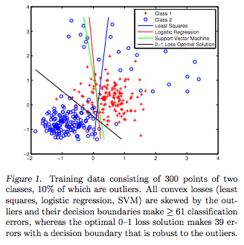
Direct optimization motivation

Slide 9
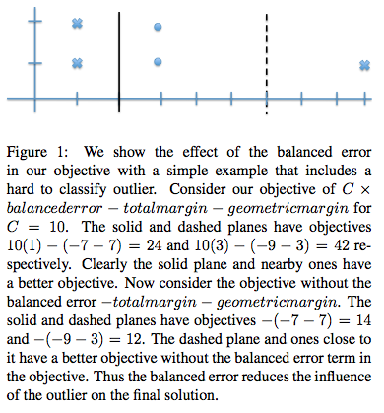
Direct optimization motivation

Slide 10
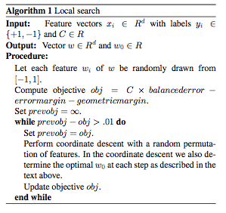
How do we directly optimize?
Today we look at local search

Slide 11
Local search
Coordinate descent:
Fix all coordinates w_{i} for I = 1 to d
Randomly pick one w_{i} and optimize
Make incremental changes in w_{i} until there is no change
Pick a different random w_{i} and optimize again.
Repeat until no change in objective after circling through all w_{i}.

Slide 12
Local minima
A major problem for optimizing NP-hard problems
How to overcome?
Random restarts
Simulated annealing
MCMC
Iterated local search

Slide 13
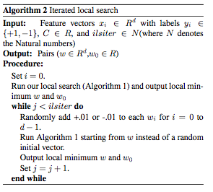
Iterated local search

Slide 14
Results
Data: 33 randomly selected datasets from UCI repository
Some were multi-class and converted into binary (largest class separated from the others)
We created ten random 90:10 splits for each dataset. All model parameters were learnt on the training dataset

Slide 15
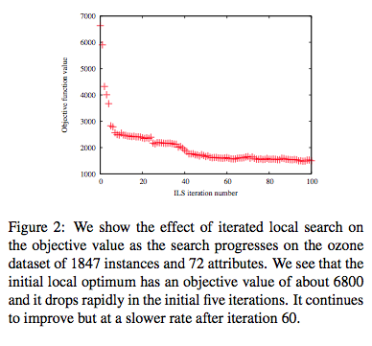
Results

Slide 16
Results
Average error of three objective functions:
w_increment = .01
Margin =14.6%, error only = 23.4% , margin + error = 13.6%
w_increment = 100
Margin = 14.3, error only = 15.5% , margin + error = 13.2%
liblinear = 12.4%
Comparable runtime: both BSP and liblinear finish within seconds but liblinear is faster

