Slide 1
Predicting Alzheimer’s disease: A neuroimaging study with 3D convolutional neural networks
Kannan Neten Dharan

Slide 2
Introduction
Alzheimer’s Disease is a kind of dementia which is caused by damage to nerve cells in the brain and the usual side effects of it are loss of memory or other cognitive impairments.
This paper introduces a method of predicting Alzheimer's disease using 3D convolutional neural networks using Neuroimages
We create a 3 way classifier which classifies as HC, AD or MCI and three binary classifiers (AD vs HC, AD vs MCI, HC vs MCI).

Slide 3
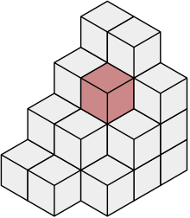
Data
The original dataset consists of 2265 from 755 patients with one image in each of the three classes (AD, MCI, HC)
Statistical Parametric Mapping (SPM) was used on the dataset to examine the differences in brain activity recorded during functional neuroimaging
Dimensions of each image are 68x95x79, which results in 510340 voxels.

Slide 4
Models
3D Convolutional Network Methodology
This model was created using a two stage approach for building the model where in we initially build the initial layer for our model using a Sparse Autoencoder.
Then we add the other layers of the neural network to build the models
2D Convolutional Neural Networks
In this, we create convolutional neural network models in a very similar way, which take 2D images as inputs to learn the model

Slide 5
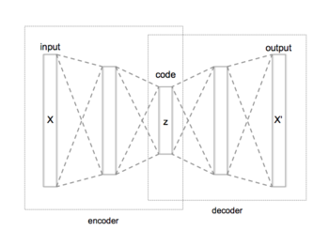
Sparse Autoencoder
An autoencoder learns to compress data from the input layer into a short code, and then uncompress that code into something that closely matches the original data.

Slide 6
Sparse Autoencoder cont..
The network has an encoder function f, which maps a given input
$x ∈ ℜn$ , to a hidden representation, $h∈ ℜp$
Then we have a decoder function which maps the representation h to the output $x’ ∈ ℜn$
Let $W ∈ ℜpxn$ and $b ∈ ℜp$ be the matrix of weights and vector of biases of the encoder function respectively, and similarly let $W’ ∈ ℜpxn$ and $b’ ∈ ℜp$ be the weights an biases of the decoder function.
This is a 3-layer neural network which has input layer, a hidden layer and an output layer.

Slide 7
Sparse Autoencoder cont..
The autoencoder estimates the following parameters
$h= f(Wx+b)$
$x’=g\left(W∗h+b’\right)$
where f is the sigmoid function and g is the identity function.
The autoencoder can be used to obtain a new representation of the input data through its hidden layer.

Slide 8
Sparse Autoencoder cont..
We try to make use of an autoencoder with an overcomplete hidden layer, i.e an autoencoder which has an equal or larger number of hidden units than the input units.
Overcomplete hidden layers can be useful for feature extraction.
One potential issue with overcomplete autoencoders is that if we only minimize the reconstruction error, then the hidden layer can potentially just learn the identity function
We therefore need to impose additional constraints. In our experiments we use autoencoders with sparsity constraints
The sparsity constraint is expected to be advantageous in this context because it encourages representations that may disentangle the underlying factors controlling the variability of MRI images.

Slide 9
Sparse Autoencoder cont..
We train an autoencoder on a set of randomly selected 3D patches of size 5 × 5 × 5 = 125 extracted from the MRI scans.
The purpose of this autoencoder training is to learn filters for convolution operations, a convolution covers a series of spatially localized regions in an input.
In total, we extract 1,000 patches from 100 scans in the training set, so we have a total of 1,00,000 patches.
We train a sparse overcomplete autoencoder with 150 hidden units on this set of patches. We use 80,000 patches for the training set, 10,000 patches for the validation set and 10,000 patches for the test set. Each patch is unrolled into a vector of size 125.
We also define as a basis the set of all the weights linking one unit in the hidden layer to all the units in the input layer.
A basis will try to extract spatially localised features in the input.

Slide 10
3D Convolutional Network Model
After training the sparse autoencoder, we build a 3D convolutional network which takes as input an MRI scan
Convolutional neural networks are artificial neural networks made up of convolutional, pooling and fully-connected layers.
The networks are characterized by three main properties: local connectivity of the hidden units, parameter sharing and the use of pooling operations.
In a hidden layer, a unit is not connected to all the units in the previous layer, but only to a small number of units in a spatially localised region. This property is beneficial in a number of ways.

Slide 11
3D Convolutional Network Model cont..
On one hand, it reduces the number of parameters, thus making the architecture less prone to overfitting whilst also alleviating memory and computational issues.
On the other hand, by modelling portions of the image, the hidden units are able to detect local patterns and features which may be important for discrimination.
A hidden layer has several feature maps and all the hidden units within a feature map share the same parameters.
This parameter sharing feature is useful because it further reduces the number of parameters, and because hidden units within a feature map extract the same features at every position in the input.

Slide 12
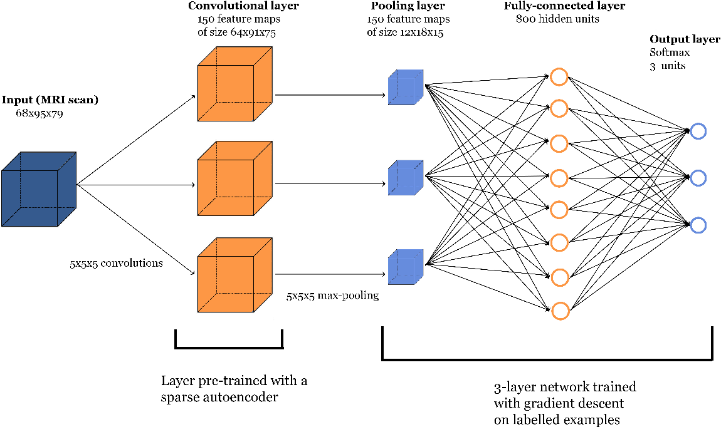

Slide 13
3D Convolutional Network Model cont..
Our network model has 3 hidden layers which are convolutional layer followed by a pooling layer and a fully connected layer.
The output layer of our convolutional layer depends on the size of our filters.
The convolution of an input map of size m×p×q with a filter of size r × s × t gives an output of size (m-r+1) × (p-s+1) × (q-t+1).
For every basis of the sparse autoencoder that we trained previously, we use the set of learned weights of that basis as a 3D filter of a 3D convolutional layer.
By applying the convolutions with all the bases, we obtain a convolutional layer of 150 3D feature maps.
Since the patches are of size 5 × 5 × 5, a convolution of an image with a basis produces a feature map of size (68−5+1)×(95−5+1)×(79−5+1) = 64 × 91 × 75.

Slide 14
3D Convolutional Network Model cont..
We also add the bias term associated with the basis and apply a sigmoid activation function to every unit in the feature map.
This convolutional layer is likely to discover local patterns and structures in the 3D input image: it allows the algorithm to exploit the 3D topology/spatial information of the image.
We then use max-pooling in the next layer, which consists of segmenting each feature map into several non-overlapping and adjacent neighborhoods of hidden units.
Pooling also builds robustness to small distortions of the image such as translations.

Slide 15
3D Convolutional Network Model cont..
In our approach, we apply a 5 × 5 × 5 max-pooling operation to reduce the size of the feature maps of the convolutional layer.
Each feature map therefore becomes a max-pooled feature map of size (64/5) × (91/5) × (75/5) = 12 × 18 × 15, where we round down to the nearest integer because we ignore the borders.
The outputs of every max-pooled feature map are then stacked. With 150 feature maps of size 12 × 18 × 15, there is a total of 150 × 12 × 18 × 15 = 486, 000 outputs.
These outputs are used as inputs for a 3-layer fully-connected neural network (i.e. with an input, hidden and output layer).
We choose a hidden layer with 800 units with a sigmoid activation function, and an output layer with 3 units with a softmax activation function.

Slide 16
3D Convolutional Network Model cont..
The 3-layer network is trained with mini batch gradient descent.
The weights of the hidden layer are randomly initialised, and the weights of the softmax layer are initialised to zero.
It is important to note that the convolutional layer is not included in the final training, the convolutional layer is only ”pre-trained” with an autoencoder.

Slide 17
2D Convolutional Network Model
The 2D approach consists in training a sparse autoencoder on 2D patches extracted from slices of the MRI scans. In this case, we extract patches of size 11 × 11 = 121. We again use 150 hidden units for the autoencoder,
We then apply 2D convolutions on all 68 slices of a scan in order to obtain a feature map: since each slice has size 95 × 79, a convolution of a slice with an autoencoder basis gives us an output of size (95−11+1)×(79−11+1) = 85×69.
As in the previous architecture, we also add a bias term and use a sigmoid activation function.
The max-pooling operation in this case consists of 10 × 10 patches, and reduces the size of a slice to (85/10) × (69/10) = 8 × 6. The outputs of all the max-pooled feature maps are then stacked.
Since we have 68 slices for each feature map, we obtain a total of 150 × 68 × 8 × 6 = 489, 600 outputs, which is comparable in size to the previous architecture.

Slide 18
Results
Results of the models on the test set. The accuracy refers to the proportion of correct predictions. 3-way means that we are trying to classify a scan as AD, MCI or HC, and the other three lines (AD vs. HC, AD vs. MCI and HC vs. MCI), refer to binary classifications. The second column corresponds to results with 2D convolutions, and the third column corresponds to results with 3D convolutions.

Slide 19
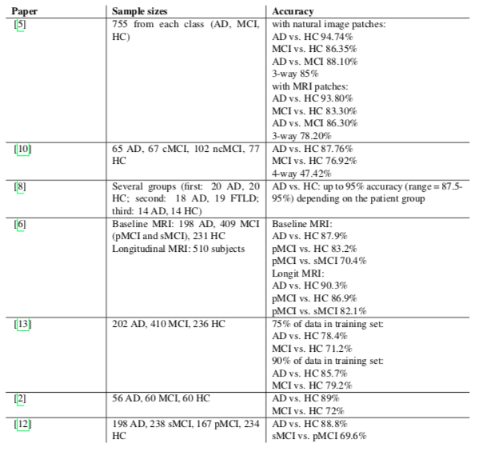

Slide 20
[8] used SVMs with linear kernels for the classification of grey matter signatures, and benchmarked their results against the performance achieved by expert radiologists, which surprisingly were found to be less accurate than the algorithm.
[13] uses a independent component analysis (ICA) as a feature extractor, coupled with a SVM algorithm
[6] describe an approach that combines penalised regression and data resampling for feature extraction prior to the classification using SVMs with Gaussian kernels.
[2] report that best performance is achieved using a SVM classifier with the bagging method (for AD vs HC) and a logistic regression model with a boosting algorithm (for MCI vs HC).
[12] extract highly discriminative patches which are then classified using a SVM with graph kernels; using methods such as t-tests or sparse coding, each patch is assigned a probability which quantifies its discriminative ability.
[5], an autoencoder is first used to learn features from 2D patches extracted from either MRI scans or natural images. The parameters of the autoencoder are then used as filters of a convolutional layer.
[10] report on a deep fully-connected network pre-trained with stacked autoencoders which is then fine-tuned

Slide 21
Conclusion
This paper was primarily interested in assessing the accuracy of such an approach on a relatively large patient population, but also wanted to compare the performance of 2D and 3D convolutions in a convolutional neural network architecture.
Our experiments indicate that a 3D approach has the potential to capture local 3D patterns which may boost the classification performance, albeit only by a small margin.
These investigations could be further improved in future studies by carrying out more exhaustive searches for the optimal hyper-parameters in both architectures.

