Slide 1
Prediction of Lung Cancer Patient Survival via Supervised Machine Learning Classification Techniques
Chip M. Lyncha, Behnaz Abdollahib, Joshua D. Fuquac, Alexandra R. de Carloc, James A. Bartholomaic, Rayeanne N. Balgemannc, Victor H. van Berkeld, Hermann B. Frieboesc,e
University of Louisville, KY, USA
International Journal of Medical Informatics, 2017
Presented By: Firas Gerges (fg92)

Slide 2
Lung Cancer
Lung cancer is one of the most dangerous type of cancer, as it was ranked as a leading cause of death related to cancer.
Can be of two types:
Small Cell Lung Cancer (SCLC)
Non-Small Cell Lung Cancer (NSCLC)
Knowing the survivability of lung cancer patient will be of a great benefits in deciding type of care and providing accurate information for both the doctors and patients.

Slide 3
Lung Cancer Survivability
Clinicians are having many struggle in efficiently and accuratly predict the survivability time frame of patients.
Current methods followed by physicians are resulting in a false prediction:
Within one month: 10%
Within 3 month: 59%
Within 4 months: 71%

Slide 4
Previous Work
Few studies have been made targeting the issue of Lung Cancer patient survivability
Researcher tackled the problem of categorizing survivability time frame rather than precise number of months
Technique included:
SVM
Logistic Regression
C4.5
Association Rule Mining

Slide 5
Data
Data extracted from the largest publicly available data set:
The Surveillance, Epidemiology, and End Results program (SEER)
Provided by: National Cancer Institute (NCI) at the National Institute of Health (NIH)
Data describes patients diagnosed with Lung Cancer from the years 2004-2009
The goal is to use different machine learning techniques to evaluate the 5-years survival time

Slide 6
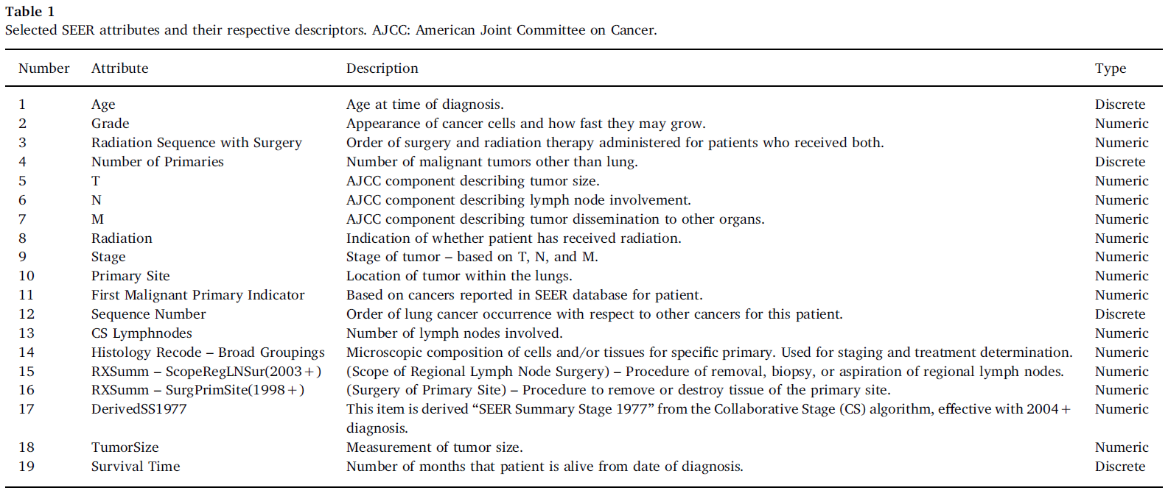
Data
10442 patient record
Each record include:

Slide 7
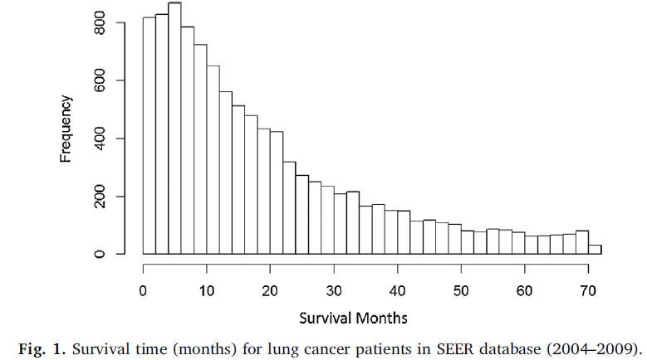
Data
The goal is to successfully and accurately predict the number of months that patient will be alive from data of diagnosis.
Survival time distribution within the data set:

Slide 8
Machine Learning Techniques
In the last few decades, ML and AI applications and use, were emerged tremendously in the bio-medical fields:
Predicting Diseases
Recommending treatment methods
Predicting required medication doses
DNA and protein-sequencing
Etc.
This papers uses 6 different ML techniques.

Slide 9
Linear Regression
Linearly separate data point (straight line)
Find the optimal weight vectors
Weights are decided in a way to minimize the mean error
Each corresponding weight is multiplied by its corresponding attribute values and summed with an intercept to compute the patient survival time

Slide 10
Decision Trees
The Random Forest (Decision Tree – based algorithm) is used
Generates multiple (and different) decision trees
A decision tree is generated by randomly splitting it at each nodes (Randomly choosing the split-attribute at each step)
The typical Decision Tree algorithm is also used.

Slide 11
Gradient Boosting Machines (GBM)
Uses small, weak models to build a more accurate predictive model
At each step, the new model is trained and added to the ensemble of models in such a way to be correlated with the negative gradient of the loss function
A model can be illustrated as a small decision tree.

Slide 12
Support Vector Machine
Mapping the cases to Data point in space
Finds a hyperplane (or line in case of linearly separable data) to separate the data

Slide 13
Custom Ensemble
Uses the predicted value of each used technique
Implement a linear regression weighting model on the predicated values (the actual value being the class label).

Slide 14
Results
Models are used to study the correlation between the selected attributes and the and the class label, which is in this case, the survival time of each patient
Survival time is described by the number of months that the corresponding patient is alive, starting from the date of diagnosis
Number of months range from 0 to 72 months

Slide 15
Performance measure
RMSE
Root mean squared error is used to identify the predictive performance of each technique
Ensemble Weighting factor
These are the weights assigned for each technique by the Custom Ensemble model
Standard Deviation of model
The changes in the model performance from one run to another
Standard Deviation of Residuals
The difference between the predicted and the target value

Slide 16
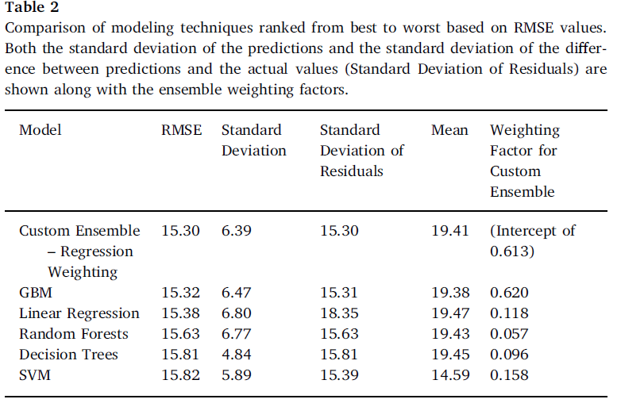
Performance Measurement
The Root Mean Square Error (RMSE) is used to describe the performance of each technique

Slide 17
Performance analysis
To show insights about the models behaviors, the predicted values of each model are plugged with respect to the actual values
Results show that in general models work well in predicting short term survivability with respect to long term
Ideally, the relationship must show a linear correlation between predicted and actual values

Slide 18
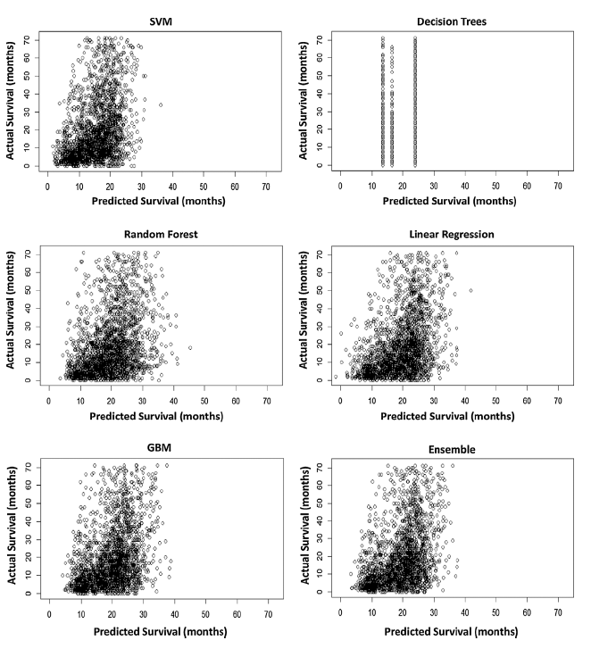
Performance

Slide 19
Performance analysis
As can be seen, most of the predictions lie within the range 0 to 25
This behavior is similar with the initial distribution of the class label (number of month)

Slide 20
Decision tree
Decision Trees graph show a different behavior than other techniques
This shows that DT model was not able to find optimal and efficient splitting points to built the trees
This can be due to the size of the data, or its vague type and relationship

Slide 21
Discussion
GBM model was able to outperform all other techniques
Linear regression was the second best one in term of RMSE
Standard deviation had high values because of the distribution:
50 % of patient had less than 15 months to survive
Predictions were biased toward these range, hence the low accuracy in longer terms survivability

Slide 22
Discussion
Comparing results to previous study and clinical estimates cannot be directly done
Most of previous work and method were classifying survivability into time frame groups rather than actual number of months

Slide 23
Conclusion
Results show that there exists correlation between the used data and the patient survivability time frame
Machine Learning in general is suitable for this problem
Decision tree is the only non-recommended technique
Models performs well when dealing with low to average survival time cases.

Slide 24
Conclusion
Future work includes further exploring the factors and limitation of used models, and revaluating the inputs for the selected models

Slide 25
Thank You

