Slide 1
Melanoma detection by analysis of clinical images using convolutional neural network
38th Annual International Conference of the IEEE Engineering in Medicine and Biology Society (EMBC)
Nasr-Esfahani, E., Samavi, S., Karimi, N., Soroushmehr, S. M. R., Jafari, M. H., Ward, K., & Najarian, K.
Presented By: Firas Gerges (fg92)

Slide 2
Outline
Introduction
Aim
Previous Studies
Methodology
Experiments and Results
Conclusion

Slide 3
Melanoma
Melanoma, known as malignant melanoma, is type of skin cancer
Caused by abnormal multiplication of pigment producing cells that give color to the skin

Slide 4
Detection Importance
Melanoma is a severe disease increasing at a high rate
It is regarded as one of the most dangerous skin-cancer type
Melanoma can be prevented and cured if diagnosed at an early stage, hence the benefit of having an efficient detection software for early-stage melanoma

Slide 5
Melanoma Detection
Experienced dermatologists are having a hard time ensuring whether a mole on the skin is benign or cancerous
Automated, computer based algorithms are being developed for this matter.

Slide 6
Aim
The aim of this study is to detect the existence of melanoma lesions using deep learning

Slide 7
Methods in Dermatology
ABCD Rules:
Rule out the existence of Melanoma based on certain characteristics of the mole.
Asymmetry, Border Irregularity, Color Pattern and Diameter
7 points checklist:
Change in size of lesion
Irregular pigmentation
Irregular border
Inflammation
Itch or altered sensation
Larger than other lesions (diameter >7mm)
Oozing/crusting of lesion

Slide 8
Computer-Aided Methods
Previous studies used image analysis techniques to produce the ABCD features.
Use ML technique to classify a cancerous mole based on the extracted features

Slide 9
Deep Learning Based Methods
Deep learning has been used widely in different domains:
Computer Vision
Natural Language Processing
Speech Recognition
Etc.
In this paper, the goal is to use deep learning for automated detection of skin cancer using digital images as input.

Slide 10
Methodology
Image Acquisition
http://www.cs.rug.nl/~imaging/databases/melanoma_naevi/
Image preprocessing for noise and illumination effects reduction
Running Convolutional NN for classification

Slide 11
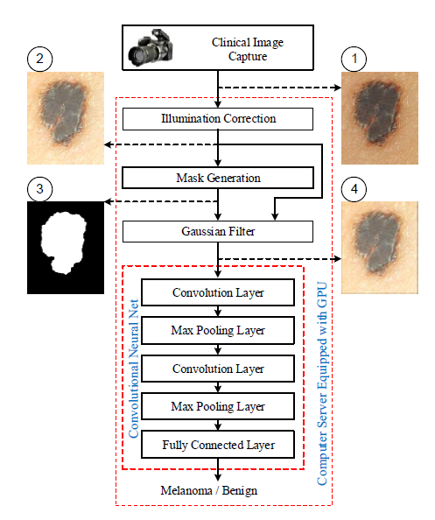
Methodology

Slide 12
Pre-Processing
The main goal of this step is to reduce the artifacts that may lead CNN to false classification
Images taken by digital cameras, generally include noises and lighting effects that should be eliminated before processing the image

Slide 13
Pre-Processing
Three main stages of image handling exists:
Illumination Correction
Segmentation
Filtering

Slide 14
Pre-Processing: Illumination Correction
Illumination effects are detected as sharp changes in HSV color space in terms of saturation and value channels
Some range of gradients (changes in colors and saturation) are excluded from the image to disregard the lightning effects.

Slide 15
Pre-Processing: Segmentation
Each image contains normal part of the skin along with the mole
Normal skin must not affect the model performance and accuracy
For this, a segmentation process took place in order to generate the image mask, in which the lesion location is shown
The importance of keeping the normal skin part is for Color Changing effects

Slide 16
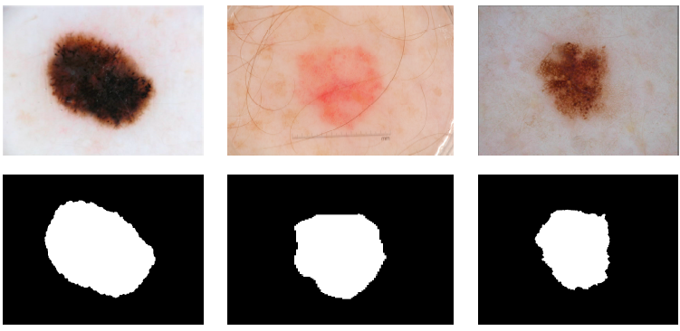
Segmentation

Slide 17
Pre-Processing: Filtering
In this step, a Gaussian filter is applied on the normal regions of the skin
This is done to smooth the area outside the lesion, hence reducing this area effect on the classification

Slide 18
CNN
CNN, as deep learning framework is used for melanoma detection
CNN uses convolve filters that examine images various structure
The difference between CNN and other techniques that the image itself is the input of the model

Slide 19
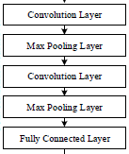
CNN Architecture
The network consists of a set of layers
A layer can be:
Convolve Layer
Pooling Layer
Last layer: fully connected layer

Slide 20
CNN Architecture
Conv. Layers uses a set of kernels to filter the input image
Each Conv. layer is followed by a pooling layer
The pooling layer reduces the size of the constructed feature map
This happens to recognize general patterns in the images.
These general patterns are observable in resized image.

Slide 21
CNN Implementation
Two Convolve layers:
Conv1:
5 x 5 Kernels
20 feature maps
Conv2:
5 x 5 Kernels
50 feature maps
Two Max Pooling layers:
Max Pool 1:
4 x 4 Kernels
Max Pool 2:
6 x 6 Kernels

Slide 22
Output Layer
Output Layer, i.e. the last layer consists of a 2-layer fully connected stage respectively having 100 and 2 neurons.
This 2-layer network forms the final diagnosis results

Slide 23
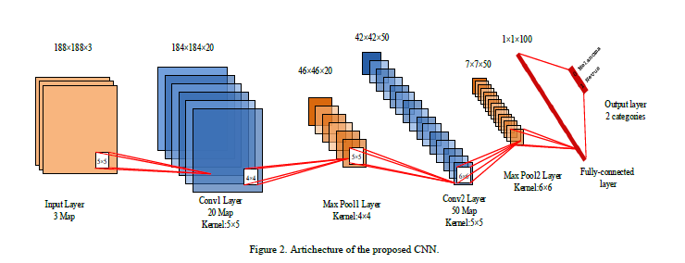
CNN Implementation

Slide 24
Training CNN: Number of Sample issue
CNN needs a lot of training power in order to result in highly accurate predictive model
Existing dataset consists of a low number of labeled images due to the fact that it is difficult to collect and label images
This problem is fixed by expending the sample

Slide 25
Expanding the dataset
Expending the data set is done by collecting a number of images from the same image
This is done by:
Cropping 5% and 10% from the corner (example, top-left corner: 5% from the top and 5% from the left)
Scaling the new image to the original size
Rotating Images by 0, 90, 180 and 270 degrees
Resizing the images to 188 x 188 pixels
This results in a 36 images from each sample

Slide 26
Dataset
Dataset of skin lesion images is used.
This dataset is publicly available on http://www.cs.rug.nl/~imaging/databases/melanoma_naevi/
It contains 170 non - dermoscopic images:
70 melanoma
100 non-cancerous
After expending the original dataset, the expanded one consists of 6120 images

Slide 27
Experiment
Data is split into 80% for training and 20% for testing
Training set is fed to the network with batches
Each batch size was 64, and the network was trained through 20000 iterations
This is repeated 50 times to ensure stability, and the mean value of the results is reported

Slide 28
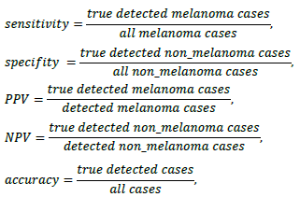
Performance Metrics

Slide 29
Comparing results
Results were benchmarked against three previous studies done on the same data:
(Zagrouba & Barhoumi, 2004) [24] is one of the first reported work, and used as baseline
(Munteanu & Coocleam, 2009) [13] is an example of used commercial tools
(Giotis et al, 2015) [12] classify cases in a semi-supervised framework

Slide 30
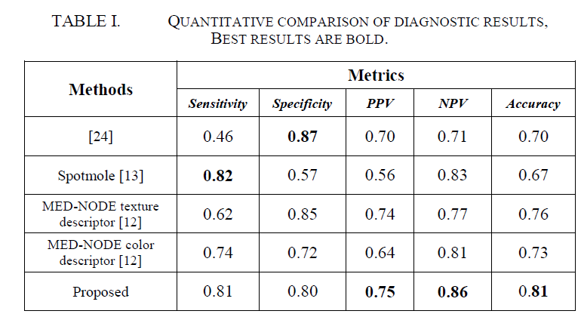
Results

Slide 31
Discussion and Conclusion
the used method in this paper (CNN) outperformed other state-of-the-art methods in terms of classification accuracy
Deep Learned – based system is able to efficiently detect melanoma cases from non-cancerous ones
Pre-processing of the images led to an increase of CNN accuracy

Slide 32
Discussion and Conclusion
The difference between CNN and previous studies, is that extracting feature is done automatically within the model, and no explicit feature extraction steps took place
Experimental results that CNN has high predictive accuracy in respect with other detection algorithms.

Slide 33
Thank You

Slide 34
Reference
Nasr-Esfahani, E., Samavi, S., Karimi, N., Soroushmehr, S. M. R., Jafari, M. H., Ward, K., & Najarian, K. (2016, August). Melanoma detection by analysis of clinical images using convolutional neural network. In 2016 38th Annual International Conference of the IEEE Engineering in Medicine and Biology Society (EMBC) (pp. 1373-1376). IEEE.
E. Zagrouba and W. Barhoumi, “A preliminary approach for the automated recognition of malignant melanoma, ” Image Analysis & Stereology, vol. 23, no. 2, pp. 121-135, 2004.
C. Munteanu and S. Cooclea, “Spotmole – melanoma control system,” 2009. Available: http://www.spotmole.com/
I. Giotis, N. Molders, S. Land, M. Biehl, M. F. Jonkman and N. Petkov, “MED-NODE: A computer-assisted melanoma diagnosis system using non-dermoscopic images,” Expert Systems with Applications, Elsevier, vol. 42, no. 19, pp. 6578-6585, 2015.

