Slide 1
Optimus: An Efficient Dynamic Resource Scheduler for Deep Learning Clusters
Presented by Xiaowei Shang

Slide 2
Deep Learning
Increasing deep learning workloads in production clusters
Speech Recognition
Object classification (automatic car)
Machine translation (google translate)
Many machine learning frameworks
TensorFlow
MXNet
PaddlePaddle

Slide 3
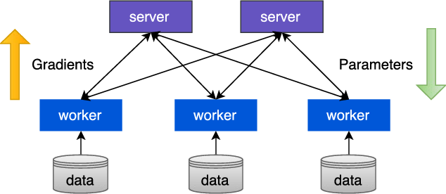
Distributed Traning
Parameter server architecture
interativeness
Read data
Compute gradient
Push gradient
Update parameters
Pull parameters

Slide 4
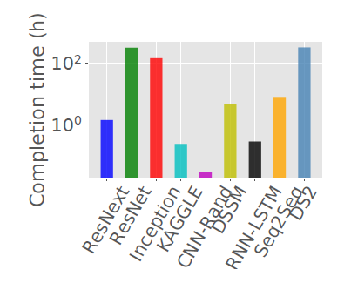
Cluster Scheduling-current works
Static allocation(fixed number of ps and worker during traing )
lower resource utilization
Job size unawareness
long job may block short jobs

Slide 5
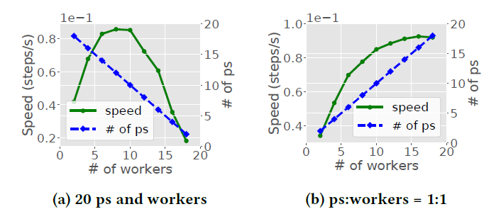
Manually specify resource configuration
suboptimal (not same for all jobs)

Slide 6
Optimus
Optimus, a customized job scheduler for deep learning clusters, which minimizes job training time based on online resource-performance models.
Main contribution:
PERFORMANCE MODELING OF DL JOBS
Learning the Convergence Curve (get remaining steps)
Resource-Speed Modeling (speed function)
DYNAMIC SCHEDULING
Resource Allocation (minimize JPC)
Task Placement

Slide 7
Learning the Convergence Curve
Online fitting
Collect and preprocess training time
Use non-negative least square solver to find best B so far
Estimate remaining steps to convergence

Slide 8
Resource-Speed Modeling
Build a performance model for parameter server architecture
Derive training speed f(p,w), replacing unknown constant with coefficient

Slide 9
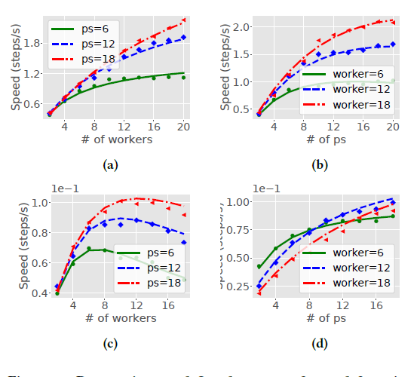

Slide 10
Greedy Resource Allocation Algorithm
Marginal gain: reduced job completion time per unit resource
In each iteration:
Try to increase one parameter server or one worker for each job and calculate the marginal gain.
The job with highest marginal gain is selected.
Allocate one parameter server or worker depending on which brings higher gain.
Update maginal gain and available resources.
Stop when some resource is used up, or the marginal gain is non-positive.

Slide 11
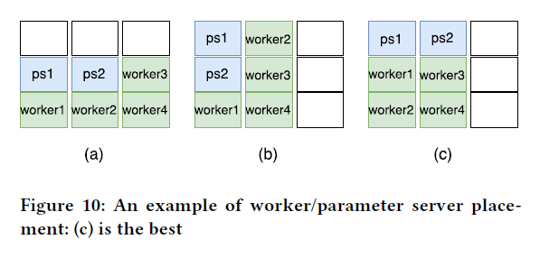
Task placement
Decide the optimal placement given the numbers of parameter servers and workers of a job
Minimize communication overhead, i.e.,cross-server data transfer
Placement principles
Co-locate parameter servers and workers
Each physical server holds the same number of parameter servers and workers

Slide 12
Evaluation
Testbed
13 servers
Trace
9 types of DL Jobs
Baselines
DRF
Teris
Metrics
Average Job Completion Time(JCT)
Makespan

Slide 13
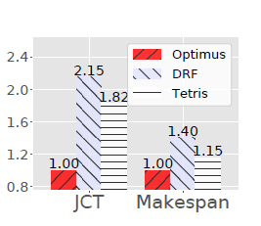
Evaluation
Performance comparison

Slide 14
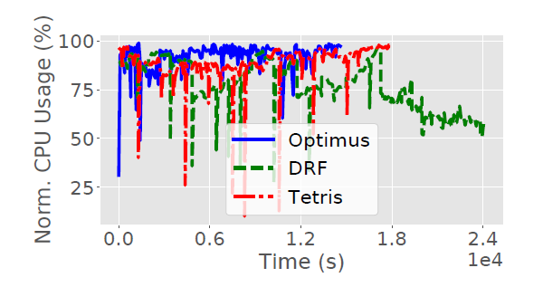
Evaluation
Normalized CPU usage of parameter servers

Slide 15
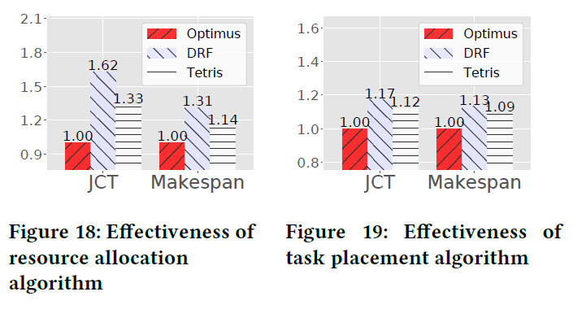
Evaluation
Performance contribution of each component(62% and 17%)

Slide 16
Conclusion
Optimus: a customized cluster scheduler targeting high training performance and resource efficiency
The core is the performance model for DL jobs
Future work
Extend Optimus to handle more DL/ML workloads
Deal with inaccurate performance model for robust scheduling

Slide 17
Questions

