Slide 1
Automatic segmentation method of pelvic floor levator hiatus in ultrasound using a self-normalising neural network
Bonmati et al, 2017

Slide 2
Outline
Background
Methods
Results

Slide 3
Background
Pelvic Organ Prolapse (POP) is the abnormal downward descent of pelvic organs
During a transperineal ultrasound examination, 3D volumes are acquired during Valsalva manoeuvre. The hiatal dimensions and its area are then recorded by manually outlining the levator hiatus in the oblique axial 2D plane at the level of minimal anterioposterior hiatal dimensions (referred to as the C-plane hereinafter).
Image segment in manually defined 2D C-planes.
Previous work needs some posterior information.

Slide 4
Methods
U-Net
SELU
Label smoothing & dice coefficient

Slide 5
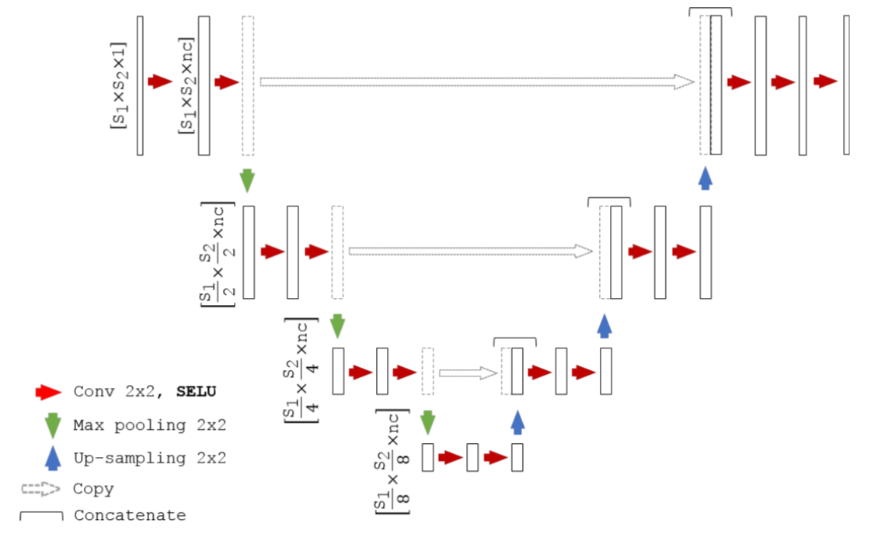
Methods
U-Net
Ronneberger et al, “U-Net: Convolutional Networks for Biomedical Image Segmentation,” (2015).

Slide 6
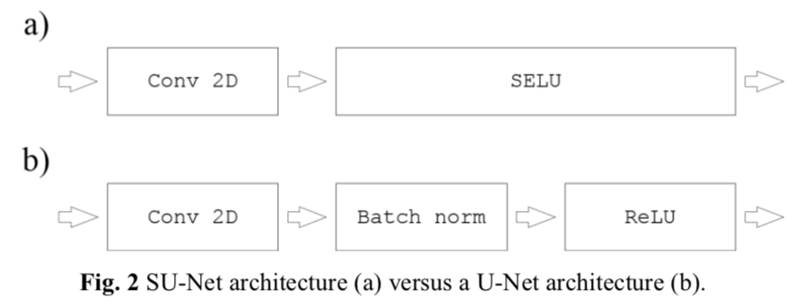
Methods
SELU
SELU constructs a particular form of parameter-free scaled exponential linear unit so that the mapped variance can be effectively normalised, i.e. by dampening the larger variances and accelerate the smaller ones.
Batch-dependent normalisation may not be needed, which means that there is no mini-batch size
𝜆 = 1.0507 and 𝛼 = 1.6733
G. Klambauer et al., “Self-Normalizing Neural Networks,” in Advances in Neural Information Processing Systems (2017).

Slide 7
Methods
Label smoothing & dice coefficient
The weighted sum of a L2 regularization loss with of the probabilistic Dice score using label smoothing is used as a loss function.
Dice similarity coefficient 𝐷(𝐴, 𝐵) = 2|𝐴 ∩ 𝐵|/(|𝐴| + |𝐵|) expresses the overlap or similarity between label 𝐴 and 𝐵
Label smoothing : makes the model more adaptable.
replace the label distribution q(k|x) = δ_{k,y} with q′(k|x) = (1 − ε)δ_{k,y} + εu(k)
G. Pereyra et al., “Regularizing Neural Networks by Penalizing Confident Output Distributions,” (2017).
F. Milletari, N. Navab, and S.-A. Ahmadi, “V-Net: Fully Convolutional Neural Networks for Volumetric Medical Image Segmentation,” (2016).

Slide 8
Methods
Post-processing
For each automatic segmentation obtained, post-processing morphological operators to fill holes (i.e., flood fill of pixels that cannot be reached from the boundary of the image).
Remove unconnected regions by selecting the region with the largest area.

Slide 9
Dataset
91 ultrasound images, from 35 patients.
35 images acquired during Valsalva, 20 images during contraction and 36 images at rest to cover all the stages during a standard diagnosis.
All 91 images were manually segmented by 3 different operators.
Data augmentation strategy, applying an affine transformation with 6 degrees-of-freedom.
35-fold validation, leave-one-patient-out cross-validation.

Slide 10
Results
Accuracy does not increase.

Slide 11
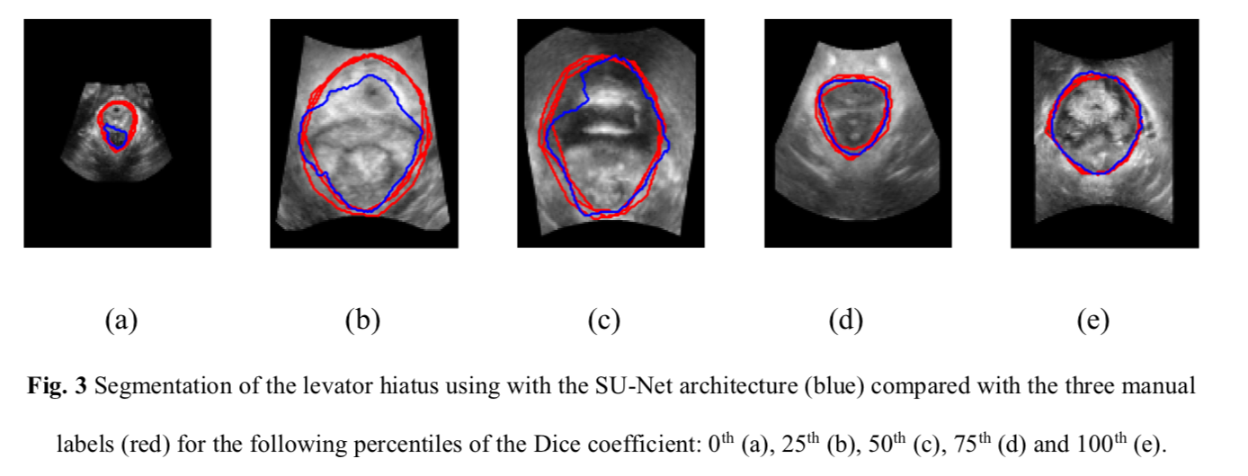
Results
Accuracy does not increase.

Slide 12
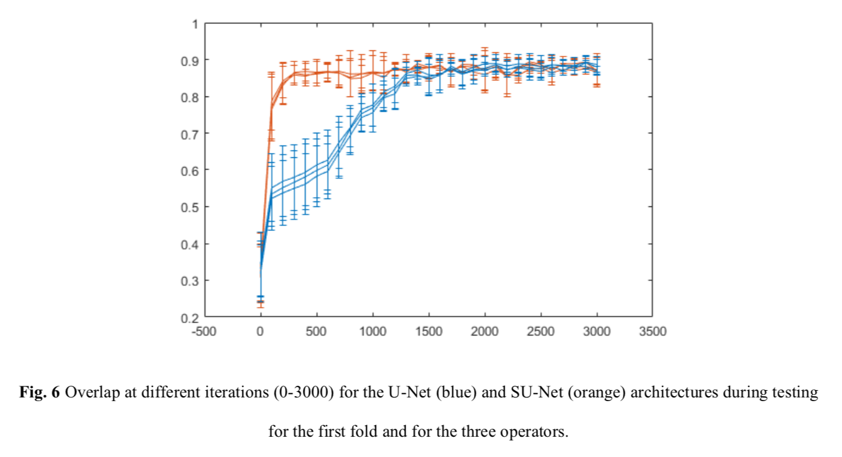
Results
Converge faster.

Slide 13
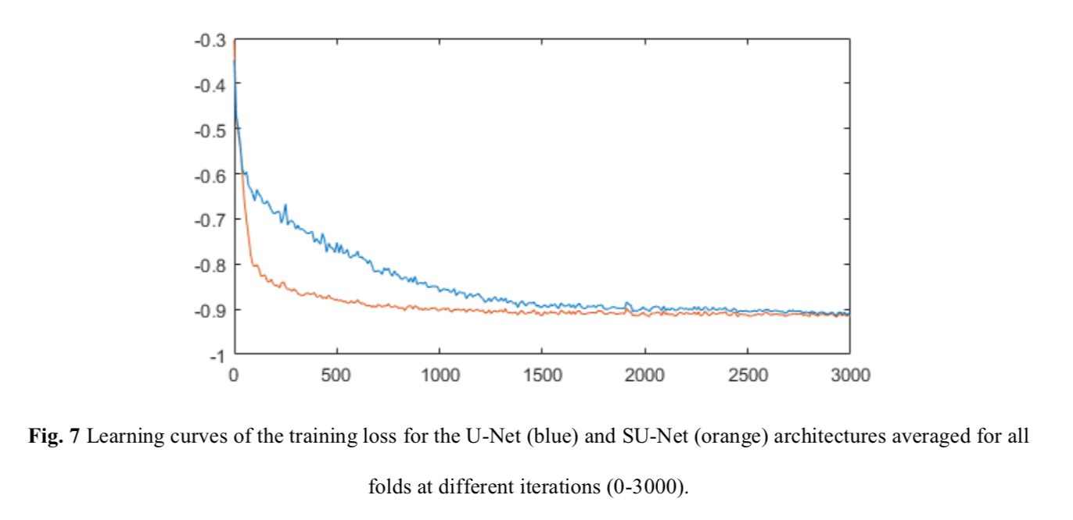
Results
Converge faster.

Slide 14
Thank you.

