Slide 1
CS 732 project report

Slide 2
Breast cancer ultrasound images Classification
Dataset
Experiment
Results

Slide 3
Dataset
Breast cancer ultrasound images
163 images, 109 benign, 54 malignant
Training 128, validation 18, testing 17 .

Slide 4
Experiment
Data augmentation
rotation_range=30,
width_shift_range=0.05,
height_shift_range=0.05,
shear_range=0.05,
zoom_range=0.05,
horizontal_flip=True,
fill_mode='nearest'

Slide 5
Experiment
VGG16
ResNet50
DenseNet201
Reshape images to size(256, 256, 3)
Keep convolution layer. Add dense layers. (2 layers (512, 1) for VGG16, 1 layer (1) for ResNet50 and DenseNet201)
Batch size = 32

Slide 6
Results
The accuracy of using VGG16 (with or without pretrained weights), ResNet50 (without pretrained weights), DenseNet201 (without pretrained weights) is around 70% - 80%.
The accuracy of using, ResNet50, DenseNet201 with pretrained weights on imagenet are 88%, 94%, respectively.

Slide 7
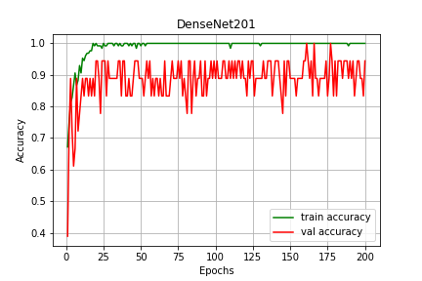
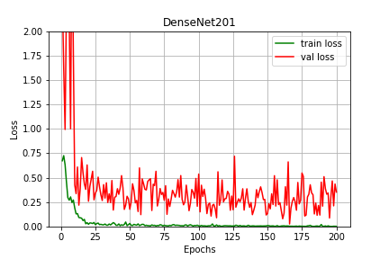
Results
Loss and accuracy on DenseNet201

Slide 8
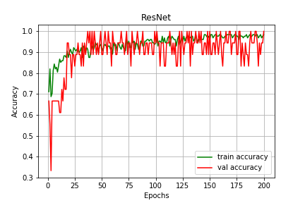
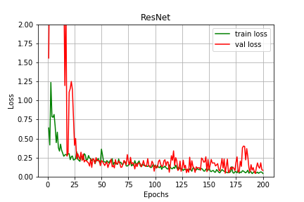
Results
Loss and accuracy on ResNet50

Slide 9
Thank you.

