Slide 1
Joint Learning of Words and
Meaning Representation for
Open-Text Semantic Parsing
Chih-yuan Li
cl524@njit.edu
Antoine Bordes, Xavier Glorot,
Jason Weston, Yoshua Bengio
1

Slide 2
Introduction
The purpose of Semantic Parsing is to analyze the structure of sentence and formally consists of mapping a natural language sentence into logical meaning representation (MR).
2

Slide 3
What are we going to have?
Introduction
Semantic Parsing Framework
Semantic Parsing Energy
Multi-task Training
Experiments
Conclusion
3

Slide 4
Introduction (cont.)
Semantic Parsing can be roughly divided into 2 tracks:
In-Domain
Open-Domain (What we focus in this paper)
4

Slide 5
Introduction (cont.)
In-Domain
Aims at learning to build highly evolved and comprehensive MRs.
Flaw: Requires highly annotated training data and/or MRs built specifically for one domain, such approach typically have a restricted vocabulary and a correspondingly limited MR representation.
5

Slide 6
Introduction (cont.)
Open-Domain
Associate a MR to any kind of natural language sentence.
6

Slide 7
Semantic Parsing Framework
WordNet-based Representations (MRs)
Inference Procedure
7

Slide 8
Semantic Parsing Framework
WordNet-based Representations (MRs)
Relations -> REL(A_{0,} A_{1,} A_{2 …….} An)
(a) Part-Of-Speech tag (NN, VB, JJ, RB)
(b) Nodes(synsets) correspond to senses, and edges define relations between those senses.
(ex: _score_NN_1 refers to the synset representing the first sense of the noun “score”)
3. Triplets (lhs, rel, rhs)
8

Slide 9
Semantic Parsing Framework
Inference Procedure
MR Structure Inference
0. Input(raw sentence): “A musical score accompanies a television program”
1. Structure Inference: ((_musical_JJ score_NN), _accompany_VB, _television_program_NN)
2. Entity Detection: ((_musical_JJ_1 score_NN_2), _accompany_VB_1, _television_program_NN_1)
3. Output (MR): _accompany_VB_1((_musical_JJ_1 score_NN_2), television_program_NN_1)
9

Slide 10
Semantic Parsing Framework
3. Output (MR): _accompany_VB_1((_musical_JJ_1 score_NN_2), television_program_NN_1)
Detection of MR entities (Word-sense Disambiguation)
10

Slide 11
Semantic Matching Energy
Framework
Parametrization
Training Objective
11

Slide 12
Semantic Matching Energy
Framework
1. Entities(Synsets, Relations Types, Lemmas)
2. Parametrized Function ɛ
12

Slide 13
Semantic Matching Energy
Parametrization
Function ɛ starts by mapping all of the symbols into embedding triplets and must also be able to handle variable-size arguments.
ɛ is also optimized to be lower for training examples than for other possible configurations of symbols.
13

Slide 14
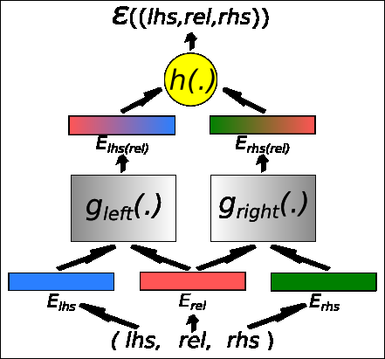
Semantic Matching Energy
* g is a parametrized function whose parameters are tuned during training
* h is a function that can be hard-coded or parametrized
Fig.: Semantic Matching Energy Function
https://tinyurl.com/yasvpnfn
14

Slide 15
Semantic Matching Energy
Training Objective
Intuitively we would like the model to predict the missing triplets correctly.
ɛ(x) < ɛ((i; relx; rhsx)); for all i : (i, relx , rhsx) ∉ D
ɛ(x) < ɛ((lhsx; j; rhsx)); for all j : (lhsx , j, rhsx) ∉ D
ɛ(x) < ɛ((lhsx; relx; k)); for all k : (lhsx , relx , k) ∉ D
D is a given training set
15

Slide 16
Multi-task Training
Multiple Data Resources
Training Algorithm
16

Slide 17
Multiple Data Resources
WordNet v3.0 (WN)
wordNet is the main resource for this paper
ConceptNet v2.1 (CN)
a common-sense knowledge base in which lemmas or groups of lemmas are linked together with rich semantic relations, based on lemmas and not synsets
Wikipedia (Wk)
Extended WordNet (XWN)
17

Slide 18
Experiments
Benchmarks
Representations
18

Slide 19
Experiments
Benchmarks
Table 1 is retrieved from this Paper.
19

Slide 20
Experiments
Representations
Entity Embeddings
WordNet Enrichment
20

Slide 21
Experiments
Representations
Entity Embeddings
*Table 2 is retrieved from this Paper
Representations
Entity Embeddings
*Table 2 is retrieved from this Paper
21

Slide 22
Experiments
Representations
WordNet Enrichment
*Table 3 is retrieved from this Paper
22

Slide 23
Conclusion
Key contributions:
An energy-based model that scores triplets of relations between ambiguous lemmas and unambiguous entities (synsets)
23

Slide 24
Conclusion
Future Expectation:
Future work should explore the capabilities of such systems further including other semantic tasks, and more evolved grammars, e.g. by using FrameNet
24

