Slide 1
An improved deep learning approach for detection of thyroid papillary cancer in ultrasound images
Li et al, 2018

Slide 2
Outline
Background
Methods
Results

Slide 3
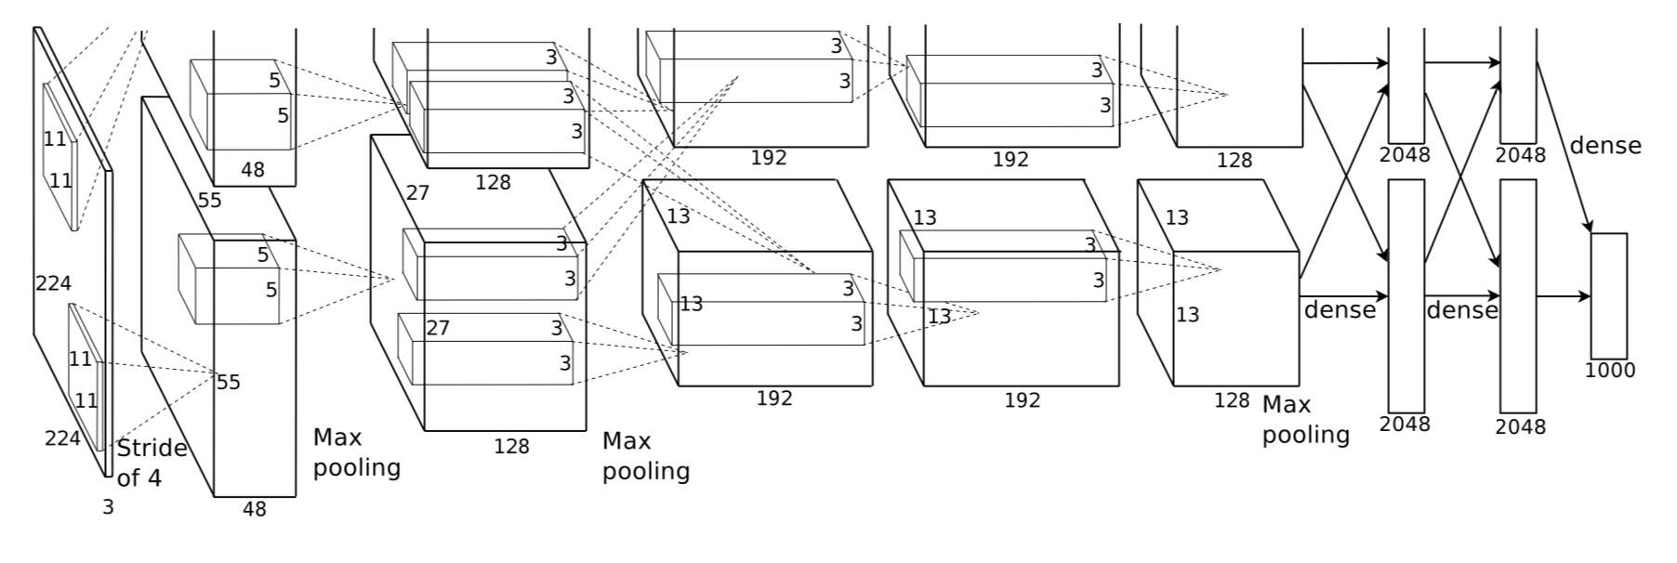
Background
Object detection: classification + localization
Classifcation: what is the object?
Localization: where is the object (x, y, w, h)?
Krizhevsky et al, ImageNet classification with deep convolutional neural networks, 2012

Slide 4
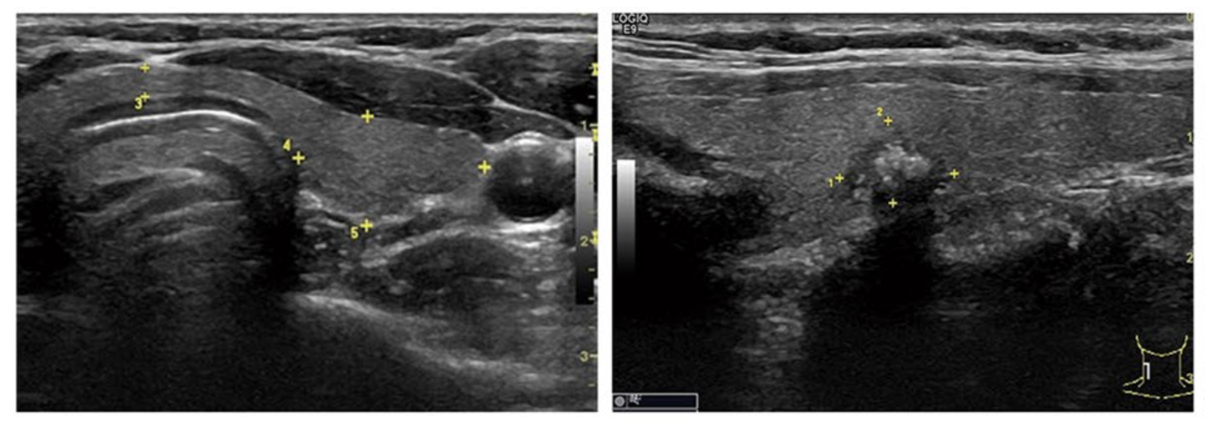
Background
Ultrasound images are monochrome and low-resolution.
Cancer regions are usually blurred, vague margin and irregular in shape

Slide 5
Background
CNN (breast cancer MR image)
fine-tuning
de-noising auto-encoders
CS Faster R-CNN
add a spatial constrained layer to Faster R-CNN
concatenating the shallow and deep layers of CNN

Slide 6
Methods
R-CNN: Regions with CNN
SPP Net: Spatial Pyramid Pooling
Fast R-CNN
Faster R-CNN
CS Faster R-CNN

Slide 7
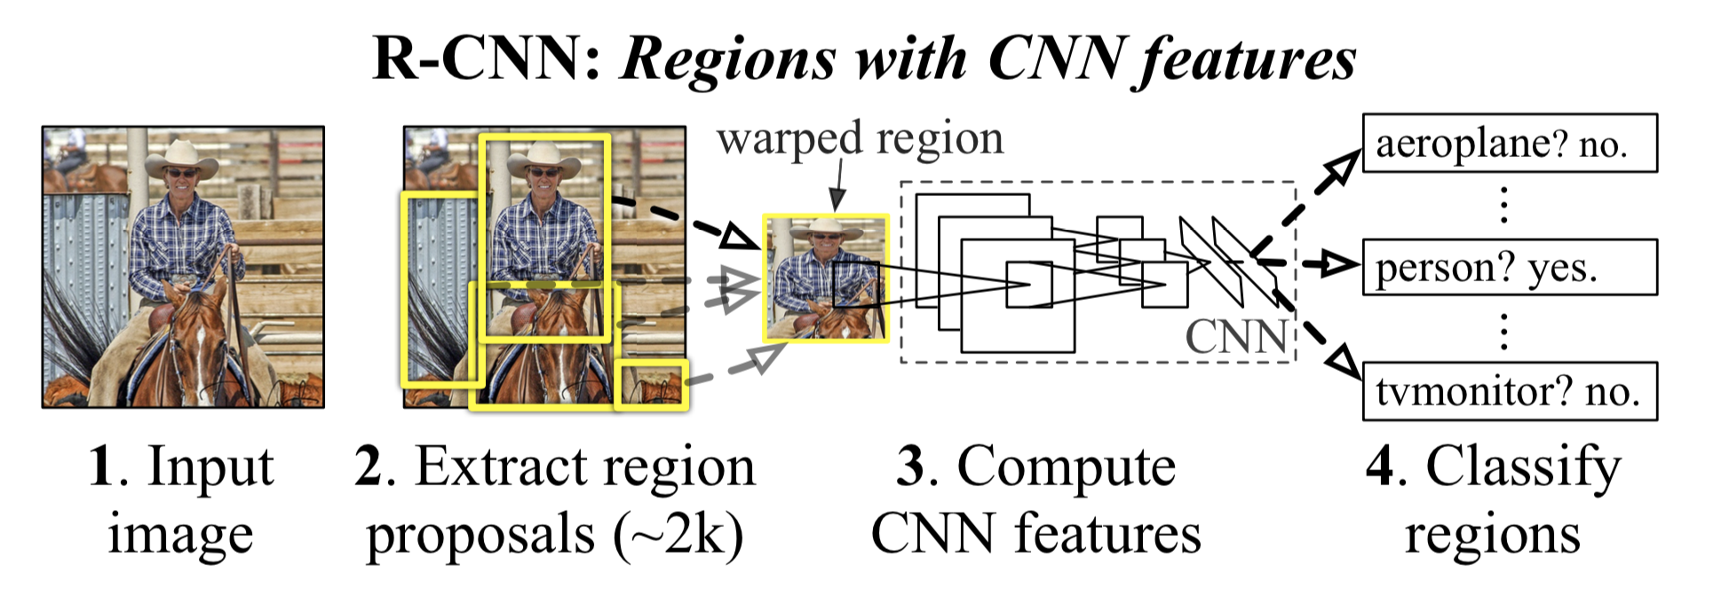
R-CNN
2000 Region Proposal: Selective Search
Warped region
CNN, feature extraction
SVM classification
Bounding-box regression
Girshick et al, Rich feature hierarchies for accurate object detection and semantic segmentation, 2014

Slide 8
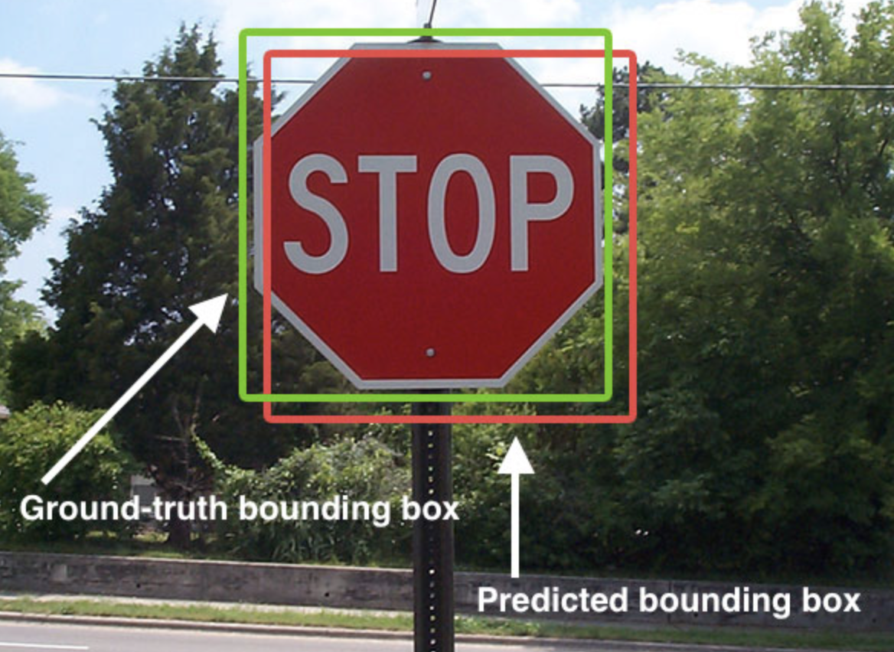
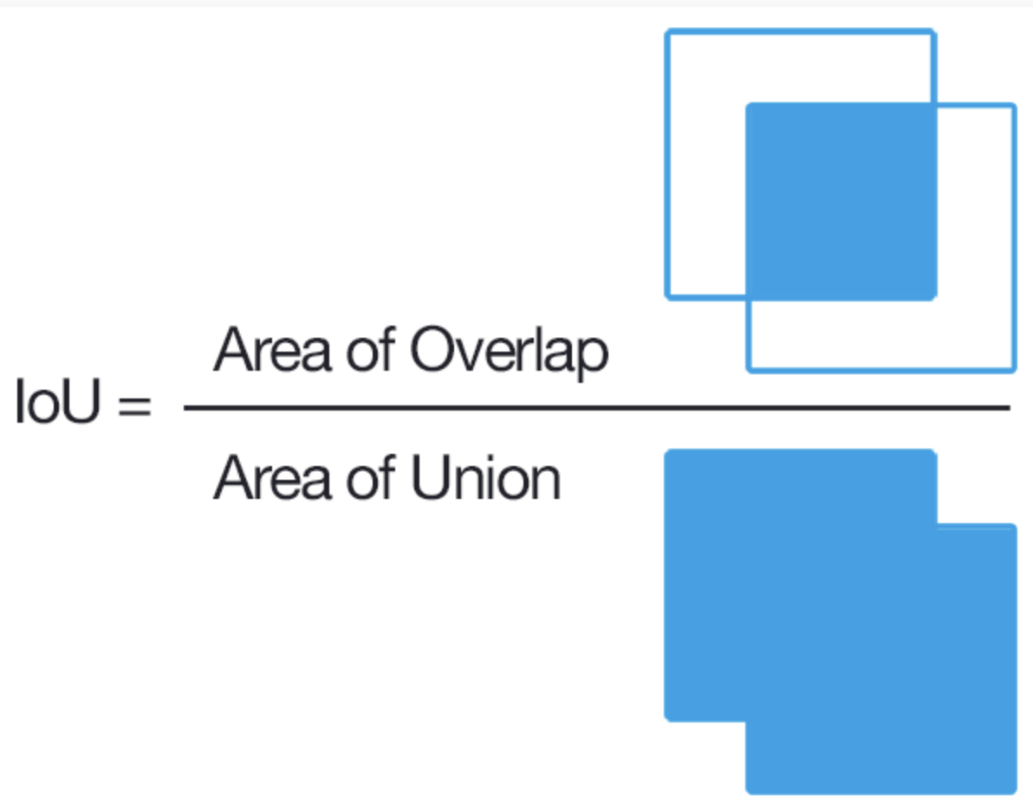
R-CNN
CNN, feature extraction
fine-tuning : (N + 1)-way classification layer
region proposals with ≥ 0.5 IoU overlap with a ground-truth box as positives for that box’s class, else negatives
Object category classifiers 21 SVM
Bounding-box regression
predict a new bounding box for the detection
G = (Gx,Gy,Gw,Gh)

Slide 9
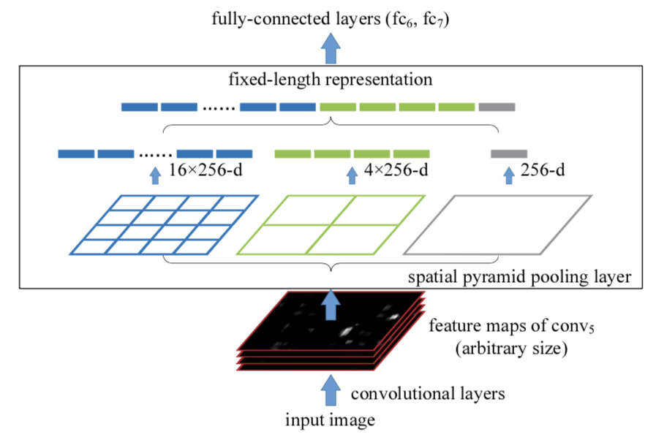
SPP Net
In R-CNN warped region may result in unwanted geometric distortion
Convolutional layers do not require a fixed image size. Fully-connected layers need to have fixed size input.
Spatial Pyramid Pooling Layer
He et al, Spatial Pyramid Pooling in Deep Convolutional Networks for Visual Recognition, 2015

Slide 10
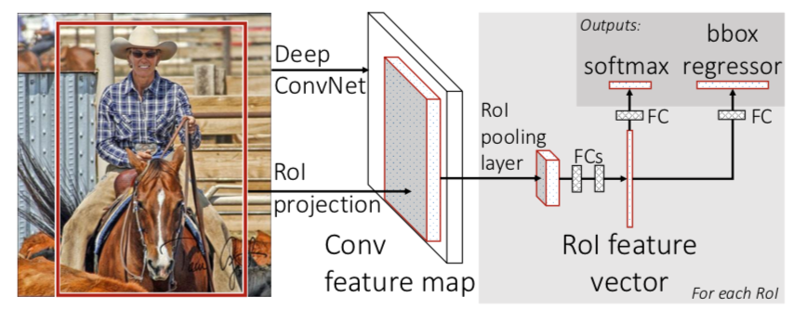
Fast R-CNN
Input: images and a list of region of interest (RoIs)
Use a RoI pooling layer extracts a fixed-length feature
Output layers: 1 use softmax probability estimates (K+1) object; 2 outputs four real-valued numbers for each of the K object classes.
Multi-task loss:
Girshick et al, Fast R-CNN, 2015

Slide 11
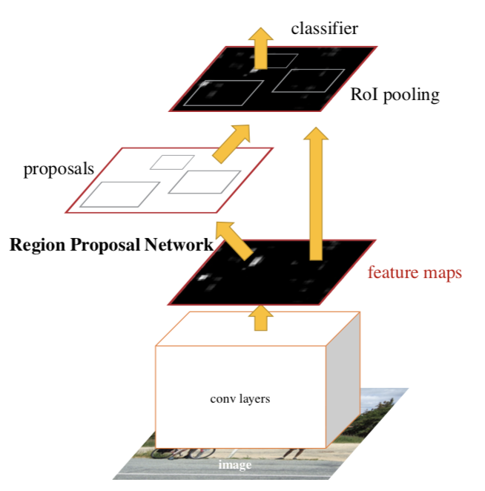
Faster R-CNN
In R-CNN, 2000 Region Proposal
Insert Region Proposal Network (RPN) to predict proposals from features
4 Loss functions:
RPN calssification(anchor good.bad)
RPN regression(anchor->propoasal)
Fast R-CNN classification(over classes)
Fast R-CNN regression(proposal ->box)
Ren et al, Faster R-CNN: Towards Real-Time Object Detection with Region Proposal Networks, 2015

Slide 12
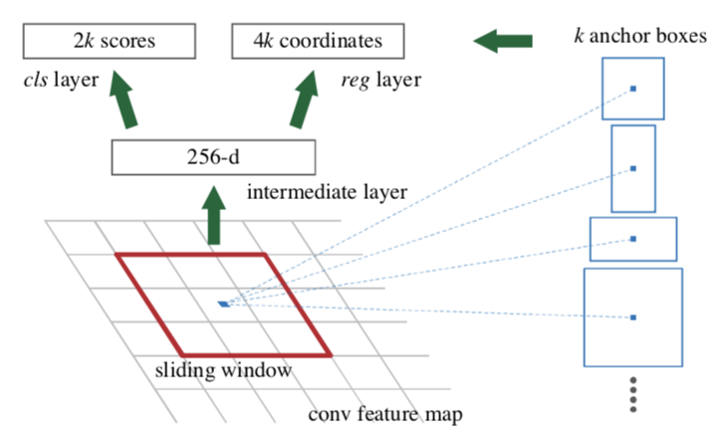
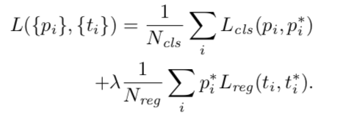
Faster R-CNN
RPN
slide a small network over the convolutional feature map output by the last shared convolutional layer
at each location generate 9 anchors(3 scales and 3 aspect ratios )
This architecture is implemented with an n×n convolutional layer followed by two sibling 1 × 1 convolutional layers (for reg and cls, respectively).
Loss function:

Slide 13
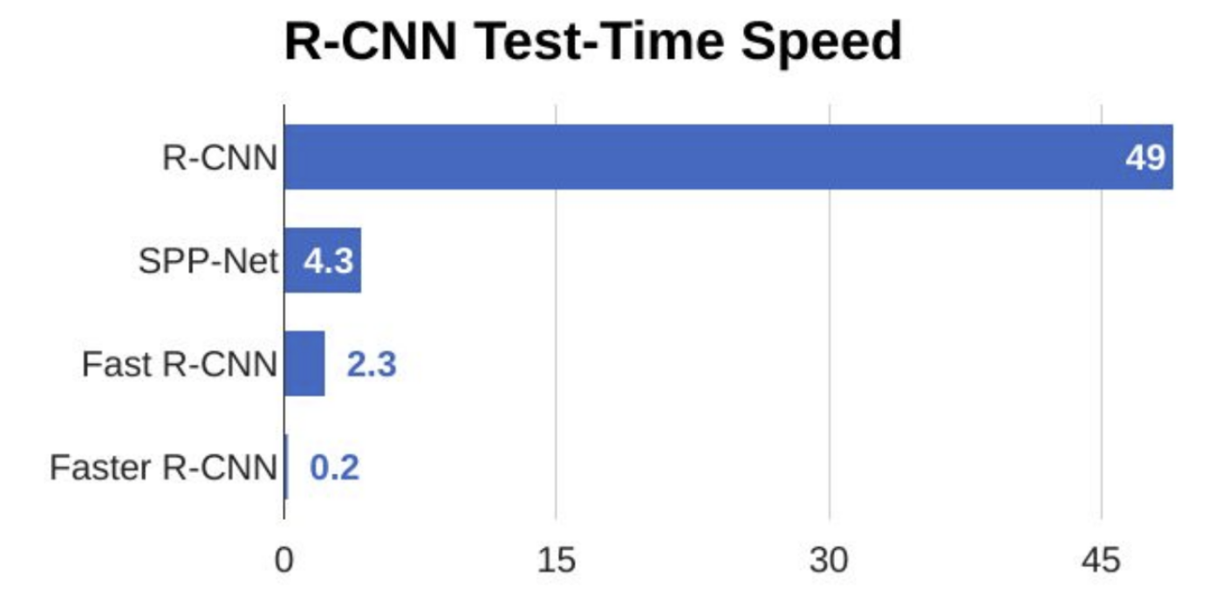
Faster R-CNN

Slide 14
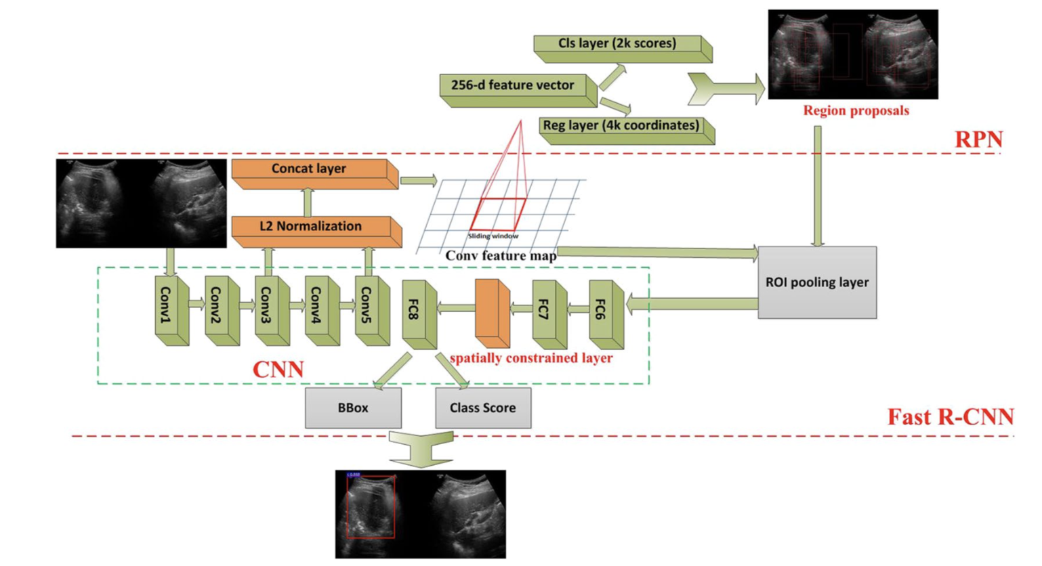
CS Faster R-CNN
ZF modle
Concatenate conv3 layer and conv5 layer
Spatial constrained layer
cancer regions depend on their residing regions which are hard to define.

Slide 15
CS Faster R-CNN
300 cases, 4670 ultrasound images
200 diagnosed cases as training samples
50 diagnosed cases and 50 normal cases as test samples
CNN pre-trained ZF model with VOC2007 database

Slide 16
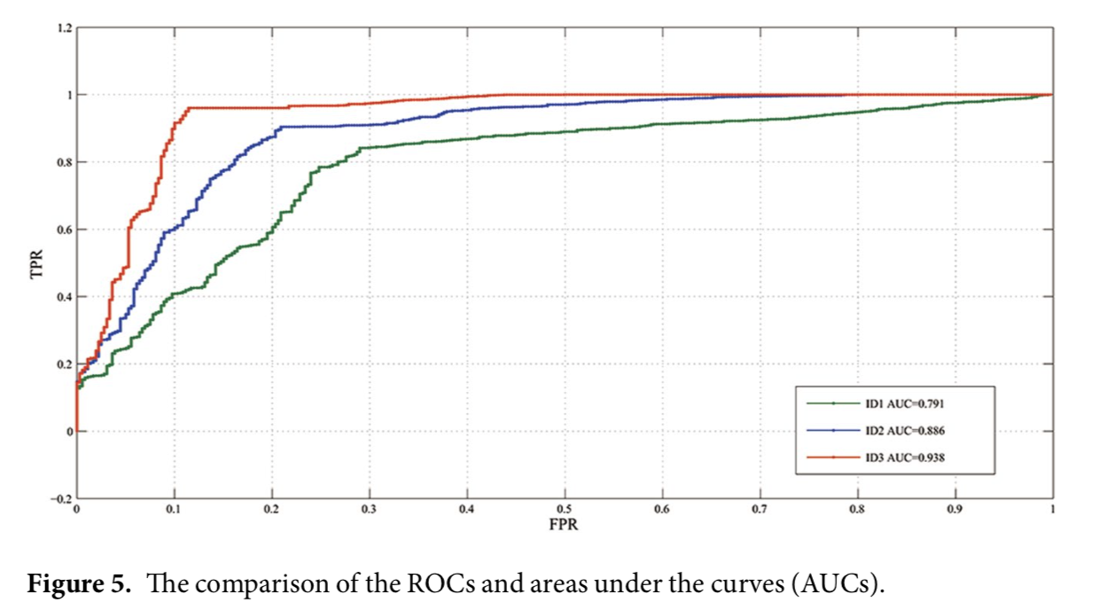
Results
ID1 does not use any strategy. ID2 uses the strategy of layer concatenation. ID3 uses the strategy of layer concatenation and spatial constrained layer.

Slide 17
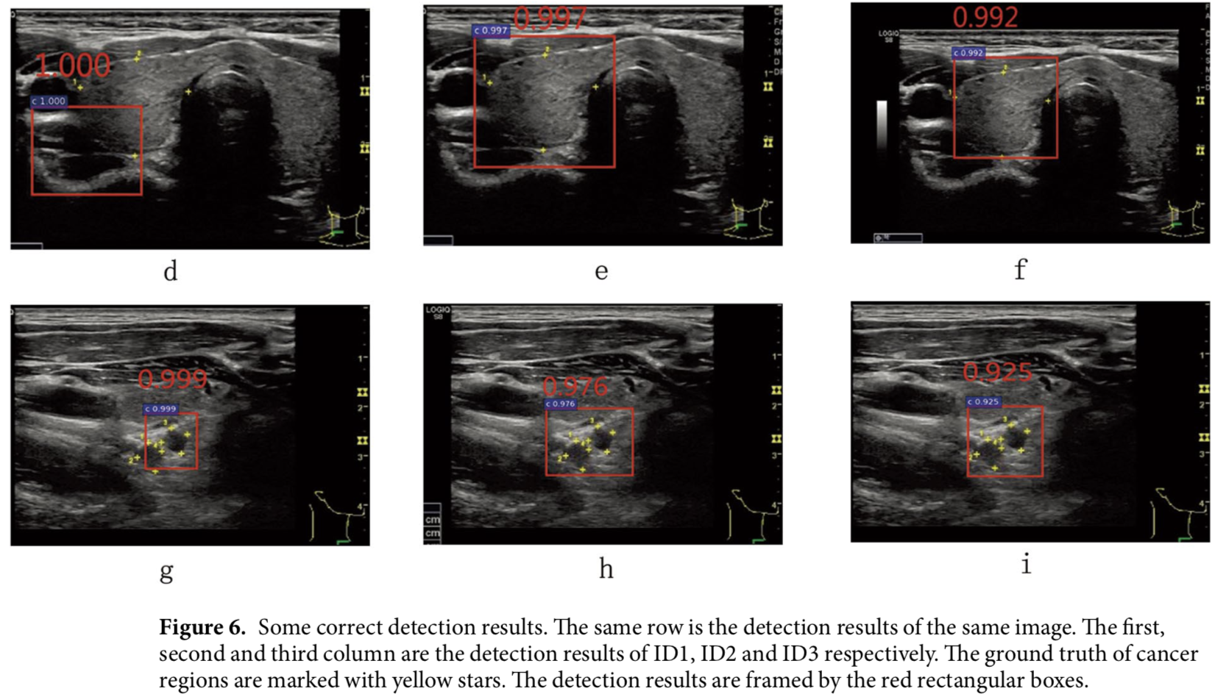
Results

Slide 18
Results

Slide 19
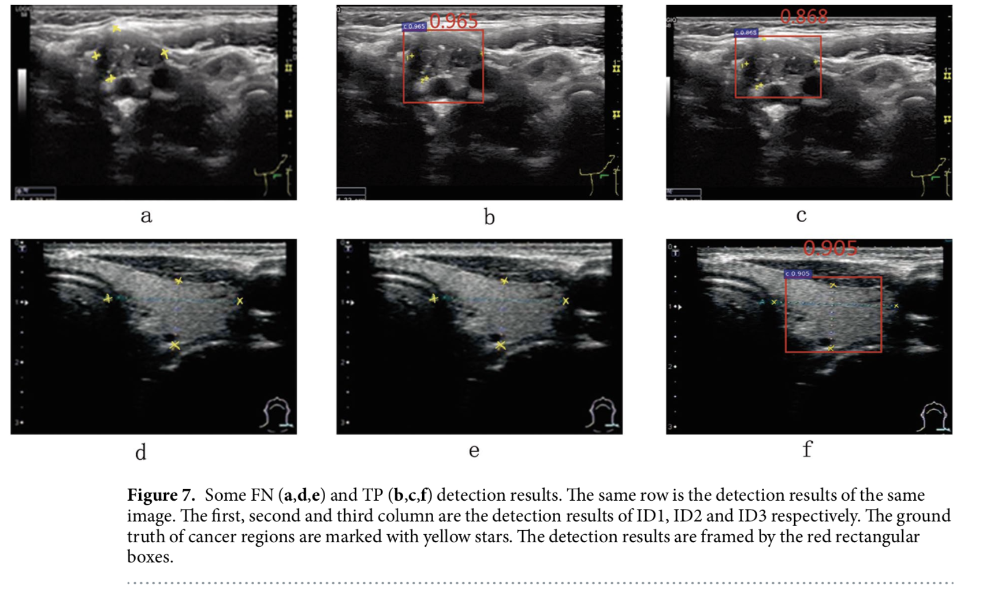
Results

Slide 20
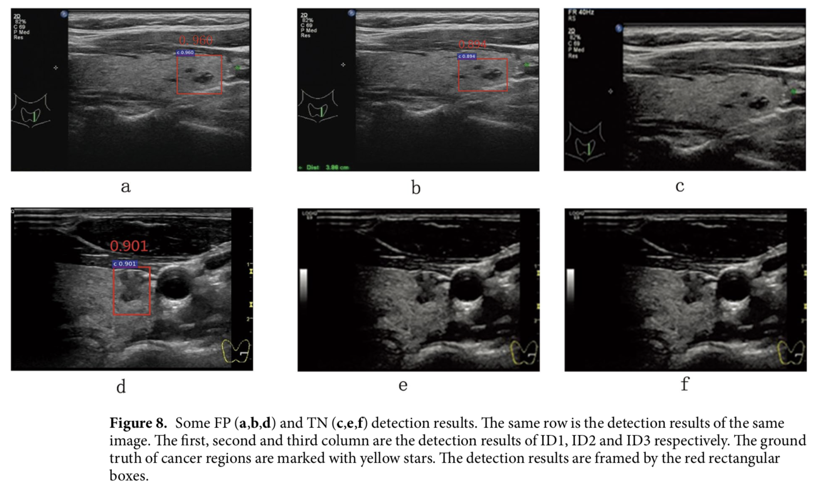
Results

Slide 21
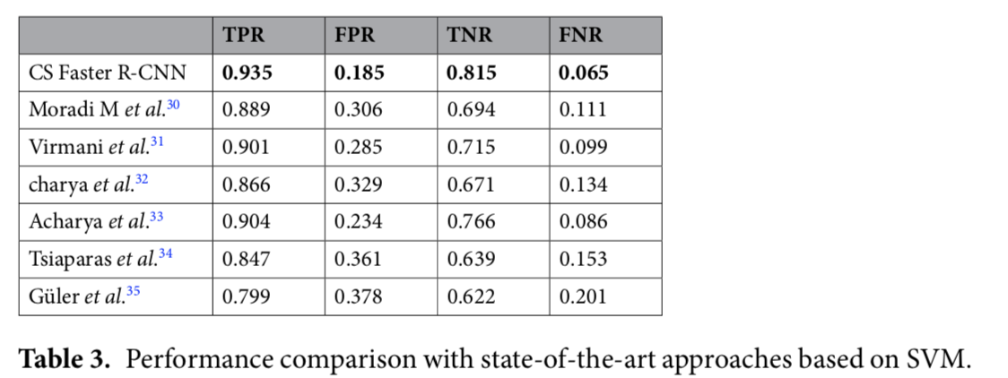
Results

Slide 22
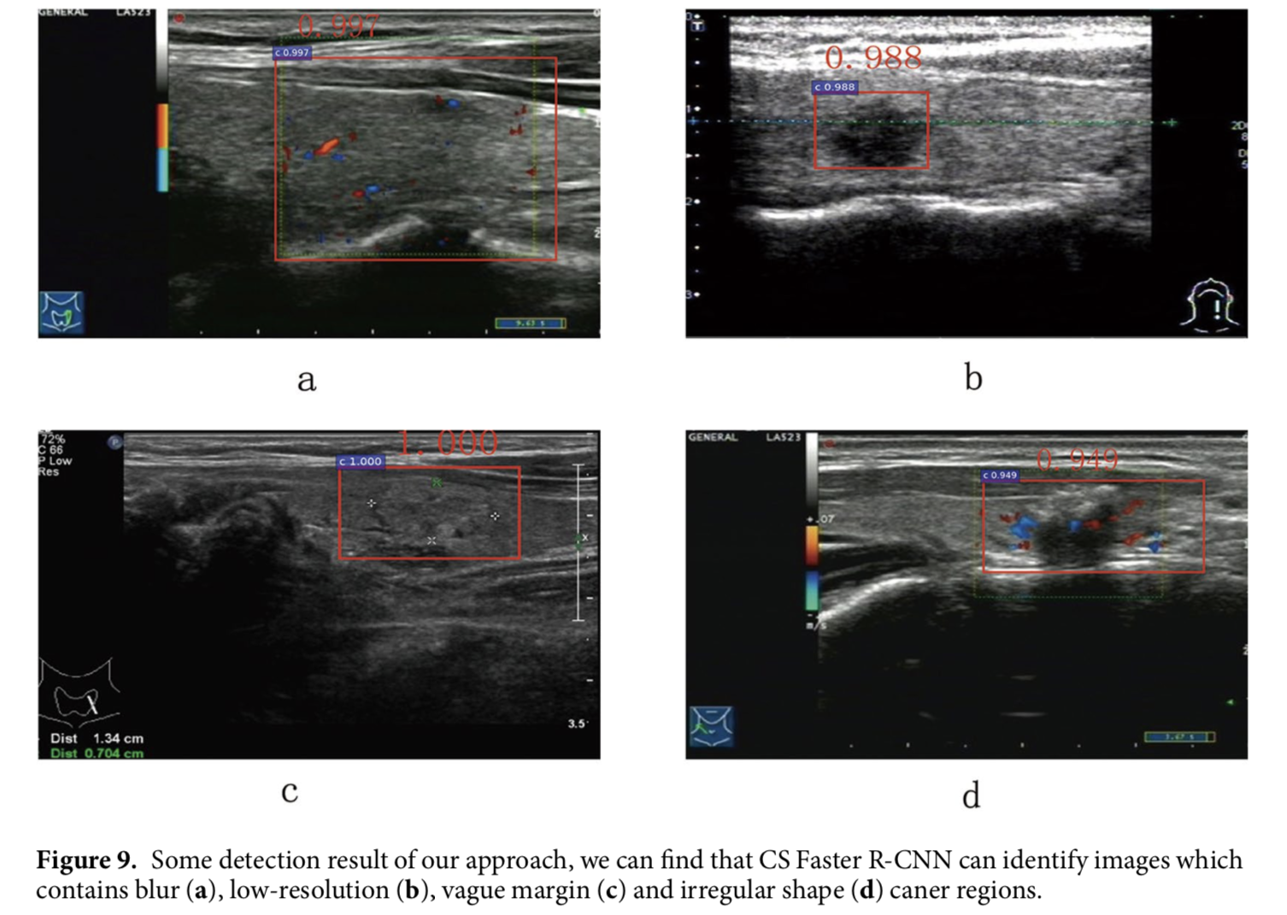
Discussion
Small amount data, ultrasound images are limited and difficult to obtain.
fine-tuning a CNN that has been pre-trained
Ultrasound images are usually blur, vague margin, irregular shape
identify their local texture features, layer concatenation
It is difficult to identify the boundaries of cancer

Slide 23
Thank you.

