Slide 1
Lung Cancer Survivability Prediction using Machine Learning and Deep Neural Network
CS 732: Advanced Machine Learning
Final Project
By: Firas Gerges (fg92)

Slide 2
Lung Cancer
Lung cancer was ranked as the leading cause for cancer-related detah
It is Important to know how much a patient has to live, as it affects the type of care, treatment, etc.

Slide 3
Lung Cancer
Currently, knowing precisely the survivability time of each lung cancer patient is a very hard task.
Even approximating this value is impossible without having a huge error rate.

Slide 4
Goal
The aim of this project is to use a wide variety of supervised machine learning techniques on Lung Cancer patient data in order to predict the number of month each patient has to survive

Slide 5
Base Paper
This work is based on a previously published paper concerning this same issue:
“Prediction of lung cancer patient survival via supervised machine learning classification techniques”
Lynch, C. M., Abdollahi, B., Fuqua, J. D., Alexandra, R., Bartholomai, J. A., Balgemann, R. N., ... Frieboes, H. B. (2017). Prediction of lung cancer patient survival via supervised machine learning classification techniques. International Journal of Medical Informatics, 108, 1–8. Mashwani, W

Slide 6
Data
Data is requested from the authors of the base paper.
Originally, the data is extracted for The Surveillance, Epidemiology, and End Results program (SEER) database, which is provided by provided by: National Cancer Institute (NCI) at the National Institute of Health (NIH)

Slide 7
Data
Each row in the data represents information (mainly medical measurements) for a lung cancer patient.
The class label is the number of months a patient had survived from the cancer diagnosing date

Slide 8
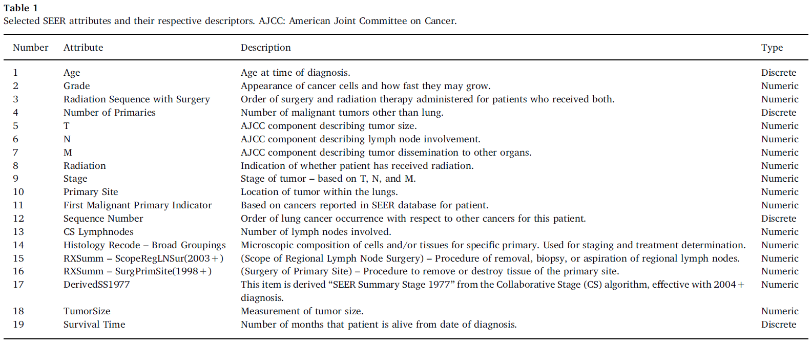
Data
10442 patient record
Each record include:

Slide 9
Problem Variation
In this work, and given that predicting the precise number of months is a hard task given the studied data (which can be seen by the results of previous work), we did three variation of the problem
Predicting the precise number of months (Regression)
Predicting the number of survivability years (Multi-Class Classification)
Predicting whether the patient will die within the first year (Binary Classification)
** All the experiments were done as 10-Folds cross validation

Slide 10
Problem 1: Regression
This problem is tackled by the base paper and resulted in high prediction error.
We used: (Scikit-Learn Library)
Random Forest
Support Vector Machine
Linear Regression
Performance Metric: given that this is a regression problem, we used the root mean squared error as a performance metrics (RMSE)

Slide 11
Problem 1: Regression (Results)
 | Train | Test
RF | 6.308486 | 16.46998
SVR | 16.49604 | 16.55717
LR | 15.61035 | 15.65975

Slide 12
Problem 2: Multi-Class
Instead of predicting the precise number of months, in this problem, we classify the patients based on within which year they are going to die
We have six different classes:
Survive less than a Year: Class 0
Survive less than two years: Class 1
Survive less than three years: Class 2
Survive less than four years: Class 3
Survive less than five years: Class 4
Survive less than six years: Class 5

Slide 13
Problem 2: Multi-Class
We used: (Scikit-Learn Library)
K-Nearest Neighbors (K=50 gave best results)
Decision Tree
Random Forest
Support Vector Machine
Linear Regression

Slide 14
Problem 2: Multi-Class - Results
 | Train | Test
KNN | 46.62879 | 44.22787
DT | 99.07999 | 33.00431
RF | 96.55132 | 40.18955
SVM | 45.02012 | 44.43168
LR | 41.35408 | 41.37104

Slide 15
Problem 3: Binary-Class
Even predicting the survivability year resulted in high prediction error. For this, we reduced once again the problem to be a binary problem. Hence, this new variation deals with whether the patient will survive more than a year or not.
We have Two different classes:
Survive less than a Year: Class 0
Survive more than a Year: Class 1

Slide 16
Problem 3: Binary-Class
We used: (Scikit-Learn Library)
K-Nearest Neighbors (K=50 gave best results)
Decision Tree
Random Forest
Support Vector Machine
Linear Regression

Slide 17
Problem 3: Binary-Class- Results
 | Train | Test
KNN | 64.54689 | 62.88037
DT | 99.46736 | 55.21957
RF | 97.71667 | 60.70107
SVM | 64.40055 | 63.21919
LR | 44.7382 | 44.74136

Slide 18
As can be seen from the binary classification results, SVM outperforms the other techniques with an accuracy of ~63%
So in order to study more the data, and it see if we can explore deep and hidden relationship, We implemented Deep Backpropagation Neural Network (DBNN)

Slide 19
Back Propagation
A backpropagation neural network is multi linear perceptron that consists of two main steps:
Feed Forward: compute output of each node, then the final output
Backpropagation: Compute error of the network and update the weights accordingly based on the gradient descent.

Slide 20
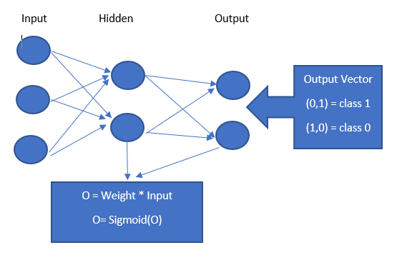
BNN Architecture

Slide 21
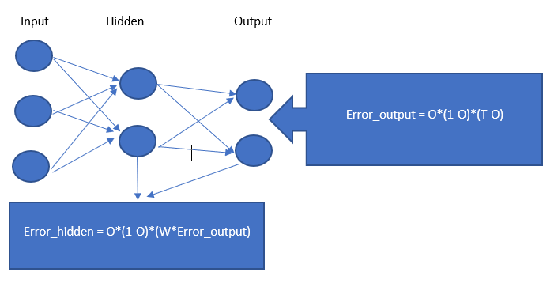
BNN Architecture

Slide 22
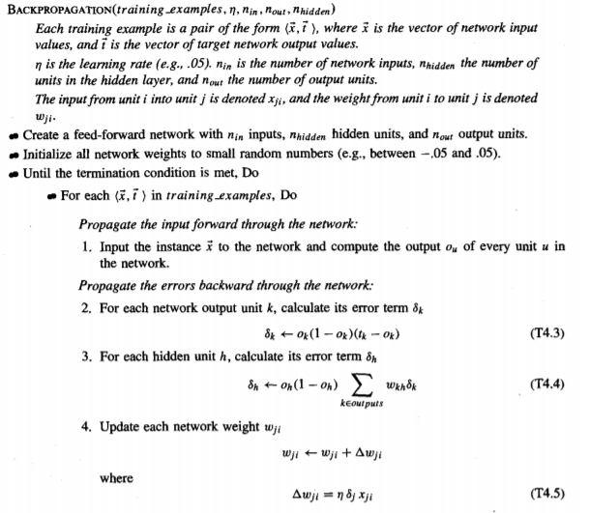
BNN Pseudo Code
From Thomas Mitchel Book: Machine Learning

Slide 23
Adding The Deep Learning
To transform the BNN to a DBNN we added for each hidden node a self loop.
This stores the output of the hidden node and uses it along the input in the next node
Output_Hidden = Weights * Input_Data + Hidden_Hidden_Weight * Prev_Output
This step, makes the network when folded across all iterations, to have inter-connected hidden layers where each layer corresponds to an iteration

Slide 24
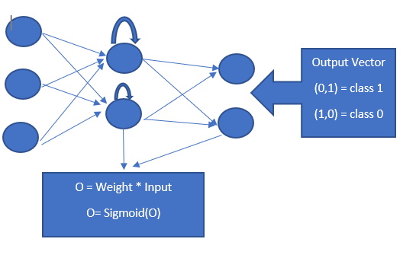
DBNN Architecture

Slide 25
DBNN Metrics
After doing more than 65 experiments (each one is 10 Folds cross validation), with different combination of learning rate, hidden nodes and number of iteration. We found that the following parameters output the best results
Learning Rate=0.2
Hidden Nodes=10
Iterations=1000

Slide 26
Complete Results of Problem 3
 | Train | Test
KNN | 64.54689 | 62.88037
DT | 99.46736 | 55.21957
RF | 97.71667 | 60.70107
SVM | 64.40055 | 63.21919
LR | 44.7382 | 44.74136
DBNN | 65.00739 | 65.05886

Slide 27
DBNN results
As can be seen from previous table, our Deep Backpropagation Neural Network outperforms all the other used technique in terms of testing accuracy.
Given that DBNN performs better than other, we tested it on Problem 2 where we deal with Multi-classification
However we changed the parameters to:
Learning Rate = 0.1
Hidden Nodes = 10
Iterations = 10,000

Slide 28
Complete Results of Problem 2
 | Train | Test
KNN | 46.62879 | 44.22787
DT | 99.07999 | 33.00431
RF | 96.55132 | 40.18955
SVM | 45.02012 | 44.43168
LR | 41.35408 | 41.37104
DBNN | 44.74467 | 45.05246

Slide 29
DBNN
DBNN also outperforms the other techniques on Problem 2 which is a multi classification problem
Even though, The results on Problem 2 are still low with the highest testing accuracy being ~45%

Slide 30
Discussion
The results of all the used supervised machine learning techniques on all the problem variation all relatively low:
Problem 1: Lowest RMSE = 15.7 (Linear Regression)
Problem 2: Highest Acc = 45.0% (DBNN)
Problem 3: Highest Acc = 65.1% (DBNN)
We can deduce from these results that the metrics used in the data set might not be an enough indicator for Cancer survivability and some other unknown data affects this index
In addition, around 45% of the original data had patients who died within 1 year, which makes the classification more bias (In problem 1 and 2)

Slide 31
Conclusion
Lung Cancer leads to death more than other type of cancers
Knowing the patient survivability is an important task
We used different machine learning techniques on different variation of the problem : Regression, Multi-Classification and Binary Classification
Results show that the data used might no be an enough indicator for the patient survivability time
Nevertheless, Deep Backpropagation Neural Network outperformed all the other techniques on the classification version of the problem

Slide 32
Thank You

Slide 33
Reference
Lynch, C. M., Abdollahi, B., Fuqua, J. D., Alexandra, R., Bartholomai, J. A., Balgemann, R. N., ... Frieboes, H. B. (2017). Prediction of lung cancer patient survival via supervised machine learning classification techniques. International Journal of Medical Informatics, 108, 1–8. Mashwani, W
Thomas M. Mitchell. 1997. Machine Learning (1 ed.). McGraw-Hill, Inc., New York, NY, USA.
https://scikit-learn.org/stable/

