Slide 1
Automatic segmentation of the spinal cord and intramedullary multiple sclerosis lesions with convolutional neural networks
Presented by Ruoyu

Slide 2
Outline
Why automating segmentation ? & Changelings
Data
Methods
Results
Limitation

Slide 3
Why automating segmentation ? & Changelings
Automating this operation eliminates inter-rater variability and increases the efficiency of large-throughput analysis pipelines
The large variability related to parameters: a precise delineation of lesions is hindered by a broad heterogeneity of lesion contrast, size, location, and shape.

Slide 4
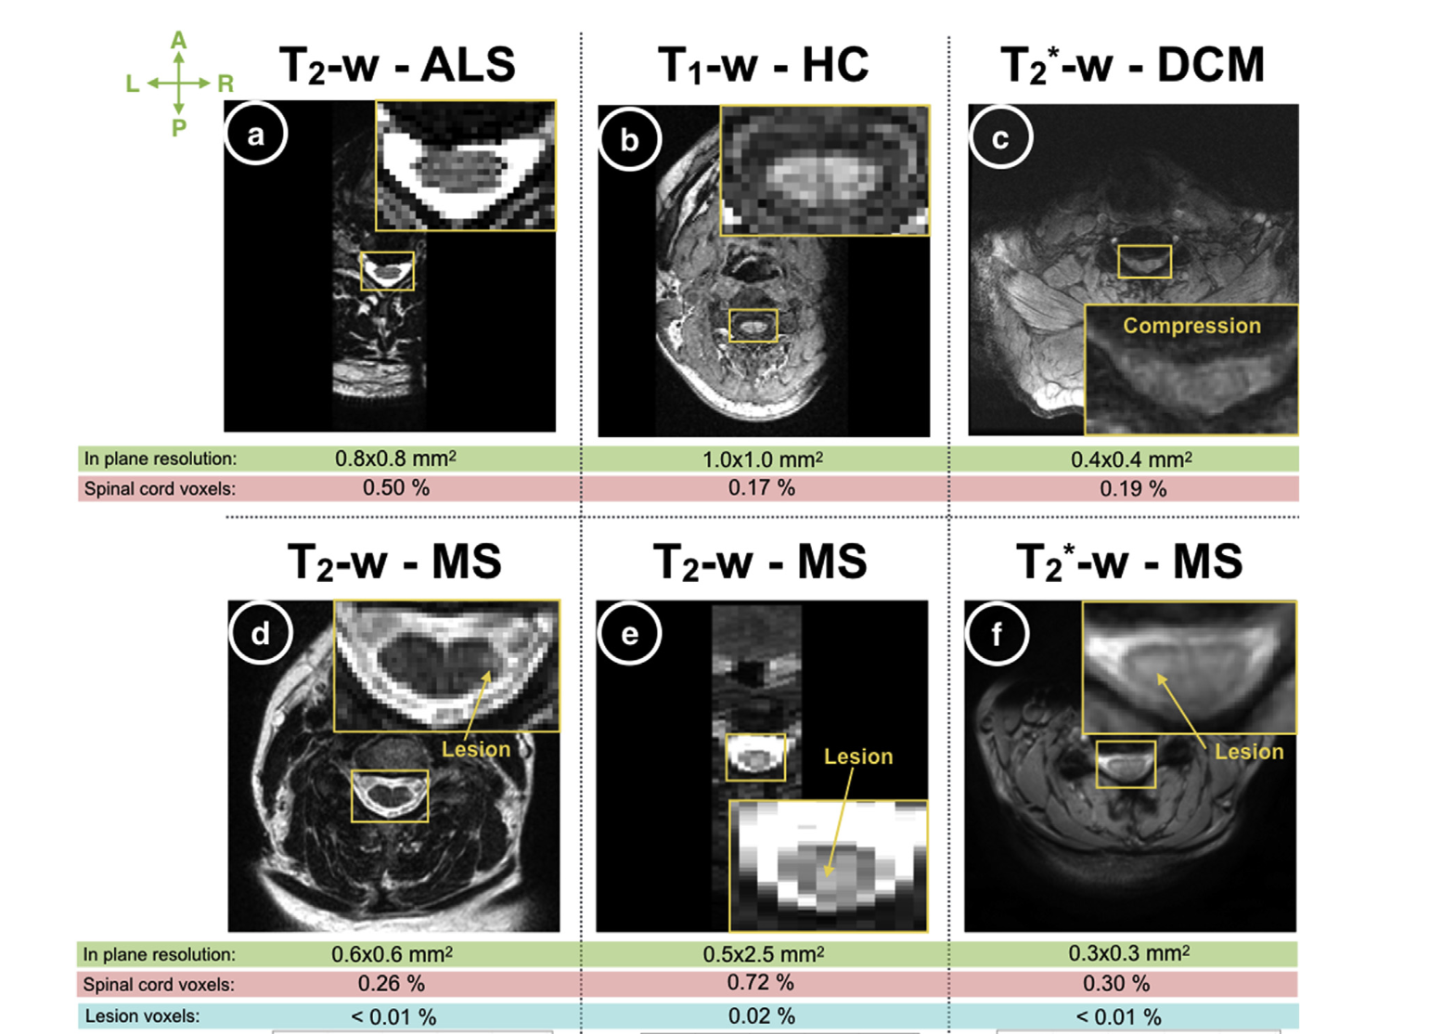
Data
Thirty centers contributed to this study, gathering real world data from 1042 subjects, including healthy controls (459), patients with MS or suspected MS (471), as well as degenerative cervical myelopathy (55), neuromyelitis optica (19), spinal cord injury (4), amyotrophic lateral sclerosis (32), and syringomyelia (2).

Slide 5
Methods
To prevent over fitting, the proposed framework split the learning scheme into two stages, each containing a CNN.
The first stage detects the spinal cord centerline
The second stage performs the spinal cord and/or lesion segmentation along the centerline

Slide 6
Method: spinal cord centerline detection
CNN1 architecture was adapted from the U-net architecture by reducing the downsampling layers from four to two layers, and by replacing conventional convolutions with dilated convolutions in the contracting path.
We infer the centerline from this spinal cord distance map using OptiC, a previously published fast global-curve optimisation algorithm.

Slide 7
Method: spinal cord and MS lesions segmentation
CNN2-SC and CNN2-lesion were independently trained and can be run separately
draw from the 3D U-net scheme. However, we reduced the depth of the U-shape from three to two, thus limiting the number of parameters and the amount of memory required for training.

Slide 8
Methods
The presented framework does not contain additional post-processing.

Slide 9
Results

Slide 10
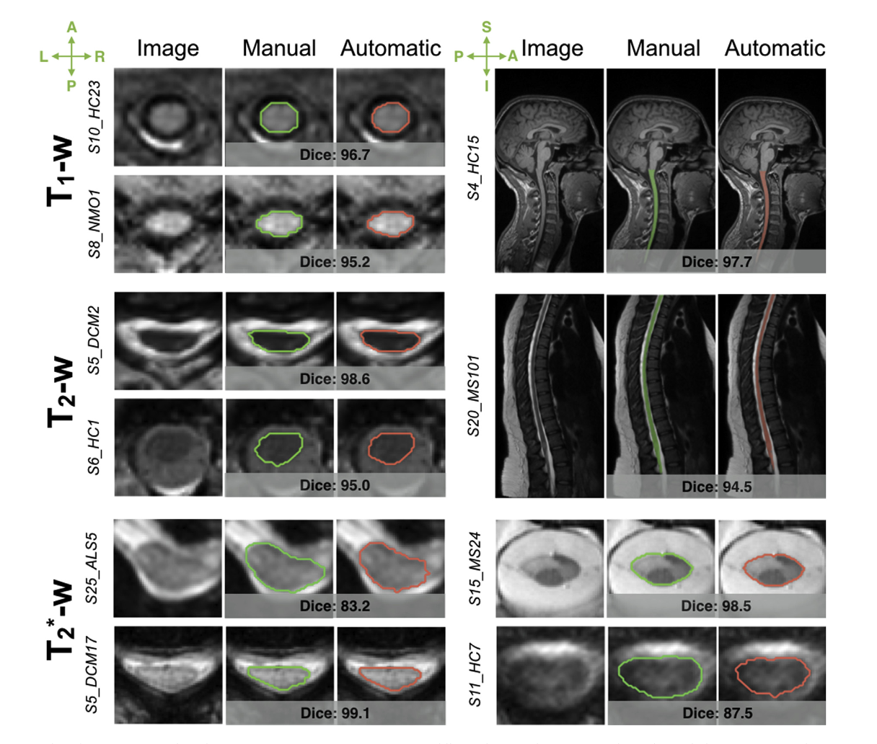
Results: spinal cord segmentations
A comparison between manual (green) and automatic (red) delineations

Slide 11
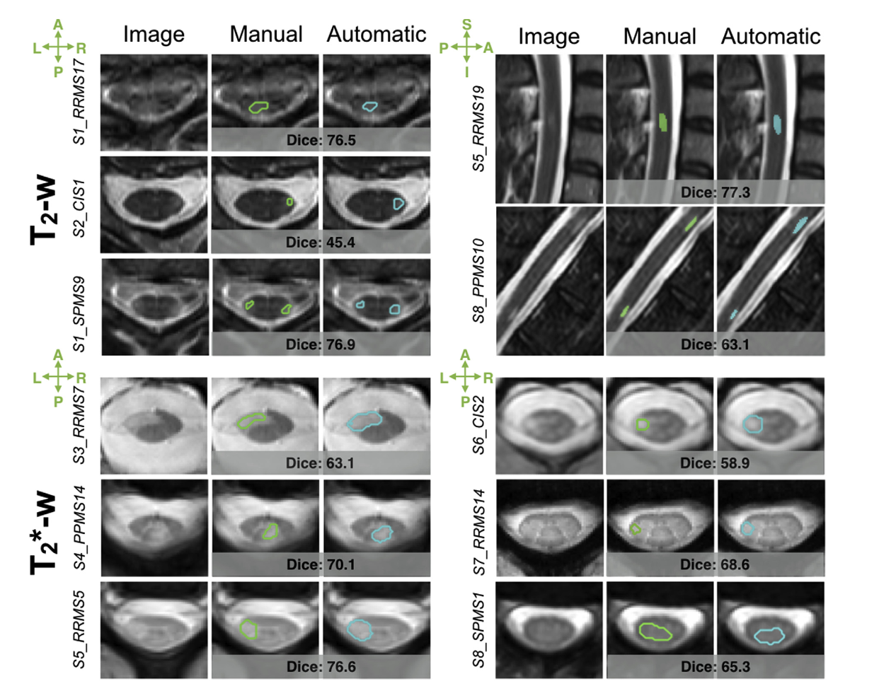
Results: lesion segmentations
a comparison between manual (green) and automatic (blue) delineations,

Slide 12
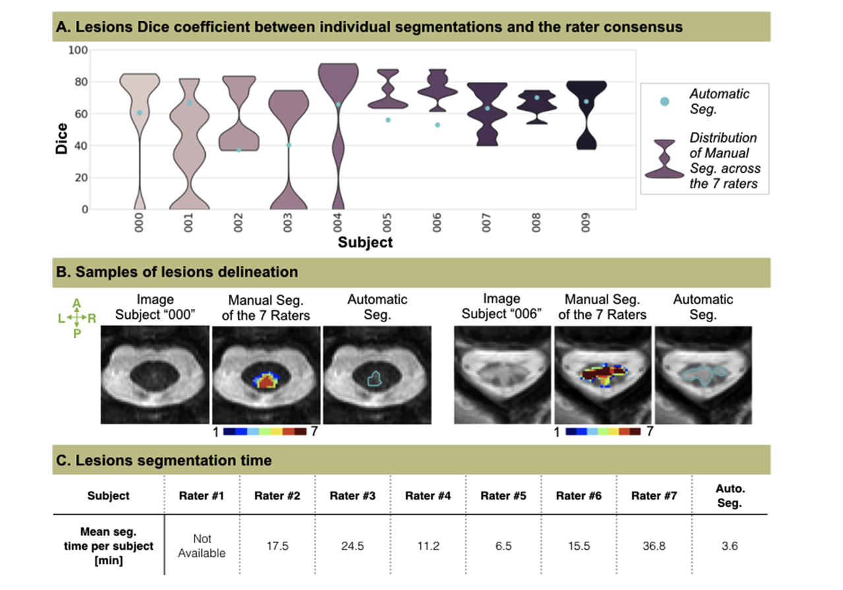
Results
Comparison between raters and automatic MS lesion segmentation on 10 testing subjects

Slide 13
Limitation
The disadvantage of the sequential approach is that the segmentation framework is sensitive to the quality of the detection module.
Fortunately though, the high performance of the spinal cord detection is reliable enough.
When scans incorporated the brain, 13% of the spinal cord centerlines extended above the pontomedullary junction, but without impacting the consecutive cord segmentation.

Slide 14
Thanks

