Slide 1
CS 732 Presentation
Yajuan Li
yl935@njit.edu

Slide 2
Learning Deep CNN Denoiser Prior for Image Restoration
Kai Zhang, Wangmeng Zuo, Shuhang Gu, Lei Zhang
School of Computer Science and Technology, Harbin Institute of Technology, Harbin, China
Dept. of Computing, The Hong Kong Polytechnic University, Hong Kong, China

Slide 3
Background
1. Methods of image restoration
Model-based optimization methods
Discriminative learning methods
2. Variable splitting techniques
Denoiser prior can be plugged in as a modular part of model-based optimization methods
Notes:
Use cnn denoiser into model based optimization method results better. Moreover, if this cnn denoiser is got from discriminative learning, results better

Slide 4
What does this paper do?
Training a set of fast and effective CNN denoisers and integrate them into model-based optimization method to solve inverse problems.
Notes:
Use cnn denoiser into model based optimization method results better. Moreover, if this cnn denoiser is got from discriminative learning, results better

Slide 5
What does this paper do?
Authors trained a set of fast and effective CNN denoisers. With variable splitting technique, the powerful denoiser can bring strong image prior into model-based optimization methods.
Integrating the merits of flexible model-based optimization method and fast CNN-based discriminative learning methods.
Cope with different image restoration problems.

Slide 6
Image Restoration (IR) Methods
Image degradation model
Notes:
Image degradation model
the purpose of image restoration is to recover the latent clean image x from its degraded observation y = Hx + v,
where H is a degradation matrix, v is additive white Gaussian noise of standard deviation σ.
Lambda: trade off parameter
From a Bayesian perspective,the solution ˆx can be obtained by solving a Maximum A Posteriori (MAP) problem,
To solve equation 2: model-based or discriminative learning, this two methods have own advantage and disadvantage. So we want to combine them. Like variable splitting technique

Slide 7
Half Quadratic Splitting (HQS) method
Notes:
Image restoration with denoiser prior.
By using HQS, introducing auxiliary variable z, Eqn. (2) can be reformulated as a constrained optimization problem which is given by 4.
Then, HQS method tries to solve the following problem 5
where μ is a penalty parameter which varies iteratively in a non-descending order. Eqn. (5) can be solved via the following iterative scheme, 6a and 6b.
As one can see, the fidelity term and regularization term are decoupled into two individual subproblems. Specifically, the fidelity term is associated with a quadratic regularized least-squares problem. 6a
A direct solution to 6a is given by 7.
According to Bayesian probability, Eqn. (8) corresponds to denoising the image xk+1 by a Gaussian denoiser with noise level sqrt(λ/μ). As a consequence, any Gaussian denoisers can be acted as a modular part to solve Eqn. (2). To address this, we rewrite Eqn. (8) by (9).
according to Eqns. (8) and (9),
The image prior psy(・) can be implicitly replaced by a denoiser prior.

Slide 8
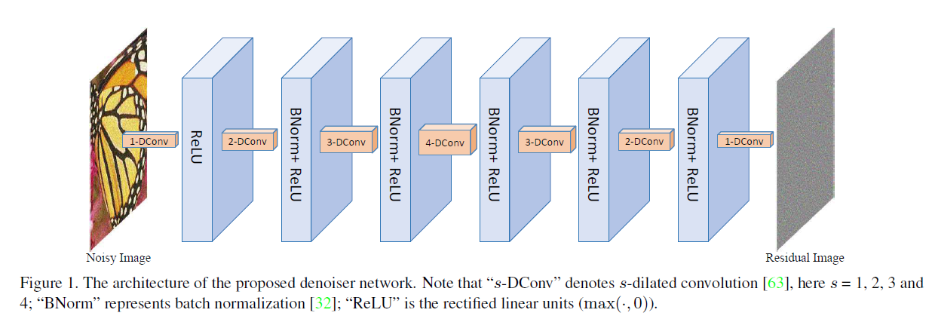
Proposed CNN Denoiser Architecture
Notes:
The architecture of the proposed CNN denoiser is illustrated
in Figure 1.
It consists of seven layers with three
different blocks, i.e., “Dilated Convolution+ReLU” block
in the first layer, five “Dilated Convolution+Batch Normalization+
ReLU” blocks in the middle layers, and “Dilated
Convolution” block in the last layer. The dilation factors of
(3×3) dilated convolutions from first layer to the last layer
are set to 1, 2, 3, 4, 3, 2 and 1, respectively. The number
of feature maps in each middle layer is set to 64. In the following,
we will give some important details in our network
design and training.

Slide 9
Details in network design and training
Notes:
In the following, we will give some important details in our network
design and training.
A dilated filter with dilation factor s can be
simply interpreted as a sparse filter of size (2s+1)×(2s+1)
where only 9 entries of fixed positions can be non-zeros.
Hence, the equivalent receptive field of each layer is 3, 5, 7,
9, 7, 5 and 3. Consequently, it can be easily obtained that
the receptive filed of the proposed network is 33×33. If thes
traditional 3×3 convolution filter is used, the network will
either have a receptive filed of size 15×15 with the same
network depth (i.e., 7) or have a depth of 16 with the same
receptive filed (i.e., 33×33).

Slide 10
Details in network design and training

Slide 11
Dataset
400 BSD images
400 selected images from validation set of ImageNet database
4,744 images of Waterloo Exploration Database
Notes:
we collect a large dataset which includes
400 BSD images, 400 selected images from validation
set of ImageNet database [20] and 4,744 images ofWaterloo
Exploration Database

Slide 12
Experiments

Slide 13
Image Denoising
Notes:
We crop the images into small patches
of size 35×35 and select N=256×4,000 patches for training.
As for the generation of corresponding noisy patches,
we achieve this by adding additive Gaussian noise to the
clean patches during training.

Slide 14
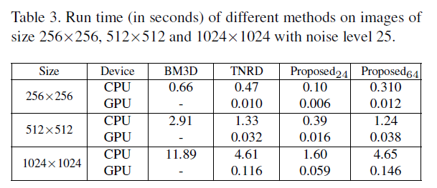
Image Denoising
Notes:
Table 1, the proposed CNN denoiser
can have a PSNR gain of about 0.2dB over those
three methods.
Table 2, it can be seen that the proposed denoiser consistently
outperforms CBM3D by a large margin
Such a promising result can be attributed to the powerful color image prior
modeling capacity of CNN.
Table 3, We can see that the proposed denoiser is very competitive
in both CPU and GPU implementation.
It is worth emphasizing
that the proposed denoiser with 24 feature maps of
each layer has a comparable PSNR of 28.94dB to TNRD but
delivers a faster speed.

Slide 15
Image Deblurring
As a common setting, the blurry images are synthesized by first applying a blur kernel and then adding additive Gaussian noise with noise level.
To make a thorough evaluation, we consider three blur kernels, including a commonly-used Gaussian kernel with standard deviation 1.6 and the first two of the eight real blur kernels from [38]
Notes:
Figure 3 illustrates deblurred Leaves image by different
methods. We can see that IDDBM3D, NCSR and
MLP tend to smooth the edges and generate color artifacts.
In contrast, the proposed method can recover image sharpness
and naturalness.

Slide 16
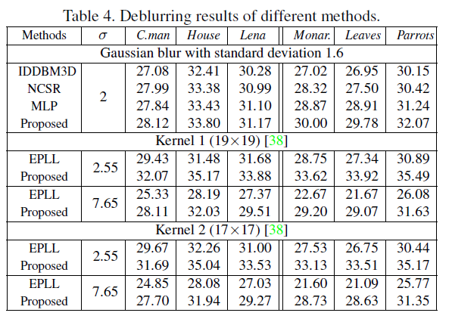
Image Deblurring
Notes:
The PSNR results of different methods are shown in Table
4. As one can see, the proposed CNN denoiser prior
based optimization method achieves very promising PSNR
Results.

Slide 17
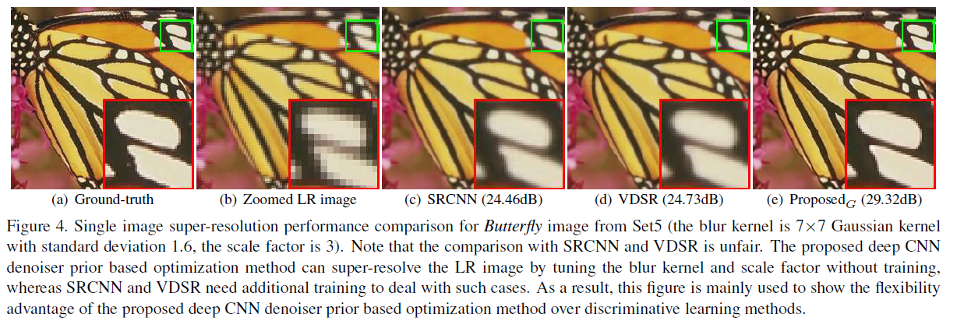
Single Image Super Resolution
This paper considers three typical image degradation settings for SISR, i.e., bicubic ownsampling with two scale factors 2 and 3 and blurring by Gaussian kernel of size 7×7 with standard deviation 1.6 followed by downsampling with scale factor 3.

Slide 18
Single Image Super Resolution
Notes:
Note that
SRCNN and VDSR(two CNN-based discriminative learning methods) are trained with bicubic blur kernel,
thus it is unfair to use their models to super-resolve the
low-resolution image with Gaussian kernel. As a matter of
fact, we give their performances to demonstrate the limitations
of such discriminative learning methods
√Second, the proposed
methods have a better PSNR result than SRBM3DC
and SRBM3DG which indicates good denoiser prior facilitates
to solve super-resolution problem. Third, both of
the gray and color CNN denoiser prior based optimization
methods can produce promising results

Slide 19
Conclusion
Extensive experimental results have demonstrated that the integration of model-based optimization method and discriminative CNN denoiser results in a flexible, fast and effective framework for various image restoration tasks.

Slide 20
Future Work
reduce the number of the discriminative CNN denoisers and the number of whole iterations
extending the proposed CNN denoiser based HQS framework to other inverse problems such as inpainting and blind deblurring
utilizing multiple priors which are complementary to improve performance
since the HQS framework can be treated as a MAP inference, this work also provides some insights into designing CNN architecture for task-specific discriminative learning.

