Slide 1
CS732 PRESENTATION
YAJUAN LI
YL935@NJIT.EDU

Slide 2
Paper intro
Title:
SVM and SVM Ensembles in Breast Cancer Prediction
Author:
Min-Wei Huang, Chih-Wen Chen, Wei-Chao Lin, Shih-Wen Ke, Chih-Fong Tsai
Data Source: http://archive.ics.uci.edu/ml/, http://www.sigkdd.org/kddcup/index.php
Published year:
2017

Slide 3
Background
Breast cancer is common, prediction is important
Decision Tree
Naive Bayes
K Nearest Neighbors SVM
SVM outperforms other techniques
SVM ensembles VS single SVM？

Slide 4
SVM
Support vector
margin
Notes:
Transform data to a higher dimension ,then find a hyperplane to separate the transformed data.
Fig 1 illustrates this procedure of a linear kernel based SVM, which maps the nonlinear
input space into the new linearly separable space

Slide 5
Two widely used kernel functions :
Polynomial
Gaussian Radial Basis Function(RBF)

Slide 6
Classifier ensembles
Combine multiple classifiers:
Bagging
Boosting

Slide 7
For example: Bagging
Bootstrapping builds k training datasets->k independent classifiers(resampling, with replacement)
Aggregate k classifiers using combination method(majority voting)
Here each training example may be repeated or doesn’t appear.
Notes:
In bagging, several classifiers are trained independently by different training sets via the bootstrap
method [31]. Bootstrapping builds k replicate training data sets to construct k independent
classifiers by randomly re-sampling the original given training dataset, but with replacement. Then, the k classifiers are aggregated via an appropriate combination
method, such as majority voting.

Slide 8
For example: Boosting
AdaBoost is most common
Initially same weight for each example, boost importance of incorrect classified examples
Train k classifiers sequentially
Final decision is based on the weighted vote of the individual classifiers
Notes:
In boosting, like bagging, each classifier is trained using a different training set. However,
the k classifiers are trained not in parallel and independently, but sequentially. The original
boosting approach, boosting by filtering, was proposed by Schapire [33]. Nowadays, AdaBoost
(or Adaptive Boosting) is the most common boosting learning algorithm used in pattern
recognition.
Initially, each example of a given training set has the same weight. For training the k-th classifier
as a weak learning model, n sets of training samples (n < m) among S are used to train the
k-th classifier. Then, the trained classifier is evaluated by S to identify those training examples
which cannot be classified correctly. The k + 1 classifier is then trained by a modified training
set which boosts the importance of those incorrectly classified examples. This sampling procedure
will be repeated until K training samples are built for constructing the K-th classifier. The
final decision is based on the weighted vote of the individual classifiers [34].

Slide 9
Related works using SVM
Problem:
most only based on RBF kernel function( other should be explored)
Most use Breast Cancer Wisconsin dataset (too small )
Accuracy is the primary evaluation metric (class imbalance)
Notes:
Table 1 compares several recent related works on breast cancer prediction using SVMin terms
of the kernel function employed, the dataset used, and evaluation metric considered.

Slide 10
To solve problems, this paper
Use different kernel functions(linear, polynomial, and RBF), single and ensembles
Use both small and large dataset
Compares classification accuracy, the ROC curve, the F-measure rate, the F-1 score, and computational time of training different classifiers.

Slide 11
Experimental procedure
(1) dived data into 90% training , 10% testing (10-flod cross validation)
(2)construct SVM classifiers use individual kernel function or ensembles(bagging or boosting)
(3)Compare results of using feature selection(genetic algorithm) or not
(4) Compare classification accuracy, ROC, and F-measure rates, the classifier training times.
Notes:
10-flod cross validation
https://www.openml.org/a/estimation-procedures/19

Slide 12
Results

Slide 13
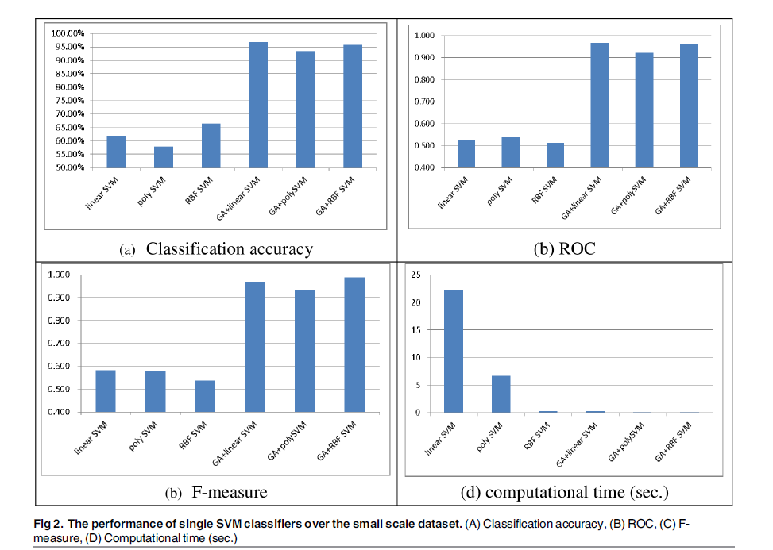
Single SVM Classifiers
Small dataset
With or without feature selection
Feature selection produce significantly better performance
No big difference between
GA + linear SVM
GA+RBF
Notes:
As we can see, performing feature selection before training the SVM classifiers allows them
to produce significantly better performance (i.e., classification accuracy, ROC, and F-measure).
In particular, the best performances are obtained by GA + linear SVM for classification accuracy
(96.85%), GA + linear SVM for ROC (0.967), and GA + RBF SVM for F-measure (0.988).
Moreover, there are no big performance differences between GA + linear SVM and GA + RBF
SVM.
In addition, there is a large reduction in the computational times for training the SVM classifiers
after performing feature selection compared with the baseline SVM classifiers withoutfeature selection. Comparison of the training times shows that training RBF SVM requires the
least time and poly SVM requires the second smallest time. The largest computational time is
required for the linear SVM classifier.

Slide 14
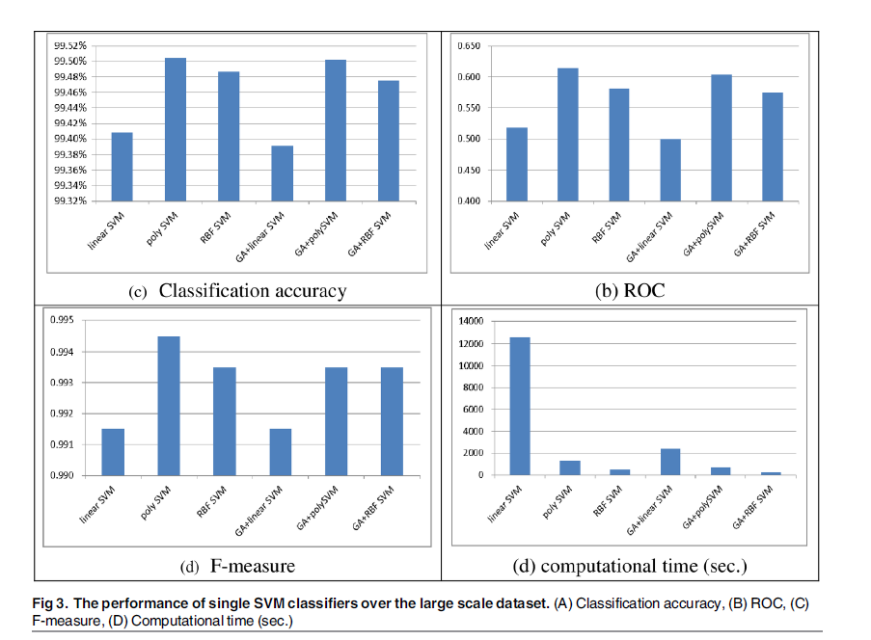
Single SVM Classifiers
Large dataset
With or without feature selection
Poly SVM outperforms
Slower but OK(20m vs 11m)
Notes:
With a large scale dataset, performing feature selection does not necessarily make the SVM
classifiers perform better than the ones without feature selection. Specifically, the best performances
are obtained by poly SVM and GA + poly SVM for classification accuracy (99.50%)
and poly SVM for ROC (0.614) and F-measure (0.994). Similar to the results obtained with the
small scale dataset, the SVM classifiers with and without feature selection based on the polynomial
and RBF kernel functions perform similarly in terms of classification accuracy and F-measure,
specifically, the performance differences are 0.02% for classification accuracy and 0.001
for the F-measure. However, when the ROC is considered as the evaluation metric, poly SVM
significantly outperforms the other SVM classifiers.

Slide 15
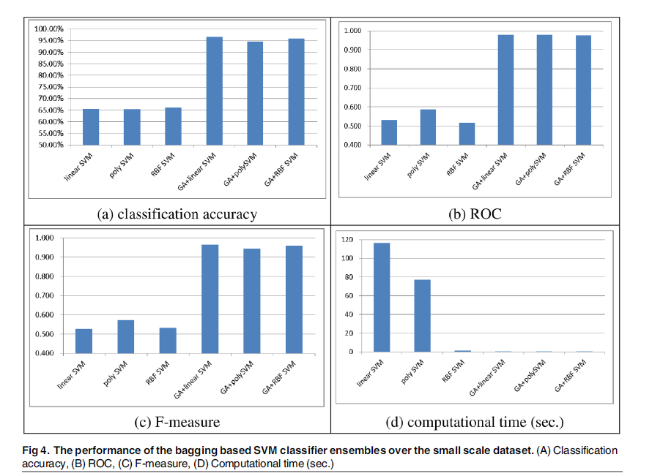
SVM classifier ensembles
Small dataset
Bagging
With or without feature selection
With feature selection is better

Slide 16
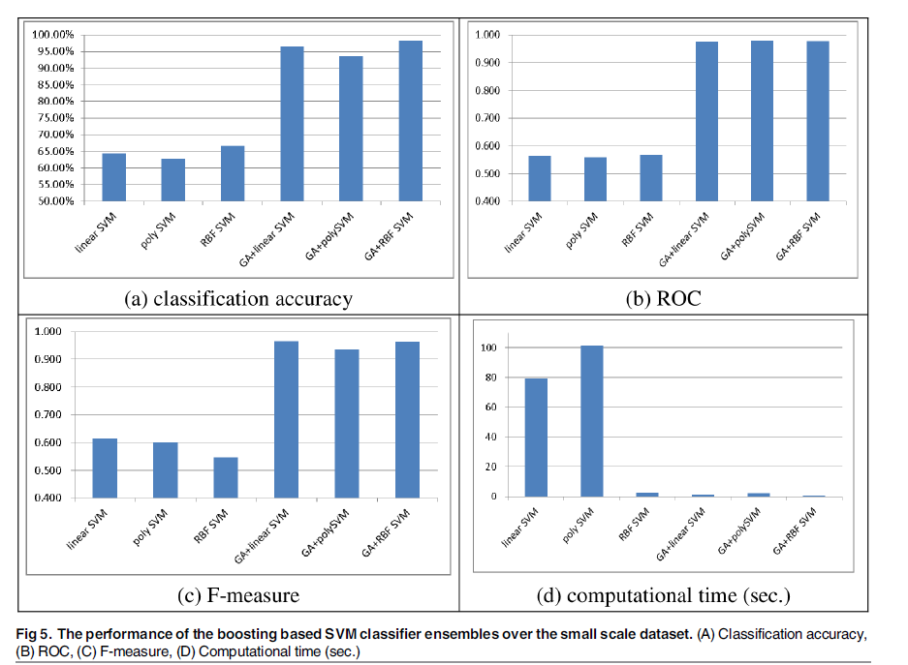
SVM classifier ensembles
Small dataset
Boosting
With or without feature selection
With feature selection is better

Slide 17
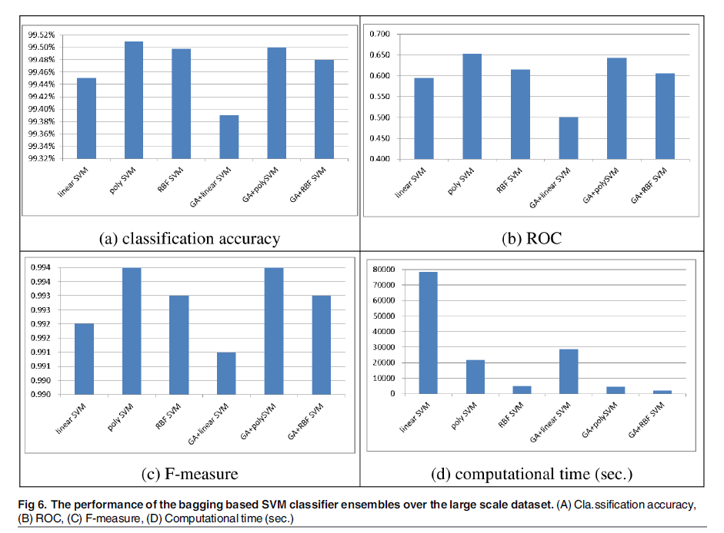
SVM classifier ensembles
large dataset
Begging
With or without feature selection
Notes:
With a large scale dataset, performing feature selection does not make the SVM ensembles
perform better than without feature selection.

Slide 18
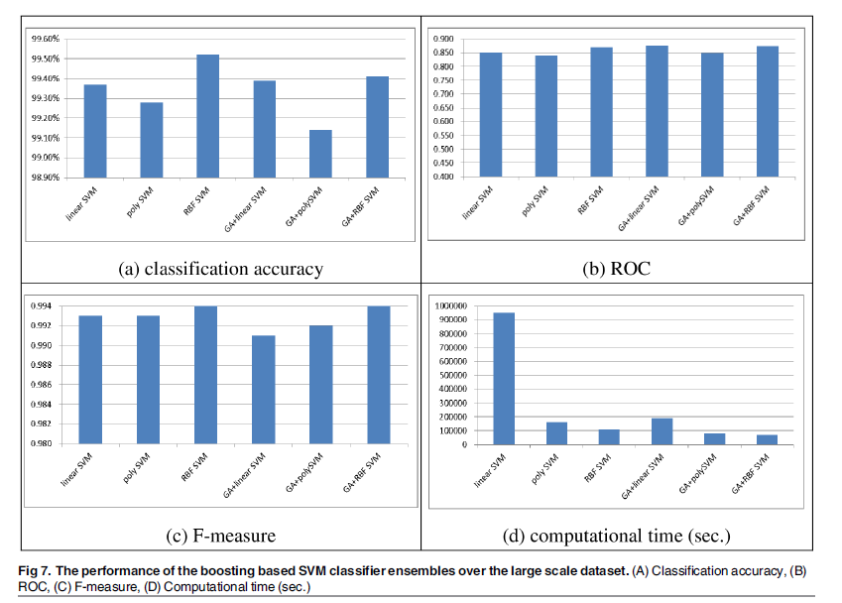
SVM classifier ensembles
large dataset
Boosting
With or without feature selection
boosting method require larger training times than the ones using the bagging method
RBF SVM ensembles require less time

Slide 19
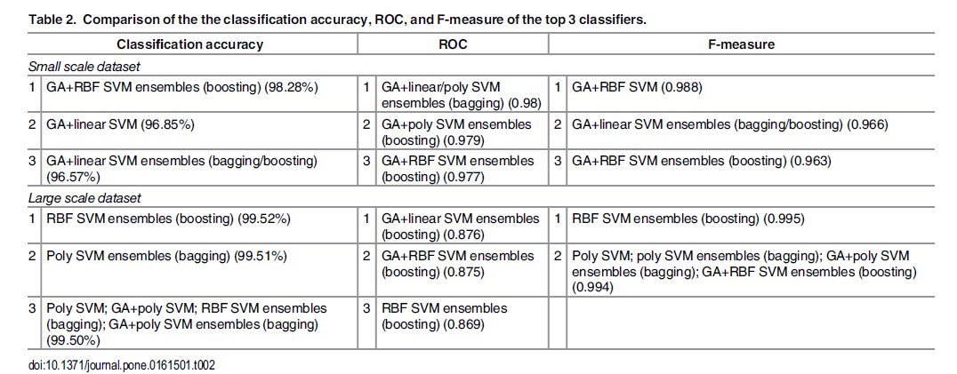
these findings are only suitable for the breast cancer prediction datasets.
contain small numbers of features and large numbers of data Samples
Notes:
It should be noted that these findings are only suitable for the breast cancer prediction datasets. These two datasets contain small numbers of features and large numbers of data Samples.

Slide 20
Discussion
For small dataset, GA + linear SVM ensembles by bagging and GA+RBF SVM ensembles by boosting are better classifiers.
For large dataset, only RBF SVM ensembles by boosting are in top 3 of 3 evaluation metrics
When the prediction performances and the classifier training time are both considered simultaneously, we recommend the GA + RBF SVM ensembles based on boosting for a larger dataset

Slide 21
Discussion
There is no single classifier that can perform the best for all of the evaluation metrics.
SVM ensembles mostly provide better performances than single SVM classifiers.

Slide 22
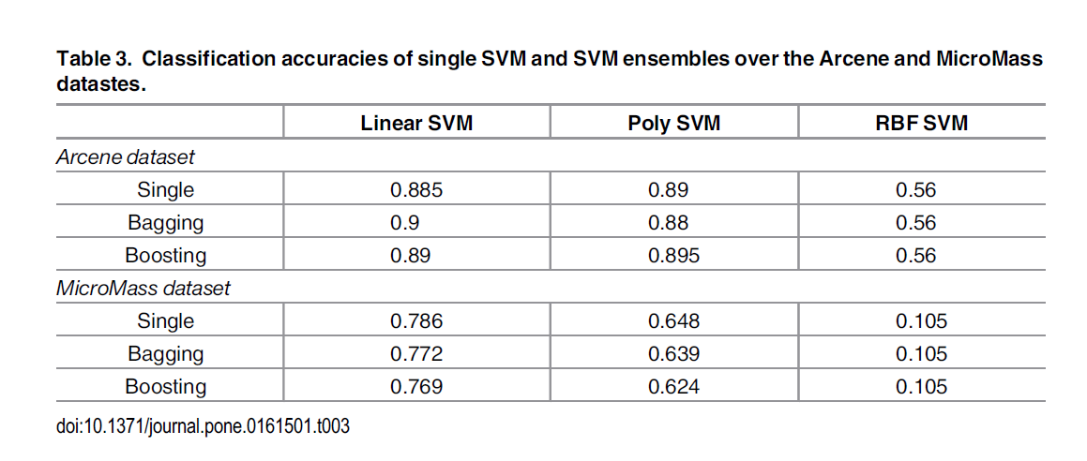
two additional datasets that contain very large numbers of features but smaller numbers of data samples are used for further analyses

Slide 23
Conclusion
SVM ensembles mostly performed slightly better
feature selection over the small scale dataset can make performance significantly better
GA + linear SVM ensembles with bagging and GA + RBF SVM ensembles with boosting are the top two prediction models (differences are not significant)

Slide 24
Conclusion
For the large scale dataset, a prediction model based on RBF SVM ensembles with boosting is the better choice.
To reduce computation time: (1) feature selection (2) use a cloud platform

