Slide 1
Convolutional neural network based Alzheimer’s disease classification from magnetic resonance brain images
RachnaJain NikitaJainªAkshayAggarwal D. JudeHemanth
Computer Science and Engineering, Bharati Vidyapeeth’s College of Engineering, New Delhi, India^{b}Department of ECE, Karunya University, Coimbatore, India

Slide 2
Overview
Introduction
Methods
Results
Future Extension

Slide 3
Alzheimer
Dementia
(a decline in memory or other thinking skills)
ALZHEIMER
(AD)
60%~80%
No Cure
Late Stage: lost ordinary activities
20%
Cognitively normal
(CN)
Mild cognitive impairment
(MCI)
Other
Notes:
Alzheimer’s disease (AD) is the most common form of dementia. Dementia is a general term that describes a set of symptoms associated with a decline in memory or other thinking skills severe enough to reduce a person's ability to perform ordinary activities.
MCI : also known as mild cognitive impairment, memory loss is mild

Slide 4
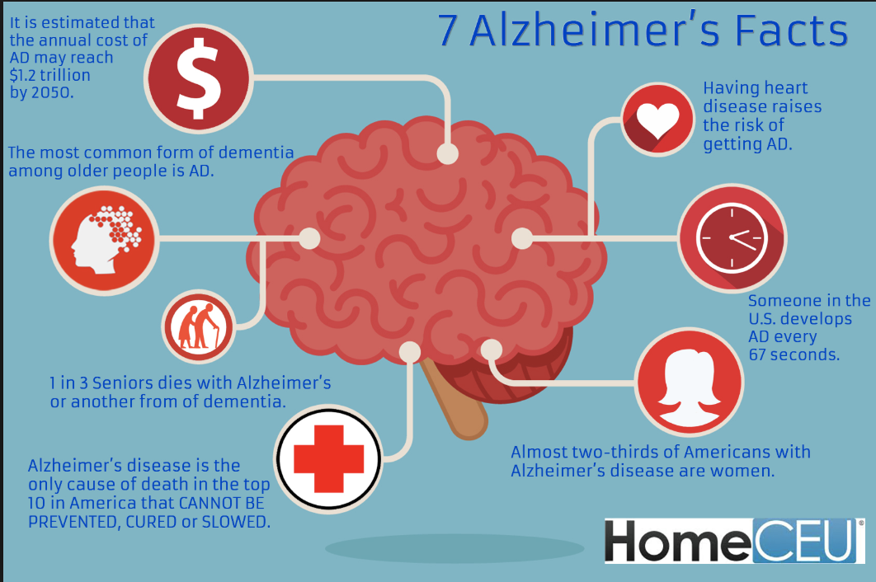
Problems and solution
No Cure
Early diagnosis
Needed!
Various medical tests
Exhausting to manually compare and analyze data
CNNs: have performed well in medical field for tasks such as visual object recognition, detection and segmentation.
Current solution

Slide 5
Limitations for current CNN solution
Limitations:
huge amount of annotated data
huge amount of computational resources
careful and tedious tuning of hyper-parameters, optimal tuning
Improvement:
Transfer learning
Mush less time (few hours than weeks)
Notes:
Proper training of deep neural networks requires huge amount of annotated data, which can be a problem especially for medical imaging field
Training of such architectures requires huge amount of computational resources.
Deep learning requires careful and tedious tuning of hyper-parameters, optimal tuning, which otherwise can lead to overfitting/underfitting, resulting in overall poor performance

Slide 6
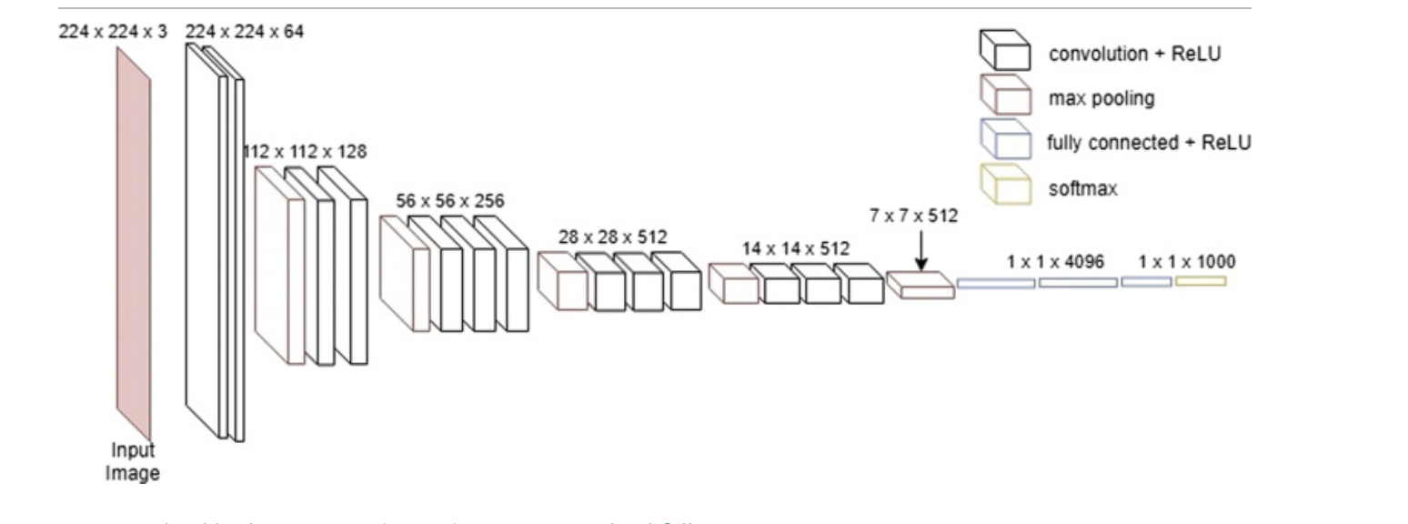
New approach
Transfer learning :is a machine learning method where a model developed for a task is reused as the starting point for a model on a second task.
Training a CNN takes weeks VS pretrained CNN takes much lesser time, typically few hours.
In this paper, VGG16 is taken as the base model for applying transfer learning.
VGG16 is a 16-layer network built by Oxfords Visual Geometry Group (VGG). It participated in the ImageNet competition in ILSVRC 2014. It is one of the first architectures to explore network depth by pushing to 16 layers and using small (3 × 3) convolution filters.
Notes:
In practice nowadays, very few people train an entire CNN from scratch (with random initialization), because it is relatively rare to have a dataset of sufficient size.

Slide 7
Methodology
Building components of CNN
Data collection
Alzheimer classification mathematical model – P_{F}S_{E}C_{TL}
Selecting most informative MRI slices based on entropy
Creating training and test sets
Classification using transfer learning

Slide 8
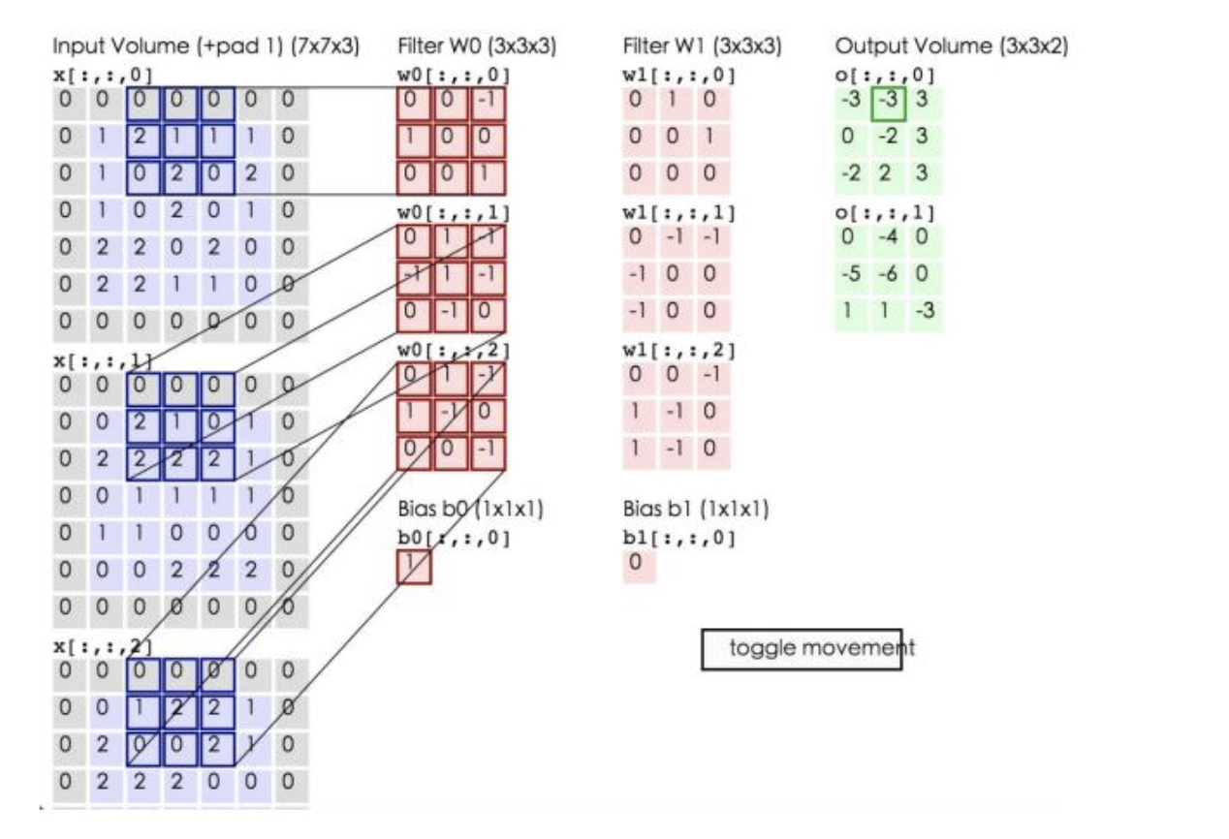
Building components of CNN
Convolutional layer is the core building block of a CNN
2+（-2+1-2）+（1-2-2） + 1= 2 - 3 - 3 + 1 = -3）

Slide 9
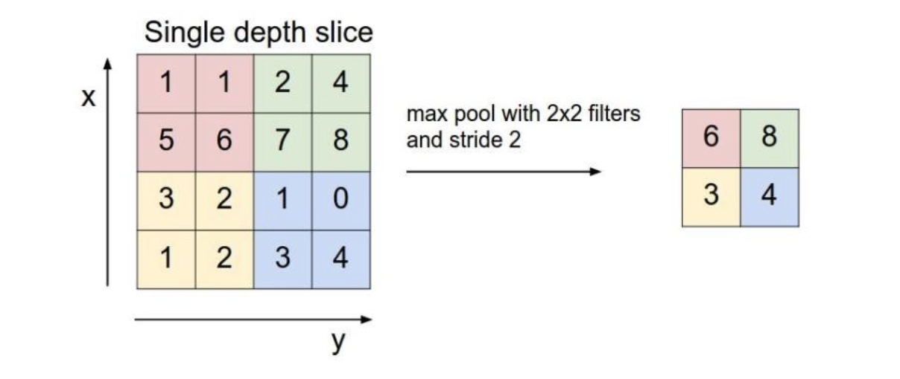
max-pooling
Max-pooling is an aggregation operation that extracts the maximum value
Main reason is to reduce the size
average POOLING

Slide 10
Dropout regulaRization
dropping out neurons (both hidden and visible) in a neural network randomly.
mainly tackle the problem of overfitting in neural networks.

Slide 11
Non-linearity layers
are also called activation functions : Rectified linear unit (ReLU)
ReLU converges six times faster than tanh and sigmoid activation functions
it converts all negative inputs to zero and the neuron does not get activated. This makes it very computational efficient as few neurons are activated per time

Slide 12
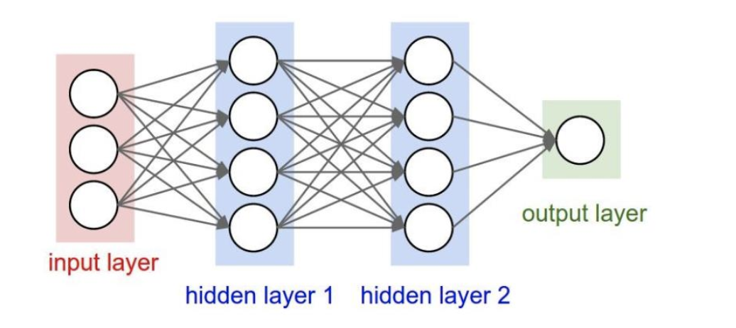
Fully-connected layers
Neurons in a fully connected layer have full connections to all activations in the previous layer
Fully-connected layers are usually appended after a combination of convolution, max-pooling and dropout layers in CNN

Slide 13
Data collection
Data used was obtained from the Alzheimer’s Disease Neuroimaging Initiative (ADNI). The ADNI was launched in 2003 as a public-private partnership, led by Principal Investigator Michael W. Weiner, MD.
T1-weighted sMRI data of 150 subjects: 50 AD; 50 CN; 50 MCI was selected for the classification task.

Slide 14
Data pre-processing using FreeSurfer
FreeSurfer image analysis suite, which is documented and freely available for download online
To remove unnecessary details of brain MR images that might cause poor training of our classification model, cortical reconstruction and volumetric segmentation.
There are five processes.

Slide 15
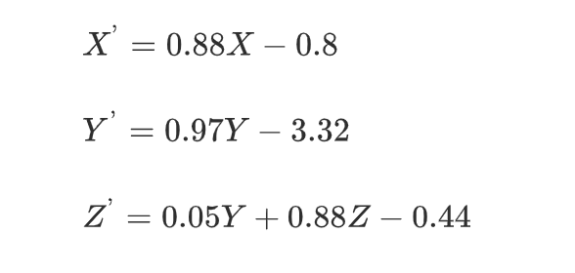
Data pre-processing using FreeSurfer
Motion Correction and conform: When there are multiple sources of volume, this process will correct for minor motions between them and will average them together.
Let inVol₁ inVol₂…inVol_{n} be the different input volumes of Image I, then after motion correction the new output Volume received will be outVolI=inVol(I)1+inVol(I)2⋯inVolIn/n
Non-Uniform intensity normalization (NU): Also called N3, corrects MR data by removing non-uniformity in intensity of the image.
Talairach transform computation: Initially the pixel coordinate are converted to Talairach coordinates using the following equations

Slide 16
Data pre-processing using FreeSurfer
Intensity normalization: This steps corrects for fluctuations in intensity. It scales intensities for all voxels such that mean intensity of white matter is 110.
White matter pathways play an important role in the human brain by connecting spatially separated areas of the CNS and enabling rapid and efficient information exchange.
Skull stripping: This step removes the skull from the normalized image.

Slide 17
Selecting most informative MRI slices based on entropy
3D image:
256*256*256
2D images:
256 slices of 256*256
Top 32 slices of 2D images
Pre-processing
Entropy

Slide 18
Classification using transfer learning
VGG16 pretrained on ImageNet dataset is taken as base model
Fully-connected layers from the base model are
new fully-connected layers are added at the end of base model in which first layer consists of 256 neurons, second layer is the dropout layer with dropout ratio 0.5 which means half of the neurons will output 0 at any instance.

Slide 19
Classification using transfer learning

Slide 20
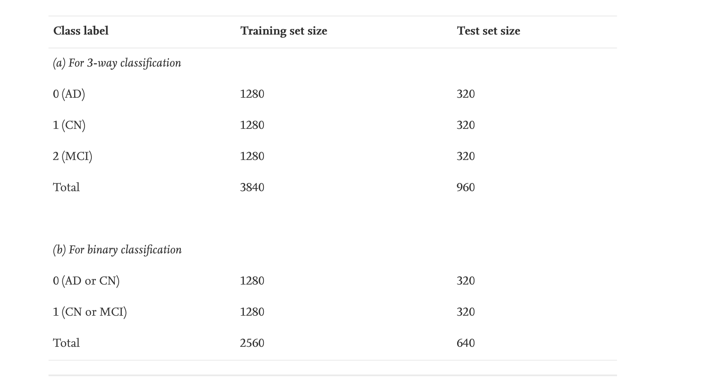
Creating training and test sets
Balanced dataset of 4800 images is shuffled and split into training and test set with split ratio 80:20.

Slide 21
REsults
Resulting accuracy for test (validation) set came out to be 95.73%
Accuracy of 99.14%, 99.30% and 99.22% for AD vs CN, AD vs MCI and MCI vs CN classifications respectively.

Slide 22
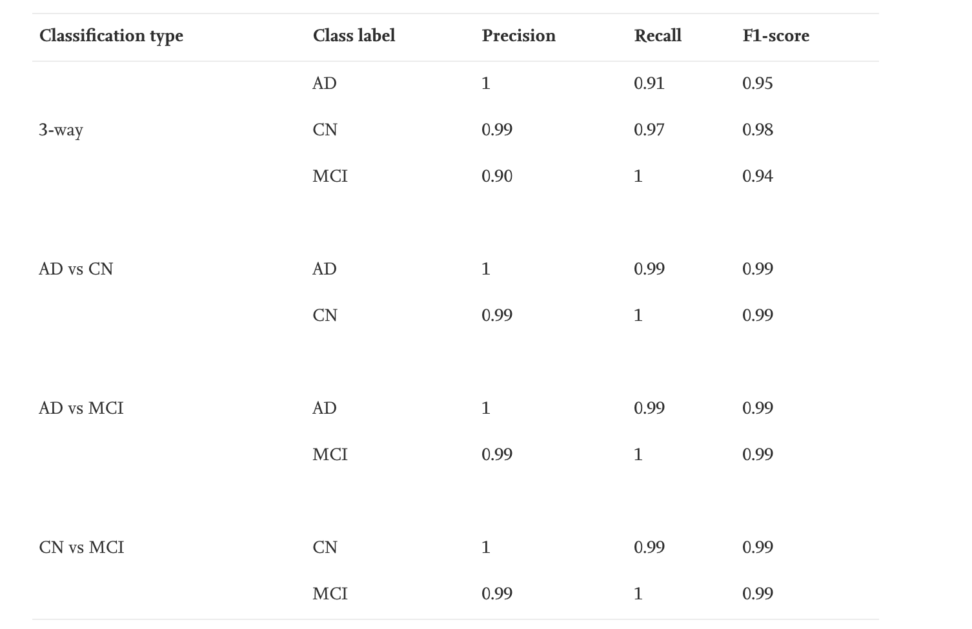
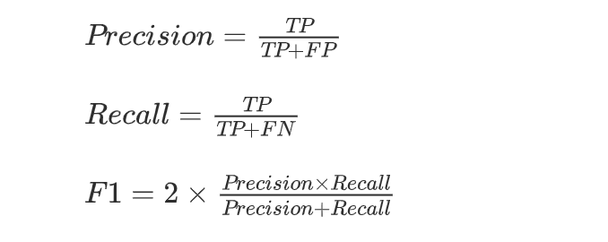
results
Notes:
false negative indicates that a condition does not hold, while in fact it does a woman is not pregnant whereas she is actually pregnant
Fp indicates a given condition exists, when it does not

Slide 23
results

Slide 24
results

Slide 25
results

Slide 26
results

Slide 27
FUTURE PROSPECTIVES
One should try other neural networks such as Inception Network, Residual Network and more recent state-of-the-art networks as base model for building the classifier.
One should also try to achieve similar or better results by skipping preprocessing steps such as skull striping, intensity normalization.

