Slide 1
Forecasting Lung Cancer Diagnoses with Deep Learning
Data Science Bowl 2017 Technical Report
By Daniel Hammack
Jiankai Li
Notes:
We describe our contribution to the 2nd place solution for the 2017 Data Science Bowl the largest Kaggle competition to date in terms of prize pool with a $1 million total pool and 2000 competing teams. The goal of the competition is to produce a system that consumes a CT scan and forecasts the probability that the patient in the scan will be diagnosed with lung cancer within a year of the scan.

Slide 2
Outline
Background
data
3. Approach
4. Neural Network Model Architecture and Training Details
1

Slide 3
Lung cancer is one of the most common forms of cancer, especially in North America. It is the most common form of cancer in men and the second most common in women.
lung cancer is also one of the least survivable common cancers with an average 5 year survival rate of less than 20%.
2
Notes:
Breast cancer is one of the most prevalent malignancies
among women worldwide. Although the incidence of
breast cancer is low compared with Western countries,
China is currently experiencing increasing trends in both
breast cancer incidence and mortality. However, the
mammography screening participation rate is only 21.7%
in China, far lower than in Western countries. Considering
the limited medical resources, especially in rural
areas of China, a risk prediction model that is suitable
for general population screening is urgently needed.

Slide 4
The Data Science Bowl (DSB) is an annual machine learning competition held on Kaggle
. The goal of the challenge is to build an automated system capable of forecasting whether a patient will be diagnosed with lung cancer in the next year given a CT scan
Only one CT scan per patient is provided and all patient-specific metadata is removed (so age, gender, weight, medical history cannot be used as indicators).

Slide 5
Tools Used
keras
theano
numpy
scipy
scikit-learn
pandas
Notes:
solution was done completely in Python making extensive use of the open source scientific libraries:

Slide 6
Outline
Background
data
3. Approach
4. Neural Network Model Architecture and Training Details
1

Slide 7
The data for this challenge are 1600 high-resolution chest CT scans with slice thickness less than 3mm
The size of a typical scan is 512 x 512 x 400 volumetric pixels (voxels) which translates to approximately 100 million integers
In real world units, scans are usually around 30cm x 30cm x 40cm
the areas of interest (nodules) are typically on the order of 1cm3
Each CT scan in the training set has an associated binary label. No additional patient metadata is available (e.g. age, smoking history, etc.), and only a single scan is available per patient.

Slide 8
External Data
use external data from the LUNA16 grand challenge
joined with data from the LIDC dataset (which is a superset of LUNA16) to give us detailed nodule annotations including features such as:
diameter
Lobulation
Spiculation
Malignancy
Calcification
sphericity

Slide 9
Outline
Background
data
3. Approach
4. Neural Network Model Architecture and Training Details
1

Slide 10
4 major steps
1. Normalize CT scan
2. Find regions likely to have nodules
3. Predict nodule attributes
4. Aggregate nodule attribute predictions into a global patient-level diagnosis forecast
Notes:
Ultimately our solution combines 17 3D convolutional neural network models and consists of two ensembles. The models in each ensemble were built using different architectures, training schedules, objectives, subsampled data, and activation functions. This added diversity makes combining the models more effective.

Slide 11
3.1 Data Normalization
Each CT scan is resized so that each voxel represents a 1mm3 volume
The scans are also clipped between -1000 and 400 Hounsfield units., each scan is rescaled to lie between 0 and 1 with -1000 mapping to 0 and +400 mapping to 1.
A crude lung segmentation is also used to crop the CT scan, eliminating regions that don’t intersect the lung
Notes:
This is necessary so that the same model can be applied to scans with different ‘slice thickness’

Slide 12
Lung segmentation example. Interior of lung has yellow tint

Slide 13
3.2 Detecting Candidate Nodules
The second step is detecting regions of the scan which are likely to have useful information. As their models use 64 mm^3 subimages for diagnosis, all of nodule models would need to be scored several hundred times per scan.
Much computation is wasted if models are scored on regions of the lung with no abnormalities
They built a model for identifying regions of the scan that appear abnormal. It used a regression objective with a single output representing a weighted combination of nodule attributes
An abnormal region is defined to be any 64 mm3 region of the scan which received a prediction higher than a chosen threshold
Notes:
Furthermore even in cases of advanced lung cancer the vast majority of the lung can appear normal

Slide 14
3.3 Predicting Nodule Attributes
The most important part of solution is their models that predict the 4 chosen nodule attributes (diameter, lobulation, spiculation, and malignancy). They built two ensembles for nodule attribute prediction.
Figure 2 shows slices from a 3D saliency map of a nodule not seen during training. The image is colored based on the contribution of the pixels in each location to the malignancy prediction. Contributions are estimated by blacking out cubes of the image and recording the change in malignancy score.

Slide 15
Slices of a 3D saliency map showing the most important parts of a 64 mm3 section of a scan. Darker blue is more important.

Slide 16
3.4 Forecasting Diagnosis from Nodule Attributes
The number of nodules per scan is variable and there are 4 predicted attributes for each nodule. We manually constructed features thought to be informative for diagnosis from the nodule attribute predictions.
• max malignancy, spiculation, lobulation, and diameter across nodules
• stdev of malignancy, spiculation, lobulation, and diameter predictions across nodules
• location of most malignant nodule
• stdev of nodule locations in each dimension
• nodule clustering features
Notes:
The nodule clustering features involve running a clustering algorithm on the nodule locations (in order to avoid double counting)

Slide 17
These 18 features are fed into a ‘slightly nonlinear’ classifier for predicting the final diagnosis. The classifier consists of a L1-penalized logistic regression model followed by an Extremely Random Trees regressor fit on the residuals from the linear model
One additional feature was added late in the competition - the output of Julian’s mass detector model. it predicts the amount of ‘abnormal mass’ in the lungs of a patient.

Slide 18
Outline
Background
data
3. Approach
4. Neural Network Model Architecture and Training Details
1

Slide 19
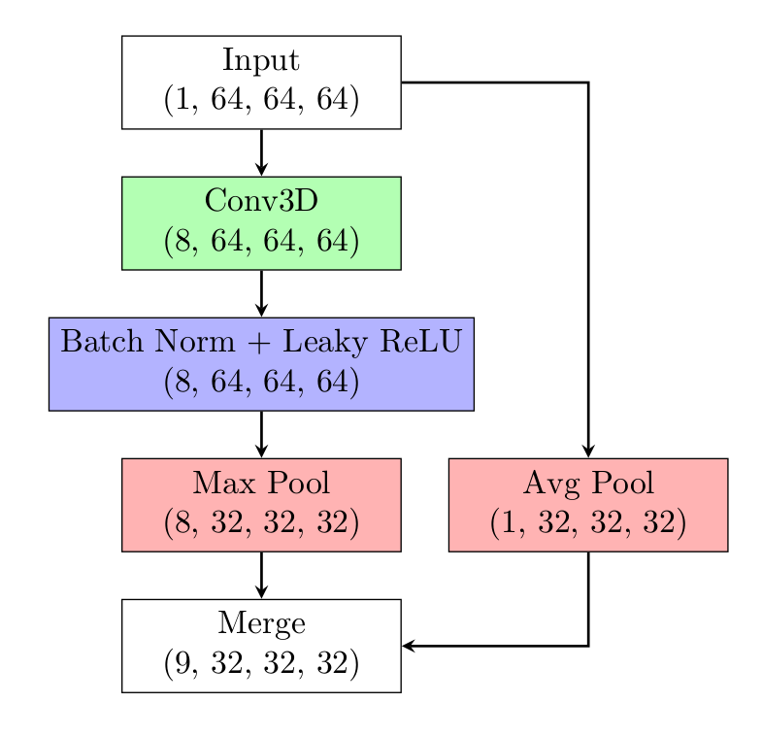
Models are trained on a combination of LUNA16 annotated nodules and LUNA16 false positives. Models consist of 5 ‘conv blocks’, followed by global max pooling and a nonnegative regression layer with a softplus activation.
The original input is downsampled and fed into each layer of the model, not just the first. Softplus activation is used because the targets for the model were non-negative

Slide 20
Thank you!

