Slide 1
Risk predication for breast Cancer in Han Chinese women based on a cause-specific Hazrad model
Jiankai Li

Slide 2
Outline
Background
Method
3. Result
4. Conclusions
1

Slide 3
In China
The incidence of breast cancer is low
The cancer incidence and mortality is increasing
Medical resources are in short supply
2
Notes:
Breast cancer is one of the most prevalent malignancies
among women worldwide. Although the incidence of
breast cancer is low compared with Western countries,
China is currently experiencing increasing trends in both
breast cancer incidence and mortality. However, the
mammography screening participation rate is only 21.7%
in China, far lower than in Western countries. Considering
the limited medical resources, especially in rural
areas of China, a risk prediction model that is suitable
for general population screening is urgently needed.

Slide 4
two most widely used risk prediction models
the Gail cause-specific hazard model with traditional risk factors as predictors
the International Breast Cancer Intervention Study (IBIS)model
Notes:
Several risk prediction models have been developed in Western countries;
the two most widely used are the Gail cause-specific
hazard model with traditional risk factors as predictors,
and the International Breast Cancer Intervention
Study (IBIS)model, which includes genetic markers.
The Gail II model was developed based on the Gail model
and provides a feasible web-based instrument [6]; however,
that model was first developed in a Caucasian ethnic population so the effects maybe uncertain when directly applied to Han Chinese women

Slide 5
Outline
Background
Methods
3. Result
4.Conclusion
3

Slide 6
Measurements and definition of risk factors
Body mass index(BMI):<24, 24-27.9, >28
Life satisfaction scores: 1/2/3/4/5
Positive breast cancer family history: first-, second-, third-degree
Information on the number of abortions, age at first live birth, and history of benign breast disease
4
Notes:
A self-designed structured questionnaire that included
demographic characteristics, female physiological and
reproductive factors, medical and family history, dietary
habits, lifestyle habits, and breast-cancer-related knowledge
was used to obtain data . Data were collected
via in-person interviews. Body mass index (BMI) was
calculated as weight in kilograms divided by height in
meters squared; BMI was divided into < 24, 24–27.9, ≥28
corresponding to normal weight, overweight, and obesity
[15]. Height was measured using a meter rule with a
precision of 0.1 cm, and weight was measured using an
electronic weight scale with an accuracy of 0.1 kg. Life
satisfaction scores (with respect to housing, income,
health, marriage, medical care, and neighbors) were
measured using 1/2/3/4/5 scale where 1 is very satisfied
and 5 is very unsatisfied. A total point of 30 was divided
into two levels by the mean value 13, people with scores
lower than 13 were defined as satisfied and scores ≥13
were defined as unsatisfied. A positive breast cancer
family history was defined as any first-, second-, or
third-degree relative with a diagnosis of breast cancer.
Information on the number of abortions, age at first live
birth, and history of benign breast disease were also collected
using the questionnaire. All of the above variables
have been reported as potential risk factors of developing
breast cancer

Slide 7
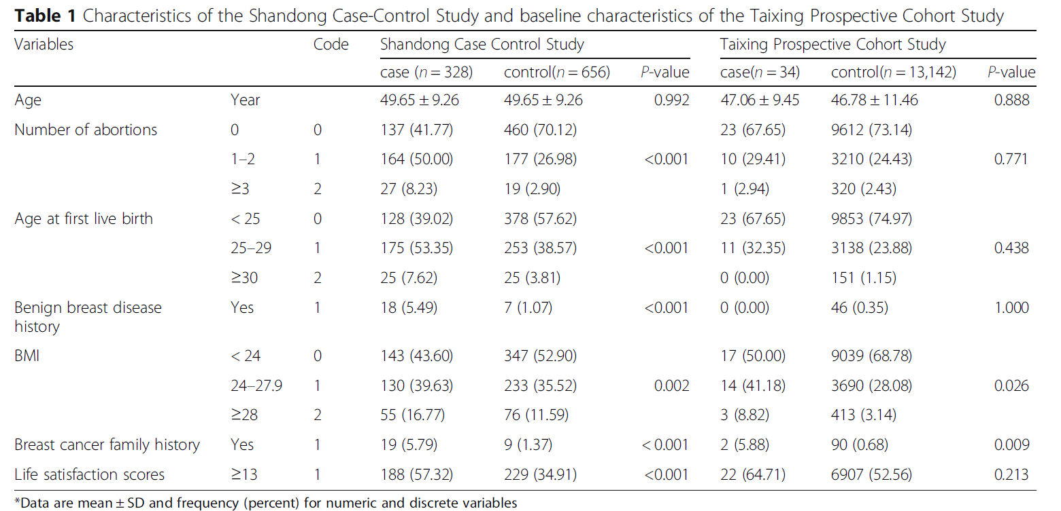
5

Slide 8
Statistical methods
The cause-specific hazard model:
Estimate the relative risks(RRs) and attributable risk(AR)
Calculate age-specific baseline hazard
Combine baseline hazards and RRs to estimate probabilities in HCBCP model
Validate the HCBCP model
6
Notes:
(1) We estimated the relative risks (RRs) and attributable
risk (AR) in the Shandong Case-Control Study.
To estimate RRs, odds ratios (ORs) and the corresponding
95% confidence intervals (CIs) were calculated in conditional
logistic regression for matched data using the above
variables and coding, as described in Table 1. Variable selection
for inclusion in the final model was based on Wald
tests for individual parameters as well as information on
previously established risk factors. To estimate the AR, we
applied Bruzzi’s method [16]. The AR was estimated using
the Taixing cohort and was applied to Taixing City only.
(2) We calculated age-specific baseline hazards for
breast cancer (based on the breast cancer incidence rate
of the Cancer Surveillance System of the Taixing Centers
for Disease Control) and for competing events (based on
non-breast cancer mortality from the Death Surveillance
System of the Taixing Centers for Disease Control).
Twelve age groups were defined (ranges 25–29, 30–34,
35–39, 40–44, 45–49, 50–54, 55–59, 60–64, 65–69, 70–
74, 75–79, 80–84 years). The baseline hazard was defined
as the hazard rate for each individual whose risk
factors were at the lowest risk level. The baseline hazards
of breast cancer were estimated by multiplying the
age-specific breast cancer incidence rates by (1 – estimated
population AR).
.
(3)We combined baseline hazards (for breast cancer
and competing events) and RRs to estimate probabilities
in the developed Han Chinese Breast Cancer Prediction
(HCBCP) model. The absolute risks were calculated according
to initial age, follow-up duration, and initial RRs
in the HCBCP model. A simple computing method for
individualized risk assessment was performed
(4)Finally, the Taixing Prospective Cohort Study was
used to validate the HCBCP model. We used E/O ratios
(which are defined as the observed divided by the expected
to assess model calibration. The C-statistic, which is the
probability that a randomly chosen positive instance will
rank higher than a randomly chosen negative one, was used
to evaluate the model’s discriminatory ability.

Slide 9
Outline
Background
Methods
3. Results
4. Conclusion
9

Slide 10
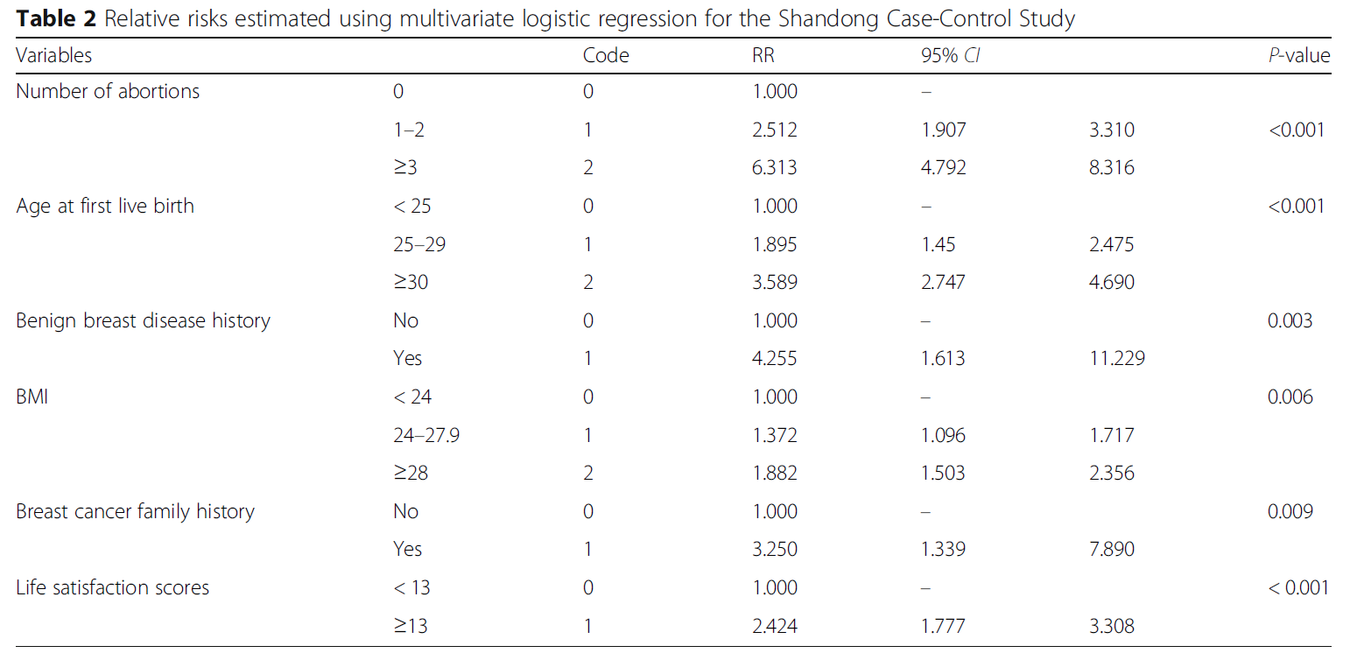
10
Notes:
Table 2 summarizes the RR of each risk factor.
Compared with the reference level, the RRs (95% CI) for a highest level of number of abortions, age at first live birth, benign breast disease history, BMI, family history of breast cancer, and life satisfaction score were 6.313 (4.792, 8.316), 3.589 (2.747, 4.690), 4.255 (1.613, 11.229), 1.882 (1.503, 2.356), 3.250 (1.339, 7.890), and 2.424 (1.777, 3.308), respectively.
For breast cancer family history, in about 8.9% of women with a positive family history was contributed from third degree relative; the prevalence of breast cancer among third-degree relatives was 62/100,000. RRs for each participant were obtained by multiplying each risk factor’s relative risk. The estimated AR was 0.78.

Slide 11
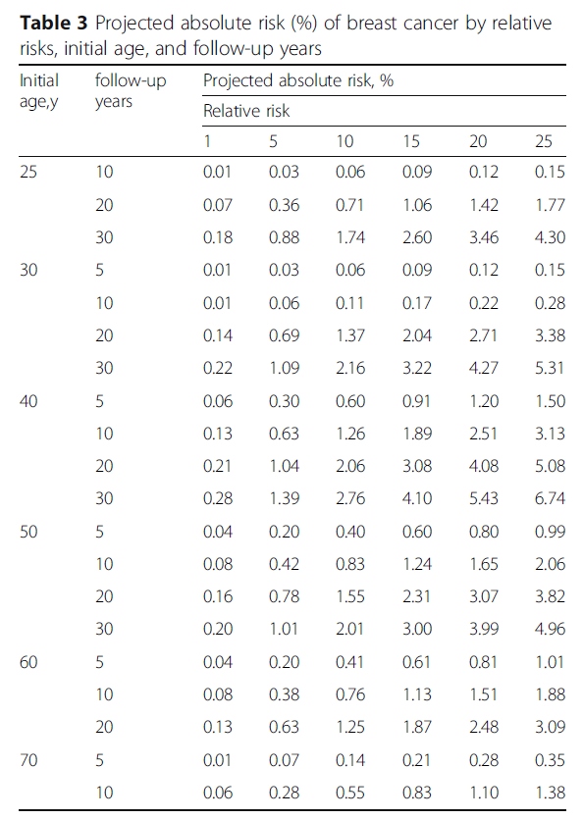
Individualized absolute risk projections
11
Notes:
For instance, we calculated the 20-year breast cancer
risk for a 30-year old woman with a history of one abortion
(code = 1), who was age 27 years at the first live
birth (code = 1), no history of benign breast disease
(code = 0), BMI of 27 (code = 1), with a family history of
breast cancer (code = 1) and life satisfaction score of 7
(code = 0); the RR is derived as 2.512 × 1.895 × 1 ×
1.372 × 3.250 × 1 = 21.23. Thus, in this example, the
20-year absolute risk would be 2.71% with RR of 20.0
(Table 3). The approximation was obtained as: 2.71
+ (3.38–2.71) (21.23–20.00)/(25–20) = 2.87%, which means
this woman has a 2.87% probability of developing breast
cancer in the next 20 years. The approximation probability
was close to the exact calculation of 2.88%

Slide 12
Outline
Background
Bat Algorithm
3. Bat Algorithm Based on PSO
4. Conclusions
12

Slide 13
conclusion
developed a risk prediction model including
fertility status and relevant disease history as well
as other modifiable risk factors. The developed model
demonstrated good discriminative accuracy
13

