Slide 1
Linear modeling
Usman Roshan
Department of Data Science
NJIT

Slide 2
Linearly separable data

Slide 3
Non linearly separable data

Slide 4
Hyperplane separators

Slide 5
Hyperplane separators
w

Slide 6
Hyperplane separators
w

Slide 7
Hyperplane separators
r
x
x_{p}
w

Slide 8
Hyperplane separators
r
x
x_{p}
w

Slide 9
Nearest mean as hyperplane separator
m₂
m₁

Slide 10
Nearest mean as hyperplane separator
m₂
m₁
m₁ + (m₂-m₁)/2

Slide 11
Nearest mean as hyperplane separator
m₂
m₁

Slide 12
Separating hyperplanes

Slide 13
Least squares perceptron

Slide 14
Gradient descent

Slide 15
Optimization

Slide 16
Perceptron training

Slide 17
Perceptron training

Slide 18
Perceptron training by gradient descent

Slide 19
Gradient descent step size

Slide 20
Gradient descent adaptive step size

Slide 21
Obtaining probability from hyperplane distances

Slide 22
Coordinate descent
Doesn’t require gradient
Can be applied to non-convex problems
Pseudocode:
Initialize entries w_{i} of w to random values
while(prevobj – obj > 0.01)
for i = 0 to columns
prevobj = obj
w_{i} += Δw (or subtract, whichever gives lower objective)
Recompute objective obj

Slide 23
Coordinate descent
Challenges with coordinate descent
Local minima with non-convex problems
How to escape local minima:
Random restarts
Simulated annealing
Iterated local search

Slide 24
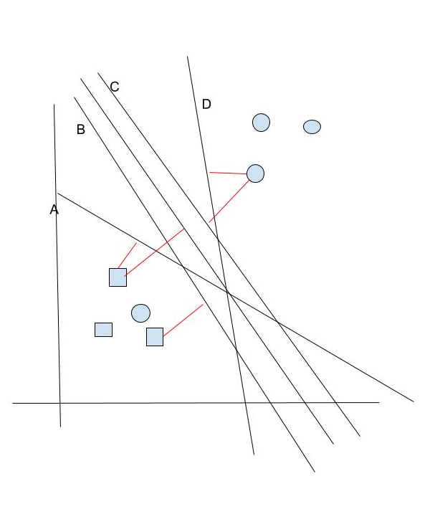
Separating hyperplanes
For two sets of points there are many hyperplane separators
Which one should we choose for classification?
In other words which one is most likely to produce least error?

Slide 25
Margin of a plane
We define the margin as the minimum distance to training points (distance to closest point)
y
x

Slide 26
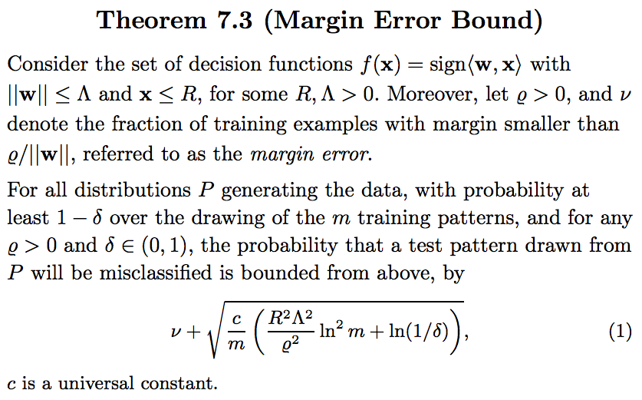
Margin error bound
Margin error theorem (7.3 from Learning with kernels)

Slide 27
Maximum margin hyperplane
Previous theorem dictates that the best hyperplane is the one that maximizes the minimum distance of all training points to the plane (Learning with kernels, Scholkopf and Smola, 2002) also called the margin.
Its expected error is at most the fraction of misclassified points plus a complexity term (Learning with kernels, Scholkopf and Smola, 2002)

Slide 28
Optimally separating hyperplane
How do we find the optimally separating (maximum margin) hyperplane?
Recall distance of a point to the plane defined earlier

Slide 29
Hyperplane separators
r
x
x_{p}
w

Slide 30
Distance of a point to the separating plane
And so the distance to the plane r is
given by
or
where y is -1 if the point is on the left side of
the plane and +1 otherwise.

Slide 31
Support vector machine: optimally separating hyperplane
Distance of point x (with label y) to the hyperplane is given by
We want this to be at least some value
By scaling w we can obtain infinite solutions. Therefore we require that
So we minimize ||w|| to maximize the distance which gives us the SVM optimization
problem.

Slide 32
Support vector machine: optimally separating hyperplane
SVM optimization criterion (primal form)
We can solve this with Lagrange multipliers to reveal the
dual optimization problem.

Slide 33
SVM dual problem
Let L be the Lagrangian:
Solving dL/dw=0 and dL/dw₀=0 gives
The x_{i} for which α_{i} is non-zero are called support vectors. Substituting w into the Lagrangian gives us the dual optimization problem

Slide 34
Support vector machine: optimally separating hyperplane

Slide 35
Another look at the SVM objective
Consider the objective:
This is non-convex and harder to solve than the convex SVM objective
Roughly it measures the total sum of distances of points to the plane.
Misclassified points are given a negative distance whereas correct ones have a 0 distance.

Slide 36
SVM objective
The SVM objective is
Compare this with
The SVM objective can be viewed as a convex approximation of this by separating the numerator and denominator
The SVM objective is equivalent to minimizing the regularized hinge risk:

Slide 37
Hinge loss empirical risk
Hinge risk:
But the max function is non-differentiable. Therefore we use the sub-gradient:

Slide 38
Hinge loss regularized risk
Regularized risk:
How does the hinge loss gradient below change for the regularized risk?

Slide 39
Least squares vs hinge risk

Slide 40
Least squares vs SVM on outliers

Slide 41
Inseparable case and 0/1 loss
What is there is no separating hyperplane? For example XOR function.
One solution: consider all hyperplanes and select the one with the minimal number of misclassified points
This is known as the 0/1 loss optimization problem
Turns out to be NP-complete and even NP-complete to polynomially approximate (Learning with kernels, Scholkopf and Smola, and references on website)
Thus hard to solve in practice but is less sensitive to outliers than least squares and hinge

Slide 42
SVM vs 01loss on outliers

Slide 43
Inseparable case
If we measure error as roughly the sum of the distance of misclassified points to the plane (as shown in following slide) then we can still solve for a support vector machine in polynomial time
Note that total distance error can be considerably larger than number of misclassified points.

Slide 44
Optimally separating hyperplane with errors
y
w
x

