Slide 1
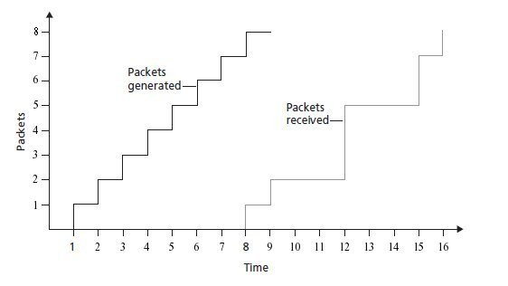
Problem P11 / CH 7
Consider the figure below. A sender begins sending packetized
Audio periodically at t = 1. The first packet arrives at the receiver
at t = 8.
d = r - t
Packet 2: 9 – 2; d = 7
Packet 3: 12 – 3; d = 9
Packet 4: 12 – 4; d = 8
Packet 5: 12 – 5; d = 7
Packet 6: 15 – 6; d = 9
Packet 7: 15 – 7; d = 8
Packet 8: 16 – 8; d = 8
a: What are the delays (from sender to receiver, ignoring any playout delays) of packets 2 through 8?

Slide 2
Problem P11 / CH 7
Consider the figure below. A sender begins sending packetized
Audio periodically at t = 1. The first packet arrives at the receiver
at t = 8.
= ontime packet
= dropped packet
Packets that arrive
after their scheduled
playout time are
discarded.
Packets 3, 4, 6, 7 and 8
Will not arrive in time
For playout
b: If audio playout begins as soon as the first packet arrives at the receiver at t = 8, which of the first
eight packets sent will not arrive in time for playout ?

Slide 3
Problem P11 / CH 7
Consider the figure below. A sender begins sending packetized
Audio periodically at t = 1. The first packet arrives at the receiver
at t = 8.
= ontime packet
= dropped packet
Packets that arrive
after their scheduled
playout time are
discarded.
Packets 3, and 6 will not
arrive in time for playout
c: If audio playout begins at t = 9, which of the first
eight packets sent will not arrive in time for playout ?

Slide 4
Problem P11 / CH 7
Consider the figure below. A sender begins sending packetized
Audio periodically at t = 1. The first packet arrives at the receiver
at t = 8.
= ontime packet
= dropped packet
Packets that arrive
after their scheduled
playout time are
discarded.
All packets will arrive on
time if audio playout
begins at t = 10
d: What is the minimum playout delay at the receiver
that results in all of the first eight packets arriving on time ?

