Slide 1
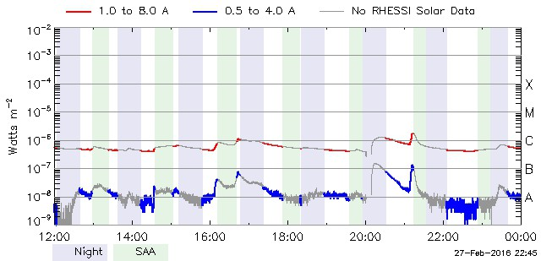
2016-02-18
DARTS link:
http://darts.isas.jaxa.jp/solar/hinode/query.php?coA=basic&fgA=basic&spA=basic&xrA=basic&eiA=basic&coB=&coC=&coD=&coE=&coF=&coG=1&coH=&coI=&coJ=&coK=&coL=&coM=&coN=&coO=&coP=&coQ=&fgD=&fgL=&fgM=&fgN=&fgO=&fgP=&fgQ=&fgR=&fgS=&fgT=&spD=1&spE=&spF=&spG=&spH=&spI=&spJ=&spK=&spL=&spM=&spN=&spO=&spP=&spQ=&spR=&spS=&spT=&spU=&spV=&xrE=&xrF=&xrG=&xrH=&xrJ=&xrK=&xrL=&xrM=&xrN=&xrO=&xrP=&xrQ=&xrR=&eiE=&eiF=&eiG=&eiH=&eiJ=&eiK=&eiL=&eiN=&eiO=&eiP=&eiQ=&eiR=&eiS=&A19=Search&inst%5B%5D=fg&inst%5B%5D=sp&inst%5B%5D=xr&inst%5B%5D=ei&plot=no&tmSY=2016&tmSM=02&tmSD=18&tmSh=18&tmSm=00&tmEY=2016&tmEM=02&tmED=19&tmEh=00&tmEm=00&posX=&posY=&posrX=&posrY=&max=1000&fgB%5B%5D=0&fgE=0&fgG=&fgH=&fgI=&fgJ=&spB%5B%5D=0&xrB%5B%5D=0&eiB%5B%5D=0
Instruments list:
XRT
http://www.lmsal.com/hek/hcr?cmd=view-event&event-id=ivo%3A%2F%2Fsot.lmsal.com%2FVOEvent%23VOEvent_ObsX2016-02-18T18%3A49%3A54.000.xml
EIS sit&stare
http://www.lmsal.com/hek/hcr?cmd=view-event&event-id=ivo%3A%2F%2Fsot.lmsal.com%2FVOEvent%23VOEvent_EIS_20160218_185632-20160218_231726_TL50727
SOT
http://www.lmsal.com/hek/hcr?cmd=view-event&event-id=ivo%3A%2F%2Fsot.lmsal.com%2FVOEvent%23VOEvent_ObsS2016-02-18T18%3A54%3A00.000.xml
IRIS sit&stare
http://www.lmsal.com/hek/hcr?cmd=view-event&event-id=ivo%3A%2F%2Fsot.lmsal.com%2FVOEvent%23VOEvent_IRIS_20160409_180221_3660259503_2016-04-09T18%3A02%3A212016-04-09T18%3A02%3A21.xml
XRT Be_thin Open
XRT Be_thin Open
2016-02-18 18:53:46 - 23:59:18
EIS sit&stare
EIS sit&stare
2016-02-18 18:56:32-23:17:26
SOT
SOT FG G band 4305 & Ca II H
2016-02-18 18:54:30-23:54:25
iris sit&stare
iris sit&stare
2016-02-18 18:49:10-23:58:56
VLA Time

