Slide 1
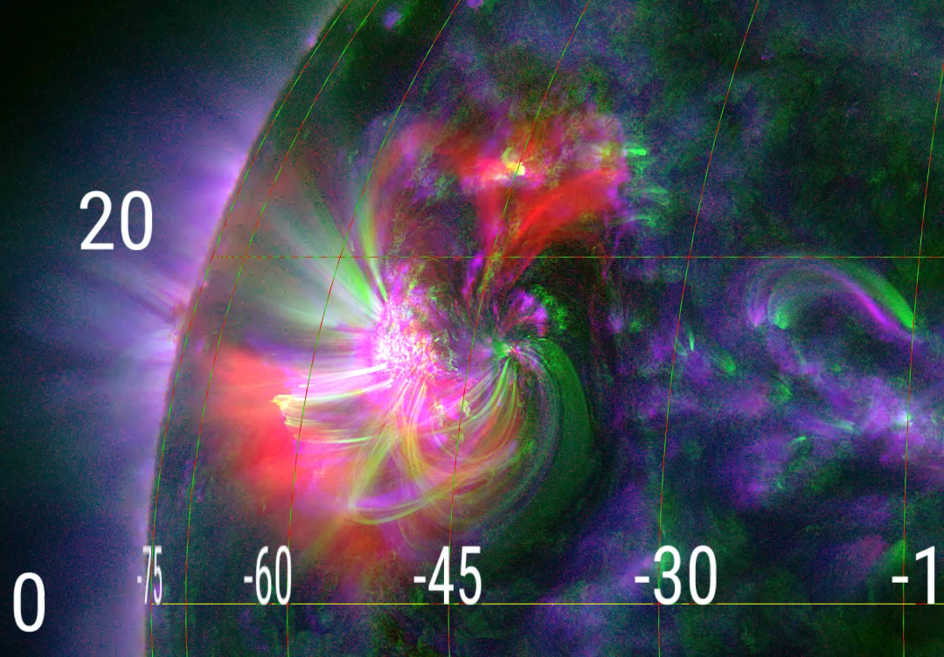
2016-04-10
Instruments list:
XRT
http://darts.isas.jaxa.jp/solar/hinode/query.php?coA=basic&fgA=advanced&spA=basic&xrA=basic&eiA=basic&inst%5B%5D=fg&inst%5B%5D=sp&inst%5B%5D=xr&inst%5B%5D=ei&tmSY=2016&tmSM=04&tmSD=09&tmSh=18&tmSm=00&tmEY=2016&tmEM=04&tmED=10&tmEh=00&tmEm=00&posX=&posY=&posrX=&posrY=&coB=&coC=&coD=&coE=&coF=&coG=1&coH=&coI=&coJ=&coK=&coL=&coM=&coN=&coO=&coP=&coQ=&fgB%5B%5D=0&fgC=&fgE=0&fgF=&fgG=&fgH=&fgI=&fgJ=&fgK=&fgD=&fgL=&fgM=0&fgN=0&fgO=0&fgP=0&fgQ=0&fgR=&fgS=&fgT=&spB%5B%5D=0&spC=&spD=1&spE=&spF=&spG=&spH=&spI=&spJ=&spK=&spL=&spM=&spN=&spO=&spP=&spQ=&spR=&spS=&spT=&spU=&spV=&xrB%5B%5D=0&xrC=&xrD=&xrI=&xrE=&xrF=&xrG=&xrH=&xrJ=&xrK=&xrL=&xrM=&xrN=&xrO=&xrP=&xrQ=&xrR=&eiB%5B%5D=0&eiC=&eiD=&eiM=&eiE=&eiF=&eiG=&eiH=&eiJ=&eiK=&eiL=&eiN=&eiO=&eiP=&eiQ=
EIS sit&stare
http://www.lmsal.com/hek/hcr?cmd=view-event&event-id=ivo%3A%2F%2Fsot.lmsal.com%2FVOEvent%23VOEvent_EIS_20160410_183534-20160410_225628_TL51528
SOTSP
http://darts.isas.jaxa.jp/solar/hinode/query.php?coA=basic&fgA=advanced&spA=basic&xrA=basic&eiA=basic&inst%5B%5D=fg&inst%5B%5D=sp&inst%5B%5D=xr&inst%5B%5D=ei&tmSY=2016&tmSM=04&tmSD=10&tmSh=18&tmSm=00&tmEY=2016&tmEM=04&tmED=11&tmEh=00&tmEm=00&posX=&posY=&posrX=&posrY=&coB=&coC=&coD=&coE=&coF=&coG=1&coH=&coI=&coJ=&coK=&coL=&coM=&coN=&coO=&coP=&coQ=&fgB%5B%5D=0&fgC=&fgE=0&fgF=&fgG=&fgH=&fgI=&fgJ=&fgK=&fgD=&fgL=&fgM=0&fgN=0&fgO=0&fgP=0&fgQ=0&fgR=&fgS=&fgT=&spB%5B%5D=0&spC=&spD=1&spE=&spF=&spG=&spH=&spI=&spJ=&spK=&spL=&spM=&spN=&spO=&spP=&spQ=&spR=&spS=&spT=&spU=&spV=&xrB%5B%5D=0&xrC=&xrD=&xrI=&xrE=&xrF=&xrG=&xrH=&xrJ=&xrK=&xrL=&xrM=&xrN=&xrO=&xrP=&xrQ=&xrR=&eiB%5B%5D=0&eiC=&eiD=&eiM=&eiE=&eiF=&eiG=&eiH=&eiJ=&eiK=&eiL=&eiN=&eiO=&eiP=&eiQ=&eiR=&eiS=&sppd%5B%5D=0&xrpd%5B%5D=0&eipd%5B%5D=0&A20=Show&max=10000&sct=wget#sp_list
IRIS sit&stare
http://www.lmsal.com/hek/hcr?cmd=view-event&event-id=ivo%3A%2F%2Fsot.lmsal.com%2FVOEvent%23VOEvent_IRIS_20160410_180921_3660259503_2016-04-10T18%3A09%3A212016-04-10T18%3A09%3A21.xml
iris sit&stare
iris sit&stare
2016-04-10 18:09:21-22:45:00
EIS sit&stare
EIS sit&stare
2016-04-10 18:35:34-22:56:28
SOTSP
SOTSP
2016-04-10
18:34:20-19:39:26
XRT
XRT
2016-04-10
18:33:21-23:59:33
VLA Time
DARTS link:
http://darts.isas.jaxa.jp/solar/hinode/query.php?coA=basic&fgA=advanced&spA=basic&xrA=basic&eiA=basic&coB=&coC=&coD=&coE=&coF=&coG=1&coH=&coI=&coJ=&coK=&coL=&coM=&coN=&coO=&coP=&coQ=&spD=1&spE=&spF=&spG=&spH=&spI=&spJ=&spK=&spL=&spM=&spN=&spO=&spP=&spQ=&spR=&spS=&spT=&spU=&spV=&xrE=&xrF=&xrG=&xrH=&xrJ=&xrK=&xrL=&xrM=&xrN=&xrO=&xrP=&xrQ=&xrR=&eiE=&eiF=&eiG=&eiH=&eiJ=&eiK=&eiL=&eiN=&eiO=&eiP=&eiQ=&eiR=&eiS=&A02=Update&inst%5B%5D=fg&inst%5B%5D=sp&inst%5B%5D=xr&inst%5B%5D=ei&plot=both&tmSY=2016&tmSM=04&tmSD=10&tmSh=18&tmSm=00&tmEY=2016&tmEM=04&tmED=11&tmEh=00&tmEm=00&posX=&posY=&posrX=&posrY=&max=1000&fgB%5B%5D=0&fgD=&fgE=0&fgG=&fgH=&fgI=&fgJ=&fgL=&fgM=0&fgN=0&fgO=0&fgP=0&fgQ=0&fgR=&fgS=&fgT=&spB%5B%5D=0&xrB%5B%5D=0&eiB%5B%5D=0

