Slide 1
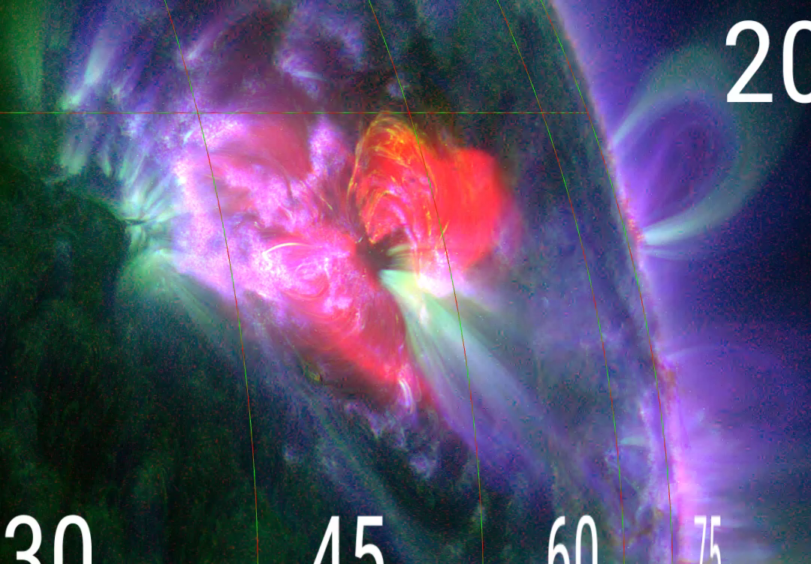
2016-04-17
EIS
EIS
2016-04-17 22:25:20-22:28:17
EIS sit&stare
EIS sit&stare
2016-04-17 18:22:20-22:28:17
VLA Time
iris sit&stare
iris sit&stare
2016-04-17 17:31:22-22:32:48
XRT
XRT
2016-04-17 18:20:08 - 23:59:34
Instruments list:
XRT
http://darts.isas.jaxa.jp/solar/hinode/query.php?coA=basic&fgA=advanced&spA=basic&xrA=basic&eiA=basic&inst%5B%5D=fg&inst%5B%5D=sp&inst%5B%5D=xr&inst%5B%5D=ei&tmSY=2016&tmSM=04&tmSD=16&tmSh=18&tmSm=00&tmEY=2016&tmEM=04&tmED=17&tmEh=00&tmEm=00&posX=&posY=&posrX=&posrY=&coB=&coC=&coD=&coE=&coF=&coG=1&coH=&coI=&coJ=&coK=&coL=&coM=&coN=&coO=&coP=&coQ=&fgB%5B%5D=0&fgC=&fgE=0&fgF=&fgG=&fgH=&fgI=&fgJ=&fgK=&fgD=&fgL=&fgM=0&fgN=0&fgO=0&fgP=0&fgQ=0&fgR=&fgS=&fgT=&spB%5B%5D=0&spC=&spD=1&spE=&spF=&spG=&spH=&spI=&spJ=&spK=&spL=&spM=&spN=&spO=&spP=&spQ=&spR=&spS=&spT=&spU=&spV=&xrB%5B%5D=0&xrC=&xrD=&xrI=&xrE=&xrF=&xrG=&xrH=&xrJ=&xrK=&xrL=&xrM=&xrN=&xrO=&xrP=&xrQ=&xrR=&eiB%5B%5D=0&eiC=&eiD=&eiM=&eiE=&eiF=&eiG=&eiH=&eiJ=&eiK=&eiL=&eiN=&eiO=&eiP=&eiQ=&eiR=&eiS=&sppd%5B%5D=0&xrpd%5B%5D=0&eipd%5B%5D=0&A20=Show&max=10000&sct=wget#xr_list
IRIS sit&stare
http://www.lmsal.com/hek/hcr?cmd=view-event&event-id=ivo%3A%2F%2Fsot.lmsal.com%2FVOEvent%23VOEvent_IRIS_20160417_173122_3660007532_2016-04-17T17%3A31%3A222016-04-17T17%3A31%3A22.xml
EIS
http://www.lmsal.com/hek/hcr?cmd=view-event&event-id=ivo%3A%2F%2Fsot.lmsal.com%2FVOEvent%23VOEvent_EIS_20160417_222520-20160417_222817_TL51648
EIS sit&stare
http://darts.isas.jaxa.jp/solar/hinode/query.php?coA=basic&fgA=advanced&spA=basic&xrA=basic&eiA=basic&inst%5B%5D=fg&inst%5B%5D=sp&inst%5B%5D=xr&inst%5B%5D=ei&tmSY=2016&tmSM=04&tmSD=17&tmSh=18&tmSm=00&tmEY=2016&tmEM=04&tmED=18&tmEh=00&tmEm=00&posX=&posY=&posrX=&posrY=&coB=&coC=&coD=&coE=&coF=&coG=1&coH=&coI=&coJ=&coK=&coL=&coM=&coN=&coO=&coP=&coQ=&fgB%5B%5D=0&fgC=&fgE=0&fgF=&fgG=&fgH=&fgI=&fgJ=&fgK=&fgD=&fgL=&fgM=0&fgN=0&fgO=0&fgP=0&fgQ=0&fgR=&fgS=&fgT=&spB%5B%5D=0&spC=&spD=1&spE=&spF=&spG=&spH=&spI=&spJ=&spK=&spL=&spM=&spN=&spO=&spP=&spQ=&spR=&spS=&spT=&spU=&spV=&xrB%5B%5D=0&xrC=&xrD=&xrI=&xrE=&xrF=&xrG=&xrH=&xrJ=&xrK=&xrL=&xrM=&xrN=&xrO=&xrP=&xrQ=&xrR=&eiB%5B%5D=0&eiC=&eiD=&eiM=&eiE=&eiF=&eiG=&eiH=&eiJ=&eiK=&eiL=&eiN=&eiO=&eiP=&eiQ=&eiR=&eiS=&sppd%5B%5D=0&xrpd%5B%5D=0&eipd%5B%5D=0&A20=Show&max=10000&sct=wget#xr_list
DARTS link:
http://darts.isas.jaxa.jp/solar/hinode/query.php?coA=basic&fgA=advanced&spA=basic&xrA=basic&eiA=basic&coB=&coC=&coD=&coE=&coF=&coG=1&coH=&coI=&coJ=&coK=&coL=&coM=&coN=&coO=&coP=&coQ=&spD=1&spE=&spF=&spG=&spH=&spI=&spJ=&spK=&spL=&spM=&spN=&spO=&spP=&spQ=&spR=&spS=&spT=&spU=&spV=&xrE=&xrF=&xrG=&xrH=&xrJ=&xrK=&xrL=&xrM=&xrN=&xrO=&xrP=&xrQ=&xrR=&eiE=&eiF=&eiG=&eiH=&eiJ=&eiK=&eiL=&eiN=&eiO=&eiP=&eiQ=&eiR=&eiS=&A02=Update&inst%5B%5D=fg&inst%5B%5D=sp&inst%5B%5D=xr&inst%5B%5D=ei&plot=both&tmSY=2016&tmSM=04&tmSD=17&tmSh=18&tmSm=00&tmEY=2016&tmEM=04&tmED=18&tmEh=00&tmEm=00&posX=&posY=&posrX=&posrY=&max=1000&fgB%5B%5D=0&fgD=&fgE=0&fgG=&fgH=&fgI=&fgJ=&fgL=&fgM=0&fgN=0&fgO=0&fgP=0&fgQ=0&fgR=&fgS=&fgT=&spB%5B%5D=0&xrB%5B%5D=0&eiB%5B%5D=0

