Slide 1
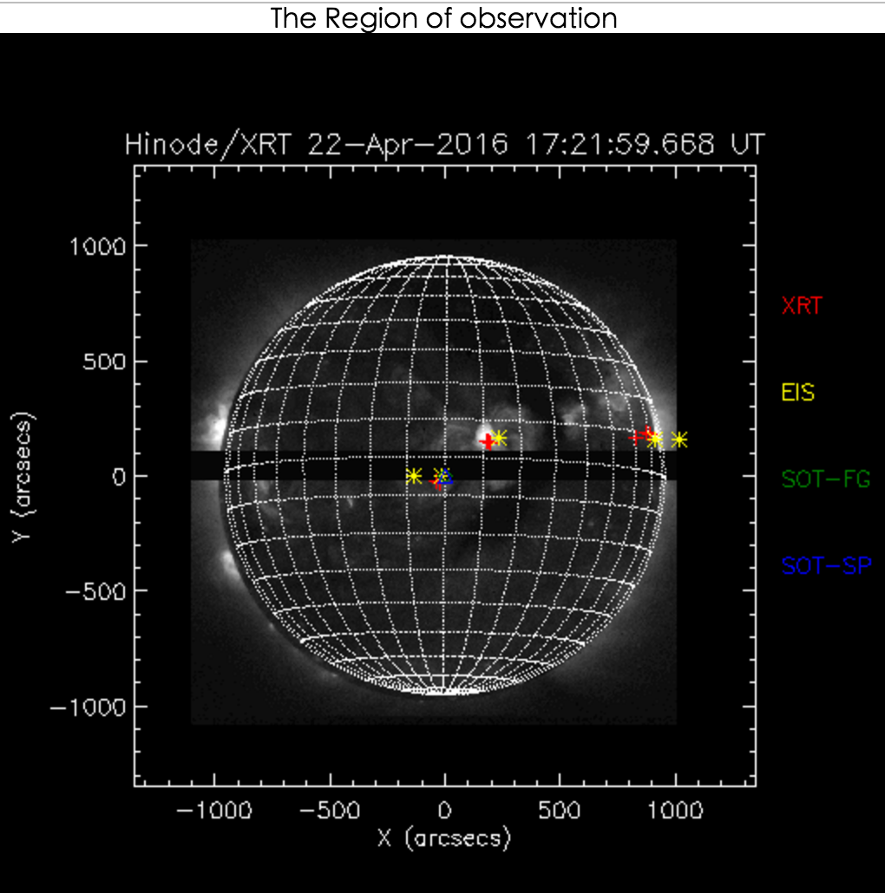
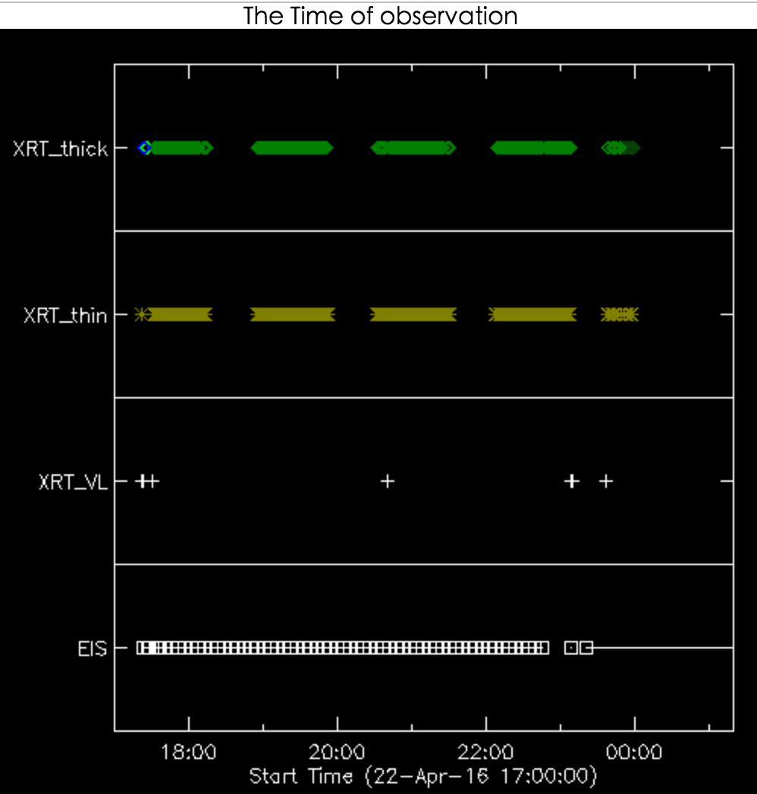
2016-02-19
2016-04-22
VLA Time
DARTS link:
http://darts.isas.jaxa.jp/solar/hinode/query.php?coA=basic&fgA=basic&spA=basic&xrA=basic&eiA=basic&coB=&coC=&coD=&coE=&coF=&coG=1&coH=&coI=&coJ=&coK=&coL=&coM=&coN=&coO=&coP=&coQ=&fgD=&fgL=&fgM=&fgN=&fgO=&fgP=&fgQ=&fgR=&fgS=&fgT=&spD=1&spE=&spF=&spG=&spH=&spI=&spJ=&spK=&spL=&spM=&spN=&spO=&spP=&spQ=&spR=&spS=&spT=&spU=&spV=&xrE=&xrF=&xrG=&xrH=&xrJ=&xrK=&xrL=&xrM=&xrN=&xrO=&xrP=&xrQ=&xrR=&eiE=&eiF=&eiG=&eiH=&eiJ=&eiK=&eiL=&eiN=&eiO=&eiP=&eiQ=&eiR=&eiS=&A02=Update&inst%5B%5D=fg&inst%5B%5D=sp&inst%5B%5D=xr&inst%5B%5D=ei&plot=both&tmSY=2016&tmSM=04&tmSD=22&tmSh=17&tmSm=00&tmEY=2016&tmEM=04&tmED=23&tmEh=00&tmEm=00&posX=&posY=&posrX=&posrY=&max=1000&fgB%5B%5D=0&fgE=0&fgG=&fgH=&fgI=&fgJ=&spB%5B%5D=0&xrB%5B%5D=0&eiB%5B%5D=0

