Slide 1
Federated Learning for Mobile Sensing Data
Cristian Borcea
^{Department of Computer Science}
New Jersey Institute of Technology

Slide 2
Federated Learning (FL)
Distributed machine learning paradigm that enables privacy-aware training on mobile devices with help from the cloud
  Uses data from all users in the system
Enables a wide range of new mobile apps that benefit from running machine learning models on mobile sensing data
  Mobile health and wellbeing (e.g., predict people’s health risks based on their behavior and mobility)
  Smart phone optimizations (e.g., predict network quality based on user mobility)
  Transportation (e.g., predict free parking spots in the city)

Slide 3


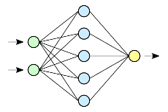

FL Operation
Initialization
Configuration
Training
Gradient Aggregation
Prediction
New
User
Registration
Prediction
Send model & configuration
Existing
User
Prediction
Send model weights & metrics
Send aggregated model
Existing
User
Prediction
Aggregation
Server selects clients to participate in training
Clients train on local data, which never leaves devices, and upload gradients to server
Server computes global model, which is then sent to clients

Slide 4
Lack of FL Systems/Apps for Mobile Sensing Data
No widespread adoption of FL models on smart phones
Limited understanding of behavior and challenges of FL applications in the wild
Most FL studies are done through simulations
Problems with the few existing FL systems
  Do not consider resource constraints on mobile devices (typical application is keyboard typing prediction)
  Unavailable for the research and practice community (e.g., Google)
Need FL system/infrastructure to enable an ecosystem of FL models/apps and proof-of-concept FL apps with mobile sensing data

Slide 5
Outline
Motivation
FLSys: An FL System for Mobile Apps
  Human Activity Recognition (HAR) model for accelerometer data collected in the wild
FGLP: FL Fine-Grained Location Prediction for Mobile Users
  Demonstrated on large mobility dataset
Lessons learned and future challenges

Slide 6
FL System for Mobile Sensing Data: Research Questions
How to balance FL model performance with resource constraints on phones?
How to ensure training conducted on phones is completed on time, despite limited resources?
How can the server achieve seamless scalability in the presence of large and variable numbers of users who train different models?
How can the system cope with potential phone failures (e.g., connectivity lost, ran out of battery)?
How can the system support efficiently concurrent FL models on the phones?
How can a third-party mobile apps utilize FL models?

Slide 7
FL System for Mobile Sensing Data: Requirements
Efficient data collection: balance resource consumption (e.g., battery) with sampling rates required by different models and training effectiveness
Fault-tolerance: tolerate phone unavailability during training and phone disconnections
Scalability: Scale to large numbers of users in terms of both computation and storage
Model flexibility: support different DL models different aggregation functions
Support for third-party apps: provide programming support for third-party apps to concurrently access different models on the phones

Slide 8
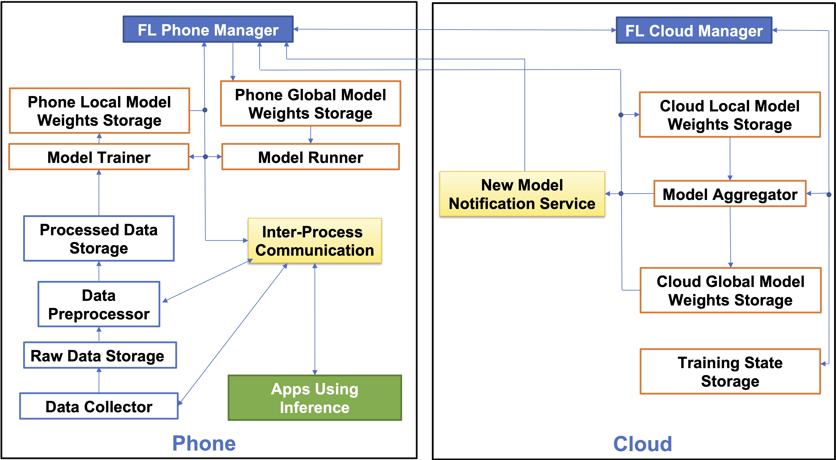
FLSys Architecture

Slide 9
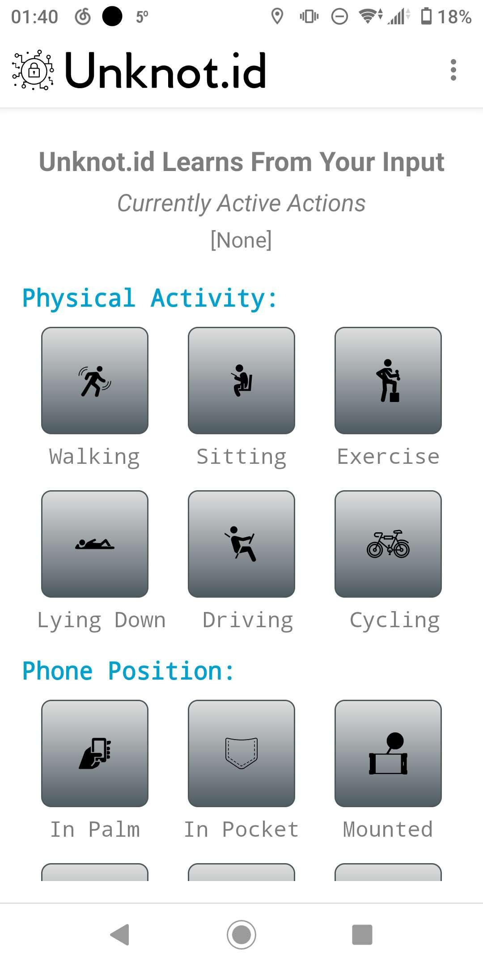
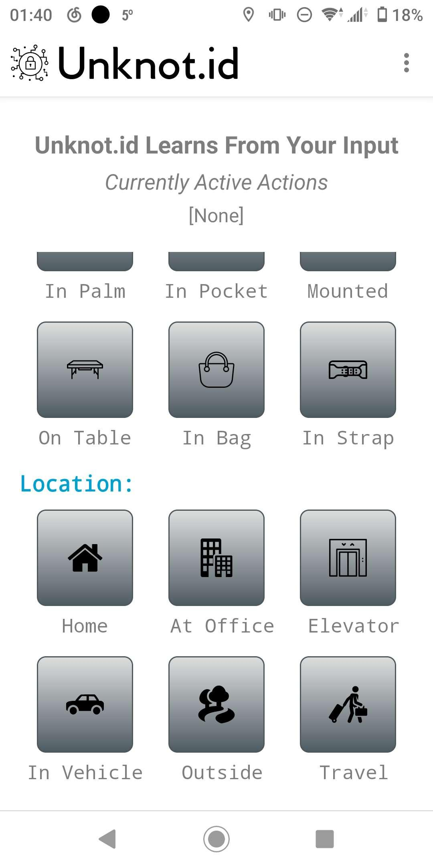
Data Collection
On-demand configuration of sensor types, sampling rates, and the period for data flushing from memory to storage
Automatically balance sampling rate with resource consumption
Key statistics of the data collection (e.g., CPU, battery life impact, etc.) shown user
Global level controls for user to adjust data collection behavior

Slide 10
Asynchronous Federated Training & Aggregation
Clients self-select to participate in training, based on local resources
Clients participating in a training round must submit local gradients before round deadline expires
Aggregation policy checks whether there are enough local gradient updates before proceeding

Slide 11
Model Concurrency
On the phone
  Preliminary experiments on smart phones show parallel training of multiple models is very slow due to resource contention
  FL Phone Manager decides sequential order to train concurrent models
  Order of training decided based on frequency of model usage by apps, training round deadlines and historical training latency
At the cloud
  FL Cloud Manager handles concurrency through services provided by underlying cloud platform, which support concurrency by design
  FL Cloud Manager orchestrates the invocation of the cloud services

Slide 12
Mobile Apps using FL Models
FL Phone Manager decouples mobile apps that need inference from the models that provide the inference
App can use multiple models, while the same model can be used by multiple apps
FLSys provides an API and a library that can be used by third-party app developers to perform inference using FL models on phones

Slide 13
FLSys Prototype
Android smart phones & AWS cloud
Deep Learning for Java (DL4J) as the underlying framework for Android DL-related operations
Android Bound Service and Android Intent for on-device communication
Core cloud components of FLSys are implemented and deployed as AWS Lambda functions (FaaS)
  Matches our asynchronous event-based design
  Provides fine-grained scalability at the function level
  Saves resources and reduces cost
  Simplifies development and deployment
  Offers development flexibility
AWS S3 and DynamoDB for storage

Slide 14
HAR-Wild Model
Human activity recognition (HAR) using mobile sensing data
CNN provides low computational complexity and GlobalAveragePooling has small memory footprint
Use just accelerometer data for faster training
Small-size model performs better on data collected in the wild, since data will likely have more distribution drift, increasing chance of overfitting on large-size models

Slide 15
Mobile Sensing Data is non-IID
Collected HAR data from 100+ students over 5 months
FL models don’t work well for non-Independent and Identically Distributed (non-IID)

Slide 16
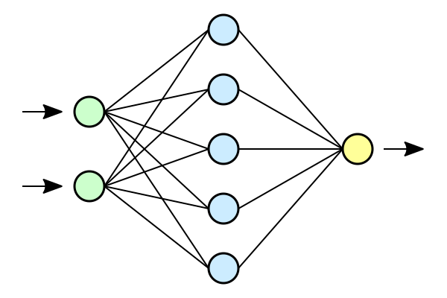
Data Augmentation to Cope with Non-IID Data
Supplement local data with small dataset of IID data provided by the server
Augmentation data delivered to clients only once
Clients use only data necessary to augment their missing data in each training round
Distribute
Local Data
Local Data
Local Data
Aggregation
Augmentation data
Sample
Sample
Sample
Train
Train
Train
16

Slide 17
HAR-Wild TensorFLow Simulation
HAR-Wild better than comparison models in centralized training
FL HAR-Wild achieves good performance (within 10% of centralized training, which is the cost of privacy protection)

Slide 18
HAR-Wild/FLSys Android & Linux Emulation
DL4J over FLSys implementation of HAR-Wild achieves similar performance with simulated-TensorFlow HAR-Wild
Good fault-tolerance: performance of HAR-Wild with up to 50% clients dropping out in each round decreases by only 3.11%

Slide 19
HAR-Wild/FLSys Scalability
Model Aggregator in AWS scales linearly with the number of participating clients

Slide 20
HAR-Wild/FLSys Smart Phone Evaluation
Training
Inference
Practical for practical scenarios
  Can do 300+ training rounds with a full phone battery
  Fast inference (<40ms) and can perform millions of inferences with a full phone battery

Slide 21
FLSys Summary
Can help create an ecosystem of FL models and associated apps
  Offer a unifying system for the development and deployment of FL models and apps
  Allow third-party developers to build FL models/apps
  Act as common middleware layer for all these apps and models
  Provide a simple way for users to take advantage of these apps
  Balance model utility with mobile device constraints
Models built over FLSys can achieve good performance, while protecting users’ privacy
  Good scalability and fault-tolerance
FLSys prototype works well on smart phones

Slide 22
Outline
Introduction to FL
FLSys: An FL System for Mobile Apps
  Human Activity Recognition (HAR) model for accelerometer data collected in the wild
FGLP: FL Fine-Grained Location Prediction for Mobile Users
  Demonstrated on Open PFLOW & Geolife datasets
Lessons learned and future challenges

Slide 23
Fine-Grained Location Prediction (FGLP) Motivation
FGLP model on smart phones can be used to improve app/system performance
  Prediction based on GPS mobility traces collected on smart phones
  Fine-grained refers to spatiotemporal scale
Applications
  Video quality adaptation as a function of the 5G network quality at predicted user locations
  Augmented reality apps that speed up content rendering based on predicted user locations
  Mobile games that adapt based on the predicted user locations
Existing solutions work at large spatial scale or at large temporal scale
  Destination prediction, POI prediction

Slide 24
Adaptive Video Streaming Example
Poor Network Quality
 | Current Location
Predicted location in next minute
Allocate additional streaming cache
Reduce and save
streaming cache
Predicted location in next minute
Good Network Quality

Slide 25
FGLP Requirements
R1: Achieve high prediction accuracy at fine-grained spatiotemporal scale
  Spatial scale: meter-level prediction
  Temporal scale: minute-level prediction
R2: Work well for pedestrians and bicyclists
  Less predictable short-term behavior than cars or public transportation systems
R3: Work in places that have not been visited by the user before
R4: Protect user location privacy

Slide 26
FL-based FGLP Overview
Use user mobility traces from all users in the app [satisfy R3]
User location data represented as relative points in an abstract 2D space [satisfy R1 & R4]
Privacy is protected by combining FL with abstract 2D representation of user location data [satisfy R3 & R4]
Model combines Bidirectional Long Short-Term Memory (BiLSTM) and Convolutional Neural Networks (CNN) [satisfy R1 & R2]
Can be implemented on top of FLSys

Slide 27
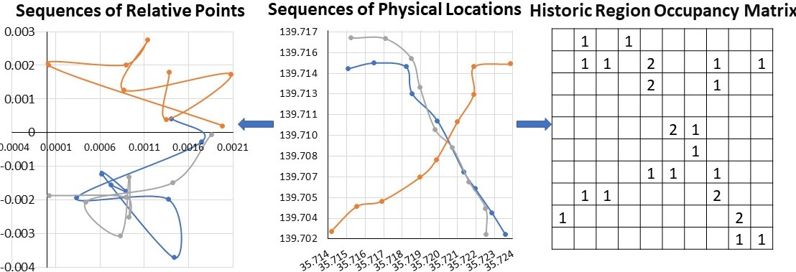
Abstract Data Representation for Model
Divide 2D space in a grid of fixed-size cells
  Cell size can be configured for different spatial granularities
Map physical locations to relative points in 2D space
  Helps with model training and privacy protection
Scale all data to the same range and avoid model bias introduced by data with high longitude and latitude values
Create two inputs for the model: sequence of relative points and historic region occupancy matrix

Slide 28
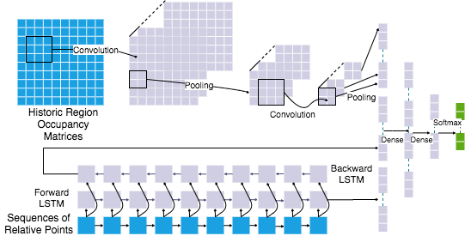
FGLP Model Architecture
Output: the grid cell where the user will be in future
Input: 2D representation of user location data
BiLSTM learns the speed and direction of the mobile users [short term behavior]
CNN learns information such as user movement preference [long term behavior]
Densenet-type connection is used to fuse BiLSTM and CNN
Batch normalization and dropout layers are added to avoid over-fitting

Slide 29
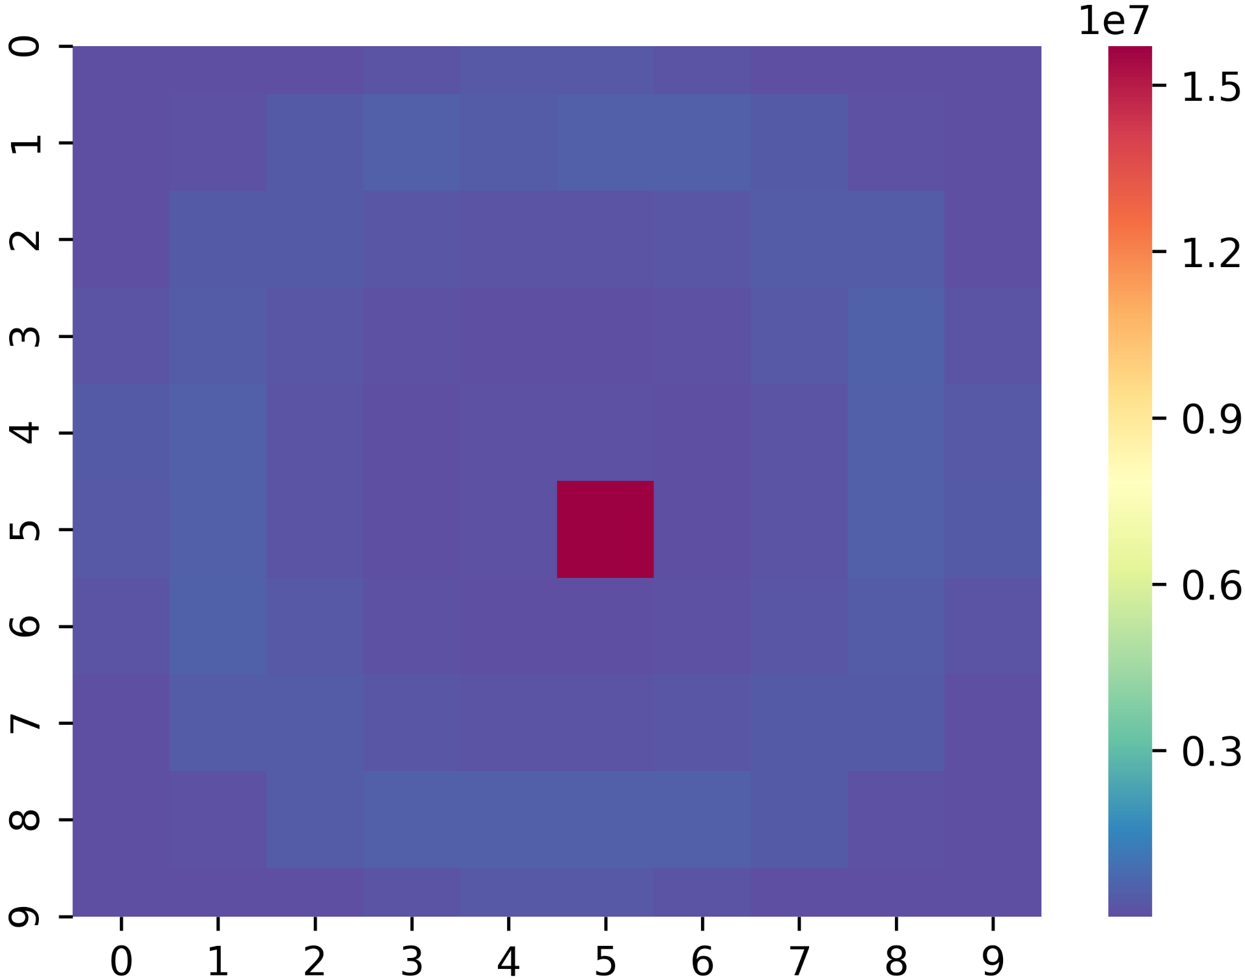
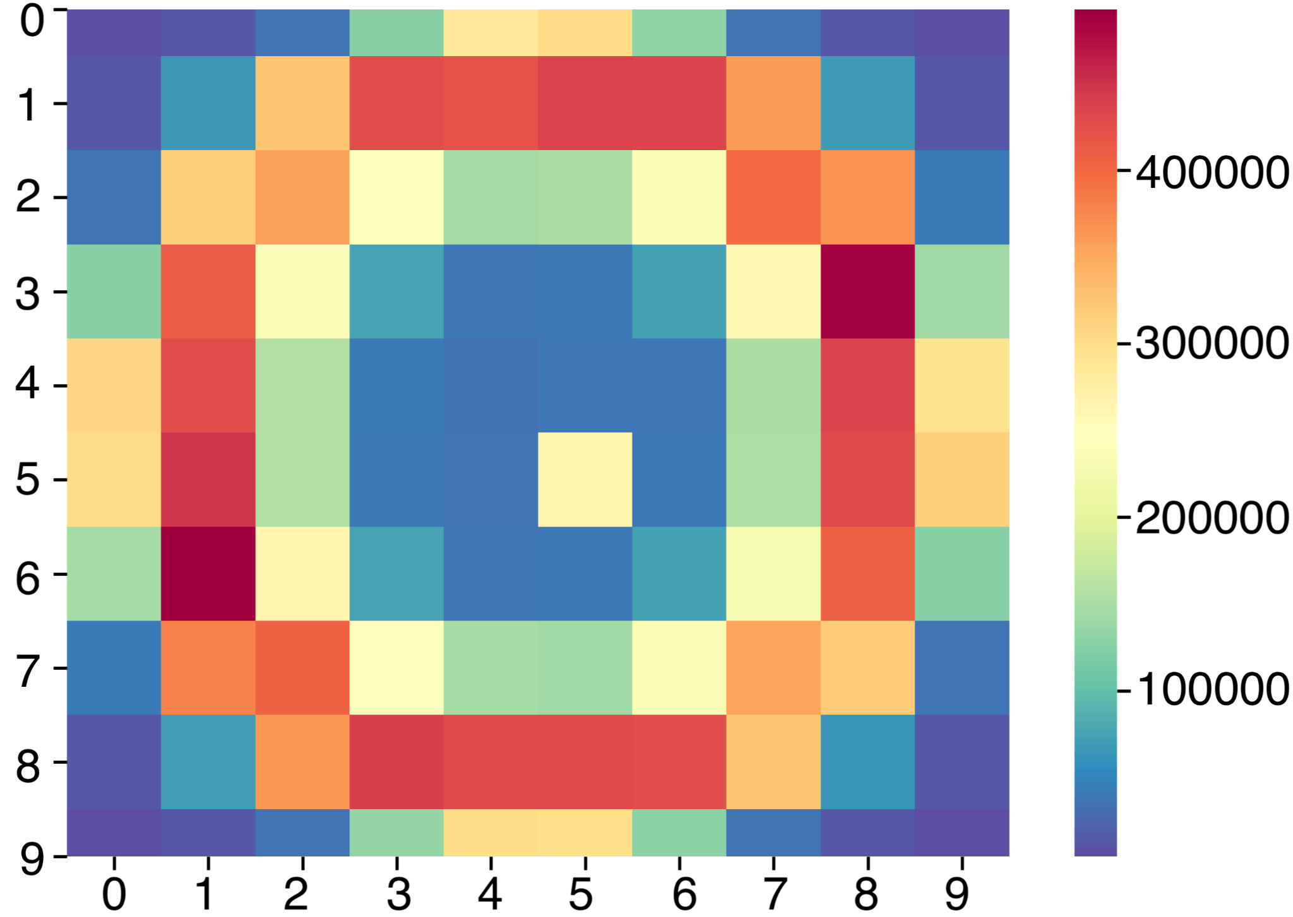
Open PFLOW Dataset
GPS trajectory data for Greater Tokyo area from 617,040 users for one day
  Sampled every minute for each user
Transportation modes: stay, walk, vehicle, train, and bicycle.
  We use walking data
Heatmap of possible next minute location in 2D space for 20mX20m grid cells: before removing standing-still data (left) and after (right)
Heatmaps show prediction is possible
Heatmap of 5th minute location in 2D space for 20mX20m grid cells

Slide 30
Centralized Model Performance
FGLP outperforms baselines
Even though the accuracy decreases as the size of the cell decreases, FGLP can still achieve good performance (87.8%) for 5m x 5m cells
Performance decreases over time, but it’s still acceptable for the 5th minute

Slide 31
Model Reuse
Good performance for bicycling when using the model trained for walking
FGLP works well in conjunction with Transfer Learning
  10% improvement on another dataset

Slide 32
FL Model Performance
5% of the users are allocated as an augmentation dataset
Randomly pick 100 samples from the augmentation dataset for each user in each round
Within 10% of the accuracy of centralized model
  Cost of privacy

Slide 33
FL Model Performance on Smart Phones
Training
Inference
Feasible to run on smart phones in terms of training/inference latency, memory, and battery power

Slide 34
FGLP Summary
Novel FL model for fine-grained location prediction that protects user privacy
Good prediction accuracy, model reusability, and system feasibility on smart phones
Can improve user’s experience in real-world applications
Can be incorporated directly into smart phone OSs

Slide 35
Outline
Introduction to FL
FLSys: An FL System for Mobile Apps
  Human Activity Recognition (HAR) model for accelerometer data collected in the wild
FGLP: FL Fine-Grained Location Prediction for Mobile Users
  Demonstrated on Open PFLOW & Geolife datasets
Lessons learned and future challenges

Slide 36
Lessons Learned
Design for flexibility: models, aggregation functions, and even underlying system components swapped in and out
Balance mobile resources and model accuracy: asynchronous design and resource usage policies
Beware the simulation pitfalls: information leakage and software that is not supported on smart phones
Build mechanisms to cope with non-IID data: mobile sensing data collected in the wild is non-IID
Augment FL with additional privacy mechanisms: Attackers can infer model parameters from gradients

Slide 37
Future Challenges
Design FL models/systems for continuous mobile sensing data collection
  How much data is needed to start with?
  How to improve the performance at the beginning when there isn’t a lot of data?
  Do we use only the new data in a new round or all the data up to that point or a certain pre-defined amount?
  How many rounds are sufficient?
  Should old users have a stronger impact on the model than new users?
FL Robustness
  Wrong labels, broken sensors, dropout
  Bad data could also be generated intentionally
  Validate local models (bad or good) before the aggregation
Zone-based FL
  Users in different zones have different behavior, while users in one zone have similar behavior
  Create one model for each zone: potentially better accuracy and better scalability

Slide 38
Thanks!
http://cs.njit.edu/~borcea/
Acknowledgments:
  NSF Grants No. DGE 1565478
  Students: Xiaopeng Jiang, Han Hu, Shuai Zhao
  Collaborators:
    Yi Chen, Hai Phan (NJIT)
    Guy Jacobson, Rittwik Jana, Wen-Ling Hsu, Manoop Talasila, Syed Anwar Aftab (ATT Research)
    Vijaya Mayyuri, An Chen (Qualcomm)

