Slide 1
Can Ad-supported Online Publishing Survive Privacy Regulations and Ad-Blockers?
Cristian Borcea
Department of Computer Science
New Jersey Institute of Technology

Slide 2
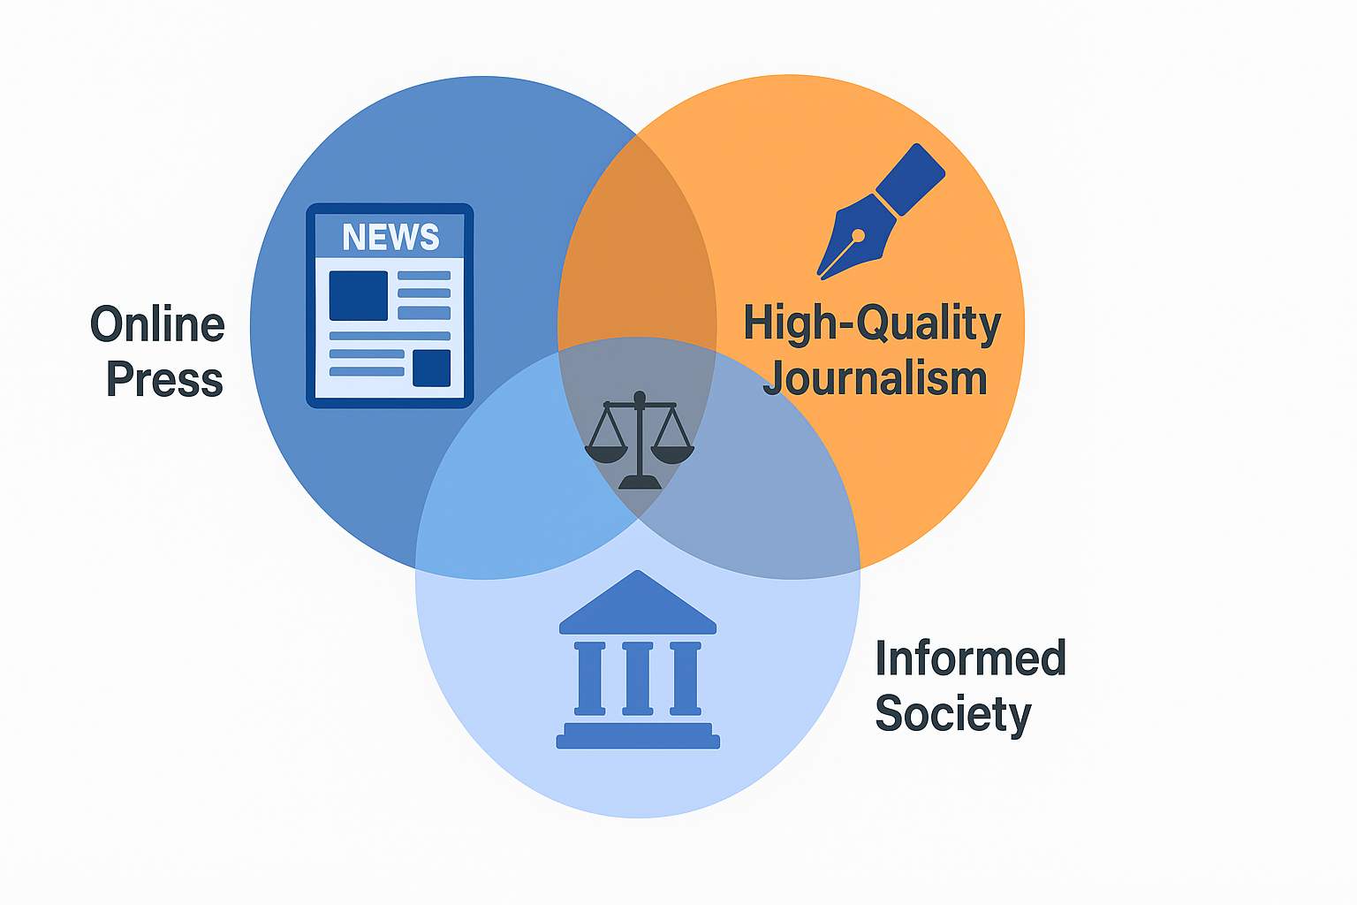
The Role of Online Press in Democracy
Online platforms are the main source of information for most people
High-quality online press is essential for a well-functioning democracy
Threats: fake news and disinformation are on the rise
Online press traditionally funded by advertising revenue

Slide 3
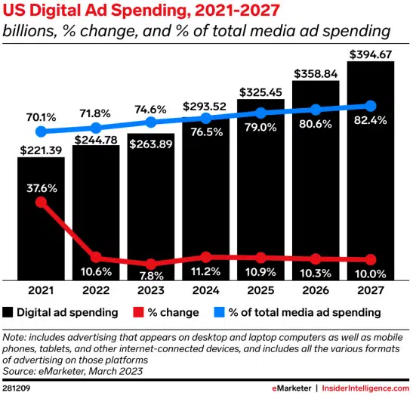
Online Advertisement – Billion Dollar Industry
Notes:
Almost the same with the fashion/clothing industry value!

Slide 4
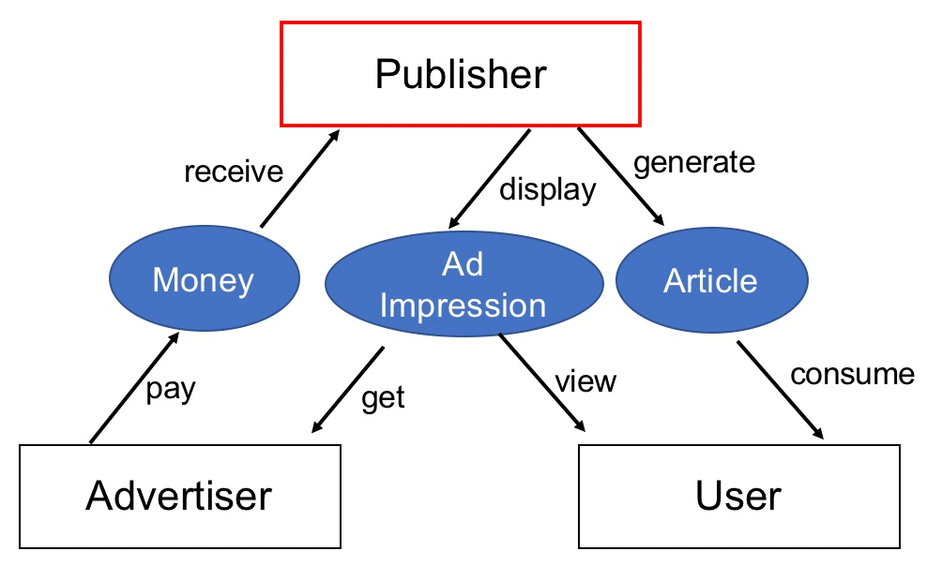
Ad-Supported Online Publishing Ecosystem
Users view free content and “pay” with their attention and data (e.g., personal information, browsing behavior) for ads displayed in the web pages
Publishers spend money to generate content and receive ad revenue
Advertisers pay a publisher for ad display and receive user’s attention on the ads
Notes:
Mention middlemen: Google, DSPs (programmatic advertising companies)

Slide 5
Challenges to the Ad-Supported Publishing Model
Users expect free access to online content
  Revenue from online ads has historically enabled this model
Two key challenges for publishers:
  Privacy regulations (e.g., GDPR, CCPA)
  Ad-blockers removing ads from websites
Consequence: Declining ad revenues hurt publishers
  Rise of paywalls limit free access
  Disappearance of local and niche publishers
  Threatens both accessibility and media diversity

Slide 6
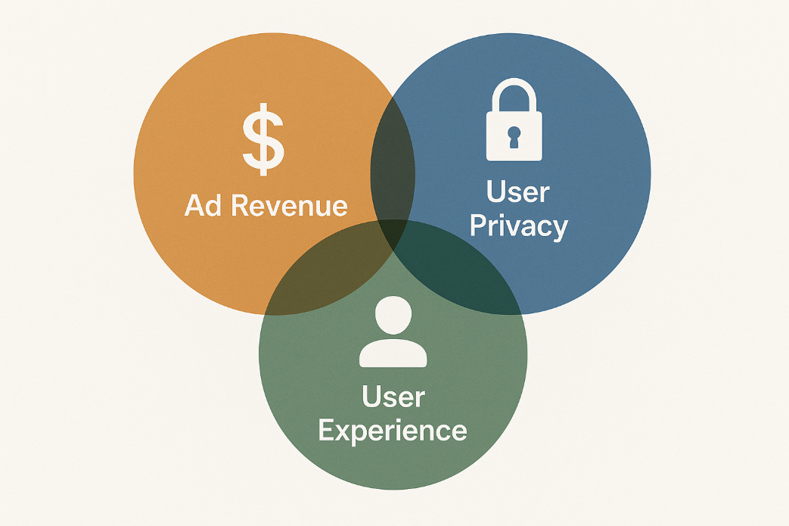
Main Research Question
How to balance ad revenue, user privacy, and user experience on ad-supported publishing websites?
  To answer, we collaborated with major international publishers (e.g., Forbes Media) in the past 10+ years for a comprehensive study of ad-supported online publishing

Slide 7
Outline
“A Study of GDPR Compliance under the Transparency and Consent Framework.” The 2024 ACM Web Conference (WWW).
Introduction
GDPR Compliance under the Transparency and Consent Framework (TCF)
In-browser Privacy-Preserving Online Advertising using Federated Learning
Personalized Dynamic Counter Ad-Blocking Using Deep Learning
Ad Price Optimization in First-Price Auctions via Multi-Task Learning
Conclusions

Slide 8
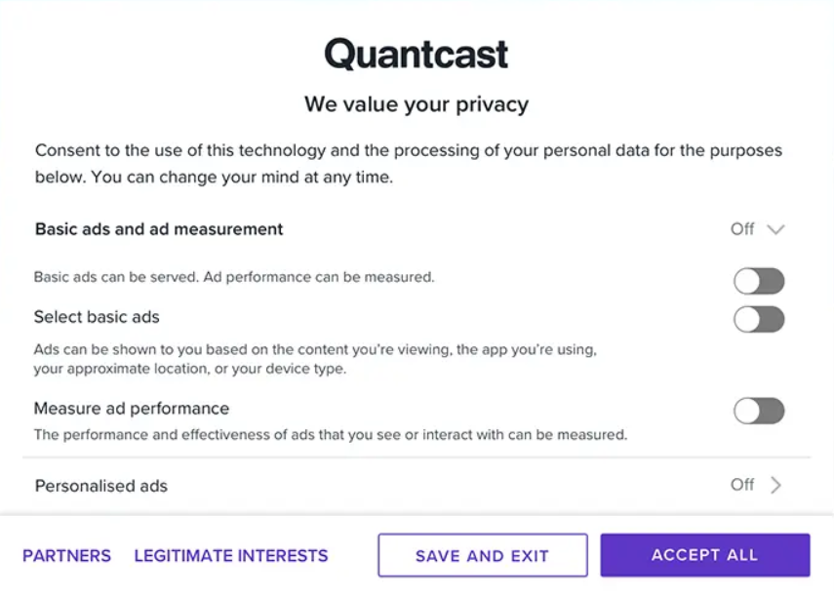
GDPR & TCF
Digital advertising companies created TCF to adhere to GDPR
  GDPR is the EU online privacy regulation
TCF framework is used by online publishing ecosystem to honor user privacy choices
Consent collection prompt example
8
Notes:
Mention consent management platforms.

Slide 9
Study GDPR Compliance under TCF
Evaluated TCF’s effectiveness in recording user privacy consent choices
  Do publishers & consent management platforms use TCF to correctly record consent?
  Are they honoring the user consent choice?
  Is non-compliance with TCF more likely among “non-premium” publishers?
Our findings offer insights into GDPR compliance to:
  Privacy regulators
  Industry practitioners
  IAB EU & IAB Techlab
9
Notes:
IAB: interactive advertising bureau (industry standards board for online advertising)

Slide 10
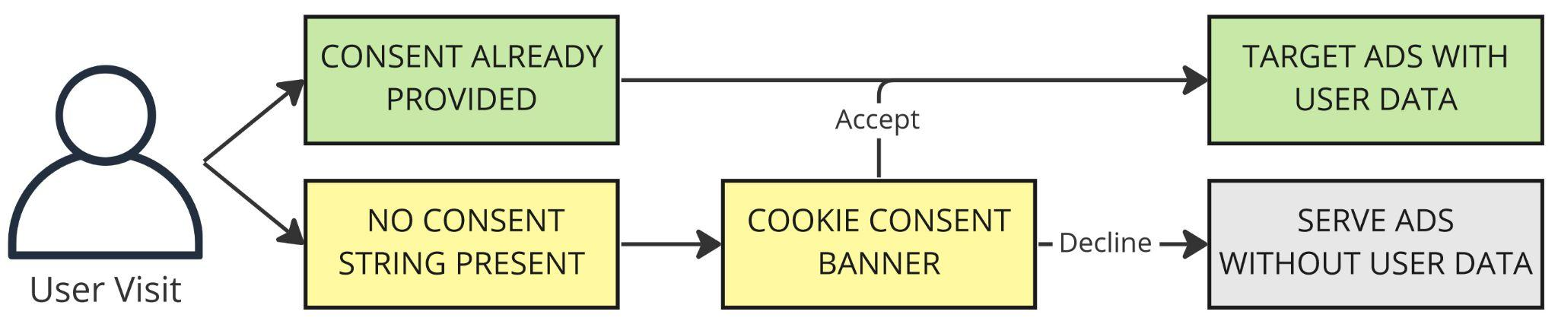
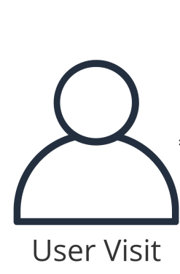
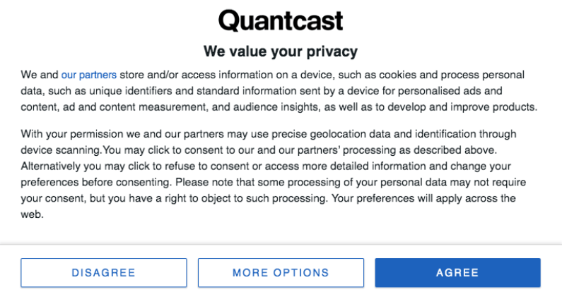
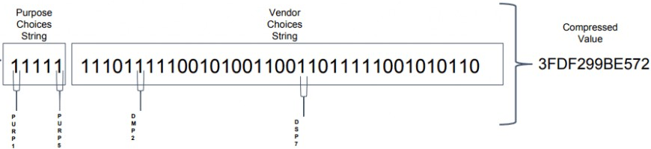
How TCF Works
Step 1: User visits web domain
Step 2: Cookie consent banner shown to user
Step 3: User’s consent election (declines or accepts)
Step 4: TC string is created for
  10 standard purposes for data collection & processing
  ad tech vendor permissions

Slide 11
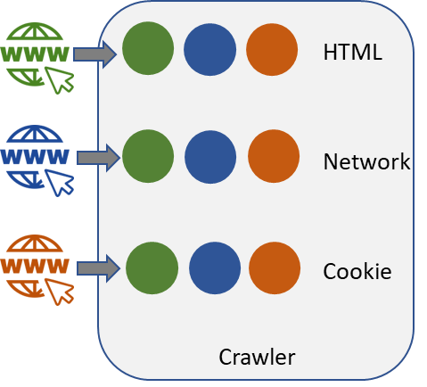



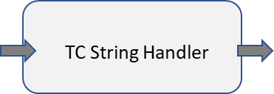
System Design
Built crawler to visit websites and identify their consent management platforms (CMP)
Simulated EU user who declined consent for websites automatically
User consent declines are encoded in TC string by CMP
Crawler collects TC strings from privacy related cookies, tracking cookies, HTTP requests, and HTML source code used to load the cookie banner
11

Slide 12
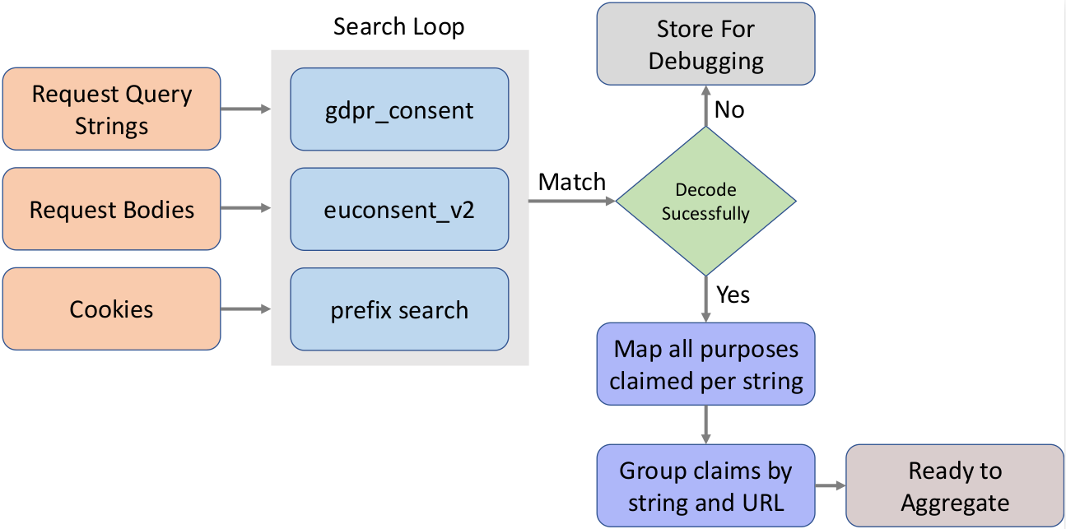
TC String Handler
TC string handler searches HTTP requests and cookies for TC strings and then decodes them using IAB’s decoder
Compares decoded string to simulated user’s consent choice (i.e., decline) to see if choice was honored
12

Slide 13
Data Analyzer for Non-Compliance Detection
Aggregates the decoded TC strings from the string handler, such that the resulting string captures all the standard purposes claimed in each individual decoded string
  There are 10 standard purposes for data collection in TCF
  For example, Purpose 1 allows storing and accessing data on the user’s device (e.g., cookies)
Non-compliance occurs when an incorrect flag is detected in the aggregated TC string
  Aggregated TC string shows consent was granted (despite our system declining consent)
  Legitimate interest (LI) is claimed for Purpose 1
13

Slide 14
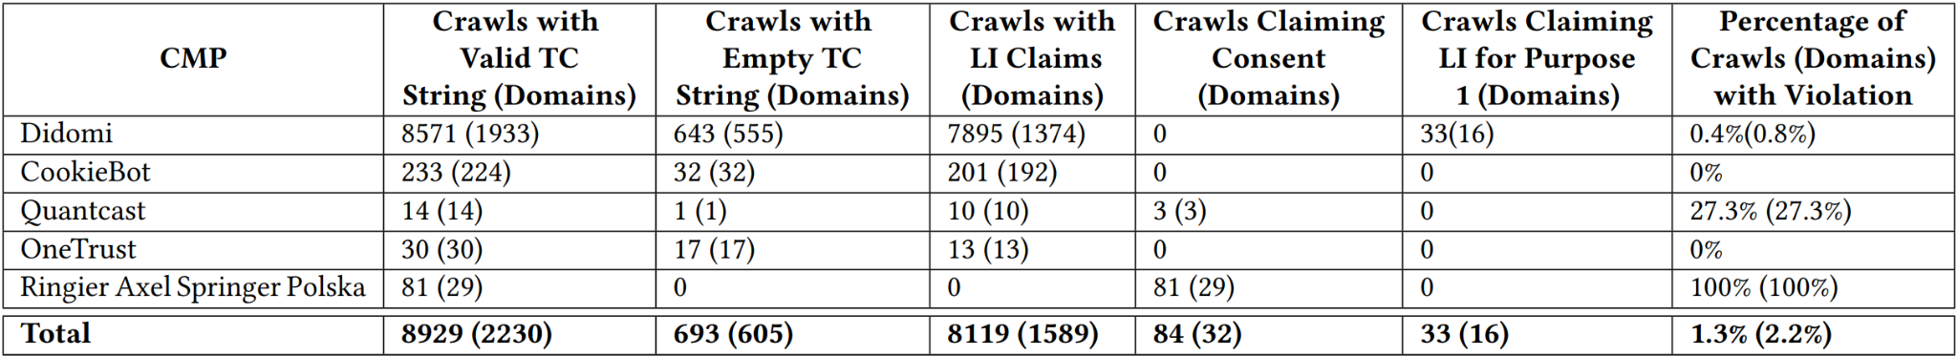
Most Websites Are Compliant with TCF, but …
Crawled 2,230 website domains employing TCF using 5 different CMPs
Overall compliance across website domains is high 97.8%
On average websites claimed legitimate interest 72.8% of the time as rationale for overriding the user’s choice of consent decline
14

Slide 15
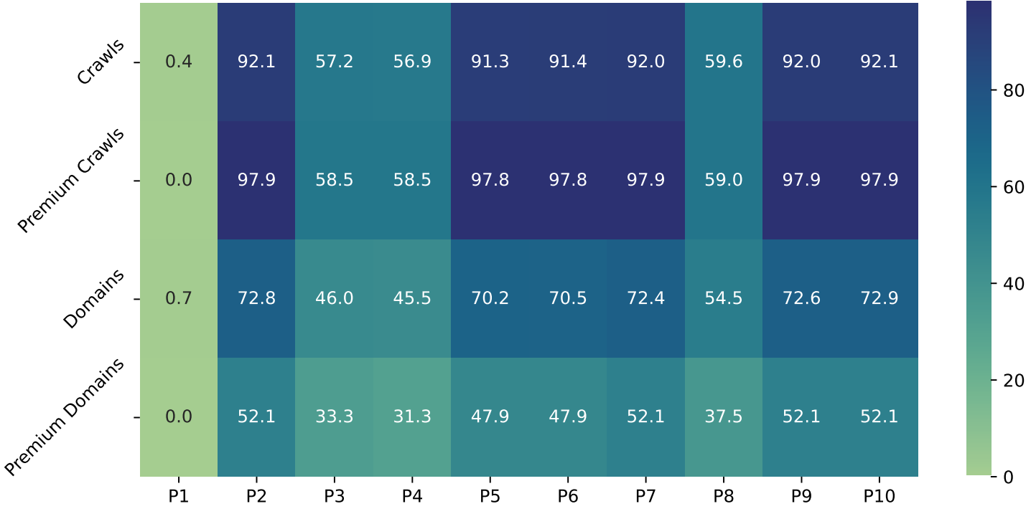
Frequent Use of Legitimate Interest
Legitimate interest often overrides the user’s decline of consent
Its frequent use defeats the purpose of GDPR
15

Slide 16
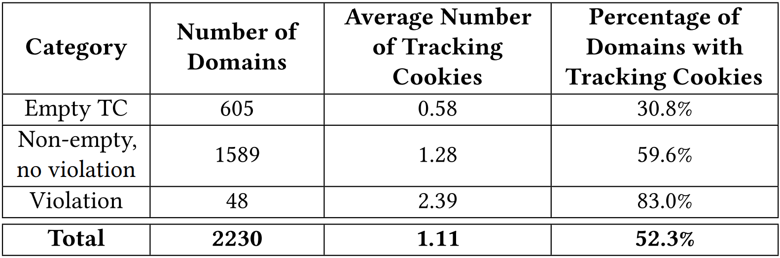
TCF Compliance & Cookie Issues
Empty TC strings result in tracking cookies → Raises GDPR compliance concerns
Non-empty TC strings without violations set tracking cookies → Indicates misinterpretation of TCF data processing purposes
Violations of TCF policies lead to more tracking cookies → Highlights the importance of proper consent recording
16

Slide 17
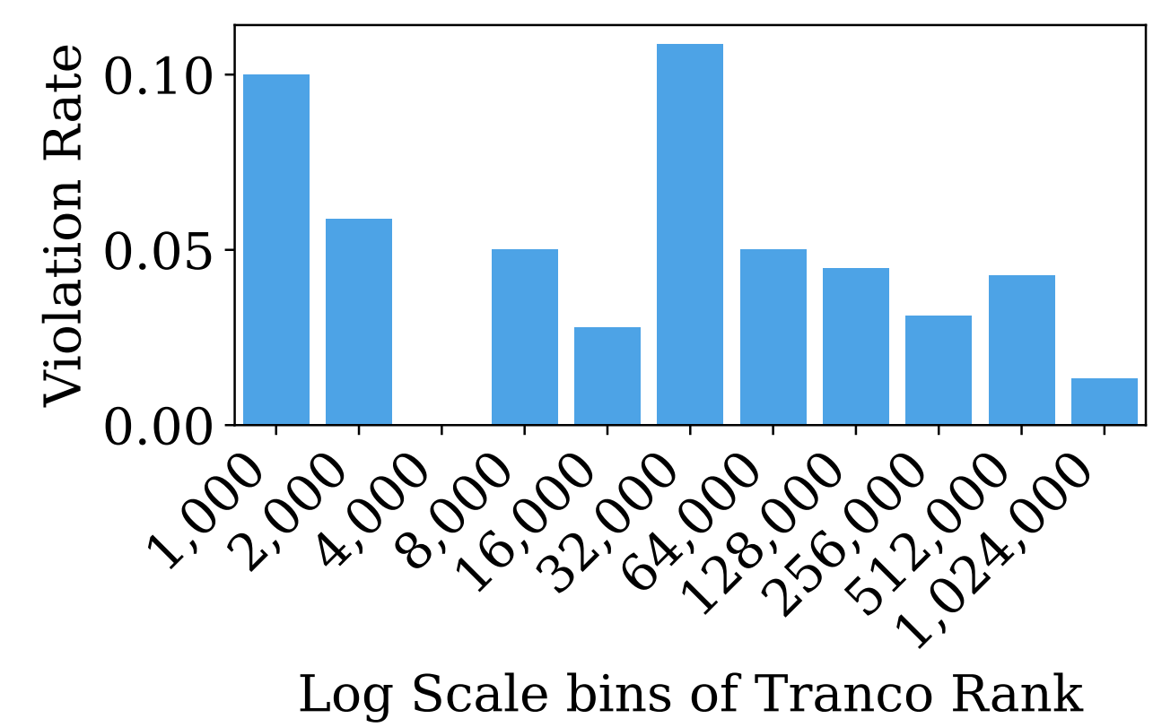
Non-Compliance of Popular Websites
Tranco: a research-oriented ranking of popular websites
TCF non-compliance is not only a phenomenon happening on obscure websites, as our results show it happens more often on popular websites
  About 10% of the top 1,000 sites in our sample showed non-compliance
17

Slide 18

Summary & Future Work
Studied: IAB EU TCF implementations by publishers, legitimate interest claims by publishers, tracking cookies, TCF non-compliance
Companies are compliant with the letter of the law but not with the spirit of the law
Our research informs regulators and market participants
System and dataset are open-sourced to allow compliance monitoring of TCF https://doi.org/10.5281/zenodo.10676338
Future research
  Develop additional compliance monitoring tools
  Expand our research to cover TCF v2.2
18

Slide 19
Outline
“AdFL: In-Browser Federated Learning for Online Advertisement.” AAAI ICWSM 2025 (under submission)
Introduction
GDPR Compliance under the Transparency and Consent Framework (TCF)
In-browser Privacy-Preserving Online Advertising using Federated Learning
Personalized Dynamic Counter Ad-Blocking Using Deep Learning
Ad Price Optimization in First-Price Auctions via Multi-Task Learning
Conclusions

Slide 20




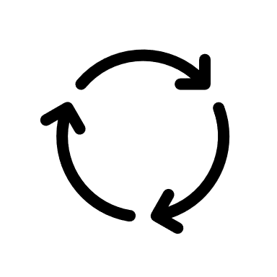


Privacy Challenges in Online Advertising
Existing systems designed around user data exposure
Incompatible with modern privacy regulations (e.g., GDPR, CCPA)
Current solutions such as TCF still permit user tracking
Content Request
Load Content, Ads Scripts
Publisher Server
Ad Scripts
Agreement
Advertisers
Ad Auction (Bidding, serving)
Adv 1
Adv 2
Adv k
3rd Party Ad Server
Ad Auction
Bids
a
b
c
y
z

Slide 21
Conflict Between Privacy and Revenue
System reliance on user data
  Advertisers: Targeted ads require user segmentation
  Publishers: Revenue depends on user data availability
Privacy dilemma: User privacy and revenue generation inherently conflict
Need for privacy-preserving online ad systems
  Process user data with informed consent
  Limit processing of raw user data to users' devices only
  Do not impact negatively publishers’ revenue

Slide 22
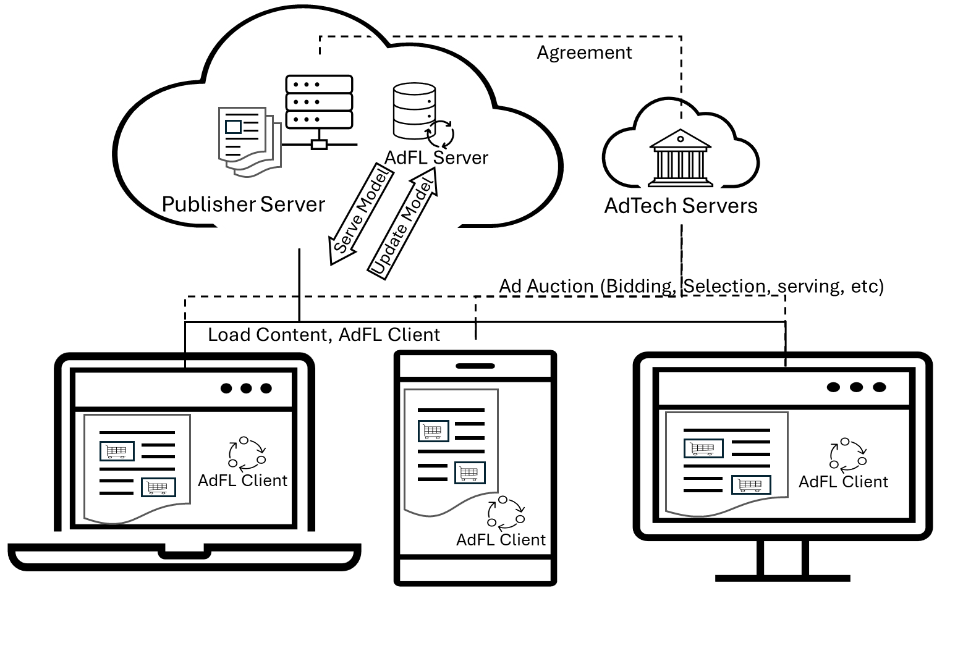
AdFL: A Privacy-Preserving FL Framework for Online Ads
In-browser training and inference: Runs asynchronously in the browser
  Works using common browser APIs, no client-side installation required
In-browser data collection: Browser data such as ad viewability & hovering, page dwell time & scroll depth
Publisher chooses the model and runs aggregation server
  Local model synchronization using first-party cookies to track global model versions

Slide 23
In-Browser AdFL Client
Ad Utility (AdU)
Send Data
Recorder
Data Preprocessing and Storage (DPS)
Ad Metrics
Feature Preprocessing
Signal Model
Retainer
Actuator
Data Collector (DC)
Session Data
Contextual Collector
Inference
Model Utility (MU)
Inference
Temp Store
Data Request & Alignment
Static Data
Retrieve Data
Load Model
Long Store
IndexedDB
Config & Mode
Run Model
Session Manager (SM)
Un/Load Components
Local Storage Module
Store
Cookies
Update Server

Slide 24
AdFL Implementation
Client-Side Implementation: Built using JavaScript; scripts hosted at publisher server
Data Storage: IndexedDB key-value store
Model Training and Inference: TensorFlow.js runs directly in the browser without extra permissions
Ad Metrics Collection
  Tracks viewability and clicks
  Collects creative ID, server query ID, ad dimensions, and ad metadata
Dynamic Ad Capturing
  Captures ad content in intermediate stages
  Handles obfuscated content from adTech agencies

Slide 25
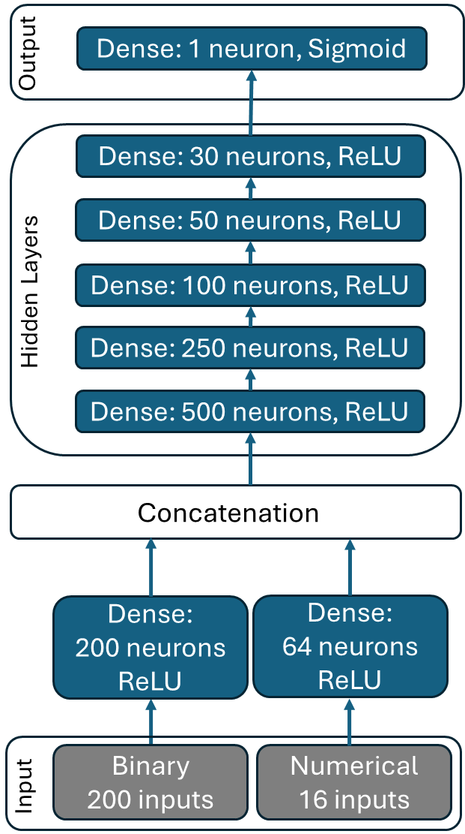
Proof-of-Concept Model: Ad Viewability
Real-time Inference
  Lightweight to work efficiently in browser
  Forecasts ad viewability during ad loading phase
  Can be used to optimize ad display time and adjust refresh rates for higher user engagement
Input Data and Features
  Feature Engineering: Initially 99 features, leading to 261 engineered features
  Feature Selection: Model uses binary and numerical features based on feature importance analysis (216 features)
Model Ground Truth
  Labels extracted from browsers, using IAB and user attention definitions
Notes:
50% of the ad pixels are visible in the browser window for 1 sec.
Model; input layers linked to dense layers, which are subsequently connected to concatenation layers. Thereafter, the five hidden layers are interlinked to yield the output layer.

Slide 26
AdFL-Enabled Data Collection and Use
Categories of Data
  User Data: Browser version, user agents, operating system, IP addresses
  Page Data: Page titles, content, URLs
  Session Data: Derived from visit metrics, such as page visits and time since the last visit
  Ad Data: Event-driven triggers, ad loading, and refreshing data from browser APIs
Future Models: The same data can be used for other ad-related models beyond viewability prediction
Category | # of Features | PII Categories (# for each)
User | 22 | Identifiers (6), Location Information (3)
Page | 16 | Personal Attributes (3)
Session | 28 | Identifiers (3), Behavioral Data (4)
Ad | 33 | Identifiers (5)

Slide 27
Model Evaluation
Experimental Setup
  Data: 10-day collection from a publisher’s site with 280K visitors
  Data Split: 80% training, 10% validation, 10% testing
  User Segmentation: Top 50, 100, and 500 users based on data samples
Performance Metrics Across User Groups
  Model shows strong performance across key metrics
  Performance slightly declines with more users due to less data per user
    Limited data collection in experiments; real-life scenarios likely provide more data per user
 | 50 Users | 100 Users | 500 Users
Avg Loss | 0.4486 ± 0.0016 | 0.5112 ± 0.0042 | 0.5434 ± 0.0020
Avg Accuracy | 0.7921 ± 0.0032 | 0.7555 ± 0.0071 | 0.7369 ± 0.0023
Avg AUC | 0.8736 ± 0.0012 | 0.8296 ± 0.0024 | 0.8078 ± 0.0013
Avg Rounds | 123.3 ± 17.5 | 212.2 ± 49.2 | 252 ± 62.12

Slide 28
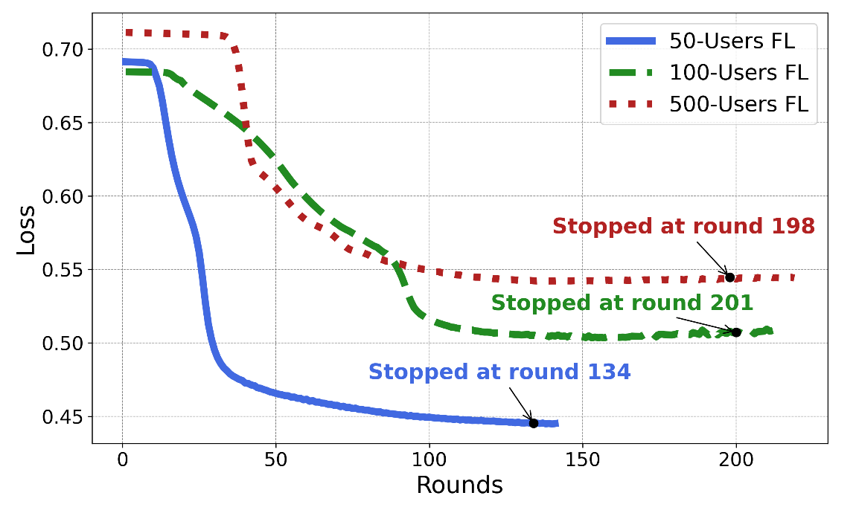
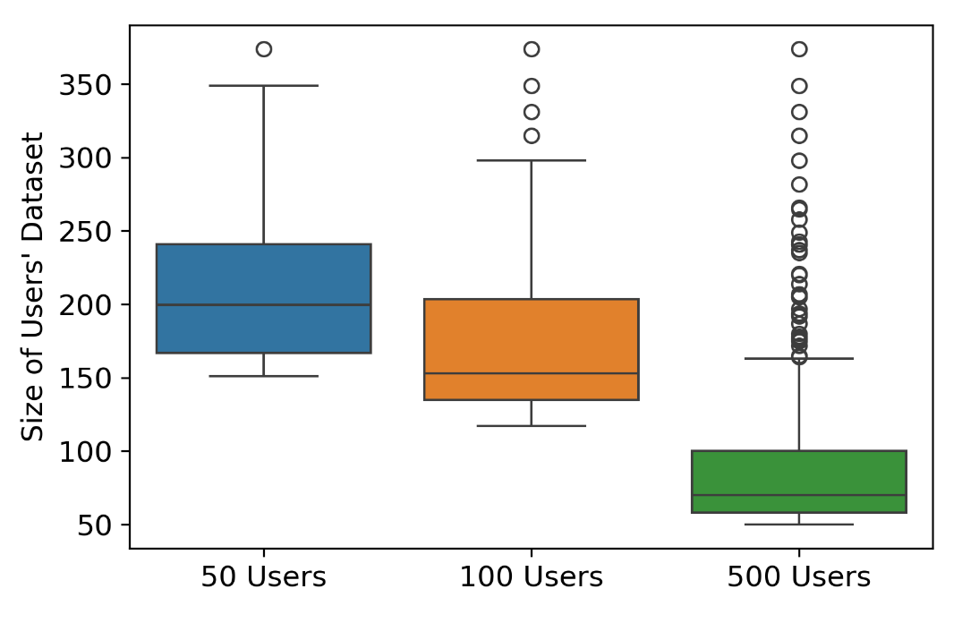
Convergence Rate
Overall data quality among participants improves the model's convergence efficiency

Slide 29
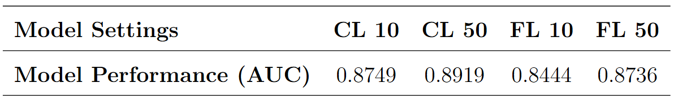
FL Model Performance
FL model achieves good performance showcasing AdFL’s effectiveness while preserving privacy
  Within a few percentage points of centralized model (CL),
FL model with differential privacy (DP) works well, with a modest decrease in performance compared to the non-DP version
  Protects local model parameters

Slide 30
AdFL Latency in the Browser
Experimental setup
  Tested on desktop (Edge browser, Windows 11) and mobile (Firefox, Samsung S21, Android)
Latencies well within acceptable limits for real-time ad loading and user interaction
  Inference Latency:
    Supports seamless ad loading and real-time prediction without noticeable overhead
  Training Latency:
    Suitable for real-time model updates and local training within the browser
Average Time | Desktop | Mobile
Preprocessing Features (ms/sample) | 0.0395 ± 0.0105 | 0.0514 ± 0.0119
Training (ms/round) | 378.086 ± 16.916 | 468.986 ± 29.658
Inference (ms/sample) | 2.072 ± 0.421 | 6.326 ± 0.744

Slide 31
AdFL Summary
End-to-end FL system for in-browser online ads, covering data collection, preprocessing, model training and inference
Works well in real-time, which is important for the latency perceived by users
Proof-of-concept ad viewability model on top of AdFL achieves good performance
  Makes it usable in applications that aim to better match ads with user interest and thus increases the publisher's revenue
Represents a promising practical solution toward balancing user privacy with publisher's revenue for targeted ads

Slide 32
Outline
“Personalized Dynamic Counter Ad-Blocking Using Deep Learning.” IEEE Transactions on Knowledge and Data Engineering (TKDE), Vol. 35, No. 8, 2023.
Introduction
GDPR Compliance under the Transparency and Consent Framework (TCF)
In-browser Privacy-Preserving Online Advertising using Federated Learning
Personalized Dynamic Counter Ad-Blocking Using Deep Learning
Ad Price Optimization in First-Price Auctions via Multi-Task Learning
Conclusions

Slide 33





Problem: Ad-Blockers Reduce Revenue
Massive ads on the web are annoying and lead to increased ad-blocker usage
  Usage has steadily increased to 42% of users
Ad-blocker: a tool, e.g., a browser plugin, to remove ads while a user is reading online content

Slide 34
Existing Counter Ad-Blocking Strategies
Subscription: costly and hard to scale to many users
  Adopted by New York Times, Wall Street Journal, Washington Post, etc.
  Revenue of New York Times fell 6.8% (about $140 million) in the first quarter after launching subscription for ad-blockers
Wall strategy: Require ad-blocker users to whitelist sites to access content: bad user experience, lose users and revenue
  Adopted by Wired, Forbes, etc.
  A large portion of ad-blocker users left the websites
AAX strategy: Pay ad-blockers to show acceptable ads
  Revenue taken by ad-blockers
  Publishers are short of money to generate high-quality content

Slide 35
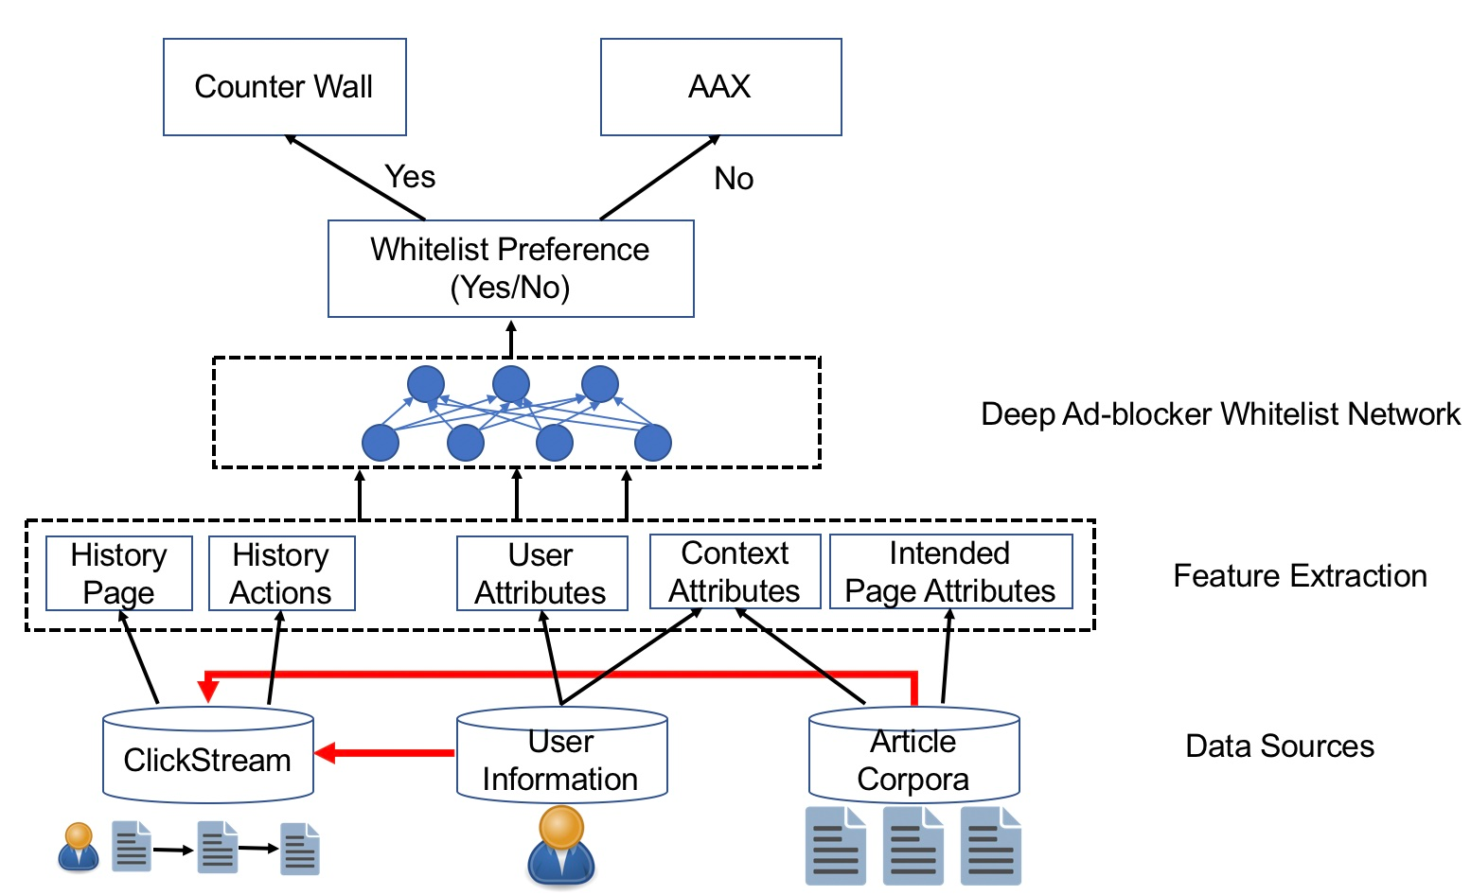
Personalized Dynamic Counter Ad-Blocking Strategy
Based on Whitelist prediction
  If whitelist predicted: show Wall
  If leave predicted: show AAX
Build model to predict whether an ad-blocker user will whitelist when visiting a given page
  Input
    User features
    Intended Page features
    Historic user engagement behavior
  Output
    Whitelist or not

Slide 36
Technical Challenges
Diverse online behavior may decrease prediction accuracy
Modeling historic behavior to extract user interest
Learning implicit user behaviors (e.g., dwell time, page views)
Large amount of categorical values (geo-location, OS, page type, etc.)
Modeling complex interactions
  User influence
  Current page characteristics
  History influence
  Context influence

Slide 37
DAWN: Deep Ad-Blocker Whitelist Network
Uses novel attention mechanism to capture interaction between historical behavior and intended page
Uses residual skip-connection to strengthen historical action influence
Uses multitask learning to increase learning ability
Notes:
Data: user profiles, user historical behavior, page features, context
Separate history behavior into two parts: pages and actions on the pages

Slide 38
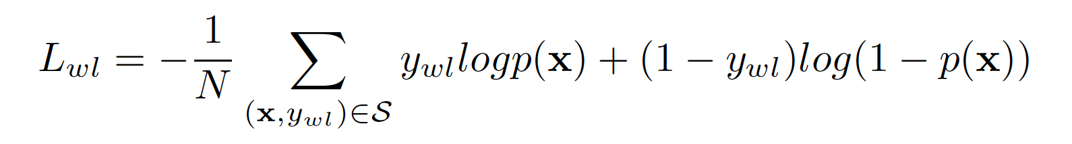
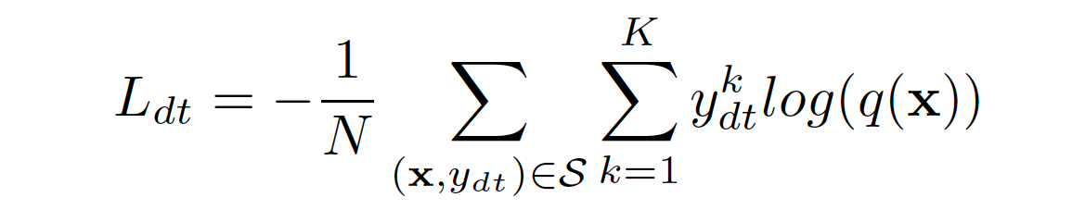
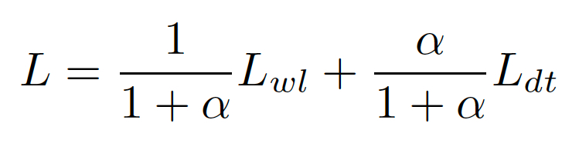
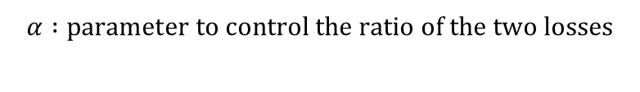
Design of Loss Function
Multitask learning of whitelist and dwell time predictions
Whitelist Loss
Dwell Time Loss
Combine Two Losses
$$α :parameter to control the ratio of the two losses$$
Notes:
Multitask learning helps overcome data scarcity. Whitelist is not a frequent event, while dwell-time can pe predicted well – a user tend to whitelist of the content is relevant (spend more time on the page)
Whitelist: binary cross-entropy
Dwell-time: discretized in bins; mean square error
Alpha: 0.0046

Slide 39
Experimental Settings
  Data from Forbes: 34K users with a total of 67K ad blocker-detected events, in which the whitelist ratio is around 20%
Split the whole dataset into training and test dataset over time with a ratio of 80:20
DAWN is implemented using Tensorflow and built upon the DeepCTR library
Adam optimizer with an 0.001 learning rate
Notes:
Here is the setting of our experiment.

Slide 40
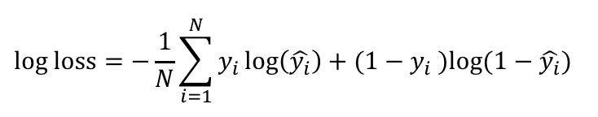
Baselines and Metrics
Baselines
  Logistic Regression: a widely used method for binary classification
  Random Forest: Bagging of Trees
  XGBoost: Boosting of Trees
  DIN: State-of-the-Art Technique
Metrics
  Log Loss: Gives high penalty for being both confident and wrong. Lower values are better
  AUC: Area under a receiver operating characteristic (ROC) curve. Higher values are better

Slide 41
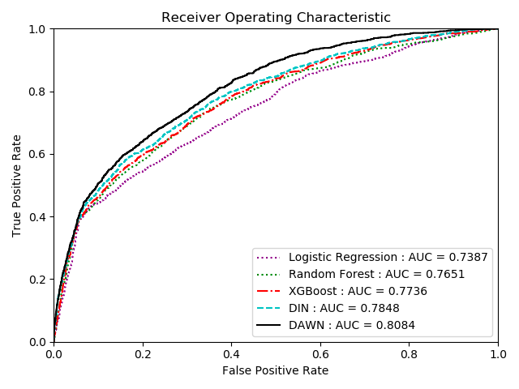
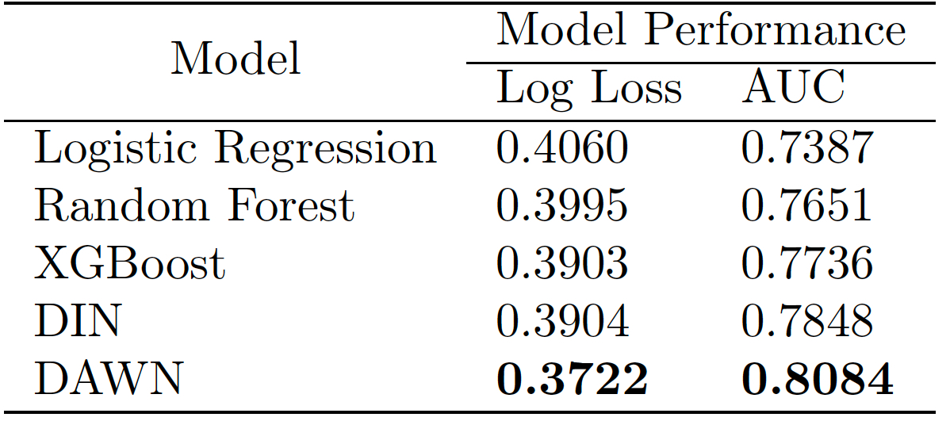
Main Results
  DAWN model outperforms baselines
  On ROC, DAWN is above baselines at all decision thresholds
Notes:
The main results are shown here.

Slide 42
Increasing Revenue with Personalized Dynamic Strategy
DAWN obtains more revenue than Wall or AAX strategies
  R1: average normal ad revenue after whitelist
  R2: average AAX ad revenue
  In R2/R1 is typically smaller than 0.4
  Decision threshold T ∈ (0, 1) is a cutoff to convert the predicted likelihood to whitelist p(x) to a binary prediction label: whitelist or not
    threshold=0 -> predict all users to whitelist, then to use deterministic Wall strategy
    threshold=1 -> predict all users not to whitelist, then to use deterministic AAX strategy

Slide 43
Summary
Proposed a personalized dynamic counter-ad-blocking strategy based on whitelist prediction to balance user experience and revenue
DAWN: A deep learning-based whitelist prediction model
  Novel attention mechanism to model historic behavior
  Co-learning whitelist prediction with dwell time prediction
  Achieves the best performance when compared with baselines
Personalized dynamic strategy based on DAWN outperforms two existing strategies in terms of revenue generation

Slide 44
Outline
“Reserve Price Optimization in First-Price Auctions via Multi-Task Learning.” 23rd IEEE International Conference on Data Mining (ICDM) 2023
Introduction
GDPR Compliance under the Transparency and Consent Framework (TCF)
In-browser Privacy-Preserving Online Advertising using Federated Learning
Personalized Dynamic Counter Ad-Blocking Using Deep Learning
Ad Price Optimization in First-Price Auctions via Multi-Task Learning
Conclusions

Slide 45

Online Advertisement Ecosystem for Real-time Bidding
Ad Exchange
5. If the highest bid > reserve price, the advertiser who bids highest is the winner. Otherwise, no winner
User
4. Ad exchange requests bids
3. Publisher sends impression information and reserve price
Advertisers
1. User clicks and triggers impressions
6. Ad exchange sends auction result
2. Publisher determines the reserve price
7. If there is a winner in ad exchange, serve the winner’s ad
Publisher
45

Slide 46

Ad Impression Revenue in First-Price Auctions
Outbid
Revenue = highest bid
reserve price
highest bid
Underbid
Revenue = $0
highest bid
reserve price
If reserve price is set too low, advertisers may not be incentivized to bid higher
If too high, ad impression revenue is zero
Goal: For each ad impression, predict in real-time the reserve price which has (1-⍺)% chance of being outbid
  ⍺ is a risk level set by publisher
46
Notes:
Publisher may hope to set the reserve price right below the highest bid, so that the impression can still be sold also the advertiser can get pressure to bid higher next time.
The publisher hopе they could have set the reserve price below the highest bid for underbid impressions. The problem is: the publisher doesn’t know the highest bid in this case.
Higher alpha means higher risk. More impressions will be underbid. However, the individual reserve price will be higher. The revenue of individual impressions will be higher.

Slide 47
Data Censorship in First-Price Auctions
The highest bids of outbid impressions are available
The highest bids of underbid impressions are not available
Uncensored
Outbid
reserve price
highest bid
Underbid
Left-censoring
highest bid
reserve price
47

Slide 48
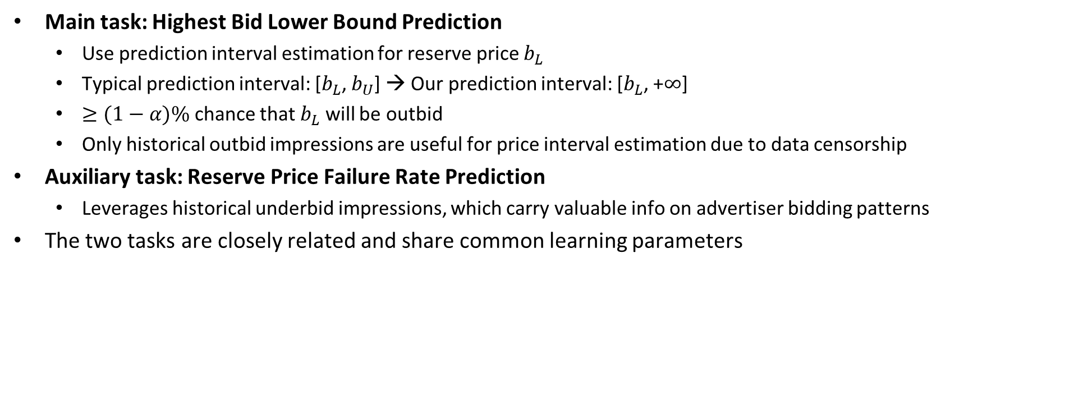
Multitask Learning Model
Main task: Highest Bid Lower Bound Prediction
  Use prediction interval estimation for reserve price $b_{L}$
  Typical prediction interval: [$b_{L}$, $b_{U}$] → Our prediction interval: [$b_{L}$, +$∞$]
  $≥(1−α)\%$ chance that $b_{L}$ will be outbid
  Only historical outbid impressions are useful for price interval estimation due to data censorship
Auxiliary task: Reserve Price Failure Rate Prediction
  Leverages historical underbid impressions, which carry valuable info on advertiser bidding patterns
The two tasks are closely related and share common learning parameters
48
Notes:
Directly predicting the exact reserve price is risky. The prediction may not be 100% accurate. Inaccurate prediction may hurt publishers’ revenue. Also, point estimation does not come with the probabilities or confidence.
Also, we wanna give publishers freedom to adjust the objective with different own business goals.
Therefore, we propose to use prediction interval estimation. Prediction interval estimation outputs a interval with a confidence, which is (1-alpha)%. Alpha can be tuned by publishers.
b_L is the possible lowerbound of the highest bid, while b_U is the possible upperbound of the highest bid.
The final reserve price can be set to be the lower bound.

Slide 49
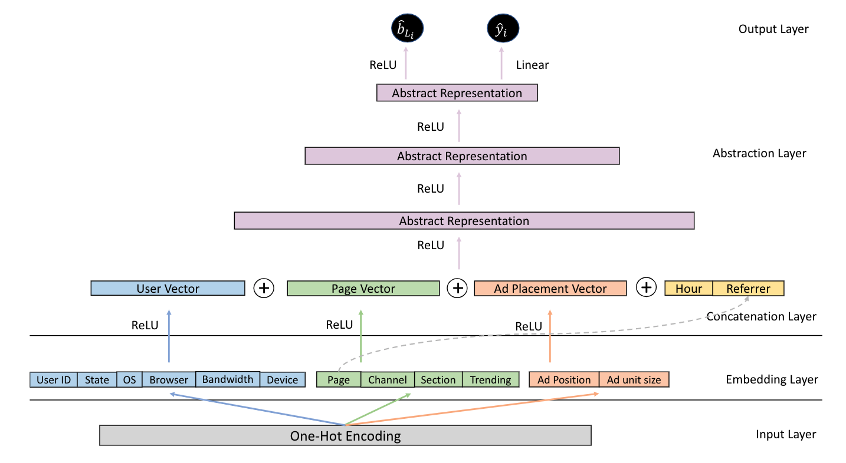
Multitask Model Architecture
49
Notes:
We use a neural network to predict highest bid lower bound and the failure rate.
Abstract representations are fully connected layers with ReLU activations.
We learn embeddings for all categorical features. The output are the highest bid lower bound and the failure rate, respectively.

Slide 50
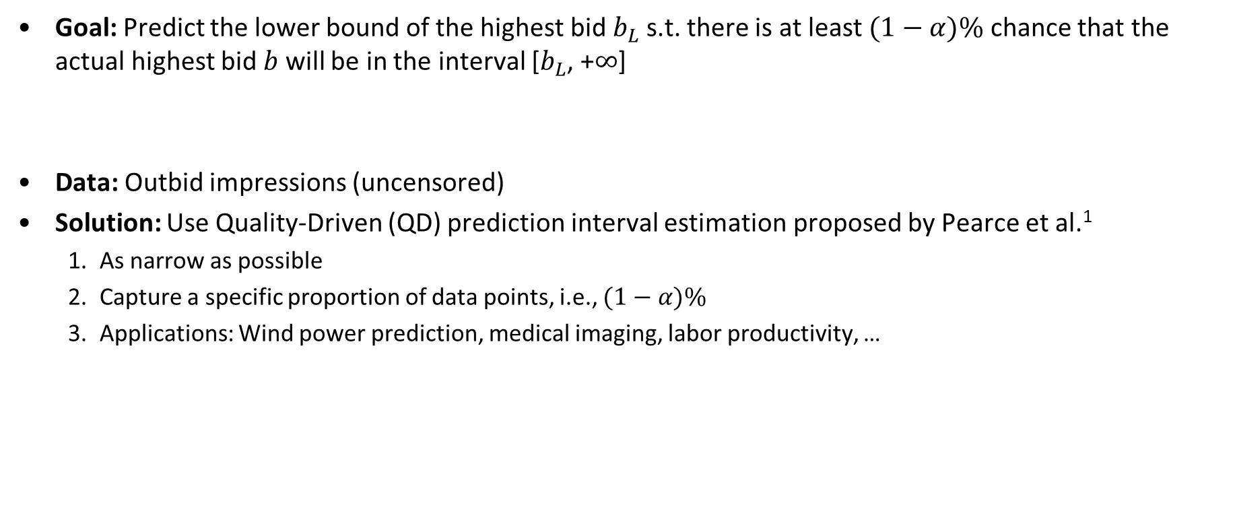


Main Task: Highest Bid Lower Bound Prediction
Goal: Predict the lower bound of the highest bid $b_{L}$ s.t. there is at least $(1−α)\%$ chance that the actual highest bid $b$ will be in the interval [$b_{L}$, +$∞$]
Data: Outbid impressions (uncensored)
Solution: Use Quality-Driven (QD) prediction interval estimation proposed by Pearce et al.¹
  As narrow as possible
  Capture a specific proportion of data points, i.e., $(1−α)\%$
  Applications: Wind power prediction, medical imaging, labor productivity, …
final reserve price
$$b_{L}$$
$$b$$
¹Pearce, Tim, Alexandra Brintrup, Mohamed Zaki, and Andy Neely. "High-quality prediction intervals for deep learning: A distribution-free, ensembled approach." In International Conference on Machine Learning, pp. 4075-4084. PMLR, 2018.
50
Notes:
A helpful prediction interval should be as narrow as possible. In our application, a narrow prediction interval means higher lowerbound b_L and thus higher final reserve price. So narrow intervals can potentially increase publishers revenue.
Second, “capture some specific proportion of data points”. Publishers have requirements on the minimum percentage of outbid impressions, which is (1-alpha)%.

Slide 51
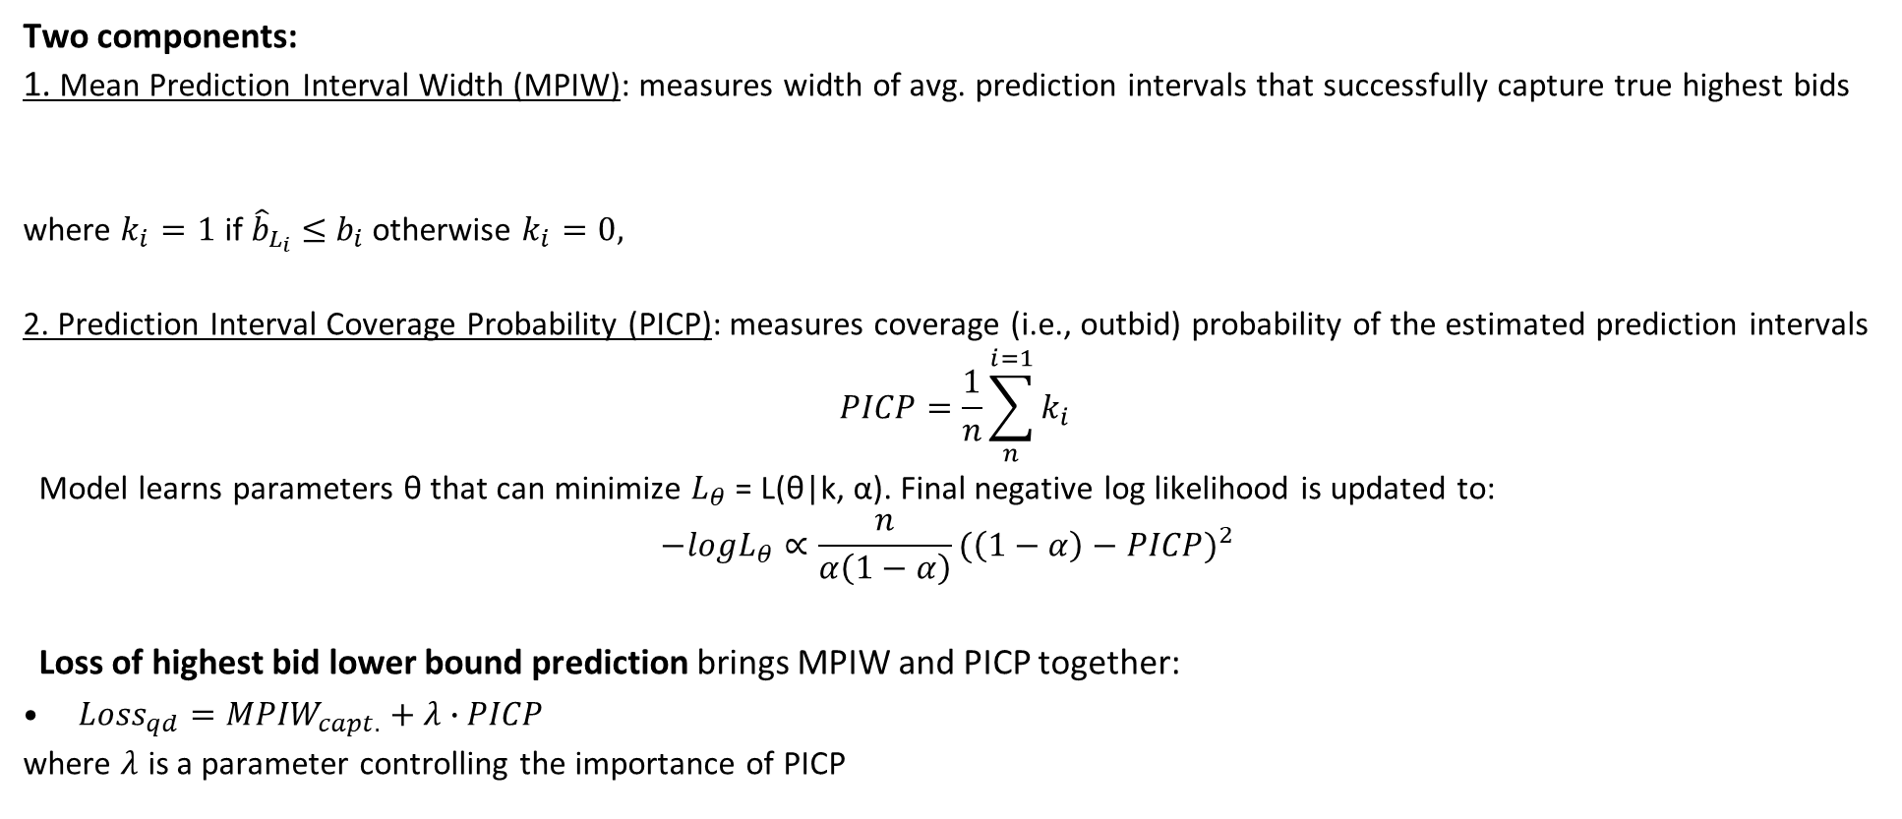
QD Loss Function
Two components:
1. Mean Prediction Interval Width (MPIW): measures width of avg. prediction intervals that successfully capture true highest bids
where $k_{i}=1$ if ${\hat{b}}_{L_{i}}$ $≤$ $b_{i}$ otherwise $k_{i}=0,$
2. Prediction Interval Coverage Probability (PICP): measures coverage (i.e., outbid) probability of the estimated prediction intervals
$$PICP=\frac{1}{n}\sum_{n}^{i=1}{k_{i}}$$
  Model learns parameters θ that can minimize $L_{θ}$ = L(θ|k, α). Final negative log likelihood is updated to:
  $$−logL_{θ}∝\frac{n}{α\left(1−α\right)}{(\left(1−α\right)−PICP)}^{2}$$
  Loss of highest bid lower bound prediction brings MPIW and PICP together:
${Loss}_{qd}={MPIW}_{capt.}+λ∙PICP$
where $λ$ is a parameter controlling the importance of PICP
51
Notes:
The QD loss function has two components which cover the two criteria we just mentioned:
The first one is Mean Prediction interval width (MPIW). k is a binary variable. It means if the true highest bids are successfully captured by the predicted lower bound hat b_L. Since the prediction intervals should be as narrow as possible, MPIW is expected to be as low as possible, hat b_L should be as high as possible. So the final reserve price can be as high as possible.
The second one is prediction interval coverage probability (PICP). It measures the coverage probability of the estimated PIs. In other words, how many impressions with predicted reserve price can be successfully outbid. Simply PICP is the number of impressions whose highest bid is not less than the predicted lower bounds divided by the total number of impressions.

Slide 52


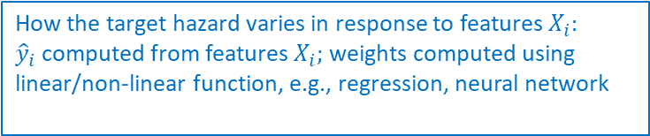
Auxiliary Task: Failure Rate Prediction
Goal: Predict the failure rate of a reserve price (i.e., probability of a reserve price being underbid)
Data: Outbid impressions (uncensored) and underbid impressions (left-censored)
Analogy to survival analysis:
  Event of interest: reserve price is underbid
  Time to event: reserve price
Solution: Cox’s proportional hazards model (Cox Regression)
          $$h\left(r, X_{i}\right)=h_{0}(r)∙e^{{\hat{y}}_{i}}$$
Hazard function: the failure rate of reserve price r for a given impression with features $X_{i}$
How the target hazard varies in response to features $X_{i}:$
${\hat{y}}_{i}$ computed from features $X_{i};$weights computed using linear/non-linear function, e.g., regression, neural network
Baseline hazard function. Percentage of training impressions whose reserve price r failed
52
Notes:
The abovementioned highest bid lower bound prediction only utilize outbid impressions because the historical highest bids are known. However, underbid impressions also carry important info on advertisers’ bidding behaviors. To take advantage of underbid impressions, we add one more task, failure rate prediction, along with highest bid lower bound prediction.
So the goal of failure rate prediction is to predict the probability of a reserve price being underbid. It uses both outbid impressions and underbid impressions.
The reasons we use Cox regression are: So we want a simple but power solution. Cox regression is very efficient and easy to tune. Cox regression is a classic survival analysis model. It has been widely used in many applications.

Slide 53
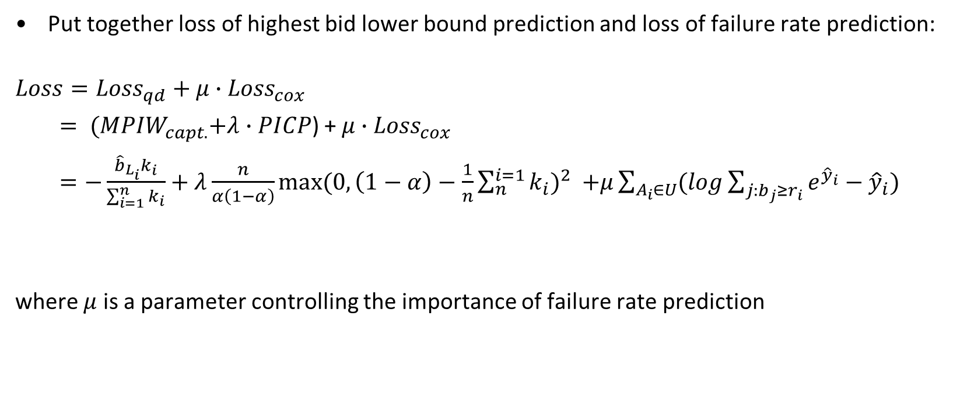
Final Loss Function of Multitask Learning
Put together loss of highest bid lower bound prediction and loss of failure rate prediction:
$$Loss={Loss}_{qd}+{μ∙Loss}_{cox}$$
$= {(MPIW}_{capt.}+λ∙PICP$) +${ μ∙Loss}_{cox}$
$=−\frac{{\hat{b}}_{L_{i}}k_{i}}{\sum_{i=1}^{n}{k_{i}}}+λ\frac{n}{α\left(1−α\right)}{max⁡(0,\left(1−α\right)−\frac{1}{n}\sum_{n}^{i=1}{k_{i}})}^{2}$ $+μ\sum_{A_{i}∈U}{(log\sum_{j:b_{j}≥r_{i}}{e^{{\hat{y}}_{i}}}−{\hat{y}}_{i})}$
where $μ$ is a parameter controlling the importance of failure rate prediction
53
Notes:
The final multi-task learning loss is obtained by putting the loss of highest bid lower bound prediction and failure rate prediction together:
Lambda is the importance of PICP and mu is the importance of failure rate prediction. They are pre-specified and determined by grid search.

Slide 54


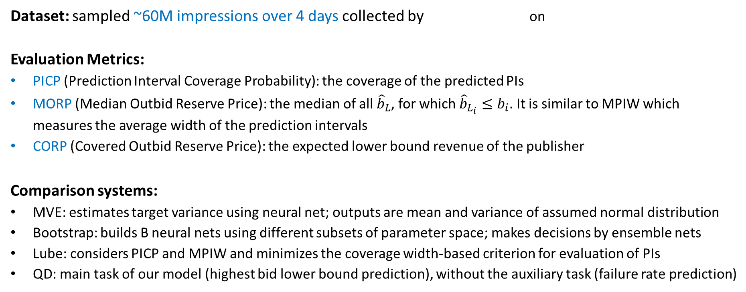
Experimental Settings
Dataset: sampled ~60M impressions over 4 days collected by on
Evaluation Metrics:
PICP (Prediction Interval Coverage Probability): the coverage of the predicted PIs
MORP (Median Outbid Reserve Price): the median of all ${\hat{b}}_{L}$, for which ${\hat{b}}_{L_{i}}≤b_{i}$. It is similar to MPIW which measures the average width of the prediction intervals
CORP (Covered Outbid Reserve Price): the expected lower bound revenue of the publisher
Comparison systems:
MVE: estimates target variance using neural net; outputs are mean and variance of assumed normal distribution
Bootstrap: builds B neural nets using different subsets of parameter space; makes decisions by ensemble nets
Lube: considers PICP and MPIW and minimizes the coverage width-based criterion for evaluation of PIs
QD: main task of our model (highest bid lower bound prediction), without the auxiliary task (failure rate prediction)
Notes:
Google Doubleclick collects 60 million impression data on Forbes website.
CORP is MORP weighted by PICP,
Three evaluation metrics are used:
The first is Prediction Interval Coverage Probability (PICP), which is the percentage of impressions that can be outbid. N is the number of test impressions. The indicator function I is either one or zero. It is determined by whether the predicted reserve price is not greater than the historical highest bid.
The second is Median Outbid Reserve Price (MORP). Since reserve prices are expected to as high as possible, MORP is used to measure predicted reserve prices. It is the median of the predicted reserve prices of all outbid test impressions. The reason of using median is because the distribution of reserve price is highly left skewed (most reserve prices were low).
The third is Covered Outbid Reserve Price (CORP). It is a unified evaluation metric, defined based on PICP and MORP. It reflects the expected lower bound revenue of the publisher. The Expected Revenue is proportional to the percentage of outbid test impressions times the median reserve price of outbid test impressions.

Slide 55
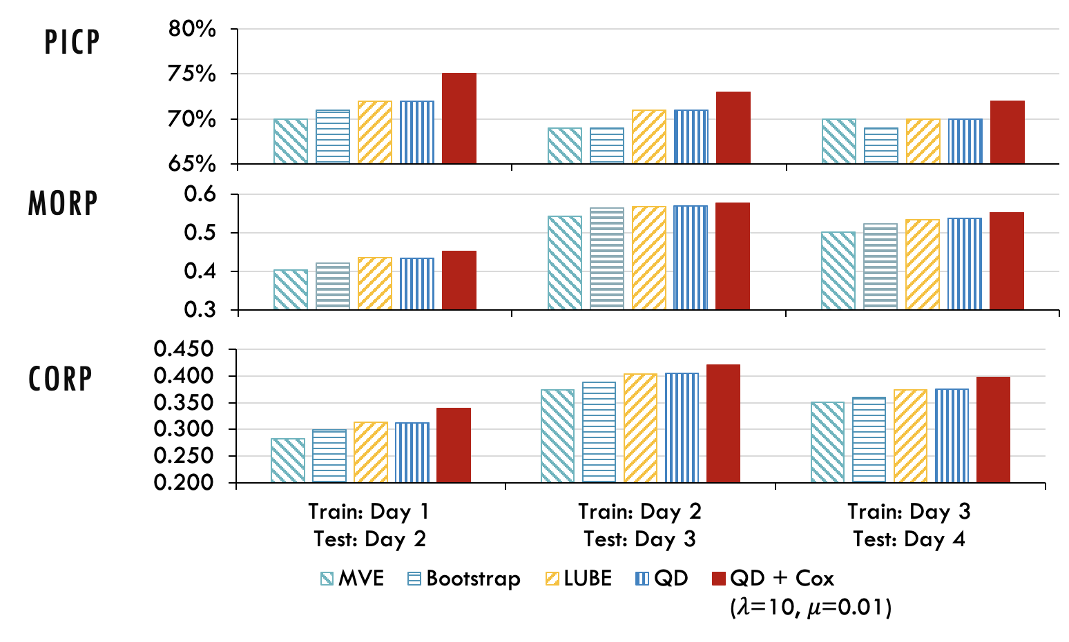
Performance of Highest Bid Lower Bound Prediction
Our solution (QD+Cox, $α$=30) significantly outperforms the comparison systems
Results show the benefits of multitask learning (QD+Cox vs. QD)
Notes:
We compare the best QD_Cox model with the comparison systems, MVE, Bootstrap, LUBE, and QD. MVE and Bootstrap are two classic methods of prediction interval estimation. LUBE and QD are two proposed recently. QD here is actually the proposed model without the failure rate prediction part. The risk level is still controlled to be 30%.
According to the result, The PICPs of most methods are more than 70%.
The performance of MVE and Bootstrap is not as high as others. MVE has a strong assumption that the variance of the highest bids follows Gaussian distribution. It is an improperestimation in our application because bids are skew to the lower left tail. Bootstrap may generate inaccurate estimation of the model misspecification variance due to limited number of NN and the potential bias. It may generate too wide or too narrow prediction intervals.
Since LUBE and QD are recognizable as having the similar loss, The have similar performance on our dataset. QD+Cox significantly outperforms QD on all three days. It indicates that considering underbid impressions can significantly improve the final prediction performance. Underbid impressions also contain useful patterns on advertisers’ bidding behavior.

Slide 56
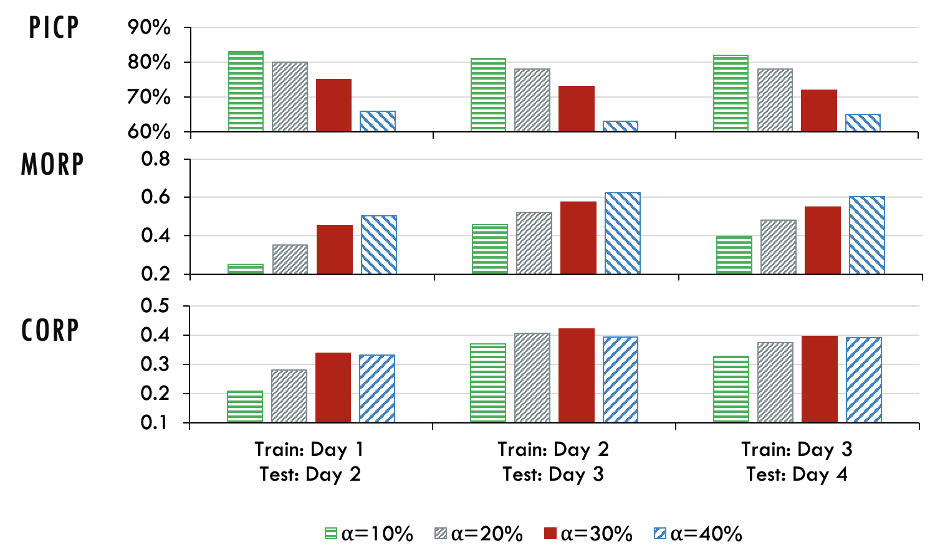

Performance for Different Risk Levels $α$
Setting $α$is a trade-off between getting outbid impressions and increasing impression price
Good performance when $α is 30−40\%$
Notes:
The risk level alpha determines the minimum coverage. In theory, there is often an inverse relationship between a model's coverage (i.e., PICP) and its lower bounds (i.e., MORP, final reserve prices), where it is possible to increase one at the cost of reducing the other. Reducing the lower bounds can increase the chance of covering the actual highest bids. On the other hand, setting up high reserve prices for individual impressions likely causes more underbid impressions. Therefore, for publishers, setting alpha is a trade-off between selling more outbid impressions and motivating advertisers to bid high in a long run.
In this experiment, we observe the performance of the proposed method by varying alpha.
When alpha=30% and 40%, the PICPs of QD+Cox with lambda=10 and mu=0.01 on the test data can meet the required minimum coverage.
It is interesting to see that when alpha=10% and 20% the PICPs on the test data are less than the required minimum coverage. The reason is that covering more than 80\% on test data is highly difficult due to the challengingness in the data. During model training, the model has to either overfit the training data or fail to meet the minimum coverage.
alpha=40% has the highest MORPs, i.e., the median reserve price is the highest. This is because that the required minimum coverage is as low as 60% when alpha=40%. Thus, the model has large room to push the predicted lower bounds much higher. On the other hand, the CORP of alpha=40% is slightly less than that of alpha=30% because PICP of alpha=40% is lower. In other words, when alpha=40%, although individual reserve prices are higher, much fewer impressions are outbid.
Therefore, setting alpha is a trade-off between harvesting many outbid impressions and increasing the unit price of impressions: A high alpha causes many underbid impressions. However, once an impression gets outbid by advertisers, the publisher can own more revenue. On the other hand, a low alpha makes many impressions will be sold through real-time bidding, while lower reserve prices may not motivate advertisers to keep their high bids. Real-time bidding algorithms of advertisers may quickly learn that high bids are unnecessary and try to bid lower next time.

Slide 57
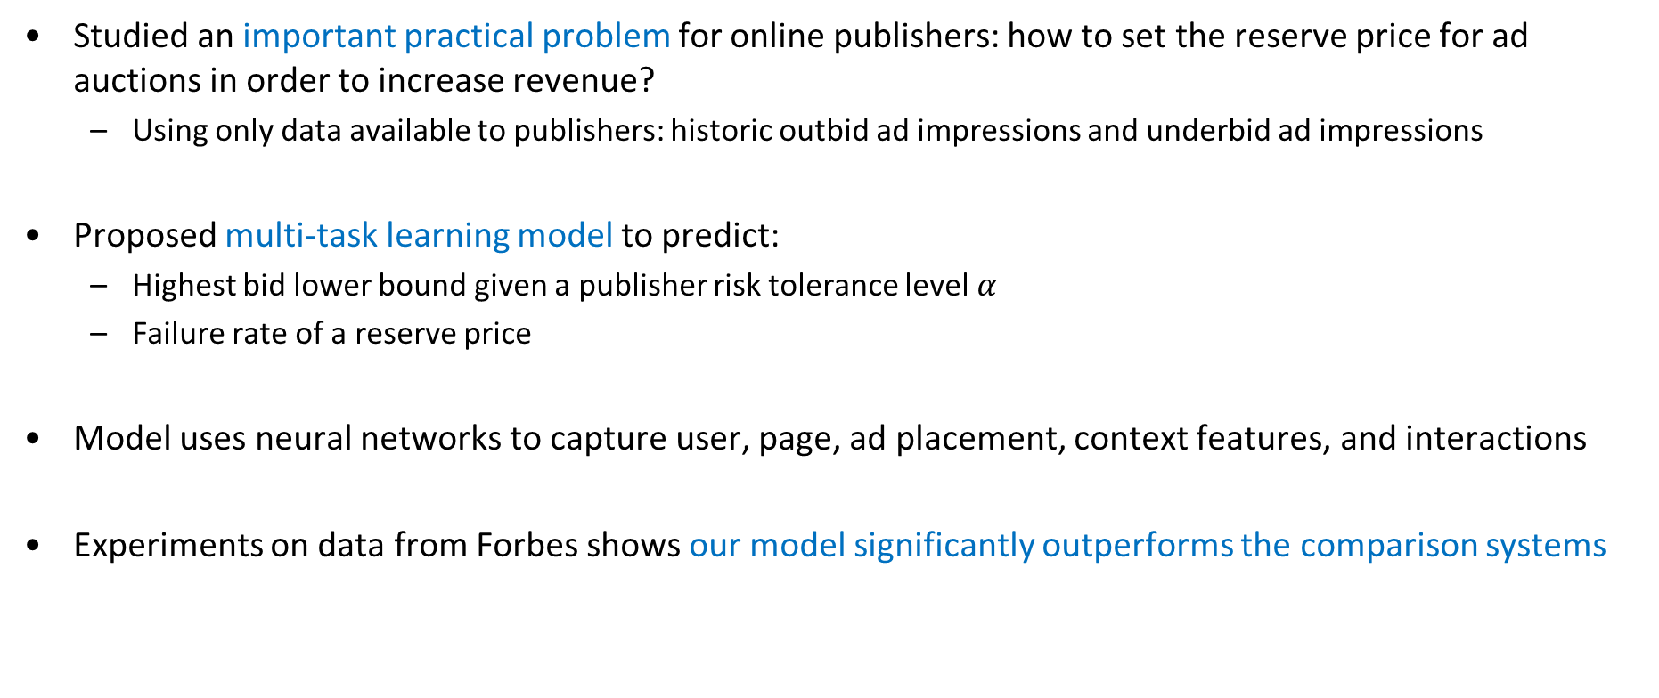
Summary
Studied an important practical problem for online publishers: how to set the reserve price for ad auctions in order to increase revenue?
  Using only data available to publishers: historic outbid ad impressions and underbid ad impressions
Proposed multi-task learning model to predict:
  Highest bid lower bound given a publisher risk tolerance level $α$
  Failure rate of a reserve price
Model uses neural networks to capture user, page, ad placement, context features, and interactions
Experiments on data from Forbes shows our model significantly outperforms the comparison systems

Slide 58
Outline
Introduction
GDPR Compliance under the Transparency and Consent Framework (TCF)
In-browser Privacy-Preserving Online Advertising using Federated Learning
Personalized Dynamic Counter Ad-Blocking Using Deep Learning
Ad Price Optimization in First-Price Auctions via Multi-Task Learning
Conclusions

Slide 59
Conclusions
Practical research with real-life impact on both society and 100s billion-dollar industry
  Informs regulators and industry standard boards as well
Complex interdisciplinary problems that require understanding of regulation, human factors, economics, and technology
AI can help balance the tradeoffs between privacy, revenue, and user experience
Ongoing works
  Distributed online ad ecosystem : improve both user’s privacy and publisher’s revenue by removing the “middleman”
  Dark patterns: consent banners manipulation to nudge the users to accept tracking
  Brand safety classification inconsistency and its negative impact on ad revenue

Slide 60
Thanks!
http://cs.njit.edu/~borcea/
Acknowledgments:
  NSF Grants DGE 2043104, SaTC 2237328
  Students: Mike Smith, Riley Grossman, Pritam Sen, Ahmad Alemari, Shuai Zhao, Chong Wang, Achir Kalra, Michael Chen
  Faculty Collaborator: Yi Chen
  Industry collaborator: Antonio Torres-Agüero

