Slide 1
Mobile Computing and Crowdsensing with Avatars and Aliens
Cristian Borcea
Computer Science Department
New Jersey Institute of Technology

Slide 2
Outline
Avatar: Mobile Distributed Computing Assisted by Cloud
Mobile Crowdsensing Incentives
  Alien vs. Mobile User Game
  McSense: A Crowdsensing Platform using Micro-payments
DIVERT: Distributed Vehicular Traffic Re-routing for Congestion Avoidance
Conclusions

Slide 3

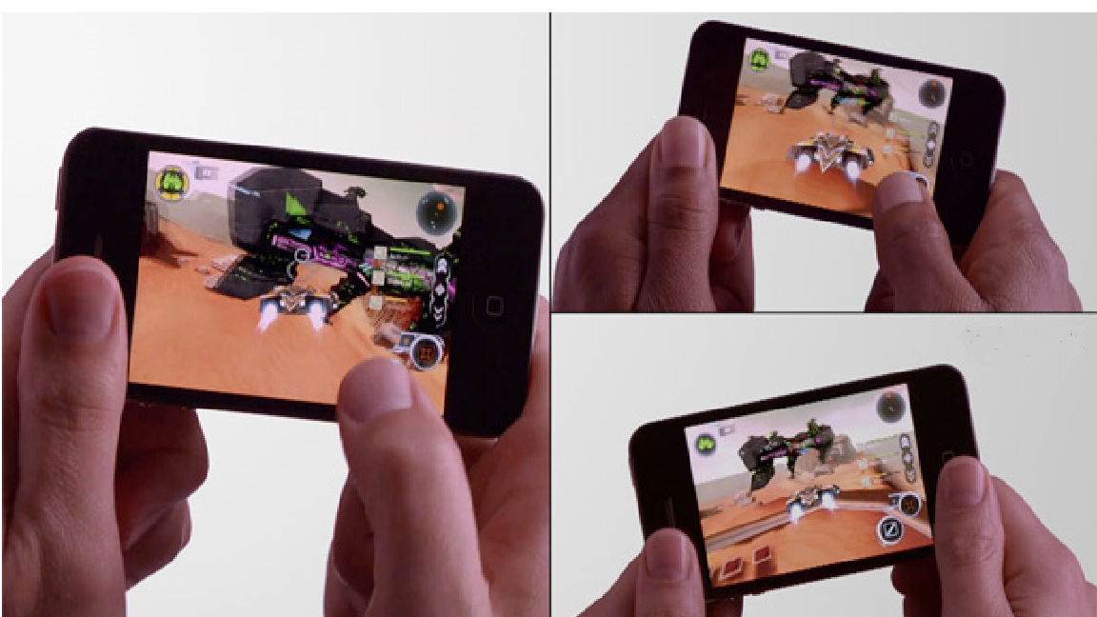

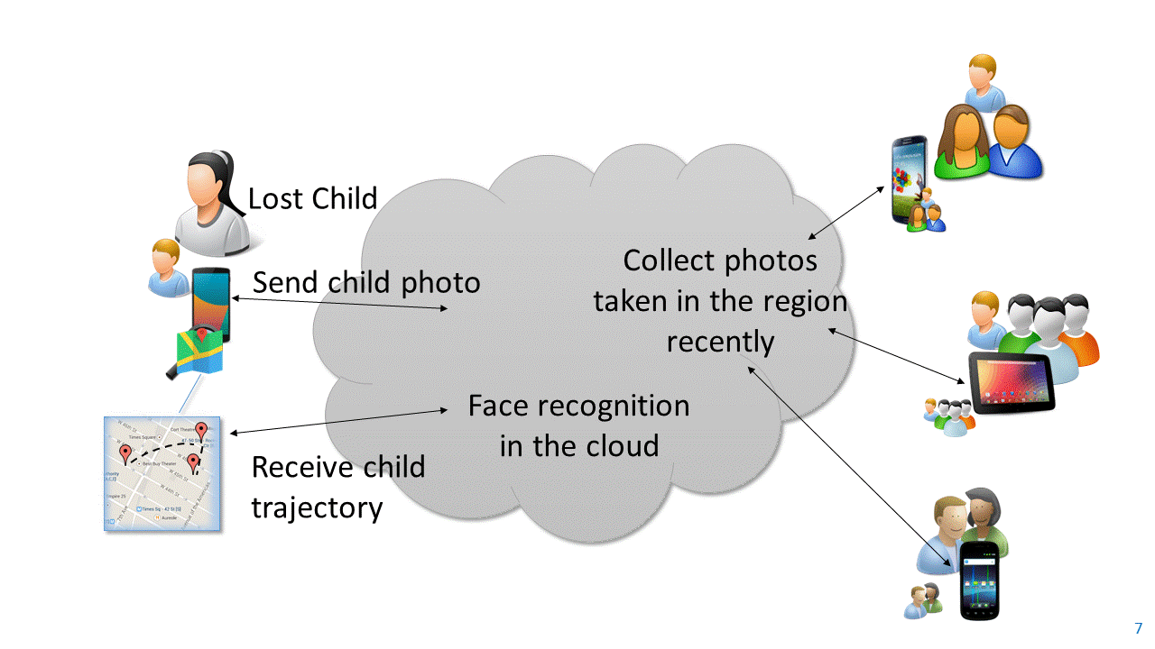
Mobile Distributed Apps Assisted by Cloud
Enable direct collaboration among mobile users
  Novel apps based on huge amounts of data generated every day by mobile devices
  Users are willing to share data with certain communities
Use cloud support for efficient execution
Examples of apps
  Healthcare and wellbeing
  Mobile multiplayer gaming
  Collaborative sensing
  Multi-user video conference
  Find people lost in the crowd

Slide 4

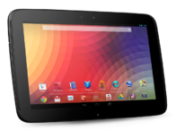
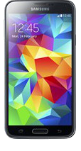



Mobile Distributed Apps over the Avatar Platform
Avatar platform
  Each mobile device has an associated avatar (i.e., VM) in the cloud
  Avatars execute app components on behalf of users’ mobile devices
Apps
  Keep running when mobile devices are turned off or disconnected
  Able to use mobile sensors/input devices seamlessly while running in cloud
Apps running on Avatar platform have
  Low latency/response time
  Energy efficiency
  High availability
avatar3
avatar1
avatar4
avatar2
Cloud

Slide 5
System Challenges for Avatar Platform
Programmability: provide programming abstractions to shield programmers from complex distributed execution environment
  Environment: distributed and synchronized (mobile, avatar) pairs
  Apps have multiple options to divide components between mobiles and avatars
Cloud scalability: design scalable and cost efficient cloud architecture and protocols, tailored for Avatar architecture
  Potentially billions of avatars
  Mobile distributed apps generate different cloud workloads compared with typical enterprise applications
Privacy: create mechanisms to efficiently store data and execute apps while protecting sensitive data and results from cloud providers
  Data needs to be used by Avatars: not good enough to just encrypt the data

Slide 6
Programming Challenges for Avatar Platform
How to provide an API to transparently use mobile-avatar pairs in apps?
What programming abstractions are needed to write apps over distributed mobile-avatar pairs?
How to integrate dynamic context such as location, time, and social relationships into the programming abstractions?
How to offload mobile-to-mobile communication to the cloud?

Slide 7
Moitree Middleware for Avatar Platform
Provides an API that implements a high-level distributed programming model for developing Avatar apps
  Communication end-points are mapped transparently to mobile-avatar pairs
  Common app execution environment on mobiles and avatars allows seamless offloading of app components
  Context-aware group-based abstractions to manage user collaboration
  Abstract communication channels to offload mobile-to-mobile communication to the cloud

Slide 8
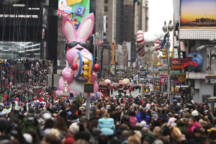
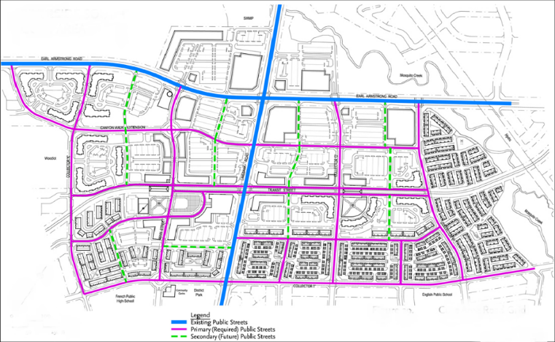
Context-aware Groups
Human collaboration breaks down into groups and sub-groups
Moitree’s programming model structures user collaboration within apps over context-aware groups
  Formed and maintained dynamically based on context parameters
  Structured hierarchically
Lost child app: group defined by location and time
(find people who took photos in this location since 1pm)
Free parking spot app: hierarchical groups of drivers
(hierarchy: city, district, block, street)

Slide 9


Communication Channels
Communication channels
  Communication abstraction for group collaboration
  Mobile-mobile communication offloaded to the cloud
  Hides programming complexity for distributed communication
Four asynchronous communication channels
  broadcast
  point2point
  anycast
  scatter-gather
Request
Channel in the cloud
Request
Request
Request
Scatter-gather channel
Response
Response
Channel in the cloud
Response
Response

Slide 10
Persistent Messages
Persistent message buffer
Used for dynamic group communication
Associated with groups, not current group members
Allow for communication with future group members

Slide 11
Examples of Moitree API
Group creation API
  Create group at initiator - createGroup(Group parent, MembershipProperties
  prop, Boolean enableLeader, Double groupLifetime)
  Join group at participant - onCreateGroup(Group group)
Group membership related API
  Based on time - setTimeBound(Time from, Time to)
  Based on location - setLocationBound(Location center, Double radius)
Group communication API
  Start receiving data - setReadCallBack(ReadCallBack callBack)
  Send over scatter-gather channel - scatterGather(ChannelID cid, Message msg)

Slide 12
LostChild Programming in Moitree
Initiator (Parent of the lost child)
1. Set dynamic group membership properties
Participant
searchForLostChild(){
MembershipProperties prop = new MembershipProperties();
prop.setLocationBound(LOCATION, RADIUS);
prop.setTimeBound(TIME_FROM,TIME_TO);
Group group =
Avatar.createGroup(null,prop,false,LIFETIME);
ReadCallback callback = new ReadCallback(){
public void scatterGather(ChannelID cid,Message msg){
//msg contains results sent by participants
//add result to potential trajectories
//update user with latest trajectories
if (ChildFound){
DONE=true;
}
}
... ... ... //other channel callbacks
}
group.setReadCallback(callback);
ChannelID cid = generateChannelID();
group.scatterGather(cid, childImage);
while (!DONE){ //block }
group.deleteGroup(group.credentials());
}
onCreateGroup(Group group){
ReadCallback callback = new ReadCallback(){
public void scatterGather(ChanelID cid, Message msg){
Image image = msg.getData();
//run face recognition with image
//if child image is recognized, set the location and time associated with the matching photo in result
group.scatterGather(cid, result);
}
... ... ... //other channel callbacks
};
group.setReadCallback(callback);
}
2. Call createGroup with the membership properties
4. Set channel callbacks
6. Receive image, run recognition and send back result
7. Receive and process recognition results
3. OnCreateGroup is called by middleware
5. Send child image

Slide 13
Moitree Architecture
Mobile
Avatar
Avatar
Mobile
Mobile Distributed Applications
Mobile Distributed Applications
Moitree API
Moitree API
Moitree Group Related Services
Moitree Mobile Middleware
Moitree Avatar Middleware
Moitree Avatar Middleware
Moitree Mobile Middleware
Cloud

Slide 14
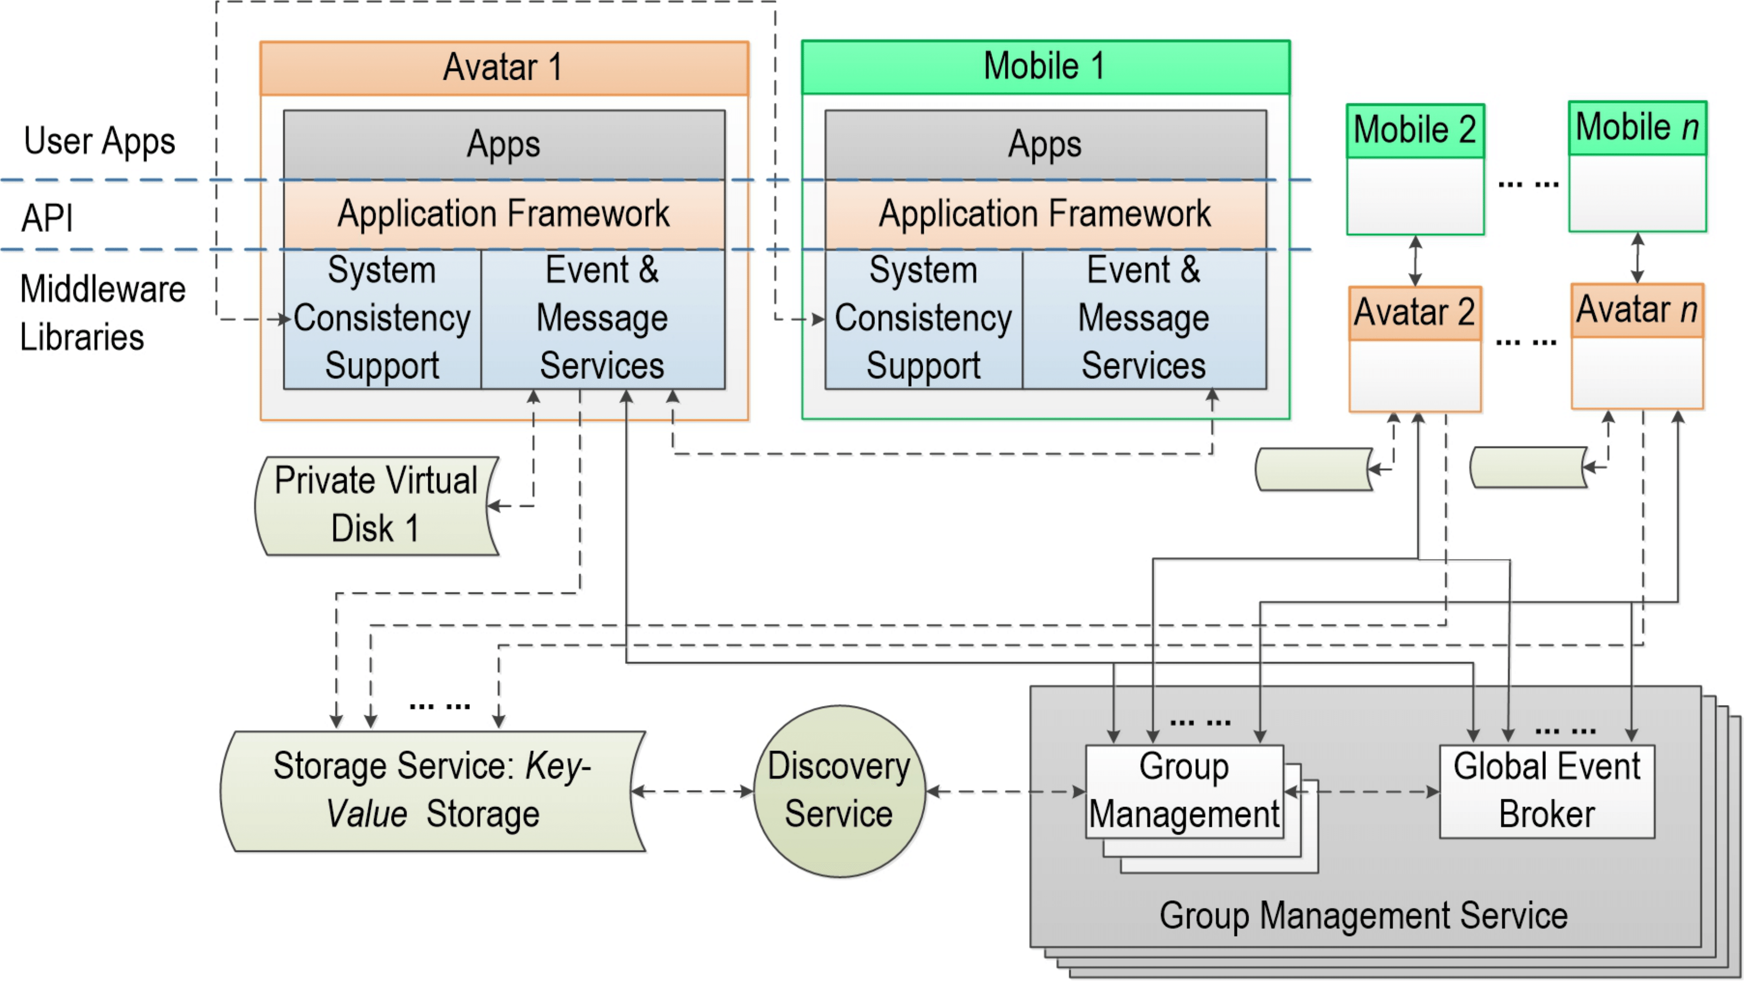
Middleware Components
Synchronizes user generated content between mobile and avatar
Processes events and messages generated by apps
Individual private avatar storage
Enables context-aware group membership
Provides dynamic group management and group communication support
Shared storage for avatars

Slide 15
Prototype Implementation
Android-based implementation
  Nexus 5 and Nexus 6 mobile devices
Built Openstack-based cloud to host avatar VMs
  Each avatar is Android-x86 VM
Implemented LostChild and FaceDate apps
  Face detection and face recognition implemented using OpenCV 2.4.10
  Number of lines of code reduced significantly when using Moitree vs. native Android implementation

Slide 16
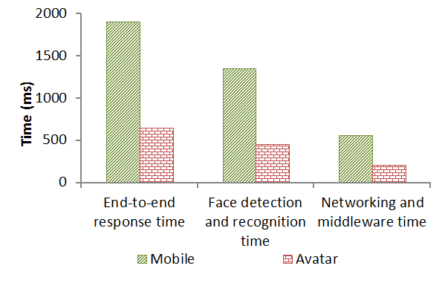
End-to-end Response Time and Power Consumption for LostChild App
Moitree can improve latency by 3 times compared to mobile only solution for this experiment
Avatar-based implementation of LostChild reduces power consumption by 25 times compared with mobile-only solution

Slide 17
Outline
Avatar: Mobile Distributed Computing Assisted by Cloud
Mobile Crowdsensing Incentives
  Alien vs. Mobile User Game
  McSense: A Crowdsensing Platform using Micro-payments
DIVERT: Distributed Vehicular Traffic Re-routing for Congestion Avoidance
Conclusions

Slide 18
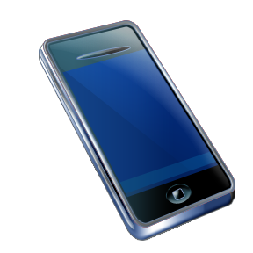
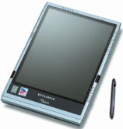

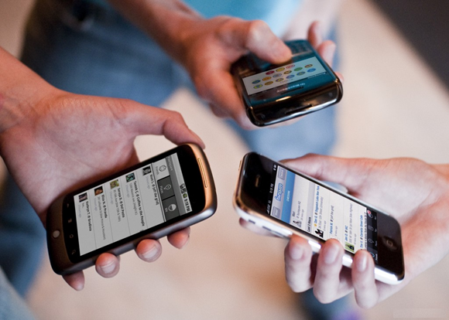
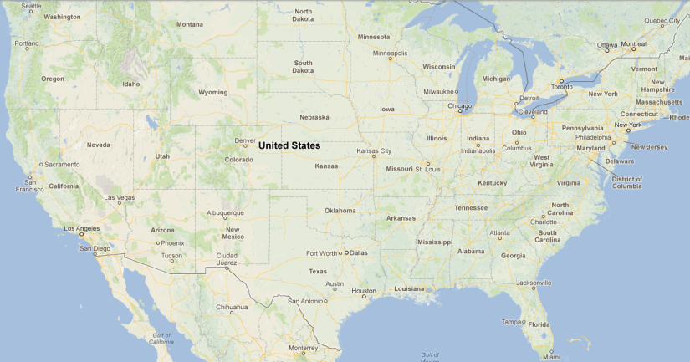
Mobile Crowdsensing
Crowdsensing: Scalable and cost effective coverage of large regions
Crowd
Sensing
Crowd sensing
Sensed Data
Camera
Accelerometer
GPS
Microphone
Bluetooth
Source: IDC

Slide 19
What Are the Incentives for Participants?
Micro-payments: sensing tasks are matched with small payments
Mobile gaming: in-game incentives to convince participants to cover the desired sensed area
Mobile Gaming vs. Micro-Payments
Initially, game development involves a relatively significant one-time cost.
Over time, choosing mobile gaming over micropayments is expected to be the economical option.

Slide 20
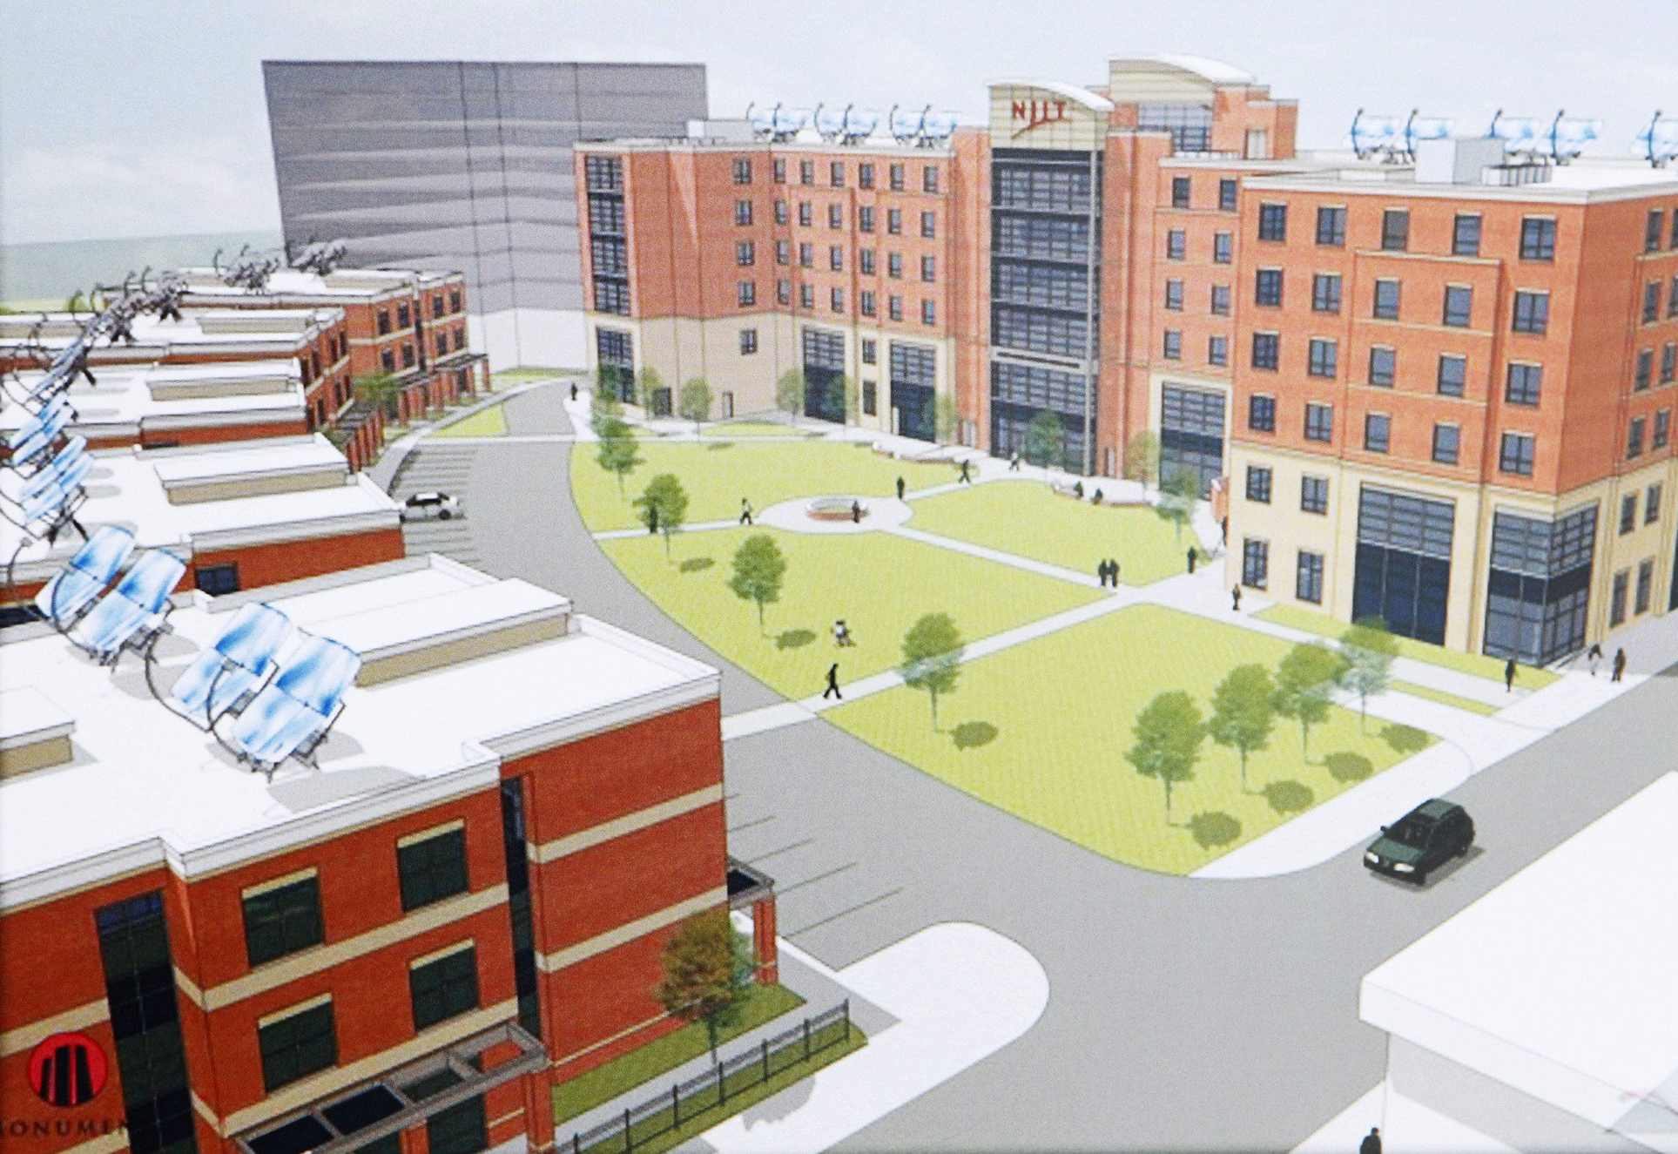







Alien vs. Mobile User Game
CGS
Found alien
Player
Tracks alien
Alien escapes
Searching aliens

Slide 21
Game Overview
Alien vs. Mobile User
The game story
Entices users to unpopular regions
Played by participants on their smart phones.
Densely and uniformly cover large area with sensing data.
Track the location of extraterrestrial aliens and destroy them.
Players collect sensing data as they move through the area.
Alien-finding hints.
More points received for destroying aliens in these regions.
Implemented in Android
Collects WiFi data: BSSID, SSID, Frequency, Signal strength.
Construct the WiFi coverage map of the targeted area.
Good and fast area coverage
User study: Mobile gaming ensures high area coverage.
Game attracts users to the uncovered regions quickly.

Slide 22
Game Strategy for Uniform Area Coverage
Game server moves the alien to a location which is not yet covered
To destroy the alien, player has to find it and shoot it three times
Sensing part of the game
Sensing data is collected periodically when the game is ON
The placement of aliens on the map will ultimately ensure full sensing coverage of the area
How to place/move the aliens?
To ensure fast and uniform coverage while maintaining a high player interest in the game

Slide 23
Progressive Movement Strategy
 | A | B | C | D | E | F | G | H
1
2 |  | X |  |  | X |  | X
3 |  | X | X |  | X | X
4 |  |  | X |  |  | X | X
5 | X | X |  | X |  |  | X | X
6 | X | X |  | X | X | X
7 | X |  |  | X |  |  | X
8
Aliens are moved to the nearest unpopular regions when they are shot
A₃
A₂
Game server swaps shot alien with closest healthy alien from an unpopular region
A₁
This alien movement makes the game challenging and unpredictable
Steadily, game server covers the targeted area in a progressive fashion
Starting from the popular regions as main centers and slowly expanding the coverage toward the unpopular regions

Slide 24
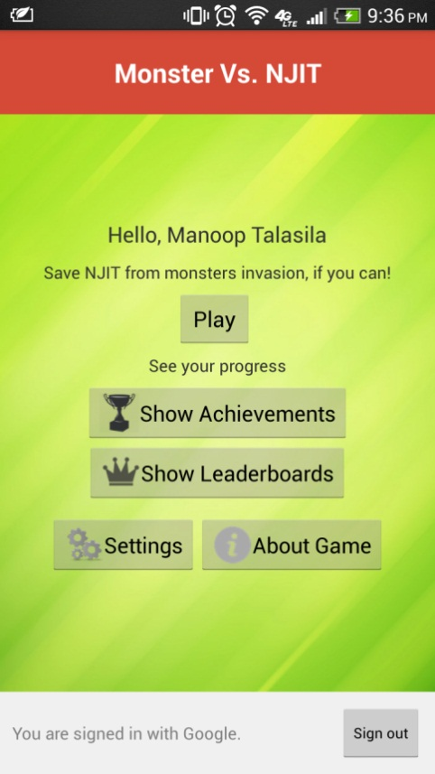
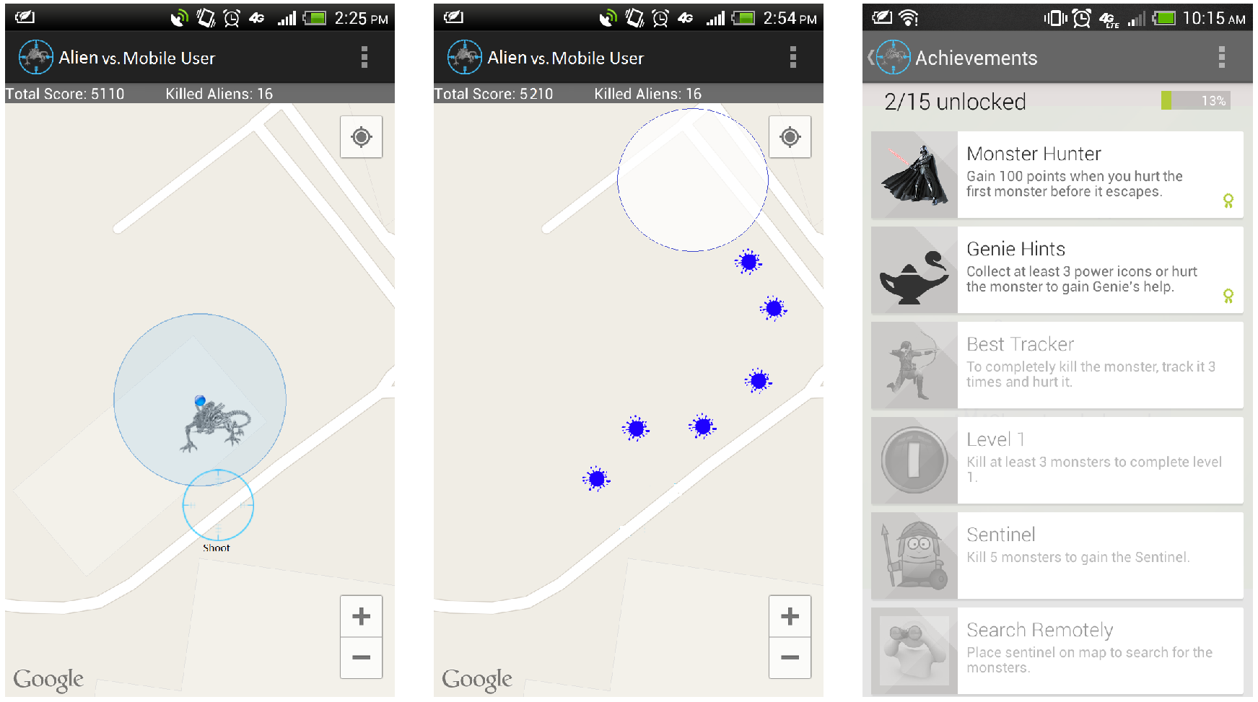
Prototype Implementation & User Study
Android implementation available in Google Play app market
User study with 53 volunteer students (unpaid) for 35 days
Collected WiFi data both outdoors and indoors throughout the campus

Slide 25
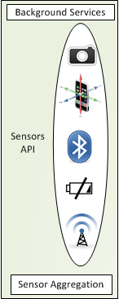
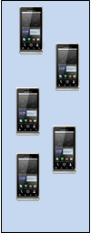
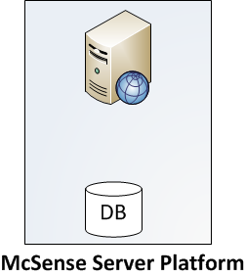

McSense: Crowdsensing with Micro-payments
Interacting Entities
McSense: central server
Client
Provider
Sensing Process
Aggregated sensed data to client
Data sensing by provider
Provider chooses a task
Client posts new sensing tasks
Registration
register
post tasks
pick task
update
aggregated
data
sensed data

Slide 26

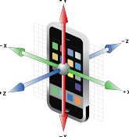

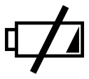

User Study & Prototype Implementation
McSense prototype implemented on Android phones
58 participants for 2 months on our campus
Participants downloaded and installed application on their phones
Deployed participatory sensing tasks in real time to participants
Participants received monetary compensation based on the number/type of completed tasks
Manual Photo Sensing Task
Automated Sensing Task using Accelerometer and GPS Sensors
Automated Sensing Task using Bluetooth radio
Automated Sensing Task for Application/Network/Battery Usage
Automated Sensing Task for WiFi Access Points Recording

Slide 27
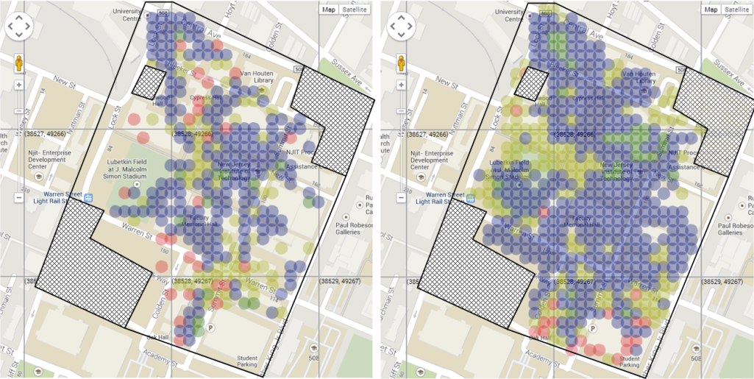
Area Coverage Efficiency
Micro-payments
Mobile gaming
Mobile gaming performs substantially better than micro-payments for area coverage
Micro-payments are better for other scenarios: sensing tasks with tight time constraints or long-term tasks for personal analytics

Slide 28
Outline
Avatar: Mobile Distributed Computing Assisted by Cloud
Mobile Crowdsensing Incentives
  Alien vs. Mobile User Game
  McSense: A Crowdsensing Platform using Micro-payments
DIVERT: Distributed Vehicular Traffic Re-routing for Congestion Avoidance
Conclusions

Slide 29
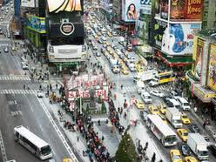
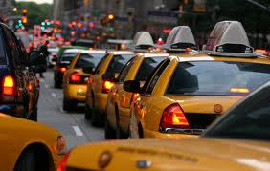
Traffic congestion: An Ever-increasing Problem
The amount of wasted fuel jumped to 2.5 billion gallons
Increase road capacity?
Optimize traffic signal control?
Traffic guidance to drivers?

Slide 30
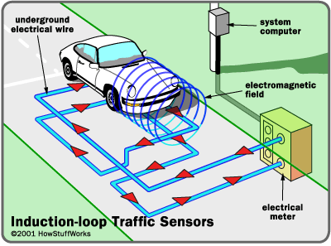
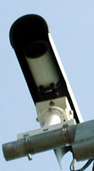
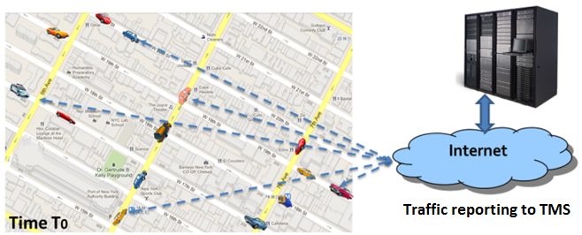
Our Solution: Congestion Avoidance using Mobile Sensing and Actuation (1)
Smart phones (mobile sensors) & road-side sensors monitor traffic at fine granularity
  Mobile sensors can be vehicular embedded systems
  Road-side sensors: loop detectors, cameras, etc.
  Demonstrated by other researchers
Traffic management service (TMS) collects data and estimates congestion in real-time

Slide 31
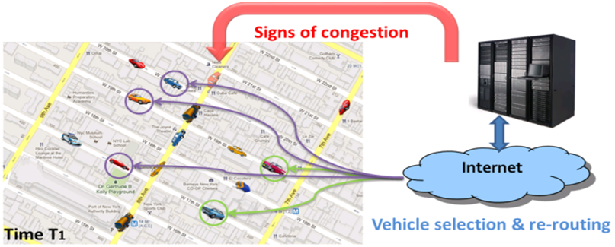
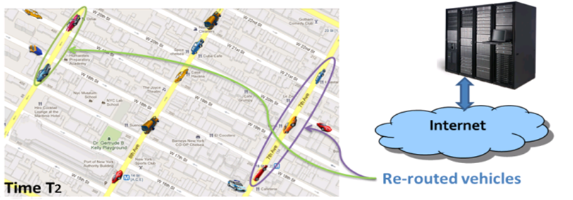
Our Solution: Congestion Avoidance using Mobile Sensing and Actuation (2)
TMS provides real-time, proactive, individually-tailored re-routing guidance to drivers to prevent congestion
  Drivers provide their trip data (e.g., origin-destination, current location)
  Guidance is pushed to drivers’ smart phones when signs of congestion are observed on their current route
  Drivers may or may not follow the guidance

Slide 32
Contributions
Cost-effective and easily deployable vehicular traffic guidance systems
Centralized re-routing strategies reduce travel time to half & work well for lower penetration/compliance rates
  Single Shortest Path Strategies: DSP, AR*
  Multiple Shortest Paths Strategies: RkSP, EBkSP, FBkSP
DIVERT: distributed re-routing strategies using a hybrid computing & communication system
  Goal: improve scalability and privacy
  Server: traffic monitoring and vehicle notification
  Vehicles: privacy-aware reporting and co-operative path computation across Vehicular Ad hoc Networks (VANETs)

Slide 33

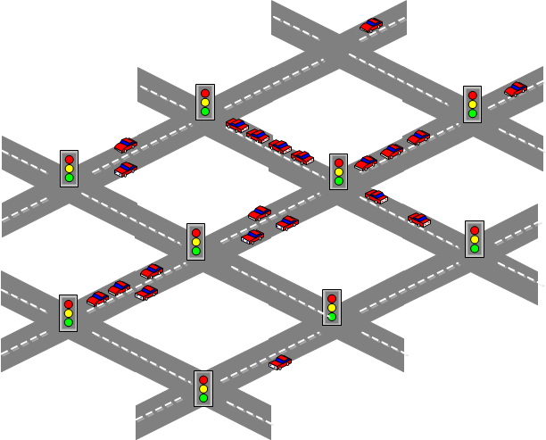
DIVERT overview
Step1:
  Server collects privacy-aware traffic reports
Step2:
  Server detects signs of congestion
Step3:
  Server sends traffic map to vehicles which reported recently
Step 4:
  Vehicles disseminate the traffic map to nearby vehicles
Step 5:
  Vehicles form VANETs, make collaborative decisions

Slide 34
Average privacy leakage
Privacy-aware reporting dramatically reduces the privacy leakage by up to 92% for both dEBkSP and dAR*

Slide 35
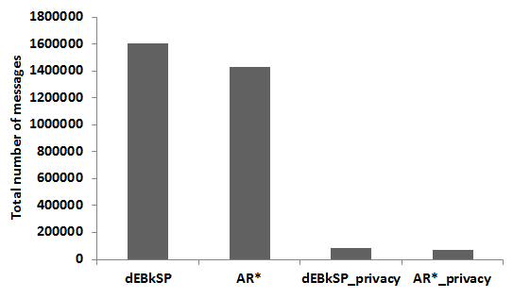
Server Scalability
Network load at the server reduced by 95%
  CPU at the server reduced by > 99%

Slide 36
Average travel time
DIVERT reaches similar average travel time as centralized version for both dEBkSP and dAR* strategies
  dEBkSP sacrifices 1.4% without privacy and 6.6% with privacy protection
  dAR* sacrifices 0.9% without privacy and 10.2% with privacy protection

Slide 37
Conclusions
Smart phones create large scale real-life environment for distributed computing and crowdsensing
  Mobile + cloud architectures enable novel apps and make existing apps more efficient
    Internet of Things is next (prediction: trillion of devices)
Significant amount of system/networking/algorithm research necessary to support applications in these environments
  Big potential for data analytics over mobile sensing data
  Applications must adapt to context and be robust to sensing errors
Scale, power, privacy, incentives, data reliability: important issues for mobile computing and crowdsensing
Testing apps/systems in real-life conditions is a must
  Ideally, at a decent scale as well

Slide 38
Thank You!
Acknowledgements: NSF Grants CNS 1409523 and DGE 1565478; NSA Grant H98230-15-1-0274
http://cs.njit.edu/~borcea/

