Slide 1
Federated Learning for Resource-Constrained IoT Devices
Cristian Borcea
^{Department of Computer Science}
New Jersey Institute of Technology

Slide 2
Federated Learning (FL)
Distributed machine learning paradigm that enables privacy-aware training on mobile & IoT devices with help from the cloud
Uses data from all users in the system
Enables a wide range of new apps that benefit from running machine learning models on mobile/IoT sensing data
Mobile health and wellbeing (e.g., predict people’s health risks based on their behavior and mobility)
Smart phone optimizations (e.g., predict network quality based on user mobility)
Asset/fleet tracking using heterogeneous IoT devices
Transportation (e.g., predict pedestrian intent for autonomous vehicles)
Significant interest from industry: started by Google
Our research done in collaboration with Qualcomm and ATT Research

Slide 3


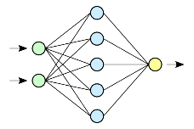

FL Operation
Initialization
Configuration
Training
Gradient Aggregation
Prediction
New
User
Registration
Prediction
Send model & configuration
Existing
User
Prediction
Send model weights & metrics
Send aggregated model
Existing
User
Prediction
Aggregation
Server selects clients to participate in training
Clients train on local data, which never leaves devices, and upload gradients to server
Server computes global model, which is then sent to clients

Slide 4
Lack of Practical FL Systems for Mobile/IoT Devices
No widespread adoption of FL models on heterogeneous resource-constrained devices
Difficult to deploy and use new models
Difficult to find good balance between model utility and overhead
Most FL studies are done through simulations
To achieve widespread FL adoption, we need:
FL systems to enable an ecosystem of FL models/apps
FL apps tested in the wild
FL optimizations for resource-constrained devices

Slide 5
Outline
Motivation
FL systems for mobile/IoT devices
FLSys & ZoneFL
Human activity recognition & heart-rate prediction models
FL optimizations for resource-constrained devices
Complement Sparsification
FedX
Lessons Learned

Slide 6
FLSys Features
Fault-tolerance: tolerate phone unavailability during training and phone disconnections
Scalability: scale to large numbers of users in terms of both computation and storage
Efficient data collection: balance resource consumption (e.g., battery) with sampling rates required by different models and training effectiveness
Model flexibility: support different deep learning (DL) models and different aggregation functions
Support for third-party apps: provide programming support for third-party apps to concurrently access different models on the phones
Modularity: interchangeable modules for simple, cost-effective deployment and scalability
Privacy: support for advanced data privacy mechanisms (e.g., differential privacy)
Paper: “FLSys: Toward an Open Ecosystem for Federated Learning Mobile Apps”, IEEE TMC 2024

Slide 7
FLSys Architecture

Slide 8
FLSys Prototype
Android smart phones & AWS cloud
Deep Learning for Java as the underlying framework for Android DL-related operations
Android Bound Service and Android Intent for on-device communication
Core cloud components of FLSys implemented and deployed as AWS Lambda functions
Matches our asynchronous event-based design
Provides fine-grained scalability at the function level
Saves resources and reduces cost
Simplifies development and deployment
Offers development flexibility
AWS S3 and DynamoDB for storage

Slide 9





Zone-based Federated Learning (ZoneFL)
Mobility awareness: different models for different geographical zones
Divide physical space into geographically non-overlapping zones
Users collect data and participate in model training for different zones
Users run different zone models based on their location
Scalability: readily deployable in mobile-edge-cloud architecture
Application example: heart health notification
Alerts about the level of cardiovascular risk
Altitude and climate of different zones impact notifications
vs.
??
Paper: “Zone-based Federated Learning for Mobile Sensing Data”, IEEE PerCom 2023
Notes:
Mention: system and model
slow

Slide 10


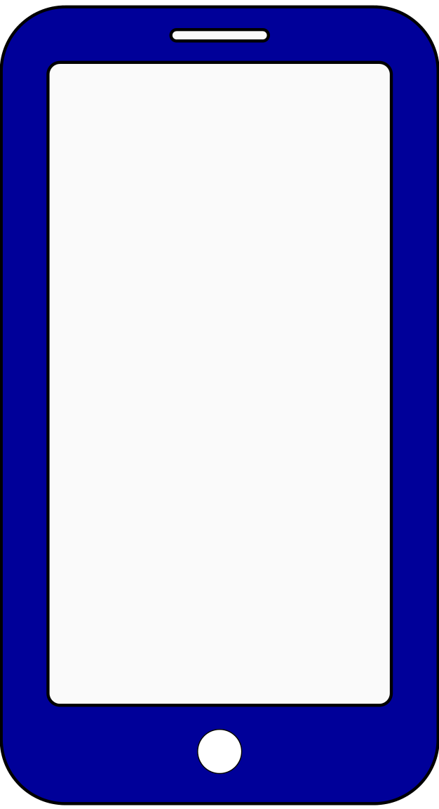
Training Architecture
Zone Partition Keeper
Cloud Layer
Latest Zone Partition Information
Zone Partition Update Information
Edge Layer
FL Zone Manager
FL Zone Manager
FL Zone Manager
Training
Training
Mobile Layer
Training
Move
User 1
User 2
User 3
User 4
User 4
User 5
Zone 1
Zone 2
Zone 3
Notes:
slow

Slide 11
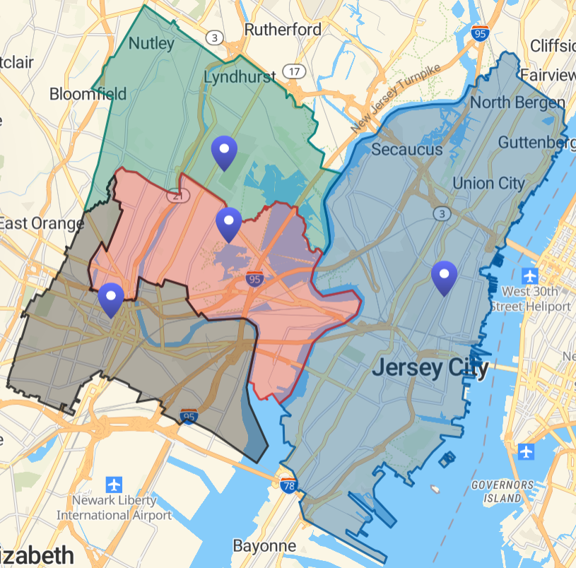
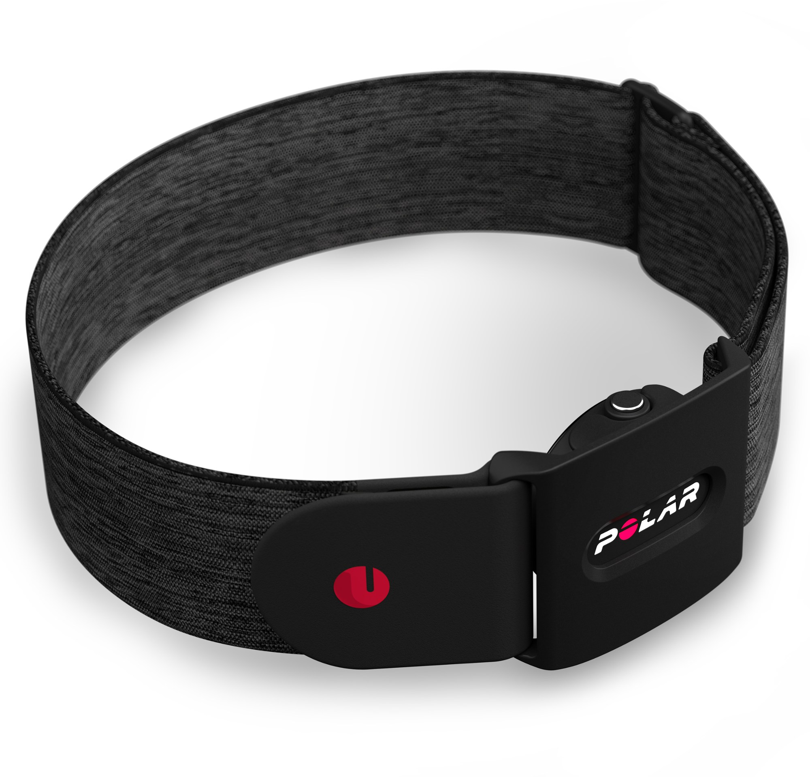
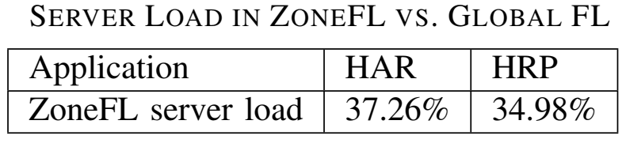
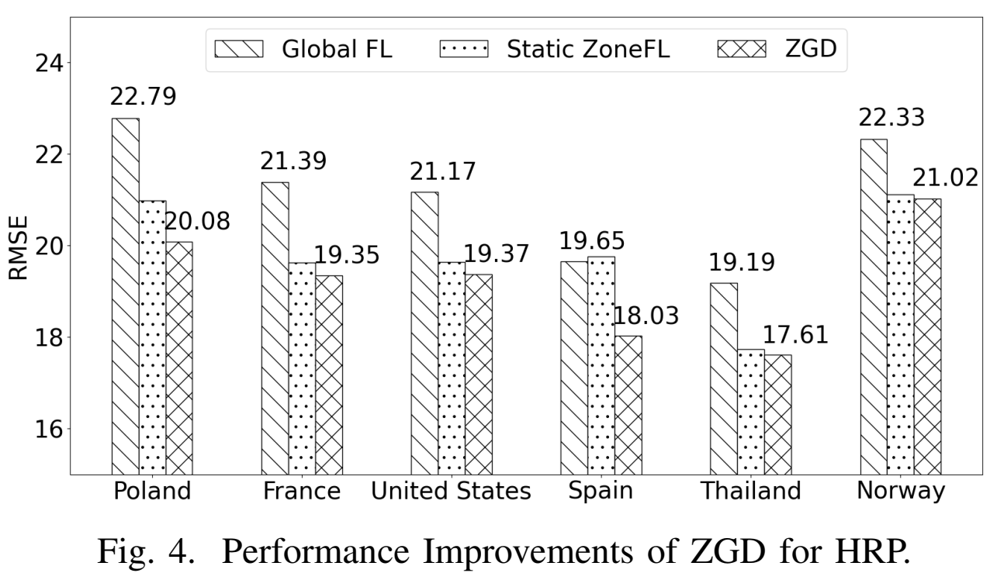
Results
Field study with 63 users for 4 months
Prototype runs robustly
Large-scale simulations with FitRec dataset
Scalability: ZoneFL has lower server load than global FL
ZoneFL outperforms global FL
Notes:
Scalability

Slide 12
Outline
Motivation
FL systems for mobile/IoT devices
FLSys & ZoneFL
Human activity recognition & heart-rate prediction models
FL optimizations for resource-constrained devices
Complement Sparsification
FedX
Lessons Learned

Slide 13
FL Overhead on Mobile/IoT Devices
Traditional FL uses dense and over-parameterized DL models
Over-parameterization comes at cost of significant memory, computation, and communication overhead
Overhead makes it difficult to run FL on resource-constrained mobile/IoT devices
Reducing overhead in FL, while maintaining good model performance is essential

Slide 14
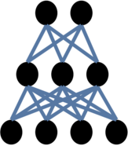
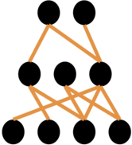
Model Pruning as Potential Solution
Produces sparse neural networks without sacrificing model performance
Three stages: training (a dense model), removing weights, and fine-tuning
Requires fine-turning to recover performance loss of removing weights
Fine-tuning together with removal of weights represents computation overhead
Cannot be used directly in FL
Server does not have access to raw training data for fine-tuning
Clients are resource-constraint to perform fine-tuning
weights
removal
training
fine-tuning

Slide 15
Model Pruning Requirements for FL
(R1) Reduce size of global model transferred from server to clients
(R2) Reduce size of local updates from clients to server
(R3) Reduce pruning computation overhead at clients
(R4) Achieve comparable model performance with dense models in vanilla FL
Under the regular FL assumption that server does not have access to raw data due to privacy concerns

Slide 16
Complement Sparsification (CS) Overview
Start from vanilla FL: clients train a dense model, server aggregates clients’ models
Server creates global sparse model with low magnitude weights removed and sends it to clients (R1)
Clients train from global sparse model, and only send weights that were originally zero in global sparse model (R2 and R3)
Server aggregates clients’ models together with global sparse model from previous round, and goes to step 2
Aggregation amplifies client sparse models to update all weights over time (R4)
Paper: “Complement Sparsification: Low-Overhead Model Pruning for Federated Learning”, AAAI 2023

Slide 17

Complement Sparsification (CS)
Consecutive Round
Pruning mask
Removed weights
0.6 | 0.6 | 0.7
0.5 | 0 | 0
0 | 0.5 | 0
1 | 1 | 1
1 | 0 | 0
0 | 1 | 0
Remaining weights
Initial Round
Client 1
Client 2
Client n
Client 1
Client 2
Client n
Train
Train
0.2 | 0.5 | 0.6
0.9 | 0.5 | 0.8
0.1 | 0.5 | 0.3
0.7 | 0.8 | 0.9
0.2 | 0.1 | 0.2
0.8 | 0.6 | 0.4
0.9 | 0.6 | 0.7
0.3 | 0.1 | 0.2
0.1 | 0.3 | 0.2
0.6 | 0.7 | 0.7
0.5 | 0.3 | 0.2
0.1 | 0.9 | 0.8
0.7 | 0.7 | 0.8
0.4 | 0.3 | 0.5
0.6 | 0.8 | 0.1
0.6 | 0.6 | 0.7
0.6 | 0.8 | 0.9
0.4 | 0.6 | 0.2
Inverted mask
0 | 0 | 0
0 | 1 | 1
1 | 0 | 1
⊙
⊙
⊙
0 | 0 | 0
0 | 0.3 | 0.2
0.1 | 0 | 0.8
0 | 0 | 0
0 | 0.3 | 0.5
0.6 | 0 | 0.1
0 | 0 | 0
0 | 0.8 | 0.9
0.8 | 0 | 0.2
Average
Pruning mask
Average
Prune
New pruning mask
0.6 | 0.6 | 0.7
0.5 | 0.2 | 0.4
0.3 | 0.5 | 0.3
0.6 | 0.6 | 0.7
0.5 | 0 | 0
0 | 0.5 | 0
1 | 1 | 1
1 | 0 | 0
0 | 1 | 0
0 | 0 | 0
0 | 0.7 | 0.5
0.7 | 0 | 0.4
0.6 | 0.6 | 0.7
0.5 | 0.7 | 0.5
0.7 | 0.5 | 0.4
0.6 | 0.6 | 0.7
0 | 0.7 | 0
0.7 | 0 | 0
1 | 1 | 1
0 | 1 | 0
1 | 0 | 0
Prune
+
Server
Aggregate

Slide 18
Technical Insights
FL clients and server are in a complementary relationship
Clients perturb global model to follow their local data distribution
Server conciliates client models to capture global data distribution
CS exploits complementary sparse models
Low overhead in computation and communication
Clients perform implicit fine-tuning
Update all weights over time
Complementary server-clients models aggregate to a new dense model
Aggregation ratio to ensure previously pruned weights outgrow others

Slide 19
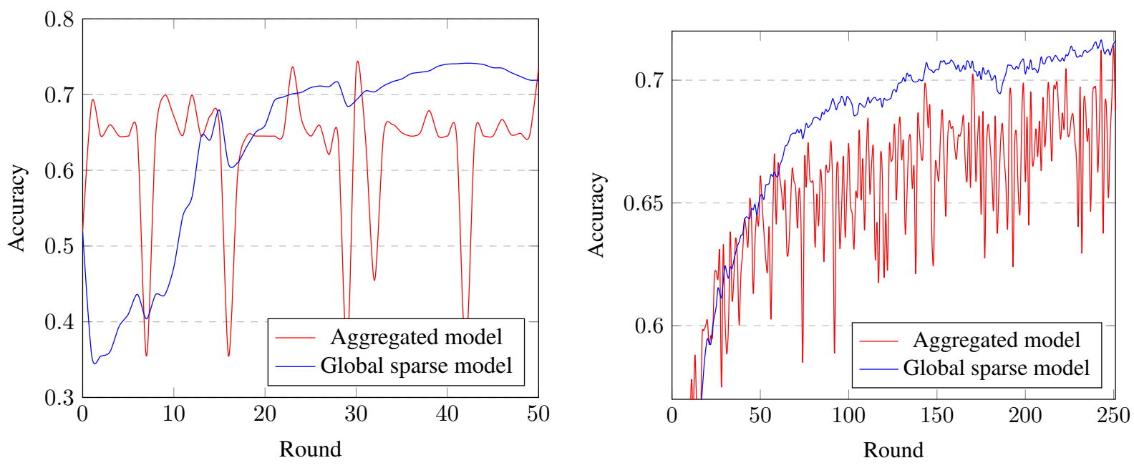
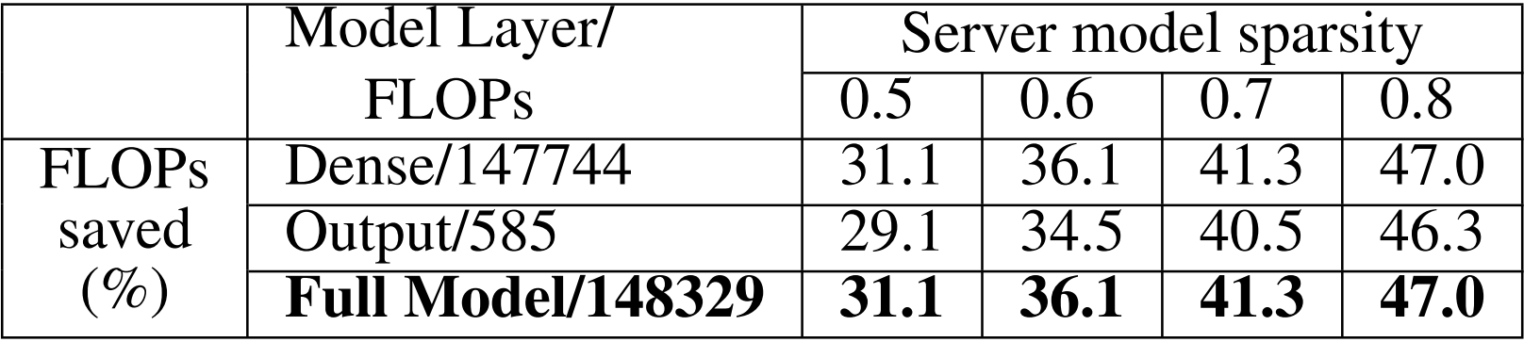
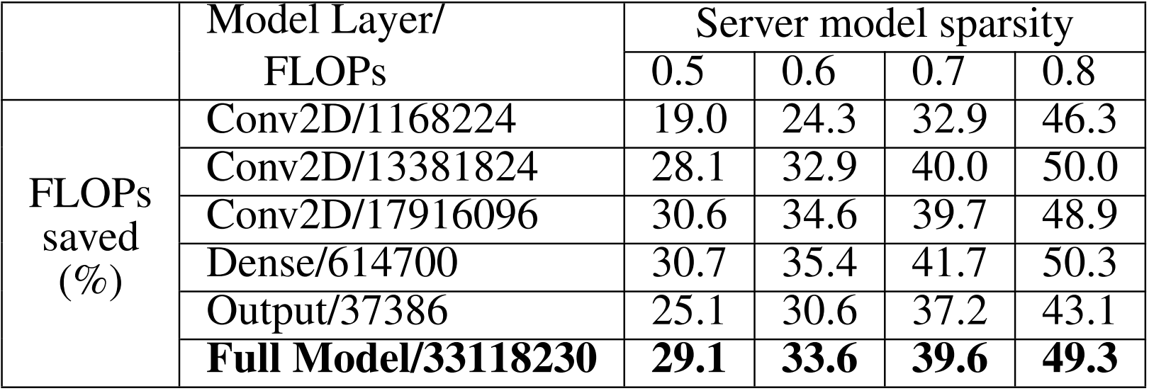
CS Effectiveness
Twitter SA
FEMNIS IC
Twitter SA
FEMNIS IC
Global sparse model outperforms aggregated dense model with less fluctuation
CS saves computation on devices , i.e., training floating point operations (FLOPs)
CS saves communication between server and clients bidirectionally

Slide 20
IoT Heterogeneity Problem for FL
IoT devices are heterogeneous in computation, communication, and storage
Challenge: How to balance FL model utility with computation and communication overhead, given heterogeneous and limited on-device resources?

Slide 21
Existing Work Didn’t Find a Good Balance
Quantization-based compression
Reduces parameter/gradient precision
Pros: Addresses computation and/or communication overhead
Cons: Often sacrifices utility or focuses on communication reduction at computation cost
Model and knowledge distillation
Trains on public data, then retrains locally on private data, or conducts model shrinking to align utility among global and local models
Pros: Effective and fair utility across clients
Cons: Impose significant computational overhead on clients

Slide 22
Our Solution: FedX
Decompose a global model into different sub-networks with different quantization levels for different devices
To balance utility and resource constraints, FedX assigns sub-networks and quantization levels based on device capabilities
A device with fewer resources receives a smaller sub-network but higher quantization levels
A device with more resources receives a larger sub-network but lower quantization levels
To reduce on-device burden, FedX performs server-side quantization
To foster knowledge sharing, FedX adds a regularization in fine-tuning the global model
Paper: “FedX: Adaptive Model Decomposition and Quantization for IoT Federated Learning,” IEEE DCOSS-IoT 2025

Slide 23

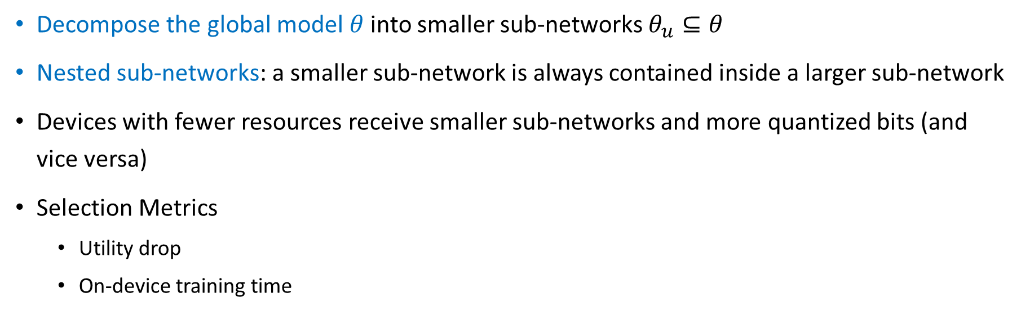








Adaptive Model Decomposition and Quantization
Decompose the global model $θ$ into smaller sub-networks $θ_{u}⊆θ$
Nested sub-networks: a smaller sub-network is always contained inside a larger sub-network
Devices with fewer resources receive smaller sub-networks and more quantized bits (and vice versa)
Selection Metrics
Utility drop
On-device training time
Sub-network 1 ($θ_{1}$)
2 layers, 3 channels ($θ_{1})$
Sub-network 2 ($θ_{2}$ where $θ_{1}⊂$ $θ_{2}$ )
4 layers, 6 channels ($θ_{2})$
2 layers, 3 channels ($θ_{1})$
4 layers, 6 channels (${\overline{θ}=θ}_{2})$
2 layers, 3 channels ($\overline{θ}=$ $\frac{θ_{1}+θ_{2}}{2}$ $)$
a) Two subnets $θ_{1},θ_{2}$
b) Aggregation of $θ_{1},θ_{2}$

Slide 24










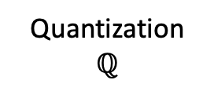





FedX Training Protocol
Coordinating Server
Before federated training
$$θ$$
$$θ^{t+1}$$
Adaptive Model Decomposition
Quantization $ℚ$
Model Aggregation
Model Fine-tuning
…
$$θ_{1}^{t+1}$$
$$θ_{2}^{t+1}$$
…
$$θ_{N}^{t+1}$$
$$θ_{1}^{0}$$
$$θ_{2}^{0}$$
$$θ_{N}^{0}$$
$$ℚ(θ_{1}^{t},q_{1})$$
$$ℚ(θ_{2}^{t},q_{2})$$
$$ℚ(θ_{N}^{t},q_{N})$$
On-device Training 1
On-device Training 2
On-device Training N
…
Device 1
Device 2
Device N

Slide 25
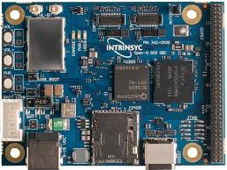
Experimental Settings
Devices
Simulation: GPU node with 4 NVIDIA GeForce Titan Xp GPUs (12G each), Intel Xeon E5-2637 v4 CPU (3.50GHz), Linux (Ubuntu 16.04), and CUDA 11.3
Prototype: Qualcomm QCS605 AI kit, NVIDIA Jetson Nano, and Rasberry Pi 5
Datasets
Image classification: Tiny-ImageNet, Cifar-10, FEMNIST
Human activity recognition: HAR dataset
Model architectures
MobileNetV3 for image datasets and HAR-Wild for HAR dataset

Slide 26
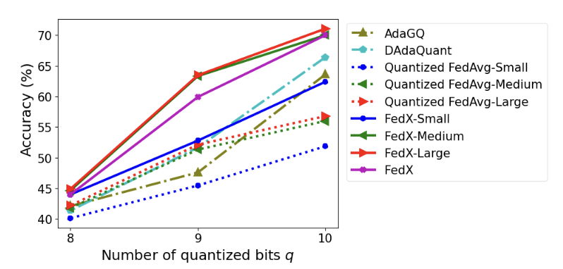
Model Utility
MobileNetV3 for Tiny-ImageNet dataset
FedX-Medium and FedX-Large perform the best
FedX achieves a better balance between sub-network size and the number of quantized bits
Marginal difference in model accuracy between FedX-Medium and FedX-Large across numbers of quantized bits
Large sub-networks do not consistently lead to notable accuracy improvement
Too small sub-network can damage model utility

Slide 27
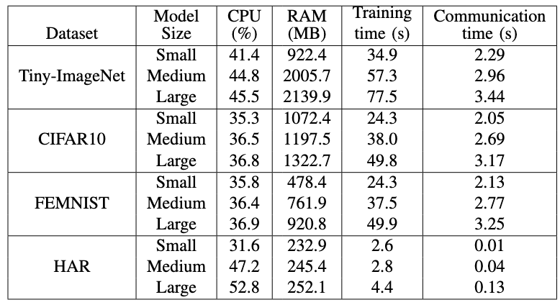
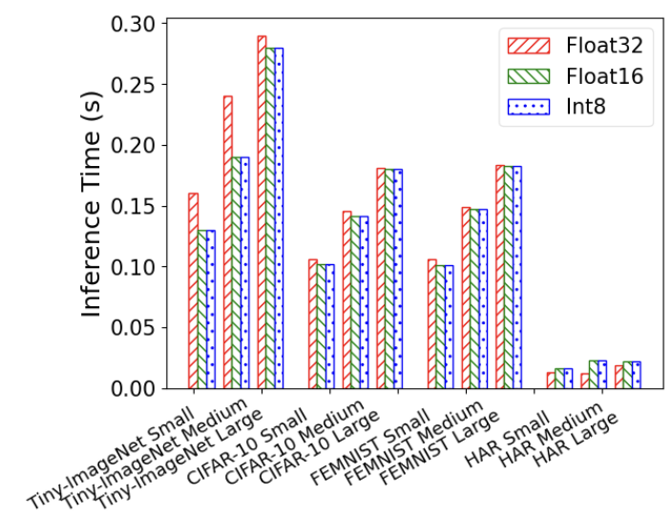
System Performance for On-Device
FedX training & inference on Qualcomm AI kit
Feasible in real-life on heterogeneous IoT devices

Slide 28
Lessons Learned
Need holistic approach: goal of widespread real-life deployment requires overcoming challenges in FL systems and FL optimizations for resource-constrained mobile/IoT devices
Use deployments in the wild: a lot of work, but this is the only way to discover new challenges
Design for flexibility: models, aggregation functions, and even underlying system components swapped in and out
Balance device resources and model accuracy: optimizations for heterogeneity and resource usage
Beware the simulation pitfalls: information leakage and software not supported on IoT devices
Build mechanisms to cope with non-IID data: IoT sensing data collected in the wild is non-IID
Augment FL with additional privacy and security mechanisms: attackers can infer model parameters from gradients or perform model poisoning

Slide 29
Thanks!
http://cs.njit.edu/~borcea/
Acknowledgments:
NSF Grants No. DGE 1565478, DGE 2043104, SaTC 2237328, ATT gift, Qualcomm contracts
Students: Xiaopeng Jiang, Phung Lai, Han Hu, Thinh On, Hessam Mohamadi
Collaborators:
Hai Phan (NJIT)
Vijaya Mayyuri, An Chen (Qualcomm)

