Slide 1
Privacy-Preserving Machine Learning Systems
Cristian Borcea
^{Department of Computer Science}
New Jersey Institute of Technology

Slide 2

Machine Learning Privacy
Safeguard individuals’ data
Secure intellectual property
Comply with legal regulations
Minimize the effect of data breaches
Maintain trust

Slide 3

Privacy-Preserving Techniques
Different techniques have been developed to tackle privacy concerns in ML
Differential Privacy
Secure Multi-Party Computation
Homomorphic Encryption
Trusted Execution Environments
Federated Learning
Choice of a technique relies on:
Balance between privacy and ML utility
Balance between overhead of privacy and available resources
No single solution works for all cases
Privacy
ML utility
Limited resources
Computation and communication overhead

Slide 4
Outline
FedMTL: privacy-preserving federated multi-task learning
CryptGNN: privacy-preserving inference for graph neural networks
Ongoing work
FedUP: federated unlearning to efficiently recover attacked models
PGCode: private code generation using LLMs
Conclusions and Lessons Learned

Slide 5

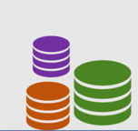
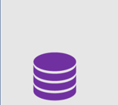
Federated Multi-Task Learning
Multi-Task Learning (MTL)
Allows simultaneous learning of related tasks
Enhances generalization performance of each task
Facilitates faster training and inference
Federated Learning (FL)
Preserves privacy of raw data
Enables collaboration among devices to improve model performance
Federated MTL
Clients have different subsets of tasks
Groups of clients may share some tasks, but not all
Server
C₁
C₂
C_{N}

Slide 6
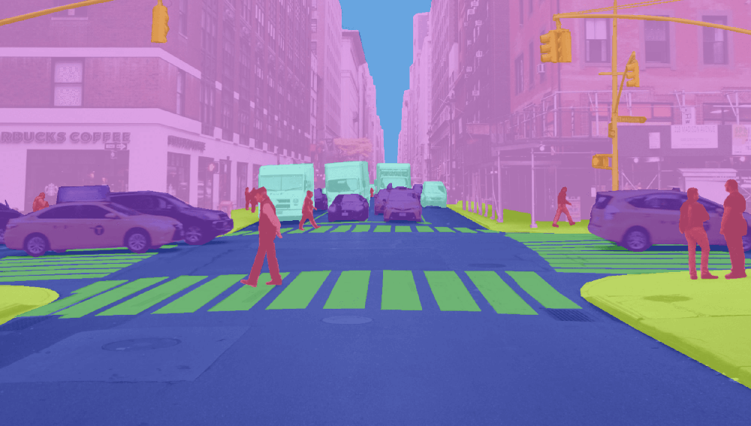

Federated MTL Use Cases
Autonomous vehicles
Data: Video data from many vehicles to train collaboratively MTL models
Tasks: Lane detection, traffic sign recognition, pedestrian intent prediction, obstacles detection
Smart phones
Data: text from messages, emails, etc. to train collaboratively MTL models
Tasks: sentiment analysis, text summarization, spam detection, named entity recognition

Slide 7
Conventional FL Not Applicable to MTL Settings
Existing approaches:
Minimizing weight differences between models
Clustering models into distinct groups to generate average models for each group
Challenges:
Heterogeneity in model structures arising from differences in the set of tasks
Difficulty of clustering models due to different subsets of tasks

Slide 8
FedMTL Overview
Designs novel aggregation to support MTL in FL settings
Applies layer-wise aggregation policies and computes different sets of weights on clients’ models for aggregation
Uses a hard parameter/weight sharing-based architecture for MTL models – shares hidden layers for the related tasks while maintaining task-specific layers
Analyzes the weights of the task-specific layers of MTL models to generate personalized MTL models based on task similarities
SecureMTL: privacy-preserving version of FedMTL based on secure multi-party computation

Slide 9

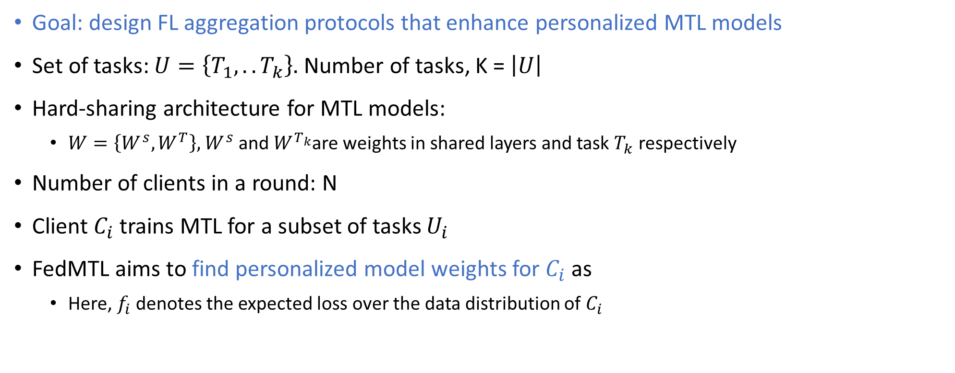
Definition of FedMTL Aggregation Problem
Goal: design FL aggregation protocols that enhance personalized MTL models
Set of tasks: $U=\left\{T_{1}, .. T_{k}\right\}.$ Number of tasks, K = $\left|U\right|$
Hard-sharing architecture for MTL models:
$W=\left\{W^{s}, W^{T}\right\},$ $W^{s}$ and $W^{T_{k}}$are weights in shared layers and task $T_{k}$ respectively
Number of clients in a round: N
Client $C_{i}$ trains MTL for a subset of tasks $U_{i}$
FedMTL aims to find personalized model weights for $C_{i}$ as
Here, $f_{i}$ denotes the expected loss over the data distribution of $C_{i}$

Slide 10
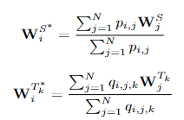





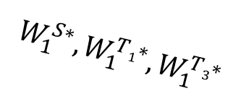

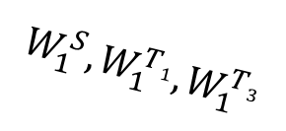
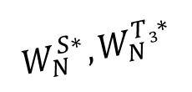
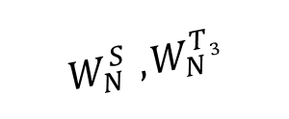
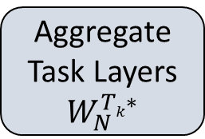
FedMTL Aggregation Design
FedMTL finds the aggregation weights $p_{i,j}$ and $q_{i,j,k}$ for shared layers and tasks $T_{k}$ respectively w.r.t client $C_{j}$
C₁
T₁
T₃
FedMTL
A
$$W_{1}^{S},W_{1}^{T1},W_{1}^{T3}$$
$$W_{1}^{S∗},W_{1}^{T1∗},W_{1}^{T3∗}$$
Compute Aggregation Weights
C₂
$$W_{2}^{S} ,W_{2}^{T1}{,W}_{2}^{T2}{,W}_{2}^{T4}$$
$$p_{i,j}$$
$$q_{i,j,k}$$
T₁
T₂
T₄
……
$$W_{2}^{S∗},W_{2}^{T1∗},W_{2}^{T2∗},W_{2}^{T4∗}$$
Aggregate Shared Layers
$$W_{N}^{S∗}$$
Aggregate Task Layers
$$W_{N}^{Tk∗}$$
$$W_{N}^{S} ,W_{N}^{T3}$$
C_{N}
T₃
$$W_{N}^{S∗},W_{N}^{T3∗}$$
Notes:
The model parameters Wi cannot be directly aggregated due to the heterogeneity in model architecture arising from variations in the number and types of tasks executed by the clients. Therefore, we consider aggregating the shared layers and task layers separately.
Although the shared layers from all clients have the same structure, identical weights pi,j should not be assigned for aggregation, as the shared layers are learned differently by clients executing different sets of tasks.

Slide 11
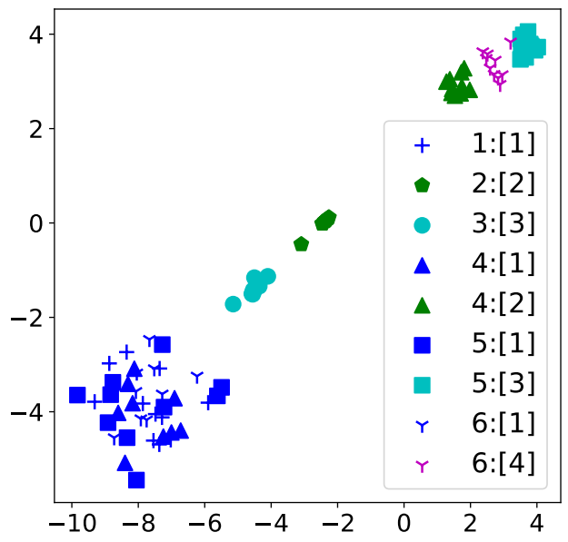
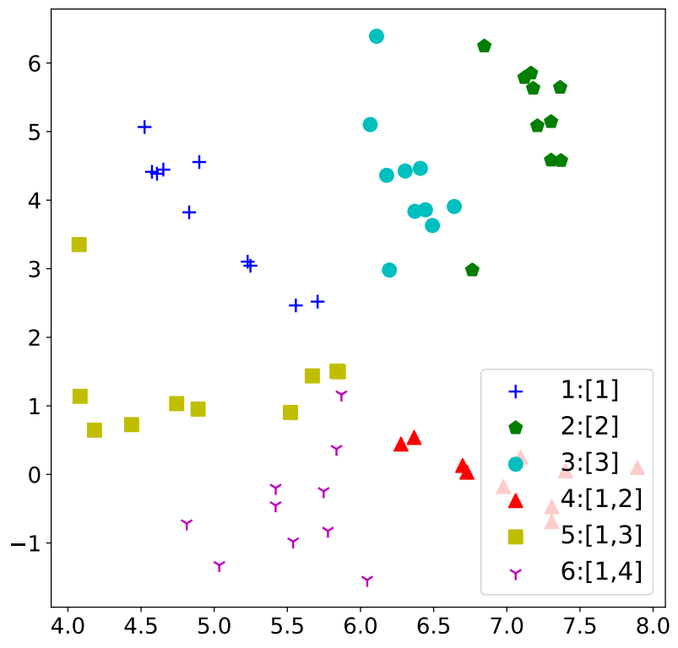
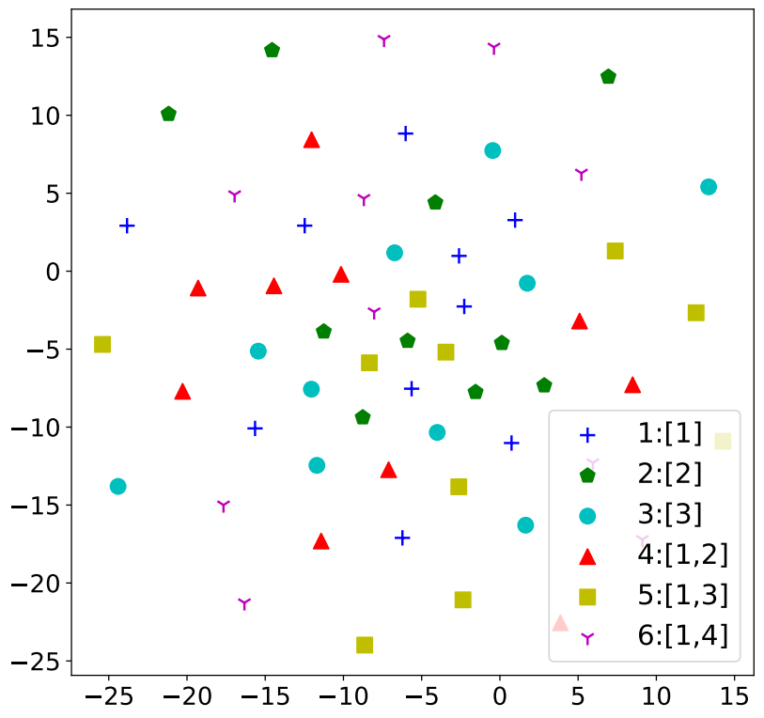
Analysis: t-SNE visualization
Provides insights into the rationale behind FedMTL aggregation
CelebA data samples are distributed among clients in 6 groups (10 clients/group)
4 tasks: each task consists of detecting 5 different face attributes
Tasks for each group: [[T1], [T2], [T3], [T1,T2], [T1,T3], [T1,T4]]
LeNet architecture as a MTL model
Weights of the task layers are very similar for the clients performing the same set of tasks
Weights of the top shared layers exhibit similarity among clients within the same group
Weights of the bottom shared layers do not show a specific pattern
Notes:
- t-SNE is a statistical method for visualizing high-dimensional data

Slide 12






Algorithm to Compute Aggregation Weights (i^{th} round)
Clients train the local MTL models and upload the model weights to the server
FedMTL computes the similarity score S_{i,j} ∈ [0, 1] for a pair of clients (C_{i}, C_{j})
Cosine similarities of all pairs of tasks
Standard Hungarian algorithm to find the one-to-one task mapping with maximum cumulative score H_{i,j}
S_{i,j} = H_{i,j}/K_{i} (K_{i} is the number of tasks for client C_{i})
Excludes models that differ significantly from aggregation by setting S_{i,j}=0, if S_{i,j} is less than a threshold value Z_{i}
Computes the aggregation weights:
p_{i,j} = S_{i,j} × D_{j} , q_{i,j,k} = S_{i,j} × D_{j} if T_{k} ∈ U_{j}
Compute p_{i,j} and q_{i,j,k}
Compute S_{i,j}
Compute H_{i,j}
$$W_{i}^{T1}$$
$$W_{i}^{T2}$$
$$W_{j}^{T1}$$
$$W_{j}^{T2}$$
$$W_{i}^{S}$$
$$W_{j}^{S}$$
C_{i}
C_{j}
Notes:
D_j is the dataset size for client C_j
Hungarian method is a combinatorial optimization algorithm that solves the assignment problem in polynomial time

Slide 13
FedMTL Privacy Problem
Threat model: server is honest but curious
Existing secure aggregation techniques do not work
Designed to protect local model weights
Not designed for MTL settings
Model structures are heterogeneous
Clients work on different sets of tasks
FedMTL aggregation also requires
Types and numbers of tasks executed by each client
Size of training datasets
Secure FedMTL: privacy protection in MTL settings

Slide 14
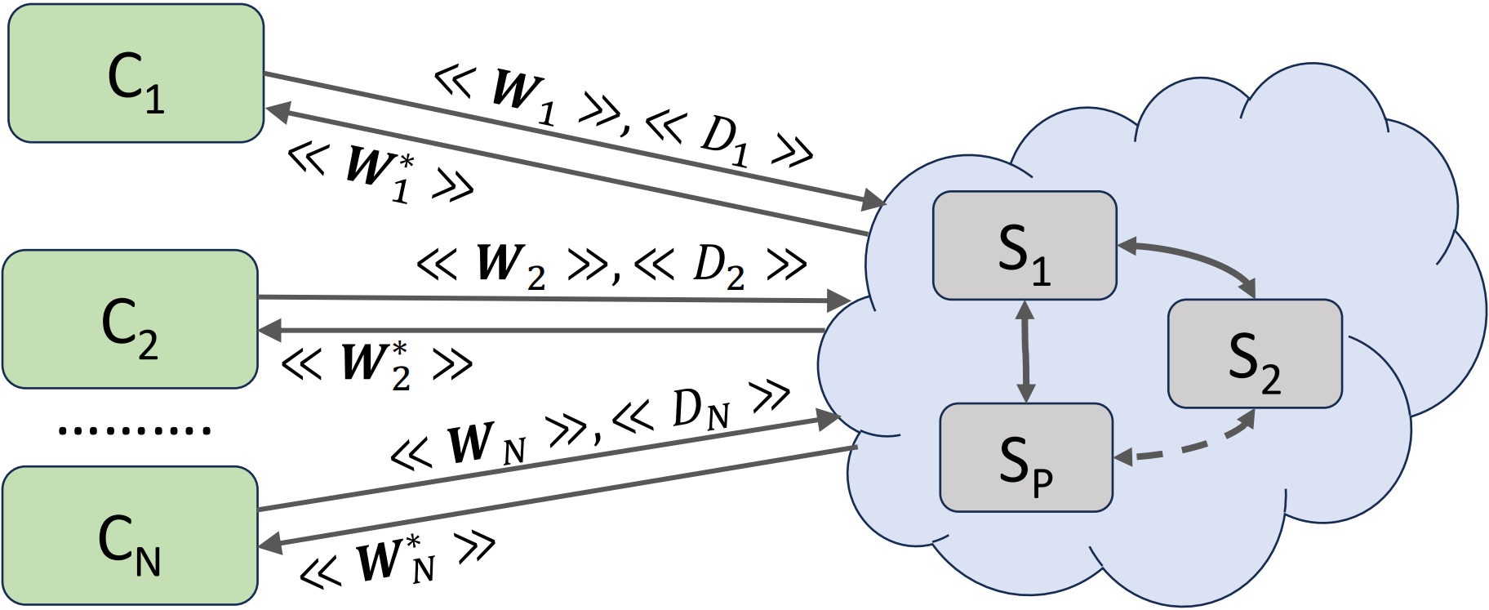
Secure FedMTL
Novel secure multi-party computation (SMPC) protocols in additive secret-sharing (A-SS) format
Strong threat model
Honest-but-curious parties/servers
Up to P − 1 servers can collude
Guarantees
Individual model weights of clients are protected
IDs and no. of tasks executed by each client are protected
Size of training dataset used by each client is protected
Secure aggregation of encrypted models results in the same accuracy as aggregation of plain-text models
100
=
30
+
60
+
10
Client
S1
S2
S3
Client data encrypted in an additive secret-sharing format in 3 party SMPC setting
C_{i} uploads encrypted model weights <<W_{i}>> and number of samples <<D_{i}>> and receives personalized model weights <<W_{i}*>>

Slide 15
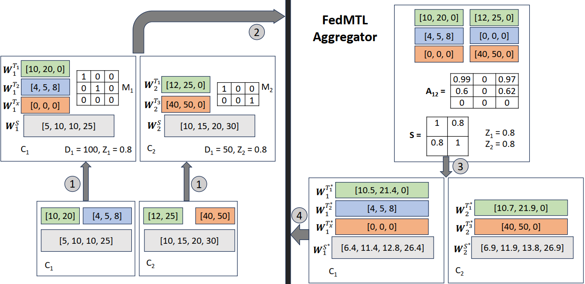
Secure FedMTL Protocols
0. Client model initialization:
- Get model and task-specific info from server
1. Client data preparation:
Pads 0s to local weights to protect task types
Generate fake task-specific weights (0s) to protect no. of tasks
Prepares a task mapping M, used to aggregate task-specific layers that have the same ID, to protect task IDs
2. Client encrypts weights, task mapping, and dataset size in A-SS and uploads them to servers
3. Servers perform aggregation on encrypted data
Standard addition and multiplication operations in A-SS
No impact of fake data, as matrix multiplication of model weights and task mappings results in 0s
4. Client retrieves and decrypts models
Gets rid of fake data as it knows no. and types of tasks
Notes:
Task mapping M
M[i][j] = 1, if i^{th} task-specific weights are associated with task j
M[i][j] = 0, otherwise

Slide 16
Implementation and Comparison Systems
FedMTL is implemented using PyTorch
Secure FedMTL leverages CrypTen from Facebook
Use open-source PFLib to implement comparison systems
FedAvg: vanilla FL technique
FedProx: employs a proximal term to formulate the clients’ optimization
MOCHA: considers each client as a separate task
pFedMe: uses a regularized loss function to optimize the personalized model
FedFomo: minimizes validation loss on each client based on model information collected from other clients
FedAMP: employs federated attentive message passing to facilitate collaboration among similar clients

Slide 17
Experimental Setup
Dataset | Number of tasks, K | Task Description | Number of clients, N | Model architecture
CelebA | 8 | Classification of 5 face attributes | 60 | LeNet, MobileNet_v2
LFWA | 8 | Classification of 5 face attributes | 60 | LeNet, MobileNet_v2
NYUD2 | 4 | 3 categories for pixel-wise semantic segmentation | 20 | SegNet
FaceA (=CelebA+LFWA) | 8 | Classification of 5 face attributes | 80 | LeNet, MobileNet_v2
Task distributions:
D₁: client C_{i} selects K_{i} = 2 tasks
D₂: client C_{i} selects K_{i} number of tasks, 1 <= K_{i} <= K

Slide 18
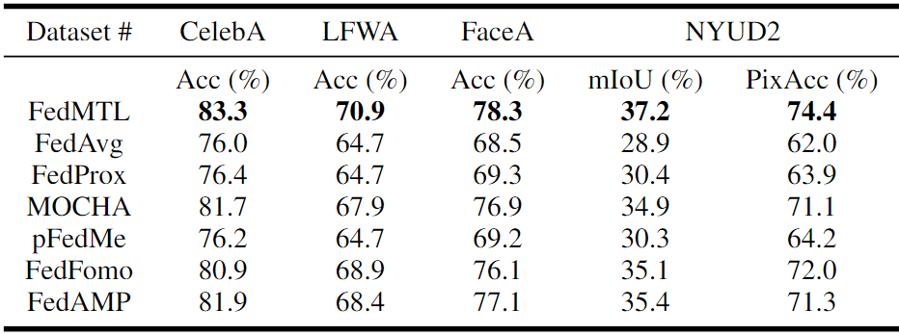
FedMTL vs. Comparison Systems
Task-distribution: D₁
FedMTL outperforms baseline approaches for all datasets
FedAvg, FedProx, pFedMe: accuracy is impacted by the aggregation of model weights from conflicting tasks
FedFomo, FedAMP: higher overhead because they apply operations that require client-side analysis of all client models

Slide 19
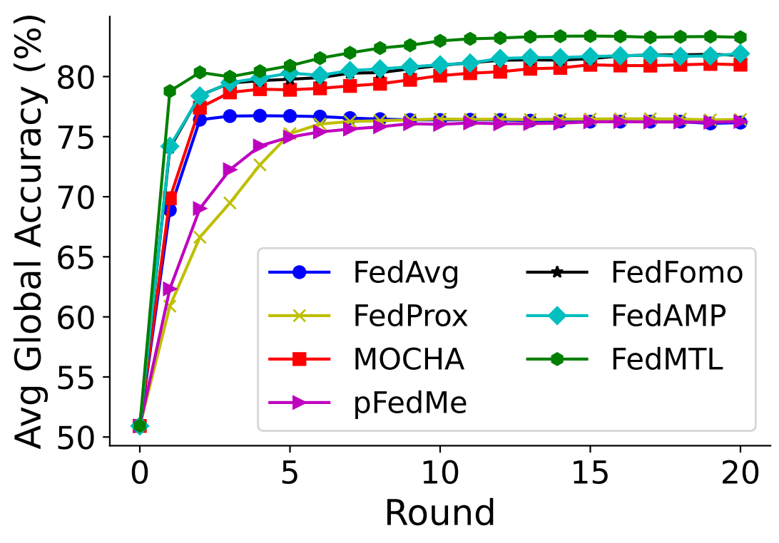
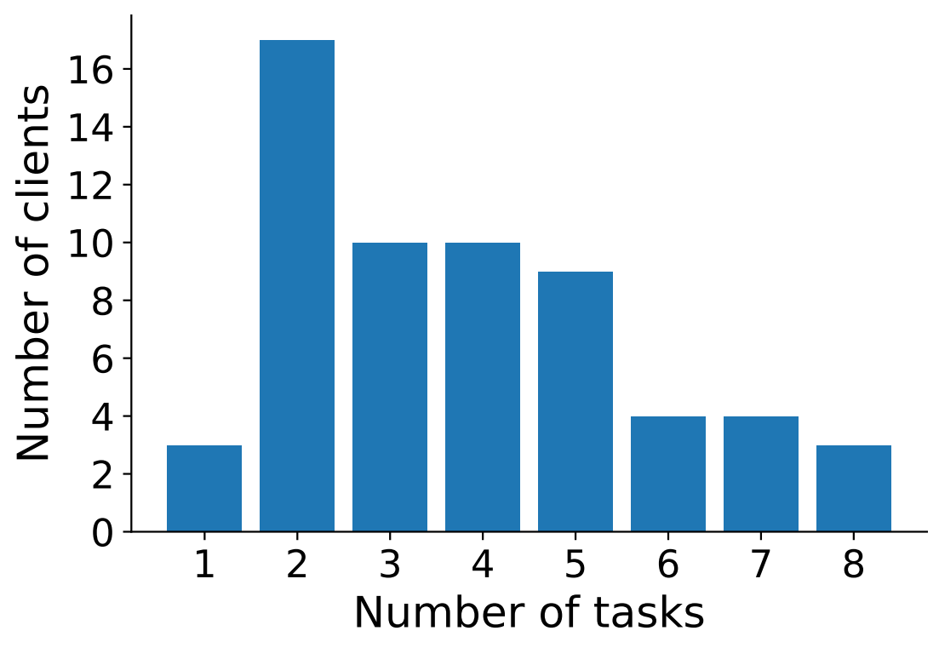
Convergence and Effect of Task Distribution
FedMTL converges faster than comparison systems
FedMTL works well when each client trains a different number of tasks
82.5% and 70.5% accuracy for CelebA and LFWA, respectively
Existing work can not support this scenario
CelebA dataset, D1 task distribution

Slide 20
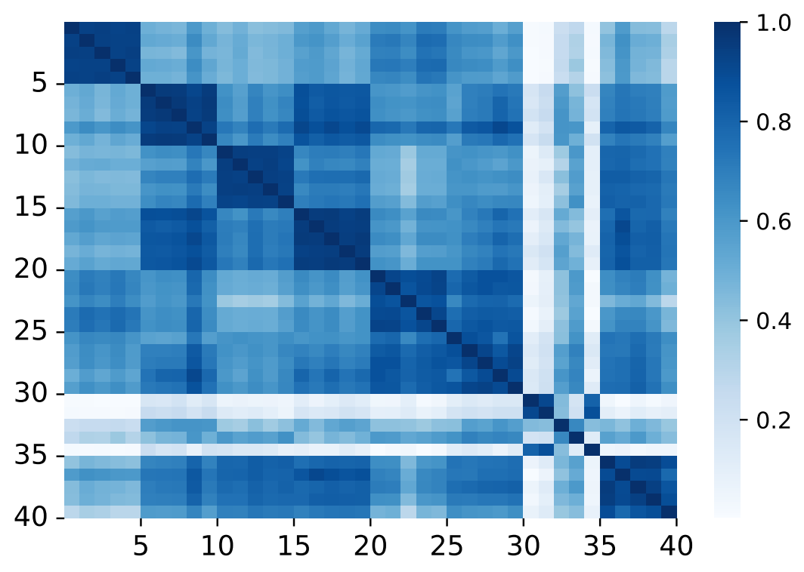
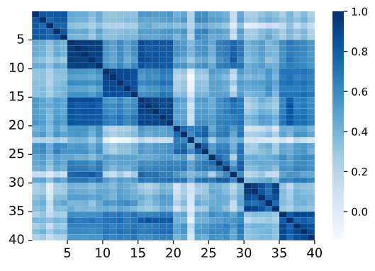
Why Does FedMTL Work Better than Comparison Systems?
Able to adapt to data and task heterogeneity
Assigns weights based on the similarities of task-specific weights instead of relying on task IDs
Experiment: 40 clients split in two groups of 20 clients
One group uses data from CelebA, the other from LFWA
Clients execute heterogenous tasks
Weights of task-specific layers of clients from different groups not very similar
Weights of task-specific layers of clients in the same group very similar
Weights of shared layers exhibit similar patterns
Similarity scores: task-specific layers
Similarity scores: shared layers
Notes:
.

Slide 21
Accuracy and System Performance of Secure FedMTL
Experimental setup
3 SMPC servers (AWS instances) performing aggregation in an additive secret-shared settings
Number of clients: 80
Each client encrypts the model weights, dataset size, and task mapping
Secure FedMTL accuracy is the same as the one of plain-text FedMTL
System performance is feasible in practice
Amount of data transferred from a client to each aggregator: 12.5 MB for an MTL model using LeNet architecture
Latency of secure aggregation: 52 seconds

Slide 22
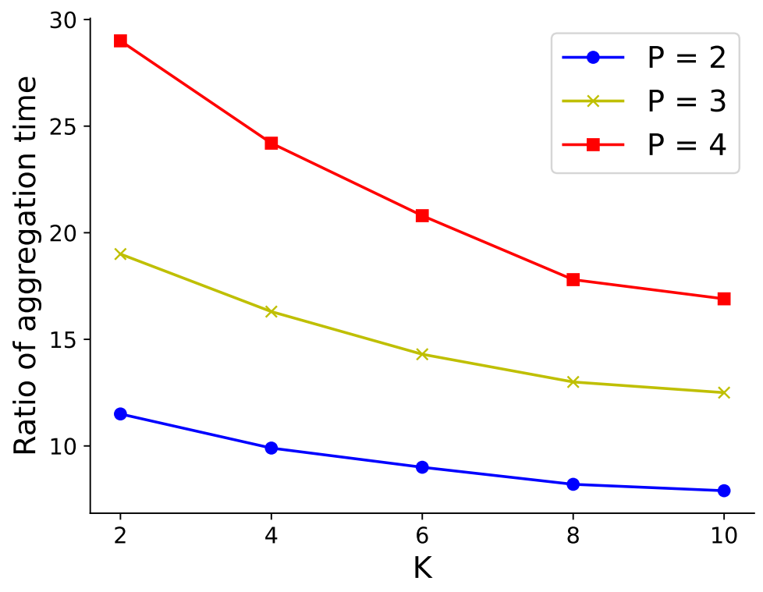
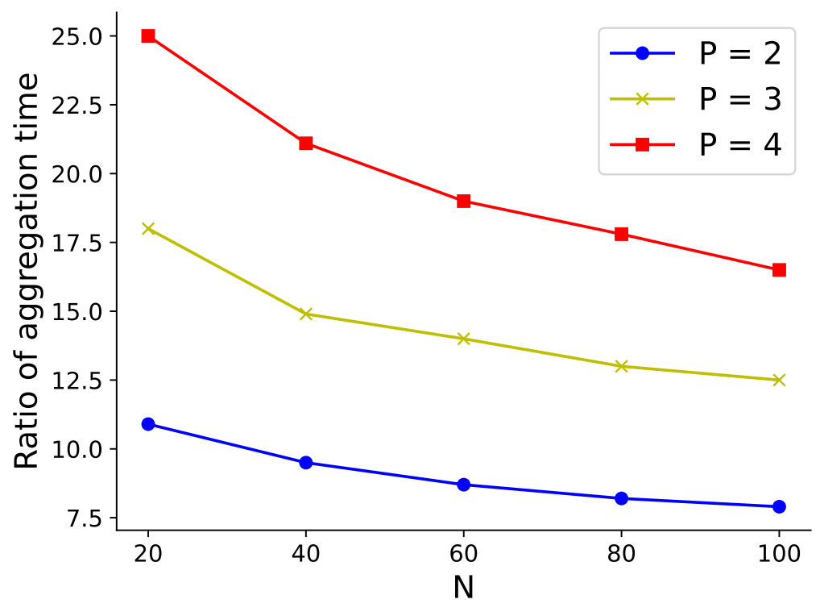
Secure FedMTL Scales Well with # Clients & # Tasks
Overhead of secure FedMTL at the servers w.r.t plain-text FedMTL decreases when the number of clients N or number of tasks K increases

Slide 23
Summary
FedMTL is a novel FL aggregation technique to improve accuracy through personalized MTL models
Key idea: analyzes weights of task-specific layers and applies layer-wise aggregation based on similarity between task-specific weights
Results: outperforms state-of-the-art FL aggregation approaches and can work when clients train heterogeneous sets of tasks
Secure FedMTL proposes novel SMPC protocols that work in heterogeneous MTL settings to protect privacy of weights, no. and types of tasks, and size of training datasets
Achieves the same accuracy as the plain-text FedMTL
Overhead is small at clients, and significant but practical at servers

Slide 24
Outline
FedMTL: privacy-preserving federated multi-task learning
CryptGNN: privacy-preserving inference for graph neural networks
Ongoing work
FedUP: federated unlearning to efficiently recover attacked models
PGCode: private code generation using LLMs
Conclusions and Lessons Learned

Slide 25
Graph Neural Networks (GNN)
GNN: a type of neural network that operates directly on a graph
Predict traffic flow and congestion in road networks
Learn user-user and user-item interactions for product recommendation
GNN learns node embeddings by exploiting node features and graph structure
Key components of a GNN
Message-passing layer (MPL): learns node embeddings by exchanging information between nodes and their neighbors
Feature transformation layer (FTL): transforms features by executing linear and non-linear operations

Slide 26
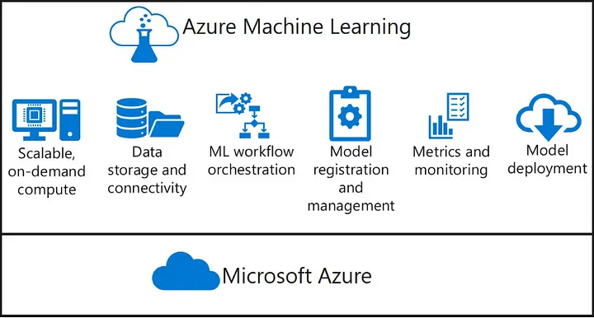
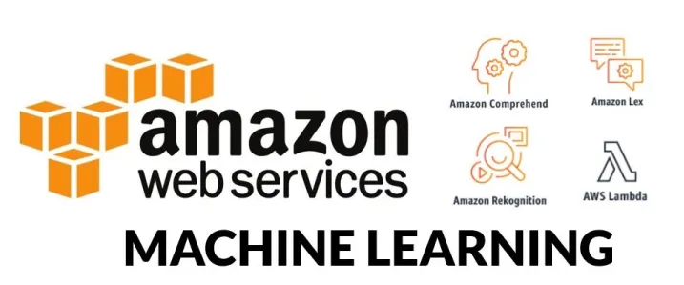
GNN Inference as a Service
Public cloud provides ML as a Service (MLaaS), which democratizes access to ML models
Examples: image and speech recognition, natural language processing, etc.
Inference as a service is appropriate for GNNs, which require large amounts of data for training and specialized models
Allows people/companies, which don’t have resources for training,
to access GNN models in the cloud
Allows third-parties that build and train models to make money by
deploying them in the cloud
Applications of GNN inference as a service
Screen out unqualified molecules in a drug discovery process
Automated code analysis by a program dependence graph
Notes:
More examples: malware detection, fault detection in IoT networks, financial fraud detection

Slide 27

Secure GNN Inference as a Service
h₁
h₂
Aims to preserve the privacy of
Model trained by third party on a proprietary dataset and deployed in cloud
User data uploaded to cloud for inference
Intermediate and final results computed in cloud
Preserving privacy of graph structure in MPLs is challenging
Exchange messages through edges by exploiting the graph structure without revealing edge source and destination nodes
Challenging to design an efficient algorithm to secure computations in FTLs
Existing solutions do not work well for secure GNNs
SecGNN has high overhead and security limitations
10 | 0 | 1
-3 | 4 | 2
V₁
V₂
V₃
1 | 2 | 0
h₃

Slide 28
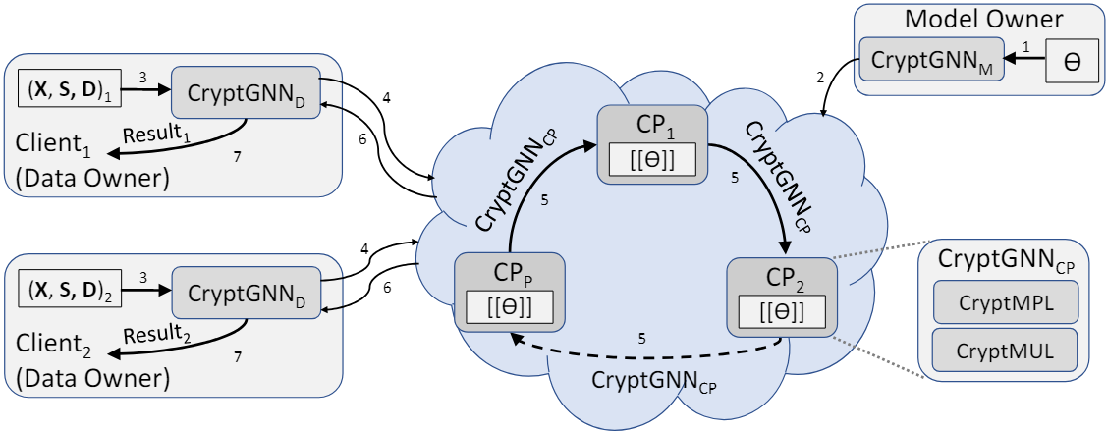
CryptGNN Overview
Secure GNN inference in the cloud using new SMPC techniques to preserve model, user data, and result privacy
Uses additive secret-shared (A-SS) format to encrypt data in a P party setting
GNN model parameters Ɵ, feature matrix X, and the graph structure (S, D) encrypted in A-SS: ǁƟǁ, ǁXǁ, ǁSǁ, ǁDǁ
Architecture of GNN known to all parties
Cloud generates encrypted inference results, and clients decrypt results locally
2 main components:
CryptMPL: computes encrypted node embeddings
CryptMUL: performs secure multiplications for FTLs

Slide 29


Threat Model (TM)
Honest-but-curious adversary in the P-party SMPC settings
Up to P - 1 parties may collude with each other
P-1 colluding parties may collude either with data owner (DO) or model owner (MO)
CryptGNN guarantees the privacy of model parameters Ɵ, input graph (X, S, D), intermediate results X_{i}, and final result R throughout the execution of its protocols
ǁƟǁ
ǁX_{i}ǁ
ǁRǁ
Graph Data
X, S, D
CryptGNN Protocol
ǁƟǁ
ǁƟǁ
ǁX_{i}ǁ
ǁRǁ
ǁX_{i}ǁ
ǁRǁ
DO
R

Slide 30
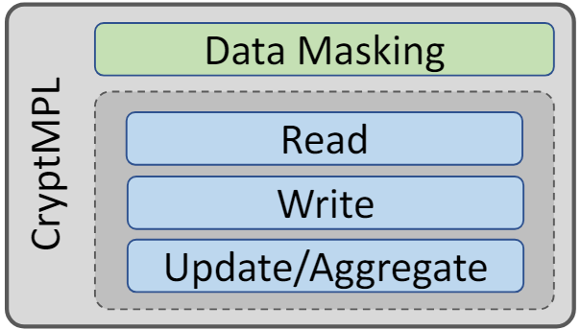
CryptMPL: Secure GNN Message-Passing
Takes graph structure (S, D) and the feature matrix A as input in A-SS format, and computes the feature matrix ǁA*ǁ = MPL(ǁAǁ, ǁSǁ, ǁDǁ) without relying on trusted server
Uses novel protocols to read the feature vector of a source node, write the feature vector at the destination node, and update the node features by aggregation
Uses a novel data masking technique, where the client collaborates with SMPC parties to protect user data against the threat model

Slide 31
CryptMPL: Secure Reading
Steps:
Each party rotates <A> and shifts <j> by random amount
After, P-1 rounds, access feature vector at updated index
Reading feature vector of a source node: Y ← read(A, S[j])
Accesses the feature vector without leaking the source index and the features of the source node
Notes:
The main idea of secure read:
Each party rotates their share of the current feature matrix A and shift their share of the source index by the same random amount, and then share the updated matrix and index with the next party.
The random amount is different at each party. After all the parties have rotated the feature matrix and shifted the source index, each party reads the vector at the updated index of the rotated matrix -> using this approach we protect the original source index, as the overall rotation is protected even if there is collusion among P-1 parties.
Since both the rotation and the shift are done by the same total amount, each party receives a correct share of the source feature vector.
Novelty: the servers share data among themselves, avoiding the need of a trusted server.

Slide 32
CryptMPL: Secure Writing and Aggregation
(2) Write to destination node of intermediate matrix <G> ← write(Y, D[j])
Without leaking the target index and feature vector
Each party rotates <A> by <j>
(3) Aggregate updates the feature matrix < ${\text{A}Ɛ}^{∗}$> ← < ${\text{A}Ɛ}^{∗}$ > + <G>
Security issue: Feature vectors and node degrees can be estimated by analyzing access patterns
Notes:
The main idea of the write protocol:
Each party writes its share of the feature vector Y at the 0-th index of its share of G and transfer it to the next party in the ring.
Each party rotates the share of the matrix G (but doesn’t shift the index) by its share of the destination index -> -> using this approach we protect the original destination index, as the overall rotation is protected even if there is collusion among P-1 parties.
Thus, the feature vector reaches the correct destination index of G
Novelty: the servers share data among themselves, avoiding the need of a trusted server.

Slide 33
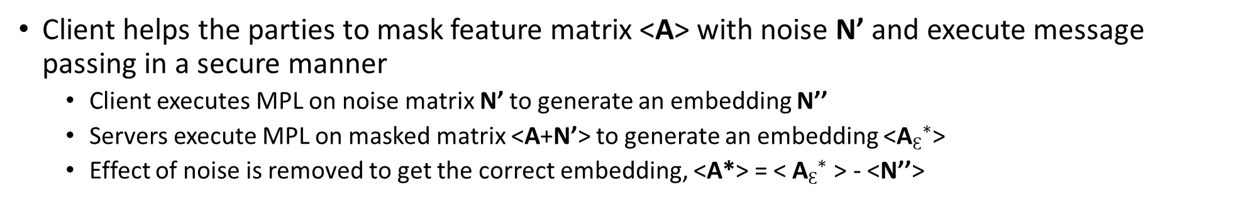


CryptMPL: Data Masking
Client helps the parties to mask feature matrix <A> with noise N’ and execute message passing in a secure manner
Client executes MPL on noise matrix N’ to generate an embedding N’’
Servers execute MPL on masked matrix <A+N’> to generate an embedding <${\text{A}Ɛ}^{∗}$>
Effect of noise is removed to get the correct embedding, <A*> = < ${\text{A}Ɛ}^{∗}$> - <N’’>
Server
CryptMPL
$${\text{A}Ɛ}^{∗}$$
A+N’
$${\text{A}}^{∗}$$
A
N’
MPL
N’’
Client
Notes:
We protect the source-destination index in Secure read and write operations. But we also need to protect the values in the feature matrix shared by the parties.
Reason 1: otherwise the parties can reconstruct the feature matrix
Reason 2: by checking the values, the parties can estimate source/destination index.

Slide 34

CryptMPL: Processing Edges in Batches
Edges can be processed in batches to reduce the computation and communication overhead
Processing each batch
Index of the first node is encrypted in A-SS format
Other node indices are represented as relative indices with respect to the first one
Feature matrix is masked with different noise matrices
Number of batches is a configurable parameter
S
D
Notes:
- Initially source and destination indices are in plain text
- We use batching: the source and destination are grouped into 3 batches
- We encrypt the first index (green) using A-SS. Other indices (orange) are stored as relative index (plain text) with respect to the first one - so they are also protected.

Slide 35
CryptMUL: Secure Multiplications for FTLs
In A-SS, the primary bottleneck in evaluating FTLs is the multiplication operation
Linear layers need matrix multiplications
Non-linear layers require element-wise multiplications
CryptMUL generates Beaver Triples for the multiplication operations without expensive operations or relying on a trusted server
Compute ǁZǁ = ǁXǁ * ǁYǁ using Beaver Triple (ǁAǁ, ǁBǁ, ǁCǁ) as Z = F(ǁXǁ, ǁYǁ, ǁAǁ, ǁBǁ, ǁCǁ)
CryptMUL conducts offline preprocessing to generate auxiliary data
Creates a set of Beaver triples required for multiplication operations in multiple inference requests from the same client
Improves performance while preserving data privacy

Slide 36
CryptGNN: Security Analysis
Theorem 1. The node features are protected against TM in CryptMPL
Feature vectors are masked with noise
Theorem 2. The graph structure is secured against TM in CryptMPL
Probability of correct reconstruction of the graph structure is N^{-R}, where N is the number of nodes and R is the number of batches
Theorem 3. DO’s input graph and MO’s model parameters are secured in CryptGNN against TM
Matrix multiplication and element-wise multiplications required for linear and non-linear functions in FTLs of GNN are secured by CryptMUL
Results of each layer are encrypted in A-SS format

Slide 37
Prototype Implementation
CryptGNN is implemented on top of CrypTen from Facebook in PyTorch
CrypTen provides APIs to support P-party SMPC computations
Implemented CryptMPL with client-side data preprocessing and server-side batching
Developed CryptMUL protocols for secure matrix multiplication and element-wise multiplication
Used 64 bits to represent the values in A-SS format
Experimental Setup: 1.7GHz quad-core Intel Core i7, with the parties running in separate processes

Slide 38
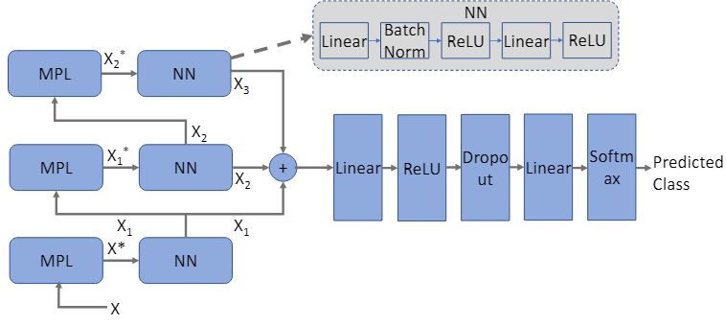
Evaluation
Verify the accuracy of CryptGNN
Analyze the performance of CryptGNN and its submodules with different types of graphs and configurations
Comparison with SecGNN and CrypTen
Evaluate CryptGNN using benchmark and synthetic datasets
GIN architecture as a GNN model for graph classification task
Datasets used to evaluate CryptGNN: FAUST, TUDataset (PROTEINS, ENZYMES)
We evaluate CryptMPL using additional datasets with a larger number of nodes: Cora, CiteSeer, PPI
GIN architecture
Notes:
GIN – well known type of GNN architecture (graph isomorphism network)

Slide 39
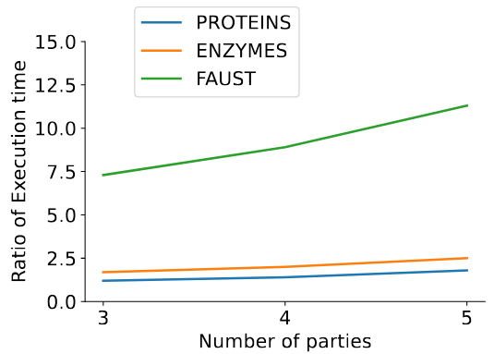
CryptGNN Results
Secure models using CryptGNN achieve the same inference accuracy results with plain-text models
Comparison with an implementation of the GIN model
CryptGNN is significantly faster than CrypTen, particularly for large-scale graphs
Models using CryptGNN work well in practice
Example: for FAUST dataset (6890 nodes and 41328 edges), average inference time of 22.3s in a 3-party setting
Network latency has minimal impact on the overall inference time
3 AWS instances as the computing parties
For the graphs in TUDataset, CryptGNN takes around 2.3 seconds to obtain the inference results
Execution time ratio of CrypTen over CryptGNN for GIN

Slide 40
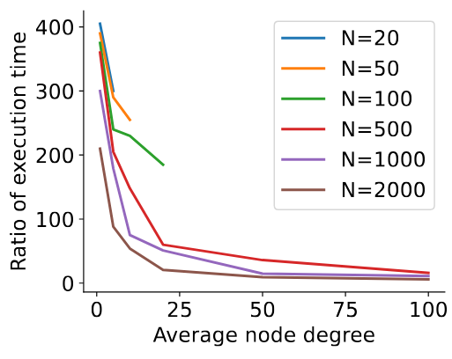
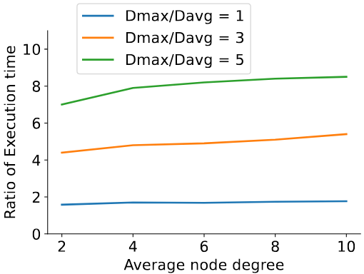
CryptMPL Comparison with Existing Techniques
Comparison with plain-text
CryptMPL performs efficiently for medium and large-scale graphs
Ratio of the execution times decreases as number of edges M increases
Despite high overhead for small graphs, CryptMPL’s execution time remains low (e.g., 190ms)
Comparison with SecGNN
SecGNN requires a trusted server throughout the MPL computation
SecGNN works only with 2 parties
Overhead of SecGNN increase with maximum node degree

Slide 41
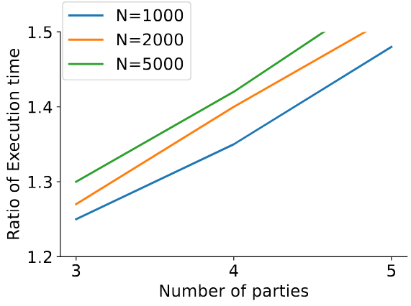
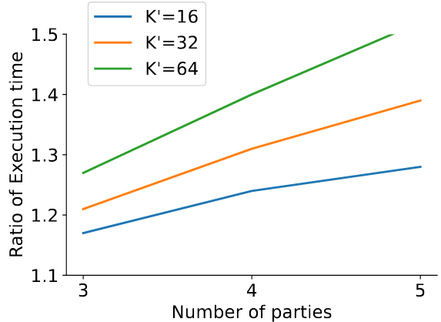
CryptMUL Results
Linear layers: ǁZǁ = ǁXǁ ⊗ ǁYǁ + ǁBǁ, X ϵ ℝ^{N×K}, Y ϵ ℝ^{K×K’}, B ϵ ℝ^{N×K’}
CryptMUL is faster than CryptTen
Set K = 3 and vary the number of parties P ∈ [3, 4, 5]
Ratio of execution time between CrypTen and CryptMUL increases with P
Execution time ratio also rises in relation to N and K′, due to higher computation overhead at the trusted server and increased communication between parties
Non-linear layers: ǁZǁ = Sigmoid(ǁXǁ)
Execution time of CrypTen and CryptMUL is almost the same, since both approaches have similar computation and communication cost

Slide 42
CryptGNN Summary
CryptGNN provably secure and effective solution for GNN inference in the cloud
Novel SMPC protocols to preserve the privacy of the model weights and the graph input data of the clients, including the graph structure
Doesn’t need a trusted server and works with any number of servers
CryptGNN is evaluated using different types of graphs and configurations
Provides the same results with plain-text inference
Latency is practical in real-life scenarios
Future work
Extend CryptMPL to support GNN message passing with different aggregation and update mechanisms

Slide 43
Outline
FedMTL: privacy-preserving federated multi-task learning
CryptGNN: privacy-preserving inference for graph neural networks
Ongoing work
FedUP: federated unlearning to efficiently recover attacked models
PGCode: private code generation using LLMs
Lessons Learned

Slide 44
FedUP: Federated Unlearning to Efficiently Recover Attacked Models
Prune malicious weights, while preserving benign weights
Challenge: malicious and benign clients share a significant number of weights
Recover after a few training rounds

Slide 45
PGCode: Private Code Generation Using LLMs
How to generate code using LLMs without disclosing prompts and generated code?
Client uses lightweight encoder to generate and submit embeddings of prompt
Server generates enriched embeddings, which the client decodes into generated code
Local differential privacy in the client vocabulary (all words used in prompts and code)

Slide 46
Conclusions and Lessons Learned
As a society, we need to get some control back from the big tech companies
Big tech may start controlling many aspects of our life
The huge amounts of potentially private data used in ML makes this a stringent problem
Companies will not take action unless pushed to do so
Three-pronged approach to address this problem
Privacy education
Privacy regulation
Privacy-preserving systems
Impossible to provide one-size fits all solution for ML privacy
We built privacy-preserving systems for federated learning, multi-task learning, graph neural networks, and LLMs
Balance privacy, model utility, overhead, and resource constraints

Slide 47
Thanks!
http://cs.njit.edu/~borcea/
Acknowledgments:
NSF Grants No. DGE 2043104, SaTC 2237328
Students: Pritam Sen, Khiem Ton, and Khang Tran (NJIT), Nicolò Romandini (University of Bologna)
Collaborators: Hai Phan (NJIT), Yao Ma (Rensselaer Polytechnic Institute), Rebecca Montanari and Luca Foschini (University of Bologna)

Slide 48
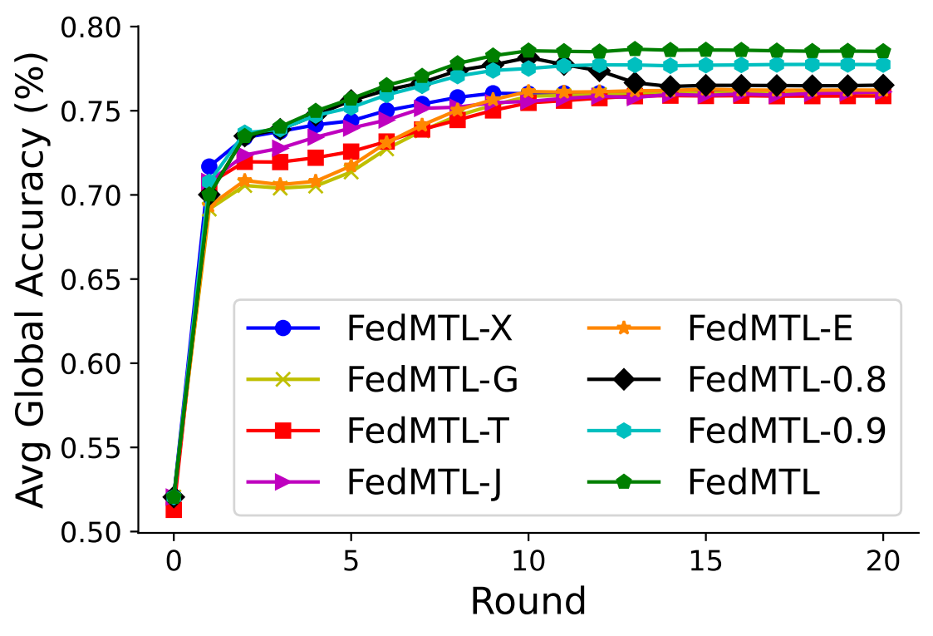
Ablation Study
Compare different versions of FedMTL
Different aggregation logic
Ignores task-layer (FedMTL-X)
Equal weights for all layers (FedMTL-G)
Equal weights for shared layers (FedMTL-T)
Different similarity score computation
Jaccard similarity (FedMTL-J)
Binary similarity (FedMTL-E)
Different Threshold settings (FedMTL-0.8 and FedMTL-0.9)
Best FedMTL version uses cosine similarity-based aggregation weights with dynamic threshold values

Slide 49
FedMTL Cost/Overhead Analysis
Plain-text FedMTL incurs similar overhead as state-of-the-art FL approaches
Secure FedMTL incurs significant overhead at server, but is feasible in practice
Small overhead at client side due to encryption
 | FedMTL without privacy | Secure FedMTL
Client computation cost | Insignificant | small
Server computation cost | O(N² × (d + K² × dt_{m} + K³)) ≈ O(N²d) | O(N² × (d + K² × dt_{m} + K³)) ≈ O(N²d) 1 multiplication in plain text is equivalent to 4 multiplications and 3 additions in A-SS format
Client to server communication cost | O(2 * model_size), same as FedAvg | O(2 * P * model_size), here P is the number of aggregator servers
Server to server communication cost | None | Significant, but feasible in practice. Communication rounds can be reduced by batch processing and pre-computation.
N = number of clients, d = number of weights, K = number of tasks, dt_{m} = max number of weights in the task layer

Slide 50
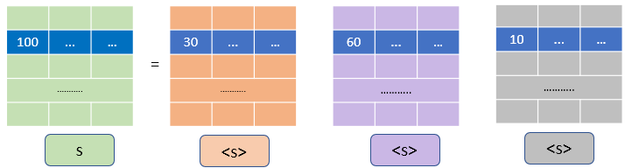

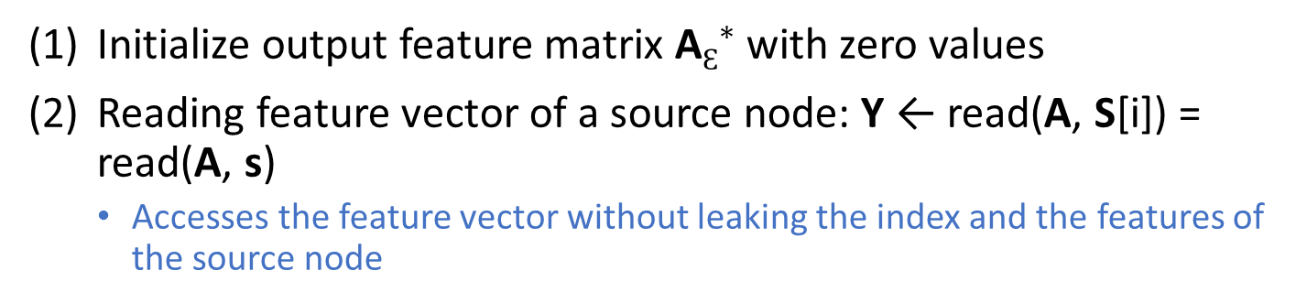
CryptMPL: Secure Reading
Initialize output feature matrix${ \text{A}Ɛ}^{∗}$ with zero values
Reading feature vector of a source node: Y ← read(A, S[i]) = read(A, s)
Accesses the feature vector without leaking the index and the features of the source node
<Y> ← read(<A>, <s>)
Steps:
Each party rotates <A> and shifts <s> by random amount
After, P-1 rounds, access feature vector at updated index
30 | ... | …
………..
100 | … | …
………..
10 | ... | …
………..
100 | ... | …
………..
30 | ... | …
………..
60 | ... | …
………..
<s>₁
=
<s>₂
<s>₃
r₁
r₂
r₃
s
<s>₁
<s>₂
<s>₃
………..
30 | ... | …
30 | ... | …
………..
30 | ... | …
………..
………..
30 | ... | …
30 | ... | …
………..
<s>₁ + <s>₂ + <s>₃ + r₁ + r₂ + r₃
<s>₁ + <s>₂ + r₁ + r₂
s + r₁ + r₂ + r₃
<s>₁ + r₁
<s>₁ + <s>₂ + r₁ + r₂
<s>₁ + r₁
10 | ... | …
30 | ... | …
60 | ... | …
Notes:
The main idea of secure read:
Each party rotates their share of the current feature matrix A and shift their share of the source index by the same random amount, and then share the updated matrix and index with the next party.
The random amount is different at each party. After all the parties have rotated the feature matrix and shifted the source index, each party reads the vector at the updated index of the rotated matrix -> using this approach we protect the original source index, as the overall rotation is protected even if there is collusion among P-1 parties.
Since both the rotation and the shift are done by the same total amount, each party receives a correct share of the source feature vector.
Novelty: the servers share data among themselves, avoiding the need of a trusted server.

Slide 51
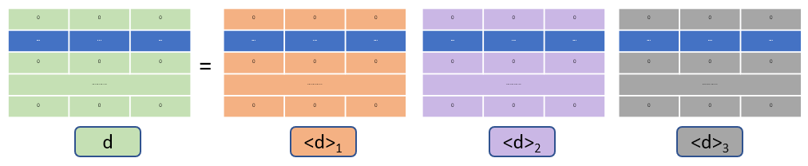
CryptMPL: Secure Writing and Aggregation
(3) Write to destination node of intermediate matrix <G> ← write(Y, D[i]) = write(Y, d)
Without leaking the target index and the feature vector
0 | 0 | 0
0 | 0 | 0
0 | 0 | 0
………..
0 | 0 | 0
0 | 0 | 0
… | ... | …
0 | 0 | 0
………..
0 | 0 | 0
0 | 0 | 0
… | ... | …
0 | 0 | 0
………..
0 | 0 | 0
0 | 0 | 0
… | ... | …
0 | 0 | 0
………..
0 | 0 | 0
0 | 0 | 0
… | ... | …
0 | 0 | 0
………..
0 | 0 | 0
… | ... | …
0 | 0 | 0
0 | 0 | 0
………..
0 | 0 | 0
0 | 0 | 0
0 | 0 | 0
0 | 0 | 0
………..
0 | 0 | 0
=
<G> ← write(<Y>, <d>)
d
<d>₁
<d>₂
<d>₃
<d>₃
<d>₁
<d>₂
0 | 0 | 0
0 | 0 | 0
0 | 0 | 0
………..
… | ... | …
0 | 0 | 0
… | ... | …
0 | 0 | 0
………..
0 | 0 | 0
0 | 0 | 0
0 | 0 | 0
0 | 0 | 0
……….. | 0 | 0
… | ... | …
0 | 0 | 0
… | ... | …
0 | 0 | 0
………..
0 | 0 | 0
0 | 0 | 0
0 | 0 | 0
… | ... | …
………..
0 | 0 | 0
0 | 0 | 0
0 | 0 | 0
… | ... | …
………..
0 | 0 | 0
0 | 0 | 0
… | ... | …
0 | 0 | 0
………..
0 | 0 | 0
0 | 0 | 0
… | ... | …
0 | 0 | 0
………..
0 | 0 | 0
(4) Aggregate updates the feature matrix < ${\text{A}Ɛ}^{∗}$> ← < ${\text{A}Ɛ}^{∗}$ > + <G>
Security issue: Feature vectors and node degrees can be estimated by analyzing access patterns
Notes:
We use $\text{A}Ɛ$* in our paper to represent output feature matrix
The main idea of the write protocol:
Each party writes its share of the feature vector Y at the 0-th index of its share of G and transfer it to the next party in the ring.
Each party rotates the share of the matrix G by its share of the destination index -> -> using this approach we protect the original destination index, as the overall rotation is protected even if there is collusion among P-1 parties.
Thus, the feature vector reaches the correct destination index of G
Novelty: the servers share data among themselves, avoiding the need of a trusted server.

Slide 52
CryptMUL: Secure Matrix Multiplication
Matrix-multiplication: ǁZǁ = ǁXǁ ⊗ ǁYǁ
For linear layers in GNN, ǁYǁ is the model parameters (the same for all inference requests)
Idea:
For each client, generate initial Beaver Triples (ǁAǁ, ǁBǁ, ǁCǁ) using homomorphic encryption or oblivious transfer
For each inference, generate new Beaver Triples (ǁA’ǁ, ǁBǁ, ǁC’ ǁ) utilizing the basic principles of matrix-multiplication
We can use the same ǁBǁ in all inference request since there are no changes in ǁYǁ
Reduces the overhead since this step does not require communication among the parties
Avoids the need of a trusted server
Use the new Beaver Triples for matrix-multiplication ǁZǁ = F(ǁXǁ, ǁYǁ, ǁA’ǁ, ǁBǁ, ǁC’ǁ)

Slide 53
CryptMUL: Secure Element-wise Multiplication
Element-wise multiplication: ǁZǁ = ǁXǁ × ǁYǁ
The maximum number of element-wise multiplications required for a single GNN inference request is predetermined by the specific model architecture
For each client:
At the pre-processing stage, the parties generate a specified set of numbers both in A-SS and multiplicative secret-sharing (M-SS) format
Precompute specific number of Beaver triples in M-SS format
Parties communicate with each other and use the data generated in the first step to convert the Beaver triple from M-SS to A-SS format as (ǁAǁ, ǁBǁ, ǁCǁ), enhancing security by avoiding the need of a trusted server
Use the new Beaver Triples for multiplication ǁZǁ = F(ǁXǁ, ǁYǁ, ǁAǁ, ǁBǁ, ǁCǁ)

Slide 54
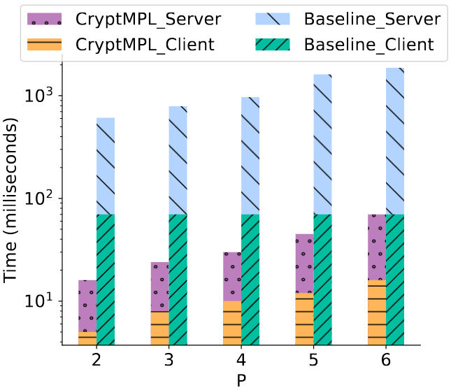
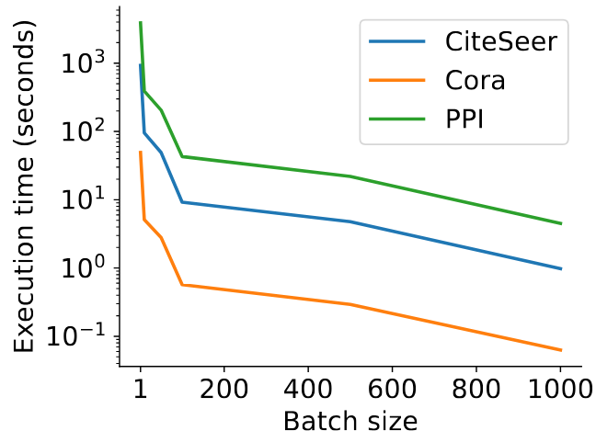
CryptMPL: Effect of Parameters
Number of parties
We compare CryptMPL with an adjacency matrix based approach
CryptMPL is 25 times faster with in 6-party SMPC setting
Batching
Execution time of CryptMPL decreases as the batch size increases
CryptMPL can use a relatively large batch size while guaranteeing good security

