Slide 1
Oozie – Workflow Engine
Building and Installing

Slide 2
Pre Requisites
Oozie-4.1.0.tar.gz
Apache maven 3.3.3
Jdk 1.6 or greater

Slide 3
Building oozie
To build oozie you can use the following command:
  Bin/mkditro.sh –DskipTests
The above command should build all the projects included in your oozie source folder and should create a binary distribution of oozie that we will use to install client and server.
After a successful build, create a new folder called oozie so that we can move our binary distribution to an individual folder

Slide 4
Use the following command:
  cp -R oozie-4.1.0/distro/target/oozie-4.1.0-distro/oozie-4.1.0/ oozie
Change your directory to oozie and create a new directory with in it called libext, we will use this directory for the required hadoop libs.
  mkdir libext
Next we need to copy all the required hadooplibs into ext folder.

Slide 5
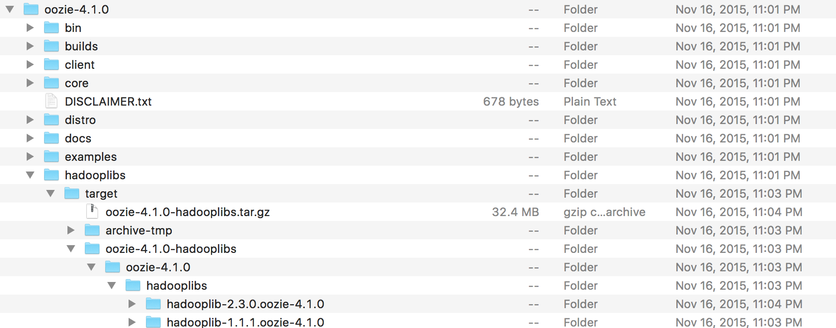
For that locate hadooplibs folder with in your oozie4.1.0 directory.
As you can see there are two hadooplibs folder, in these we have the tar files and we need to extract one of them.

Slide 6
After extracting the hadooplibs we need to move the libraries to libext, using the following command:
cp oozie-4.1.0/hadooplibs/hadooplib-2.3.0.oozie-4.1.0/* libext/
The above command will make all the hadooplibs available to oozie.
We need to make one configuration change in hadoop.

Slide 7
Update ../hadoop/conf/core-site.xml as follows:
Here you need to mention the host and if you have a specific user hadoop.
<property> <name>hadoop.proxyuser.hduser.hosts</name> <value>localhost</value> </property> <property> <name>hadoop.proxyuser.hduser.groups</name> <value>hadoop</value> </property>

Slide 8
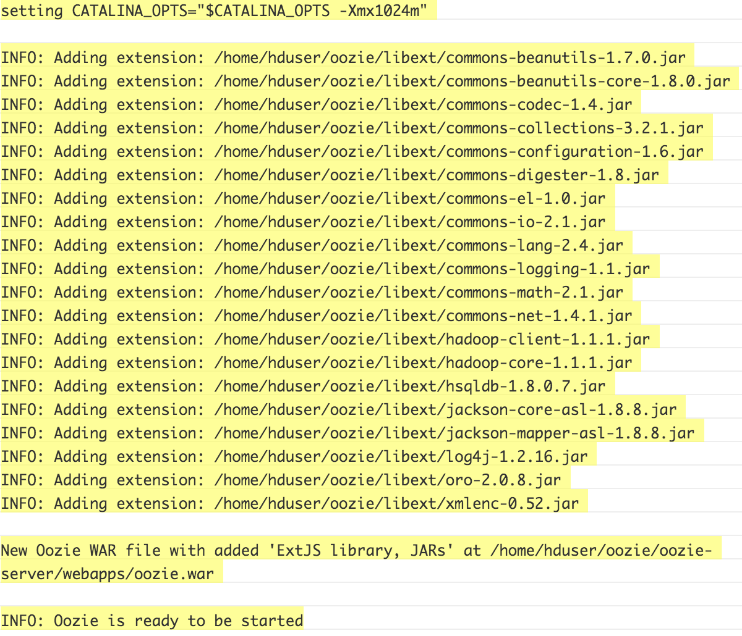
Run the following commands to install oozie:
/bin/oozie-setup.sh prepare-war

Slide 9
Create sharelib on HDFS
$ ./bin/oozie-setup.sh sharelib create -fs hdfs://localhost:54310
  setting CATALINA_OPTS="$CATALINA_OPTS -Xmx1024m"
  the destination path for sharelib is: /user/hduser/share/lib
./bin/ooziedb.sh create -sqlfile oozie.sql –run
./bin/oozied.sh start
./bin/oozied.sh run

Slide 10
After the run command the oozie server should be up and running.
To monitor the status run the following command:
  $ ./bin/oozie admin -oozie http://localhost:11000/oozie -status
  You should get the following status:
  System mode: NORMAL

