Slide 1
2018 NCWIT Summary
Patricia Morreale
June 14, 2018

Slide 2
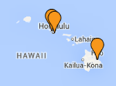
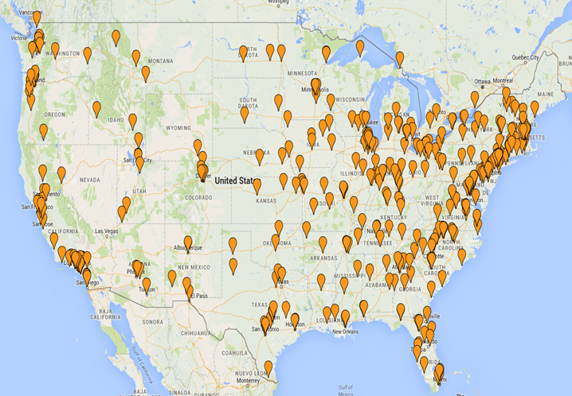
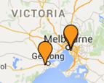
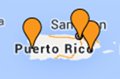
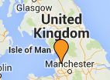
AA: Geographic Membership Breakdown
Notes:
Maureen
https://drive.google.com/open?id=1jFC0h05Pj4P6Jp-j446m1gNabkc&usp=sharing

Slide 3
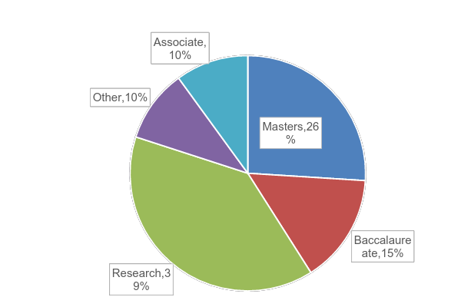
AA: Basic Carnegie Classification Breakdown
Notes:
Maureen
ASSOCIATES BASIC CARNEGIE CLASSIFICATION [NOTE: Carnegie did a major revamp of Associate’s classification in 2015 and updating those in NCWIT’s database is a summer project!]: Current classifications include: Associate’s, Associate's--Public 2-year colleges under 4-year universities, Associate's--Public 4-year Primarily Associate's, Associate's--Public Rural-serving Large, Associate's--Public Rural-serving Medium, Associate's--Public Rural-serving Small, Associate's--Public Suburban-serving Multicampus, Associate's--Public Suburban-serving Multicampus, Associate's--Public Urban-serving Single Campus
OTHER CARNEGIE CLASSIFICATION: Specialized Institutions—Theological seminaries and other specialized faith-related institutions, Specialized Institutions—Medical schools and medical centers, Specialized Institutions—Other, separate health profession schools, Specialized Institutions—Schools of engineering and technology, Specialized Institutions—Schools of business and management, Specialized Institutions—Schools of art, music, and design, Specialized Institutions—Schools of law, Specialized Institutions—Teachers colleges, Specialized Institutions—Other specialized institutions, Tribal colleges and universities, Not classified, not in classification universe

Slide 4
Established in 2004 to “significantly increase the participation of women and girls in CS and IT”
Annual Summit Meeting May 15-17, Grapevine, TX
Three subgroups: K-12, Academic, Workforce
AA is 550 organizations, over 2,000 individual mbrs
Joining is free!
Previous: CS in K-12, University engagement
Emphasis this year: diverse and inclusive technology cultures for all groups

Slide 5
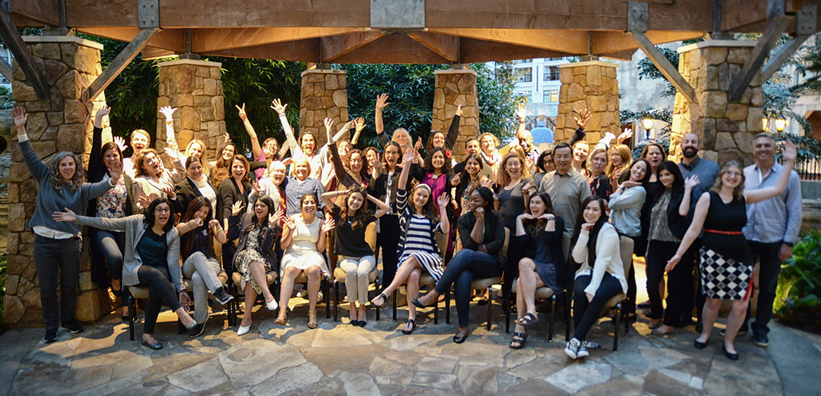
Previous:
K-18 seamless connections Aspirations in IT
High School, College, Educator
https://www.aspirations.org/
CS4All https://www.csforall.org/
Collegiate Awards
HP, Qualcomm Sponsors

Slide 6
Now: Meaningful participation
What needs to take place for that to occur?

Slide 7
Male Advocates
Diversity and inclusion past the Ph.D.
Recruiting/retaining for CS through:
access and accessibility: routine, not a favor
changing physical environments
recognizing multiple identities

