Slide 2
Chapter 10 Fluids

Slide 3
Contents of Chapter 10
Phases of Matter
Density and Specific Gravity
Pressure in Fluids
Atmospheric Pressure and Gauge Pressure
Pascal’s Principle
Measurement of Pressure; Gauges and the Barometer
Buoyancy and Archimedes’ Principle
Fluids in Motion; Flow Rate and the Equation of Continuity

Slide 4
Contents of Chapter 10
Bernoulli’s Equation
Applications of Bernoulli’s Principle: Torricelli, Airplanes, Baseballs, Blood Flow
Viscosity
Flow in Tubes: Poiseuille’s Equation, Blood Flow
Surface Tension and Capillarity
Pumps, and the Heart

Slide 5
10-1 Phases of Matter
The three common phases of matter are solid, liquid, and gas.
A solid has a definite shape and size.
A liquid has a fixed volume but can be any shape.
A gas can be any shape and also can be easily compressed.
Liquids and gases both flow, and are called fluids.

Slide 6
10-2 Density and Specific Gravity
The density ρ of an object is its mass per unit volume:
The SI unit for density is kg/m³. Density is also sometimes given in g/cm³; to convert g/cm³ to kg/m³, multiply by 1000.
Water at 4°C has a density of 1 g/cm³ = 1000 kg/m³.
The specific gravity of a substance is the ratio of its density to that of water.
(10-1)

Slide 7
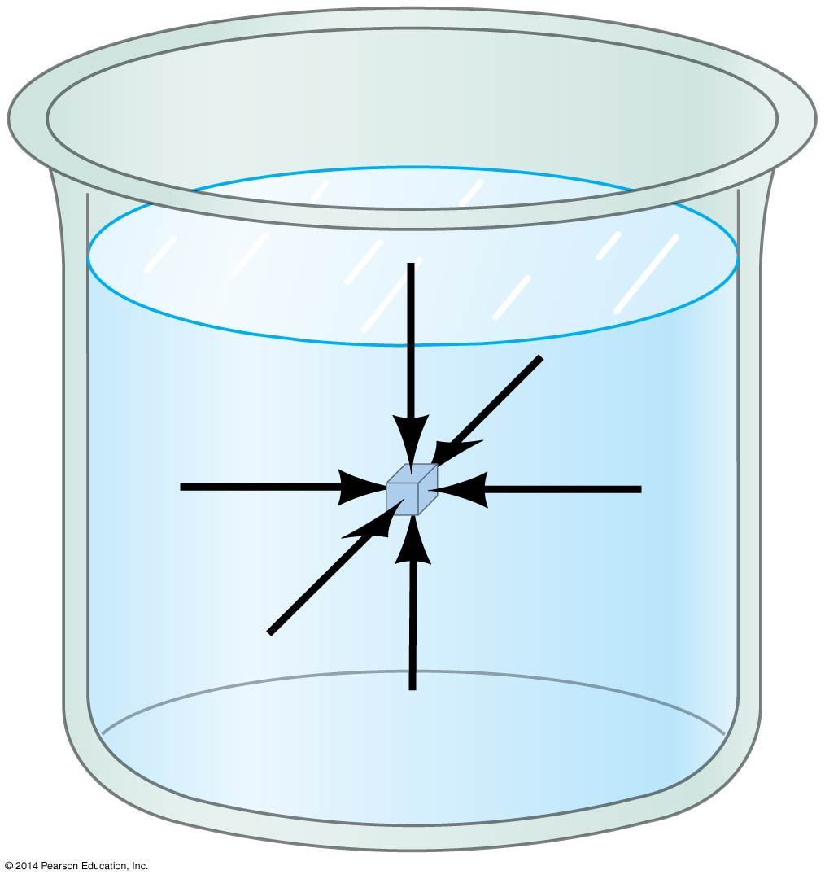
10-3 Pressure in Fluids
Pressure is defined as the force per unit area.
Pressure is a scalar; the units of pressure in the SI system are pascals:
1 Pa = 1 N/m²
Pressure is the same in every direction in a fluid at a given depth; if it were not, the fluid would flow.

Slide 8
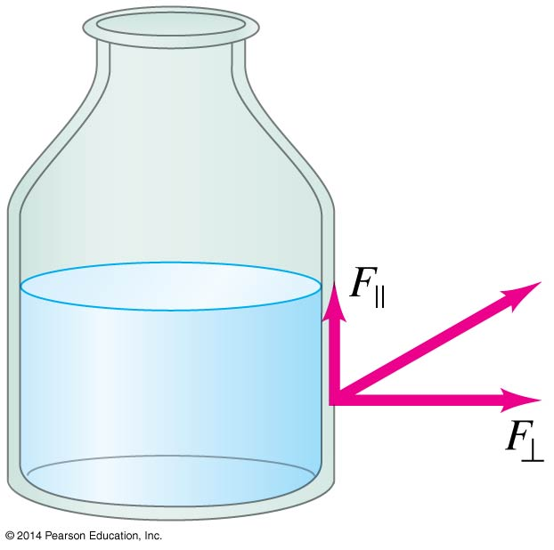
10-3 Pressure in Fluids
Also for a fluid at rest, there is no component of force parallel to any solid surface— once again, if there were the fluid would flow.

Slide 9
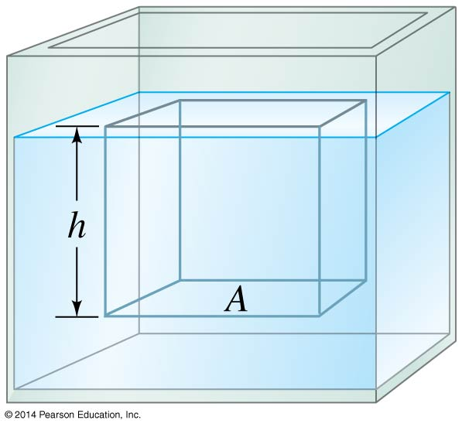
10-3 Pressure in Fluids
The pressure at a depth h below the surface of the liquid is due to the weight of the liquid above it. We can quickly calculate:
This relation is valid for any liquid whose density does not change with depth.
(10-3a)

Slide 10
10-4 Atmospheric Pressure and Gauge Pressure
At sea level the atmospheric pressure is about 1.013 × 10⁵ N/m²; this is called one atmosphere (atm).
Another unit of pressure is the bar:
1 bar = 1.00 × 10⁵ N/m²
Standard atmospheric pressure is just over 1 bar.
This pressure does not crush us, as our cells maintain an internal pressure that balances it.

Slide 11
10-4 Atmospheric Pressure and Gauge Pressure
Most pressure gauges measure the pressure above the atmospheric pressure—this is called the gauge pressure.
The absolute pressure is the sum of the atmospheric pressure and the gauge pressure.
P = P_{A} + P_{G}

Slide 12
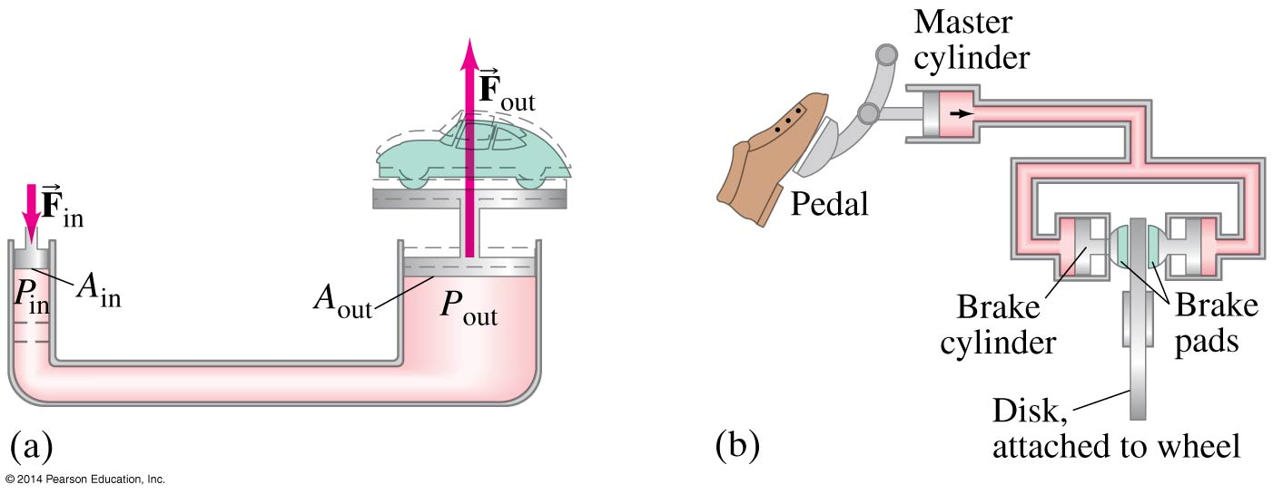
10-5 Pascal’s Principle
If an external pressure is applied to a confined fluid, the pressure at every point within the fluid increases by that amount.
This principle is used, for example, in hydraulic lifts and hydraulic brakes.

Slide 13
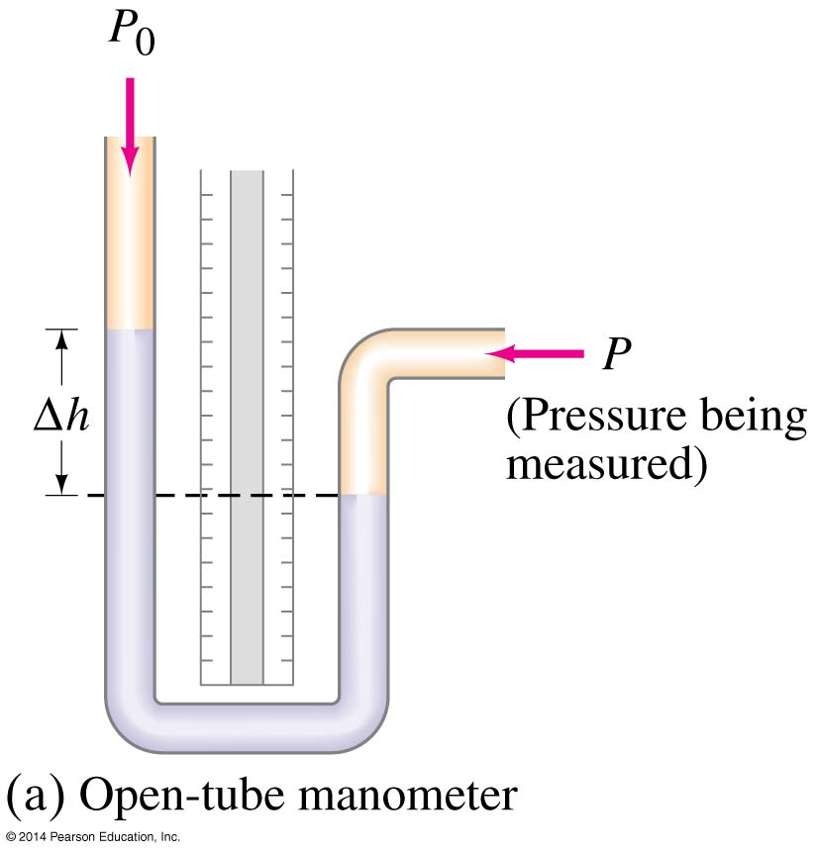
10-6 Measurement of Pressure; Gauges and the Barometer
There are a number of different types of pressure gauges. This one is an open-tube manometer. The pressure in the open end is atmospheric pressure; the pressure being measured will cause the fluid to rise until the pressures on both sides at the same height are equal.

Slide 14
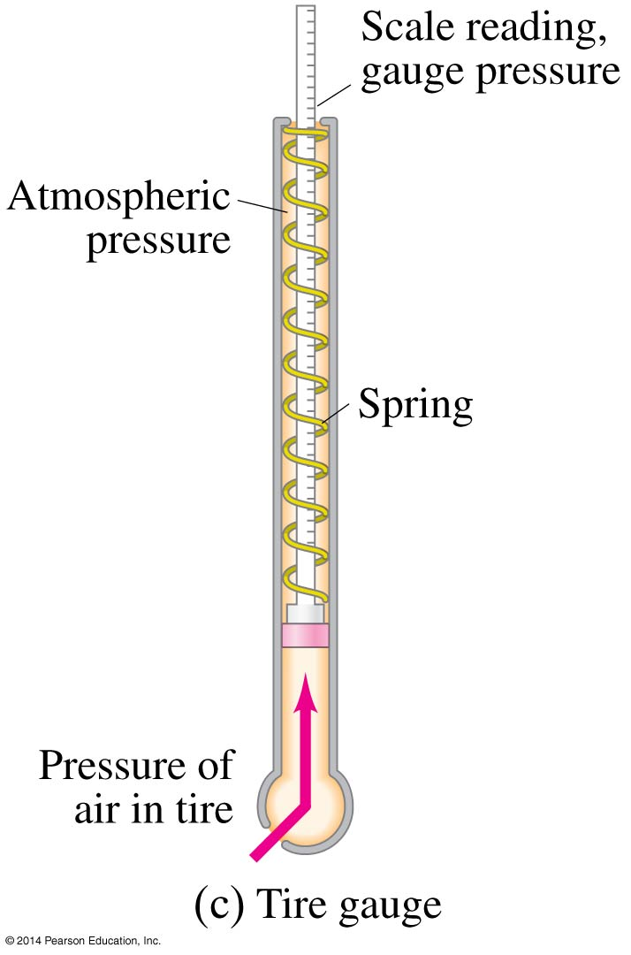
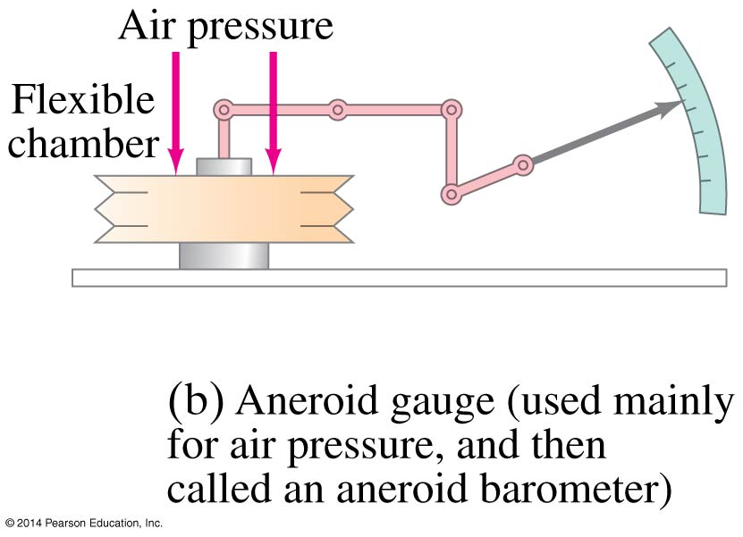
10-6 Measurement of Pressure; Gauges and the Barometer
Here are two more devices for measuring pressure: the aneroid gauge and the tire pressure gauge.

Slide 15
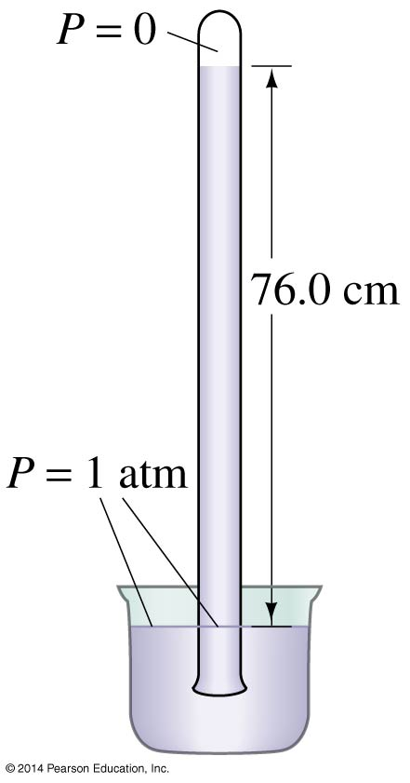
10-6 Measurement of Pressure; Gauges and the Barometer
This is a mercury barometer, developed by Torricelli to measure atmospheric pressure. The height of the column of mercury is such that the pressure in the tube at the surface level is 1 atm.
Therefore, pressure is often quoted in millimeters (or inches) of mercury.

Slide 16
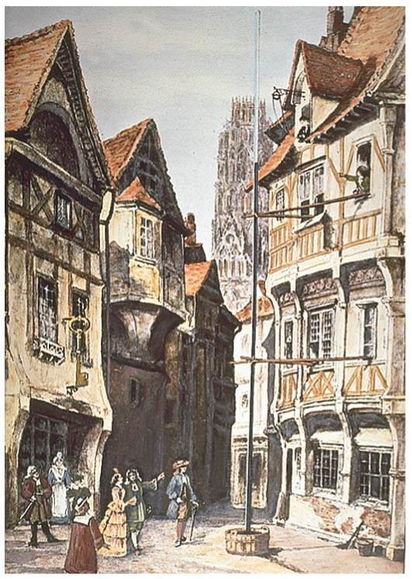
10-6 Measurement of Pressure; Gauges and the Barometer
Any liquid can serve in a Torricelli-style barometer, but the most dense ones are the most convenient. This barometer uses water.

Slide 17
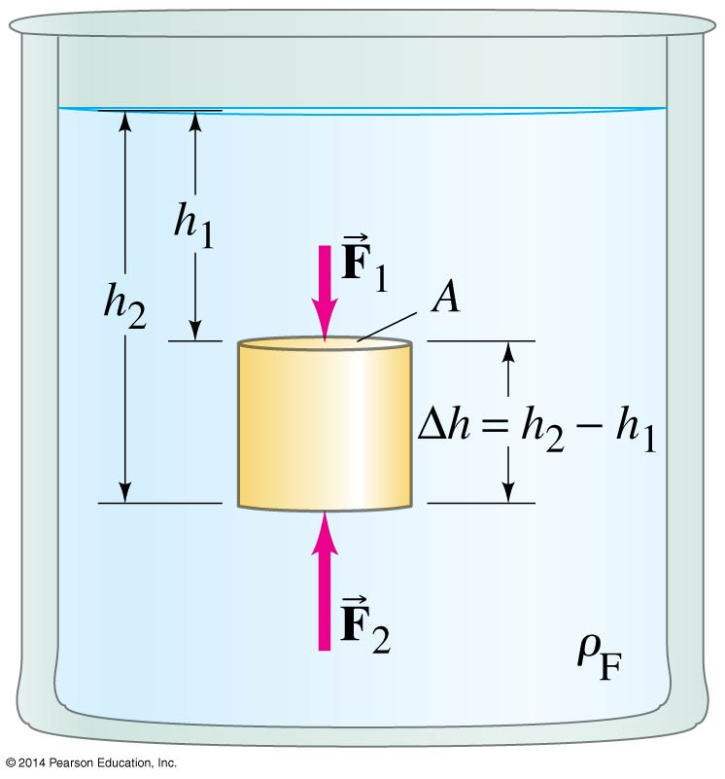
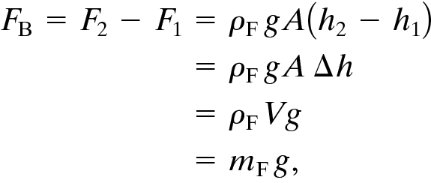
10-7 Buoyancy and Archimedes’ Principle
This is an object submerged in a fluid. There is a net force on the object because the pressures at the top and bottom of it are different.
The buoyant force is found to be the upward force on the same volume of water:

Slide 18
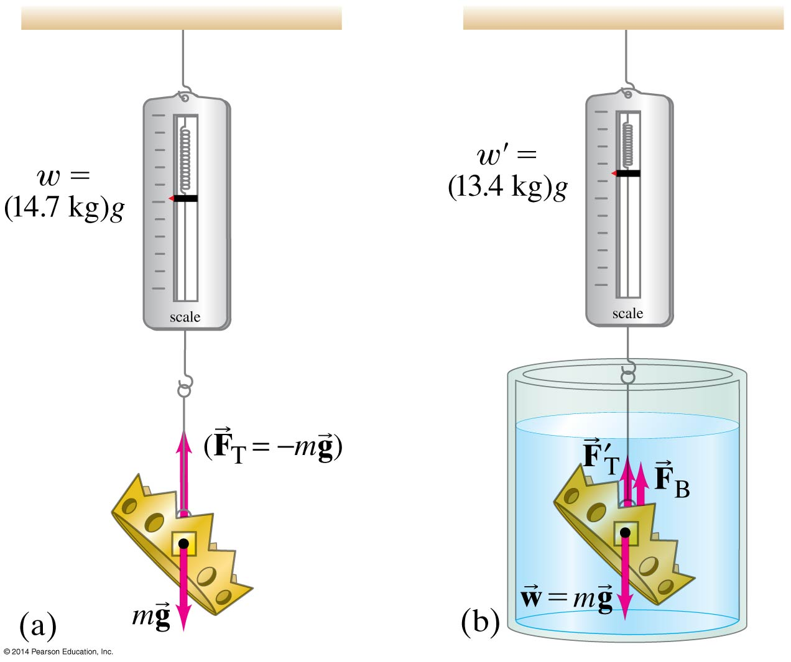
10-7 Buoyancy and Archimedes’ Principle
The net force on the object is then the difference between the buoyant force and the gravitational force.

Slide 19
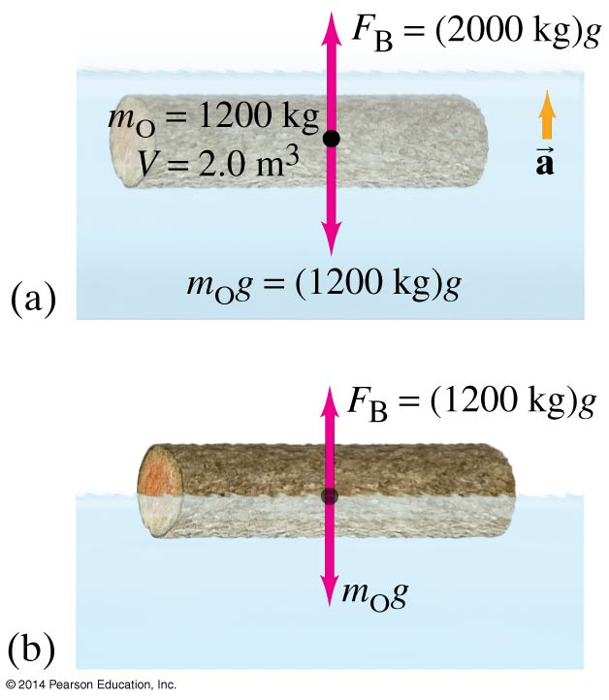
10-7 Buoyancy and Archimedes’ Principle
If the object’s density is less than that of water, there will be an upward net force on it, and it will rise until it is partially out of the water.

Slide 20
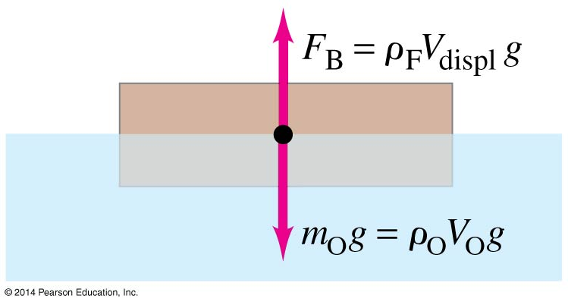
10-7 Buoyancy and Archimedes’ Principle
For a floating object, the fraction that is submerged is given by the ratio of the object’s density to that of the fluid.

Slide 21
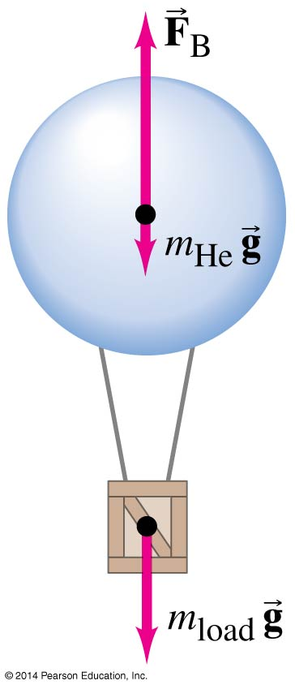
10-7 Buoyancy and Archimedes’ Principle
This principle also works in the air; this is why hot-air and helium balloons rise.

Slide 22
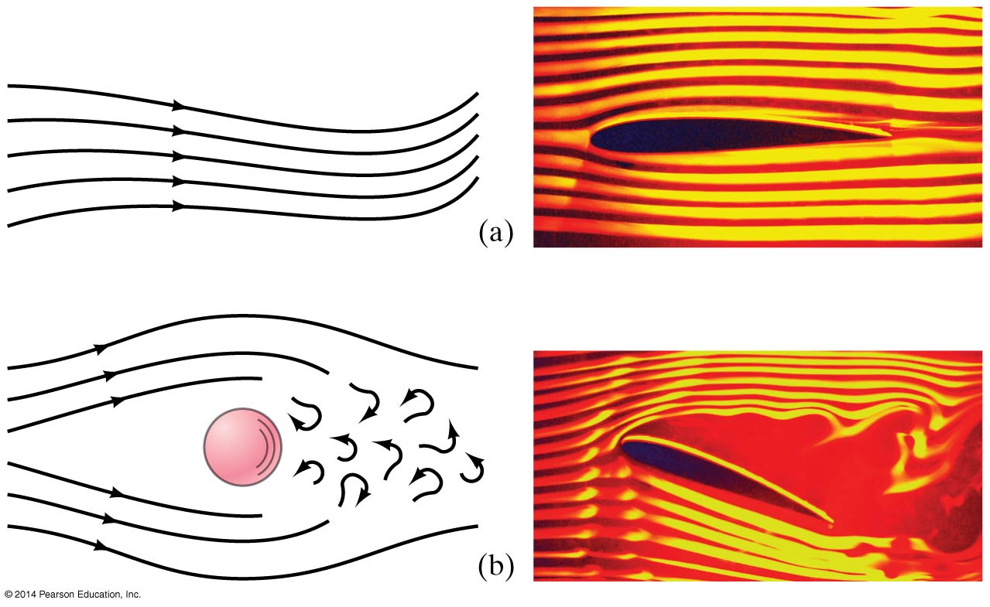
10-8 Fluids in Motion; Flow Rate and the Equation of Continuity
If the flow of a fluid is smooth, it is called streamline or laminar flow (a).
Above a certain speed, the flow becomes turbulent (b). Turbulent flow has eddies; the viscosity of the fluid is much greater when eddies are present.

Slide 23
10-8 Fluids in Motion; Flow Rate and the Equation of Continuity
We will deal with laminar flow.
The mass flow rate is the mass that passes a given point per unit time. The flow rates at any two points must be equal, as long as no fluid is being added or taken away.
This gives us the equation of continuity:
(10-4a)

Slide 24
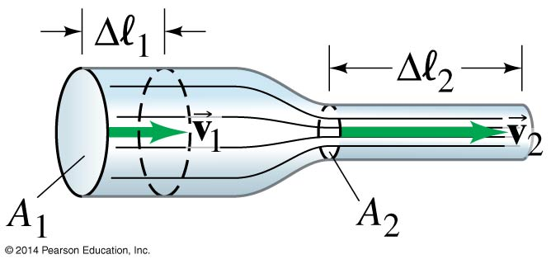
10-8 Fluids in Motion; Flow Rate and the Equation of Continuity
If the density doesn’t change—typical for liquids—this simplifies to A₁v₁ = A₂v₂. Where the pipe is wider, the flow is slower.

Slide 25
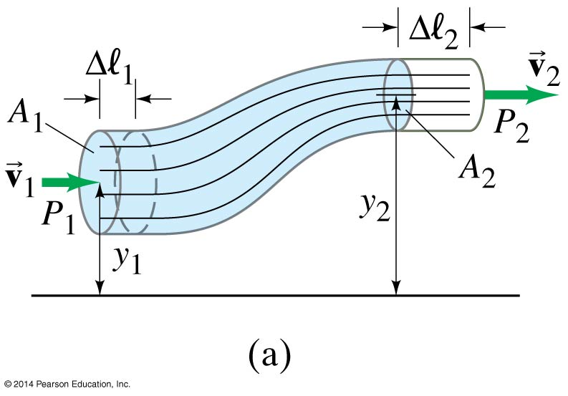
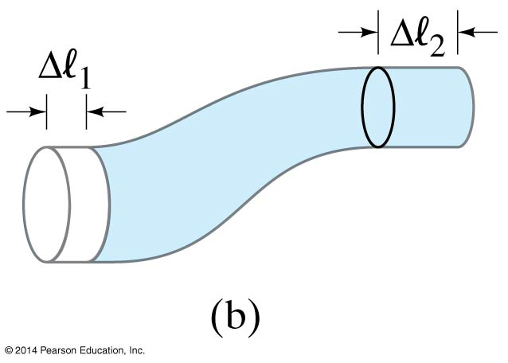
10-9 Bernoulli’s Equation
A fluid can also change its height. By looking at the work done as it moves, we find:
This is Bernoulli’s equation. One thing it tells us is that as the speed goes up, the pressure goes down.
(10-5)

Slide 26
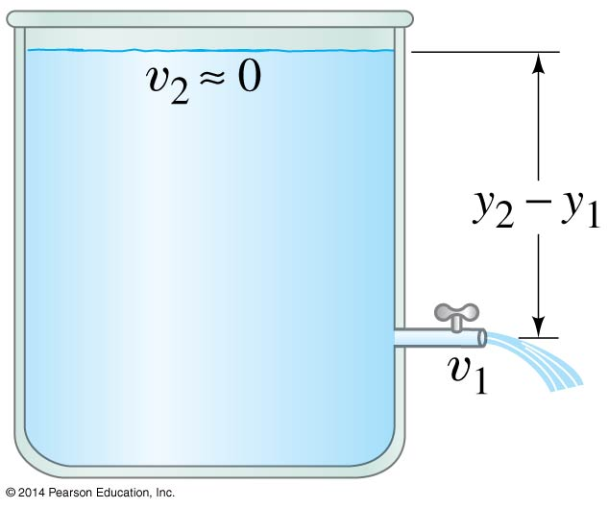
10-10 Applications of Bernoulli’s Principle: Torricelli, Airplanes, Baseballs, Blood Flow
Using Bernoulli’s principle, we find that the speed of fluid coming from a spigot on an open tank is:
This is called Torricelli’s theorem.
(10-6)

Slide 27
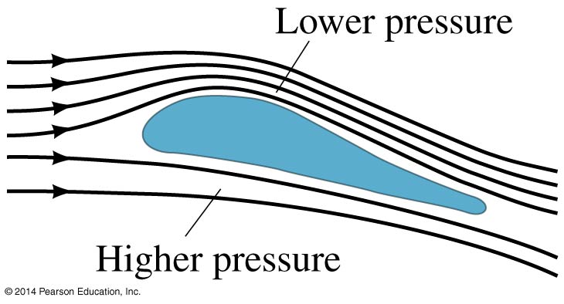
10-10 Applications of Bernoulli’s Principle: Torricelli, Airplanes, Baseballs, Blood Flow
Lift on an airplane wing is due to the different air speeds and pressures on the two surfaces of the wing.

Slide 28
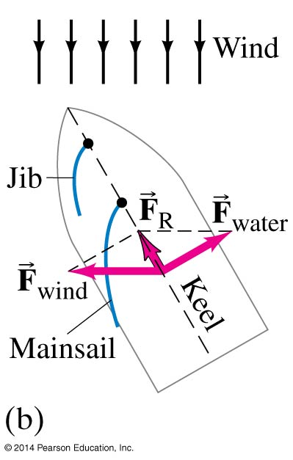
10-10 Applications of Bernoulli’s Principle: Torricelli, Airplanes, Baseballs, Blood Flow
A sailboat can move against the wind, using the pressure differences on each side of the sail, and using the keel to keep from going sideways.

Slide 29
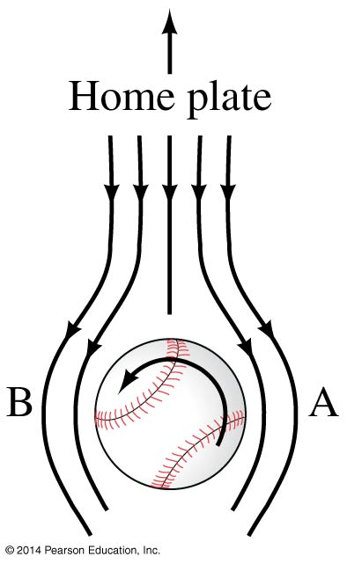
10-10 Applications of Bernoulli’s Principle: Torricelli, Airplanes, Baseballs, Blood Flow
A ball’s path will curve due to its spin, which results in the air speeds on the two sides of the ball not being equal.

Slide 30
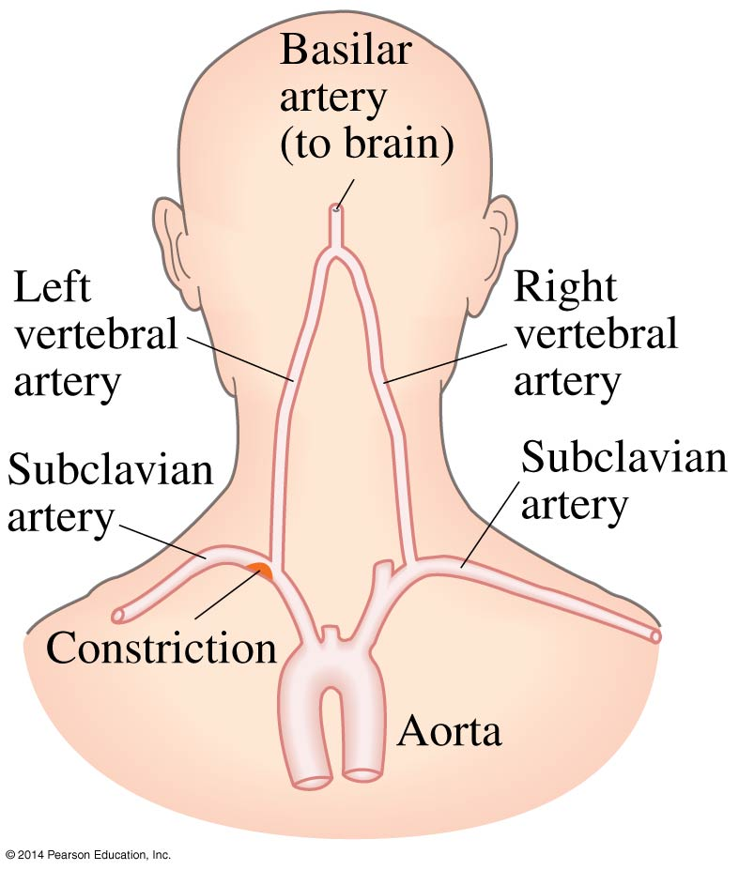
10-10 Applications of Bernoulli’s Principle: Torricelli, Airplanes, Baseballs, Blood Flow
A person with constricted arteries will find that they may experience a temporary lack of blood to the brain as blood speeds up to get past the constriction, thereby reducing the pressure.

Slide 31
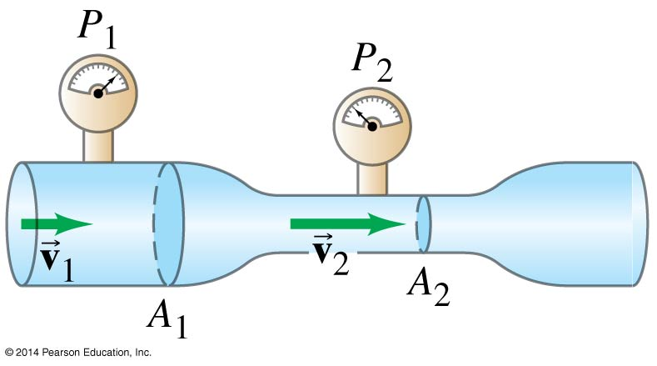
10-10 Applications of Bernoulli’s Principle: Torricelli, Airplanes, Baseballs, Blood Flow
A venturi meter can be used to measure fluid flow by measuring pressure differences.

Slide 32
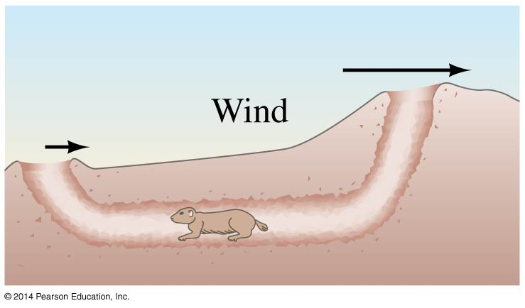
10-10 Applications of Bernoulli’s Principle: Torricelli, Airplanes, Baseballs, Blood Flow
Air flow across the top helps smoke go up a chimney, and air flow over multiple openings can provide the needed circulation in underground burrows.

Slide 33
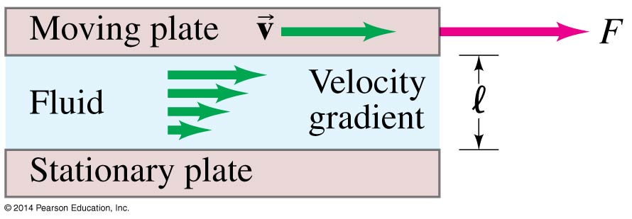
10-11 Viscosity
Real fluids have some internal friction, called viscosity.
The viscosity can be measured; it is found from the relation
where η is the coefficient of viscosity.
(10-8)

Slide 34
10-12 Flow in Tubes; Poiseuille’s Equation, Blood Flow
The rate of flow in a fluid in a round tube depends on the viscosity of the fluid, the pressure difference, and the dimensions of the tube.
The volume flow rate is proportional to the pressure difference, inversely proportional to the length of the tube and to the pressure difference, and proportional to the fourth power of the radius of the tube.

Slide 35
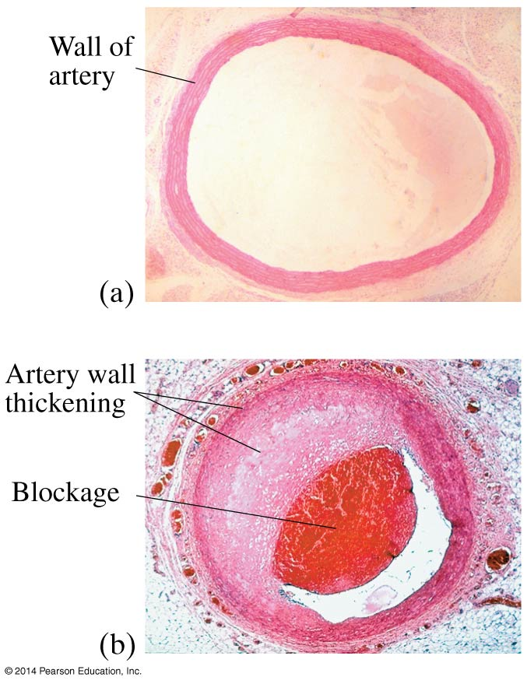
10-12 Flow in Tubes; Poiseuille’s Equation, Blood Flow
This has consequences for blood flow—if the radius of the artery is half what it should be, the pressure has to increase by a factor of 16 to keep the same flow.
Usually the heart cannot work that hard, but blood pressure goes up as it tries.

Slide 36
10-13 Surface Tension and Capillarity
The surface of a liquid at rest is not perfectly flat; it curves either up or down at the walls of the container. This is the result of surface tension, which makes the surface behave somewhat elastically.

Slide 37
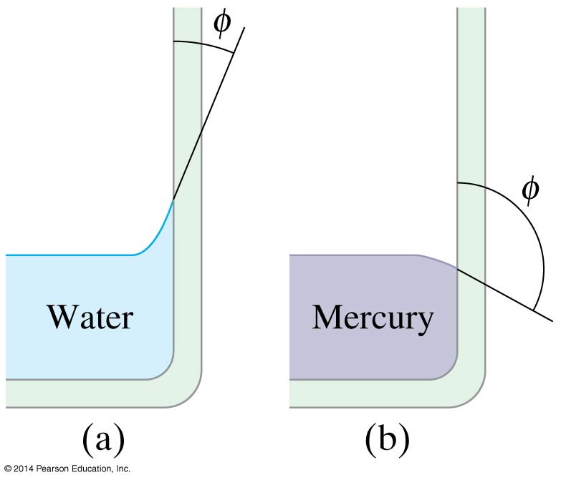
10-13 Surface Tension and Capillarity
Soap and detergents lower the surface tension of water. This allows the water to penetrate materials more easily.
Water molecules are more strongly attracted to glass than they are to each other; just the opposite is true for mercury.

Slide 38
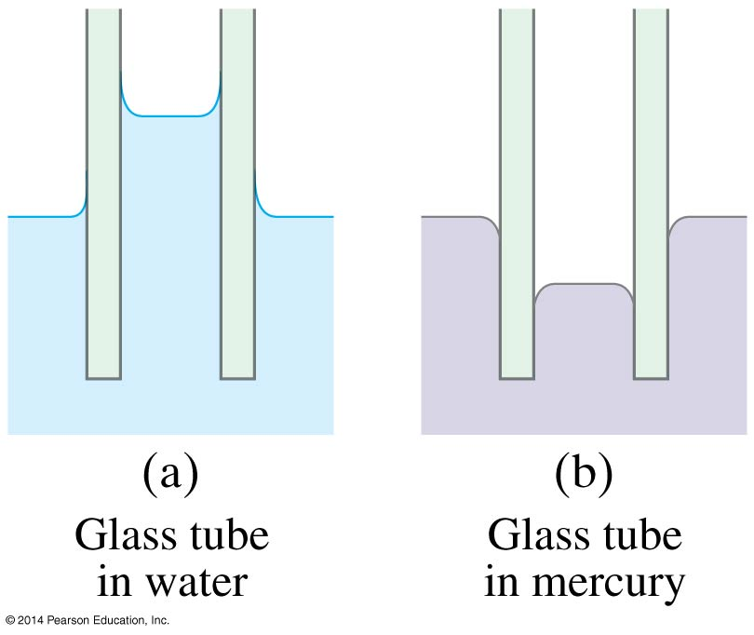
10-13 Surface Tension and Capillarity
If a narrow tube is placed in a fluid, the fluid will exhibit capillarity.

Slide 39
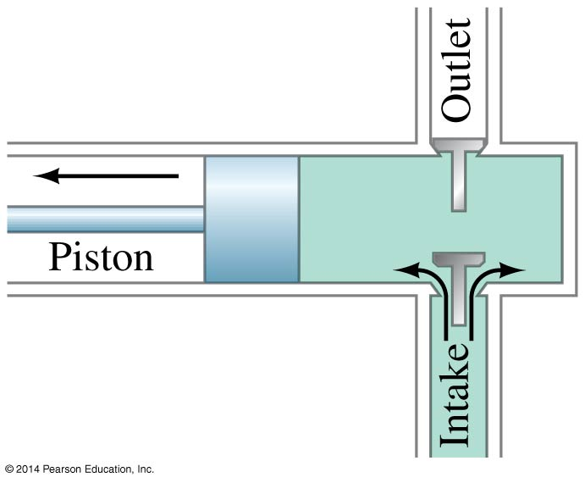
10-14 Pumps, and the Heart
This is a simple reciprocating pump. If it is to be used as a vacuum pump, the vessel is connected to the intake; if it is to be used as a pressure pump, the vessel is connected to the outlet.

Slide 40
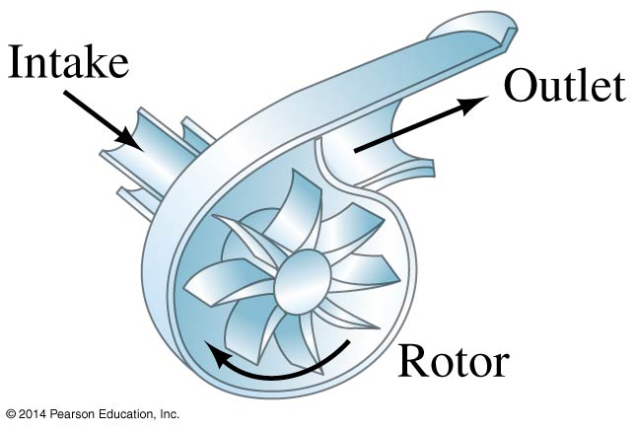
10-14 Pumps, and the Heart
This is a centrifugal pump. The rotating blades force fluid through the outlet pipe.

Slide 41
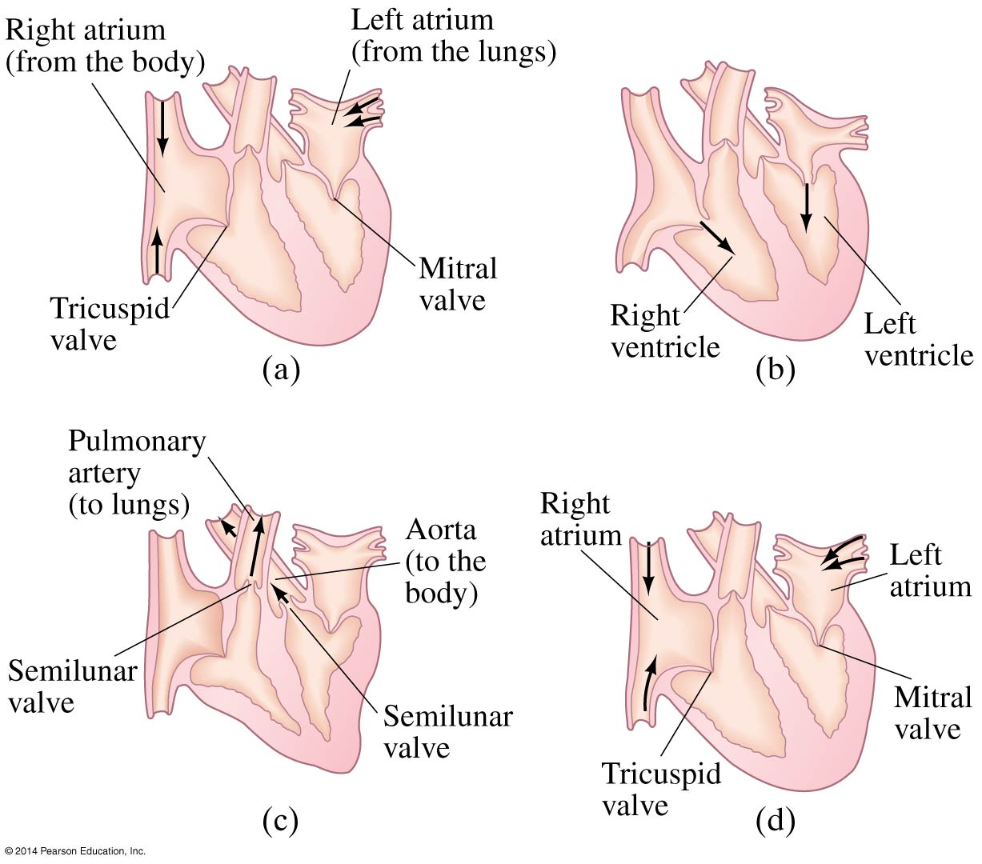
10-14 Pumps, and the Heart
The heart of a human, or any other animal, also operates as a pump.

Slide 42
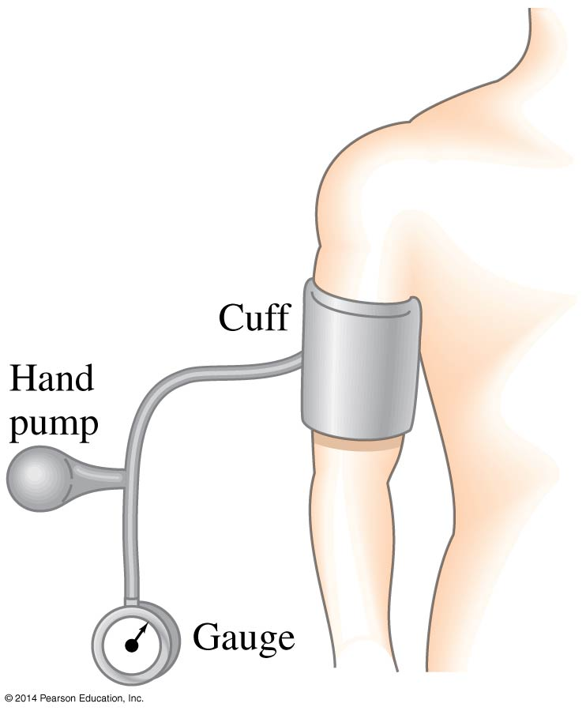
10-14 Pumps, and the Heart
In order to measure blood pressure, a cuff is inflated until blood flow stops. The cuff is then deflated slowly until blood begins to flow while the heart is pumping, and then deflated some more until the blood flows freely.

Slide 43
Summary of Chapter 10
Phases of matter: solid, liquid, gas.
Liquids and gases are called fluids.
Density is mass per unit volume.
Specific gravity is the ratio of the density of the material to that of water.
Pressure is force per unit area.
Pressure at a depth h is ρgh.

Slide 44
Summary of Chapter 10
External pressure applied to a confined fluid is transmitted throughout the fluid.
Atmospheric pressure is measured with a barometer.
Gauge pressure is the total pressure minus the atmospheric pressure.
An object submerged partly or wholly in a fluid is buoyed up by a force equal to the weight of the fluid it displaces.
Fluid flow can be laminar or turbulent.

Slide 45
Summary of Chapter 10
The product of the cross-sectional area and the speed is constant for horizontal flow.
Where the velocity of a fluid is high, the pressure is low, and vice versa.
Viscosity is an internal frictional force within fluids.
Liquid surfaces hold together as if under tension.

