Slide 2
Chapter 24 The Wave Nature of Light

Slide 3
Contents of Chapter 24
Waves Versus Particles; Huygens’ Principle and Diffraction
Huygens’ Principle and the Law of Refraction
Interference—Young’s Double-Slit Experiment
The Visible Spectrum and Dispersion
Diffraction by a Single Slit or Disk
Diffraction Grating

Slide 4
Contents of Chapter 24
The Spectrometer and Spectroscopy
Interference in Thin Films
Michelson Interferometer
Polarization
Liquid Crystal Displays (LCD)
Scattering of Light by the Atmosphere

Slide 5
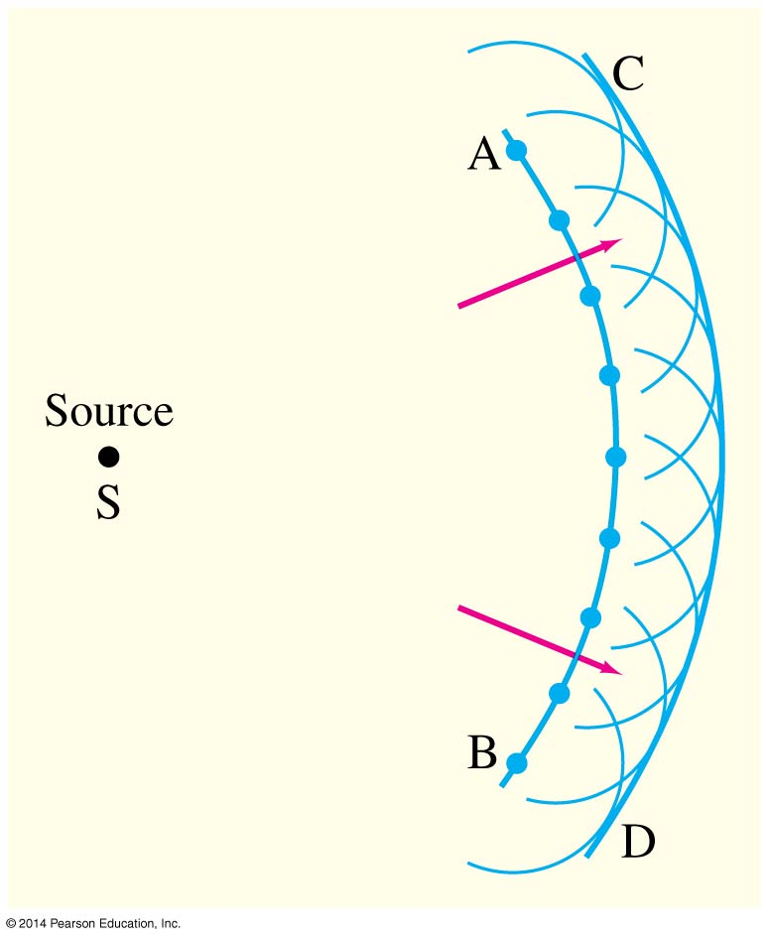
24-1 Waves Versus Particles; Huygens’ Principle and Diffraction
Huygens’ principle: Every point on a wave front acts as a point source; the wavefront as it develops is tangent to their envelope

Slide 6
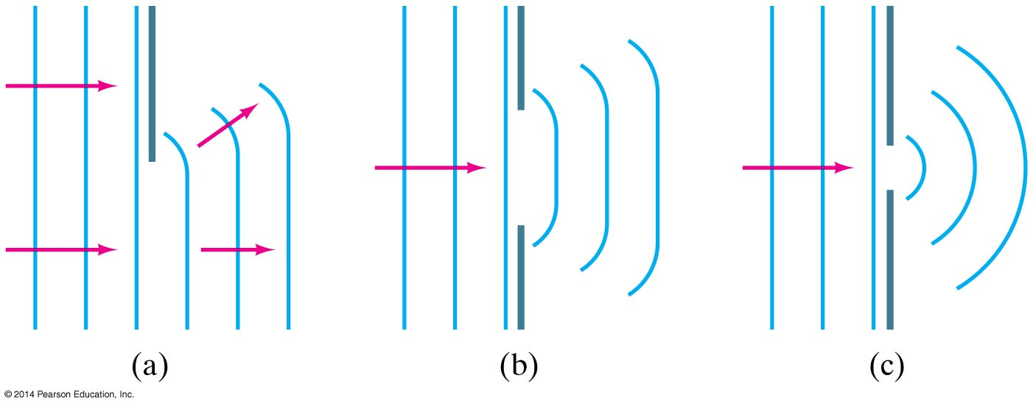
24-1 Waves Versus Particles; Huygens’ Principle and Diffraction
Huygens’ principle is consistent with diffraction:

Slide 7
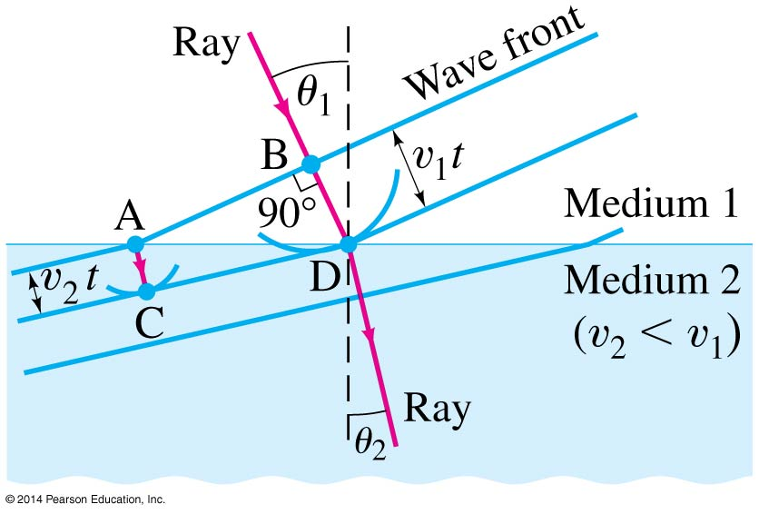
24-2 Huygens’ Principle and the Law of Refraction

Slide 8
24-2 Huygens’ Principle and the Law of Refraction
Huygens’ principle can also explain the law of refraction.
As the wavelets propagate from each point, they propagate more slowly in the medium of higher index of refraction.
This leads to a bend in the wavefront and therefore in the ray.

Slide 9
24-2 Huygens’ Principle and the Law of Refraction
The frequency of the light does not change, but the wavelength does as it travels into a new medium.
(24-1)

Slide 10
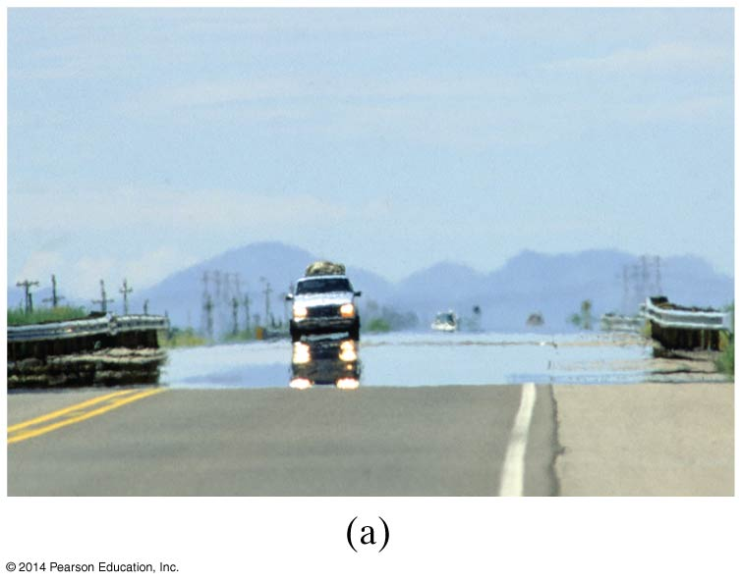
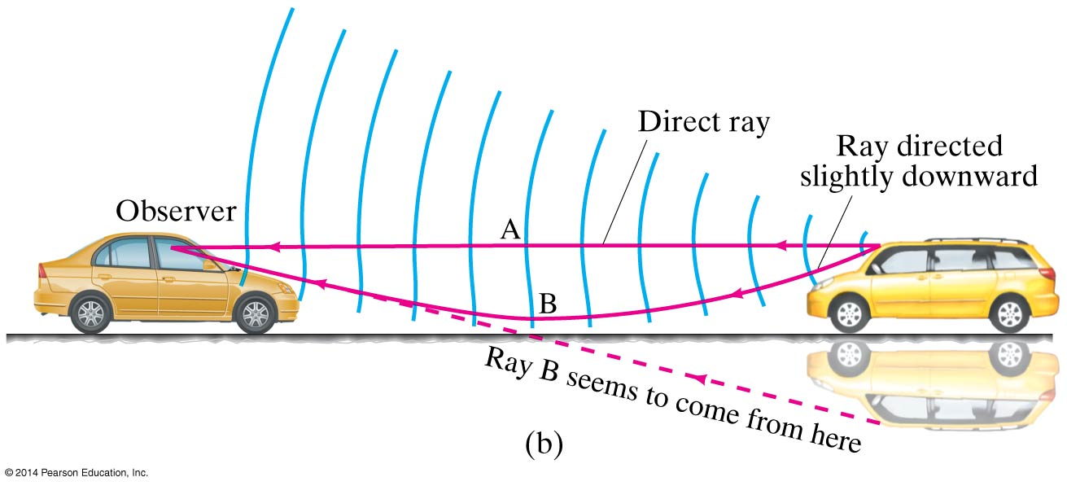
24-2 Huygens’ Principle and the Law of Refraction
Highway mirages are due to a gradually changing index of refraction in heated air.

Slide 11
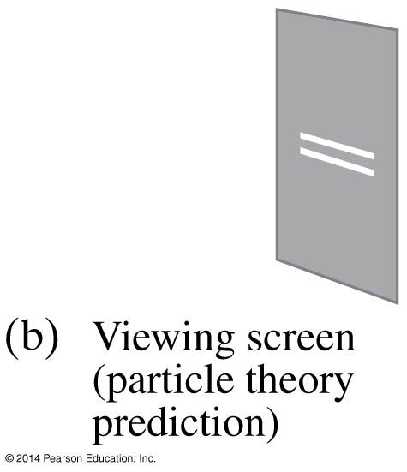
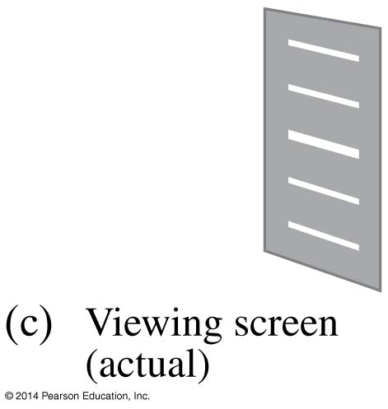
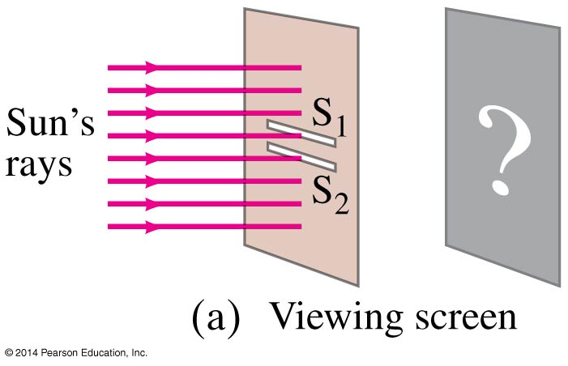
24-3 Interference—Young’s Double-Slit Experiment
If light is a wave, interference effects will be seen, where one part of wavefront can interact with another part.
One way to study this is to do a double-slit experiment:

Slide 12
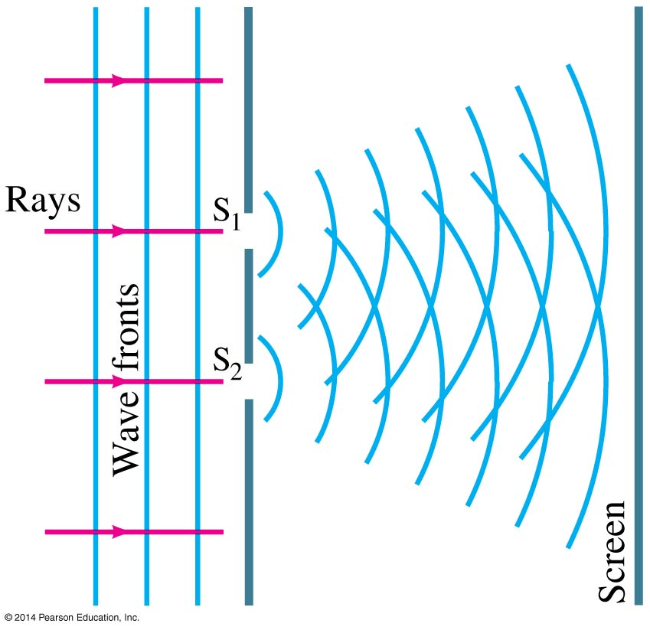
24-3 Interference—Young’s Double-Slit Experiment
If light is a wave, there should be an interference pattern.

Slide 13
24-3 Interference—Young’s Double-Slit Experiment
The interference occurs because each point on the screen is not the same distance from both slits. Depending on the path length difference, the wave can interfere constructively (bright spot) or destructively (dark spot).

Slide 14
24-3 Interference—Young’s Double-Slit Experiment
We can use geometry to find the conditions for constructive and destructive interference:
(24-2a)
(24-2b)

Slide 15
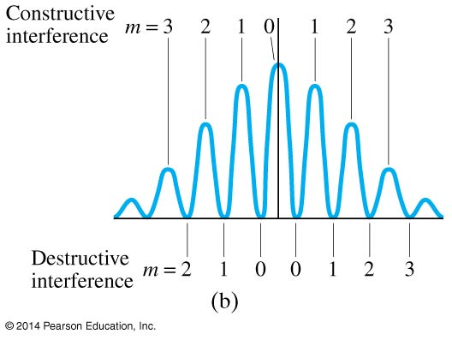
24-3 Interference—Young’s Double-Slit Experiment
Between the maxima and the minima, the amplitude varies smoothly.

Slide 16
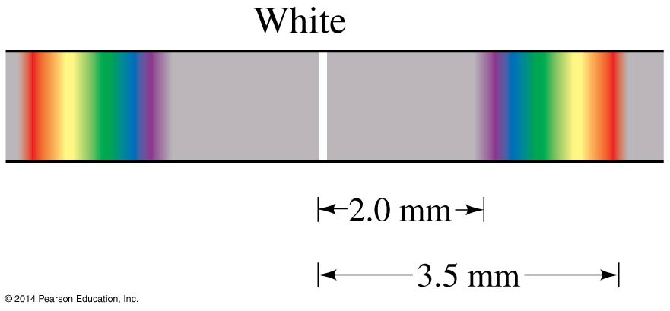
24-3 Interference—Young’s Double-Slit Experiment
Since the position of the maxima (except the central one) depends on wavelength, the first- and higher-order fringes contain a spectrum of colors.

Slide 17
24-4 The Visible Spectrum and Dispersion
Wavelengths of visible light: 400 nm to 750 nm
Shorter wavelengths are ultraviolet; longer are infrared

Slide 18
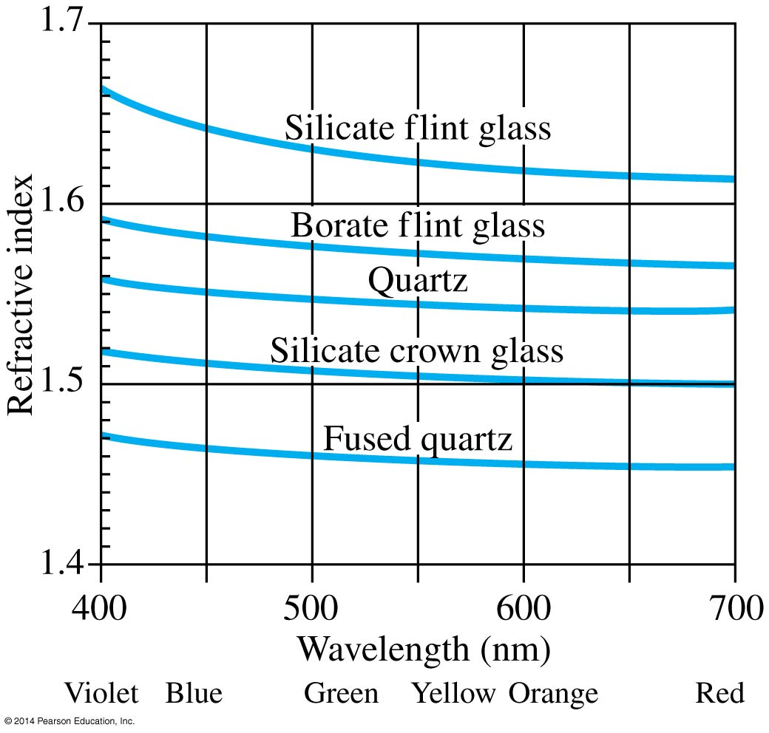
24-4 The Visible Spectrum and Dispersion
The index of refraction of a material varies somewhat with the wavelength of the light.

Slide 19
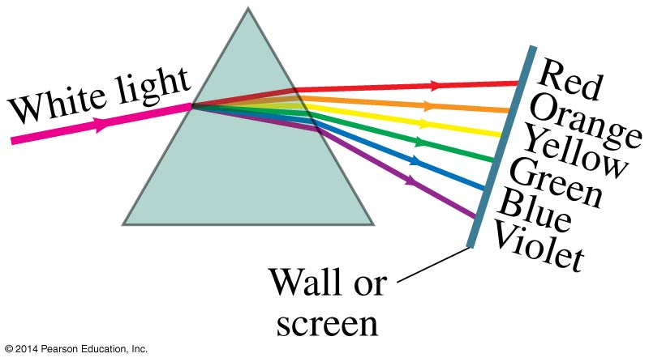
24-4 The Visible Spectrum and Dispersion
This variation in refractive index is why a prism will split visible light into a rainbow of colors.

Slide 20
24-4 The Visible Spectrum and Dispersion
Atmospheric rainbows are created by dispersion in tiny drops of water.

Slide 21
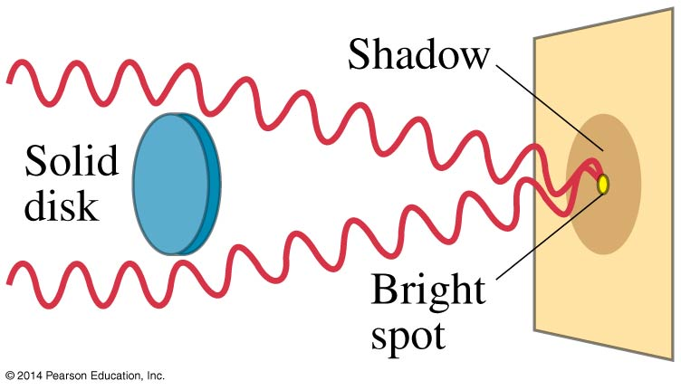
24-5 Diffraction by a Single Slit or Disk
Light will also diffract around a single slit or obstacle.

Slide 22
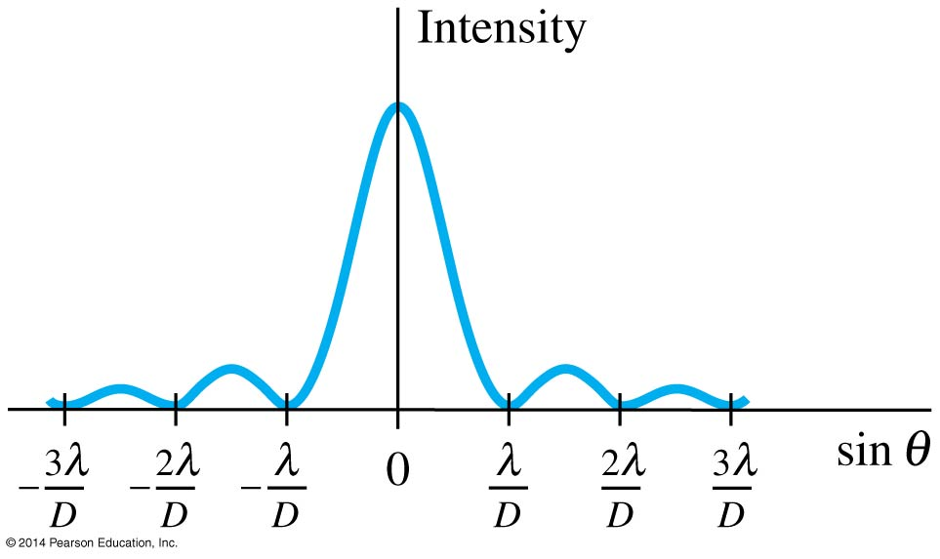
24-5 Diffraction by a Single Slit or Disk
The resulting pattern of light and dark stripes is called a diffraction pattern.
This pattern arises because different points along a slit create wavelets that interfere with each other just as a double slit would.

Slide 23
24-5 Diffraction by a Single Slit or Disk
The minima of the single-slit diffraction pattern occur when
(24-3b)

Slide 24
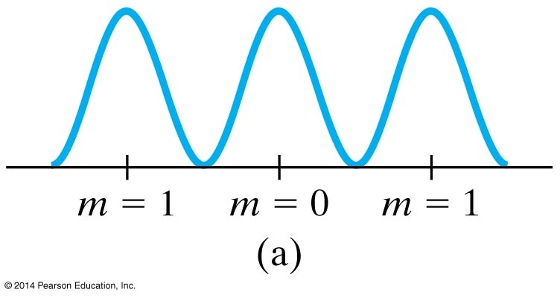
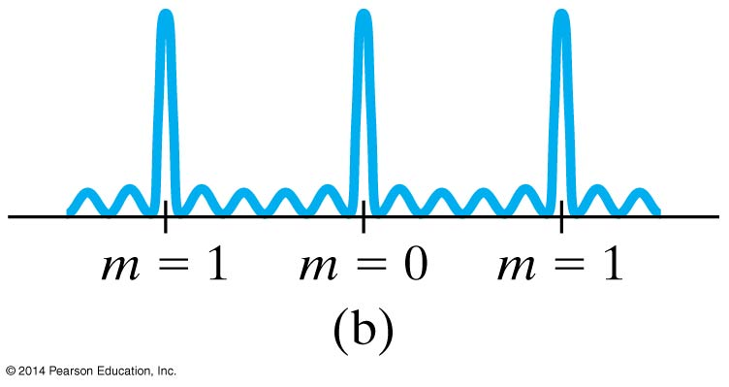
24-6 Diffraction Grating
A diffraction grating consists of a large number of equally spaced narrow slits or lines. A transmission grating has slits, while a reflection grating has lines that reflect light.
The more lines or slits there are, the narrower the peaks.

Slide 25
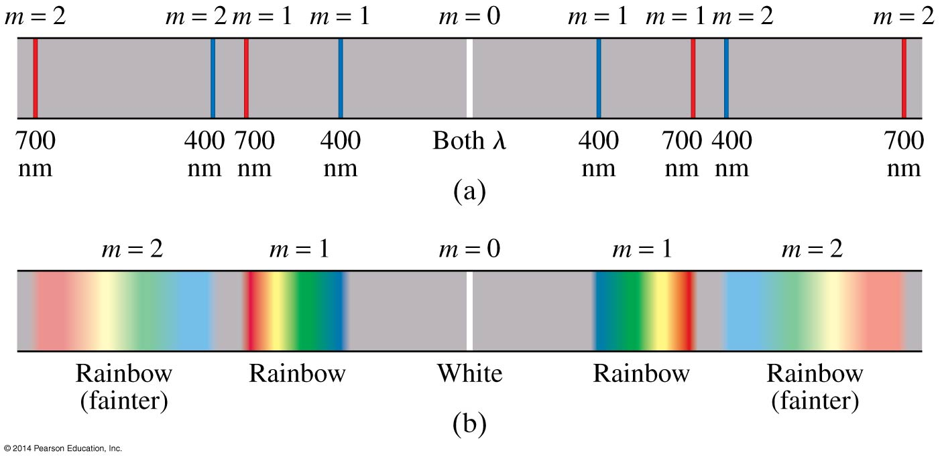
24-6 Diffraction Grating
The maxima of the diffraction pattern are defined by
(24-4)

Slide 26
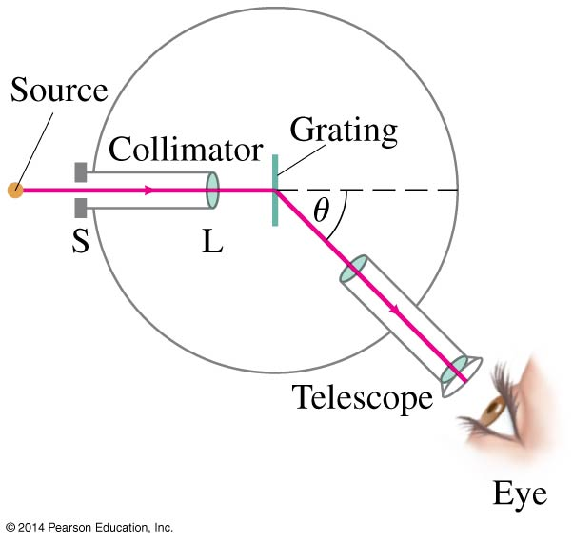
24-7 The Spectrometer and Spectroscopy
A spectrometer makes accurate measurements of wavelengths using a diffraction grating or prism.

Slide 27
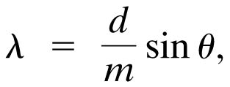
24-7 The Spectrometer and Spectroscopy
The wavelength can be determined to high accuracy by measuring the angle at which the light is diffracted.
Atoms and molecules can be identified when they are in a thin gas through their characteristic emission lines.

Slide 28
24-8 Interference in Thin Films
Another way path lengths can differ, and waves interfere, is if the travel through different media.
If there is a very thin film of material—a few wavelengths thick—light will reflect from both the bottom and the top of the layer, causing interference.
This can be seen in soap bubbles and oil slicks, for example.

Slide 29
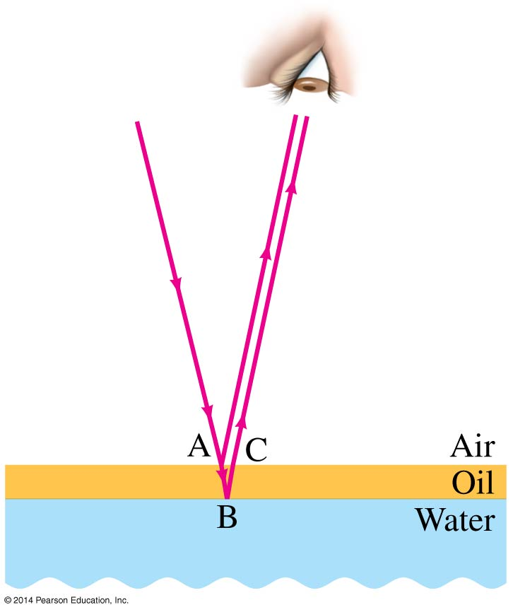
24-8 Interference in Thin Films
The wavelength of the light will be different in the oil and the air, and the reflections at points A and B may or may not involve reflection.

Slide 30
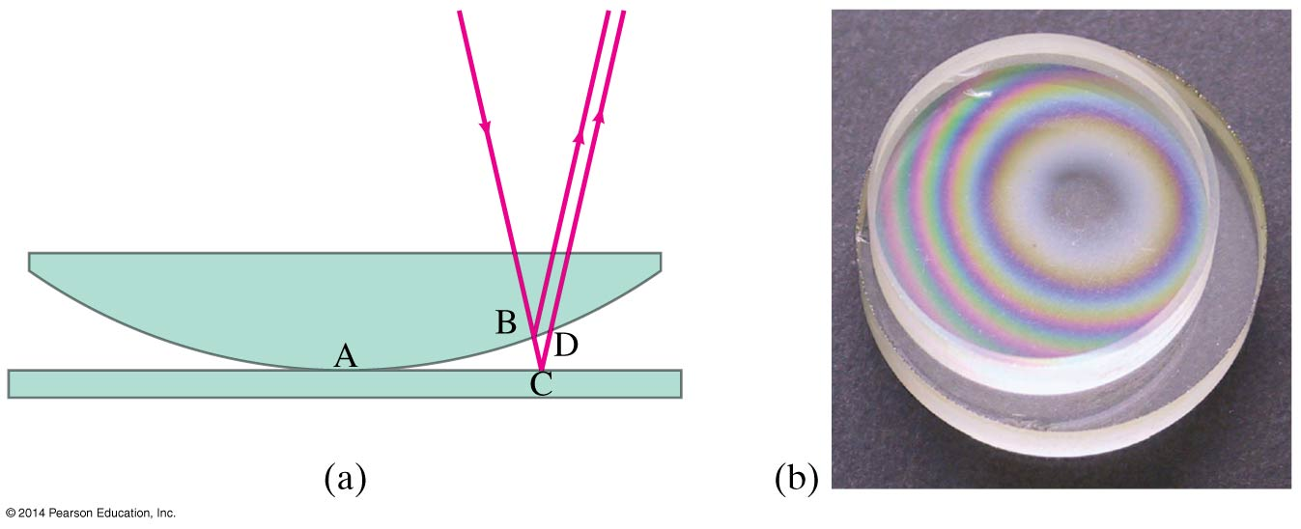
24-8 Interference in Thin Films
A similar effect takes place when a shallowly curved piece of glass is placed on a flat one. When viewed from above, concentric circles appear that are called Newton’s rings.

Slide 31
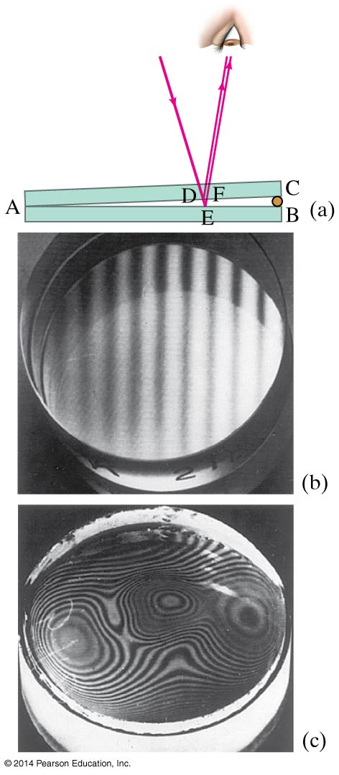
24-8 Interference in Thin Films
One can also create a thin film of air by creating a wedge-shaped gap between two pieces of glass.

Slide 32
24-8 Interference in Thin Films
Problem Solving: Interference
Interference occurs when two or more waves arrive simultaneously at the same point in space.
Constructive interference occurs when the waves are in phase.
Destructive interference occurs when the waves are out of phase.
An extra half-wavelength shift occurs when light reflects from a medium with higher refractive index.

Slide 33
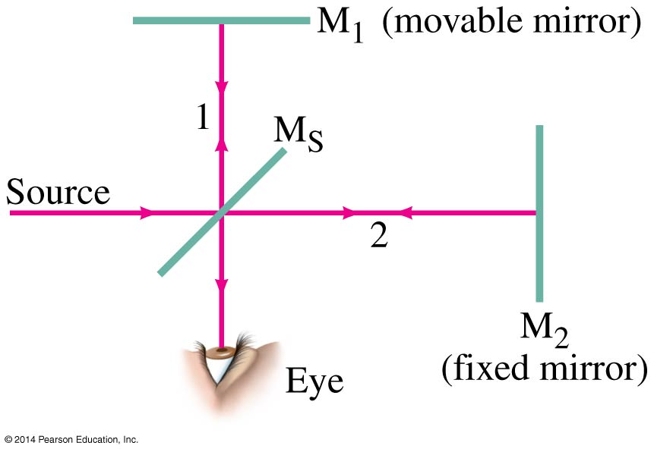
24-9 Michelson Interferometer
The Michelson interferometer is centered around a beam splitter, which transmits about half the light hitting it and reflects the rest. It can be a very sensitive measure of length.

Slide 34
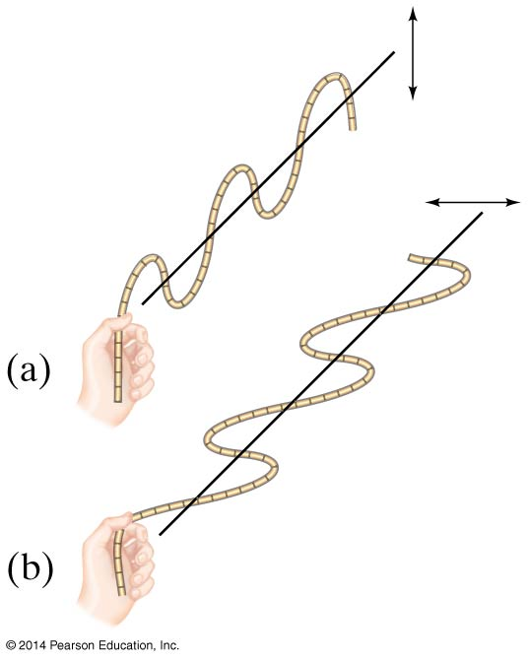
24-10 Polarization
Light is polarized when its electric fields oscillate in a single plane, rather than in any direction perpendicular to the direction of propagation.

Slide 35
24-10 Polarization
Polarized light will not be transmitted through a polarized film whose axis is perpendicular to the polarization direction.

Slide 36
24-10 Polarization
When light passes through a polarizer, only the component parallel to the polarization axis is transmitted. If the incoming light is plane-polarized, the outgoing intensity is:
(24-5)

Slide 37
24-10 Polarization
This means that if initially unpolarized light passes through crossed polarizers, no light will get through the second one.

Slide 38
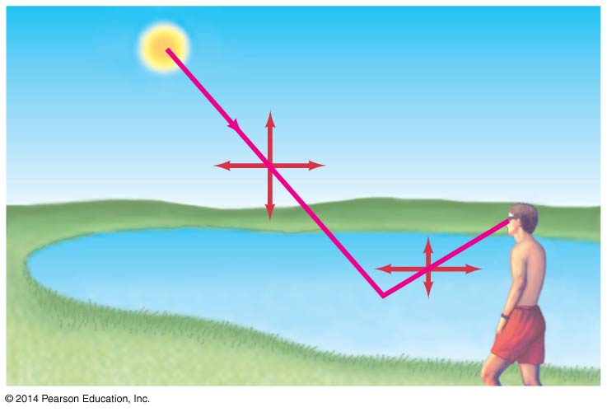
24-10 Polarization
Light is also partially polarized after reflecting from a nonmetallic surface. At a special angle, called the polarizing angle or Brewster’s angle, the polarization is 100%.
(24-6a)

Slide 39
24-11 Liquid Crystal Displays (LCD)
Liquid crystals are unpolarized in the absence of an external voltage, and will easily transmit light. When an external voltage is applied, the crystals become polarized and no longer transmit; they appear dark.

Slide 40
24-11 Liquid Crystal Displays (LCD)
Liquid crystals can be found in many familiar applications, such as calculators and digital watches.
Color LCD displays are more complicated; each pixel has three subpixels to provide the different colors. A source of light is behind the display (unlike calculators and watches, which use ambient light). The pixels must be able to make finer adjustments than just on and off to provide a clear image.

Slide 41
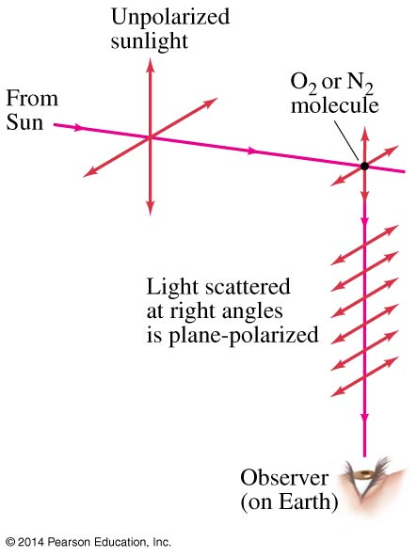
24-12 Scattering of Light by the Atmosphere
Skylight is partially polarized due to scattering from molecules in the air. The amount of polarization depends on the angle that your line of sight makes with the sun.

Slide 42
Summary of Chapter 24
The wave theory of light is strengthened by the interference and diffraction of light
Huygens’ principle: every point on a wavefront is a source of spherical wavelets
Wavelength of light in a medium with index of refraction n:
Young’s double-slit experiment demonstrated interference

Slide 43
Summary of Chapter 24
In the double-slit experiment, constructive interference occurs when
and destructive interference when
Two sources of light are coherent if they have the same frequency and maintain the same phase relationship

Slide 44
Summary of Chapter 24
Visible spectrum of light ranges from 400 nm to 750 nm (approximately)
Index of refraction varies with wavelength, leading to dispersion
Diffraction grating has many small slits or lines, and the same condition for constructive interference
Wavelength can be measured precisely with a spectroscope

Slide 45
Summary of Chapter 24
Light bends around obstacles and openings in its path, yielding diffraction patterns
Light passing through a narrow slit will produce a central bright maximum of width
Interference can occur between reflections from the front and back surfaces of a thin film
Light whose electric fields are all in the same plane is called plane polarized

Slide 46
Summary of Chapter 24
The intensity of plane polarized light is reduced after it passes through another polarizer:
Light can also be polarized by reflection; it is completely polarized when the reflection angle is the polarization angle:

