Slide 1
Section 3-5,6 Keys and Couplings
MET 301

Slide 2
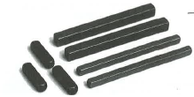
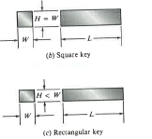
Keys
Key is used to transmit torque between shaft and the component mounted on the shaft.
Square and flat keys are most common.

Slide 3
Other types of keys

Slide 4
Key size

Slide 5
Actual stresses acting on keys are difficult to determine

Slide 6
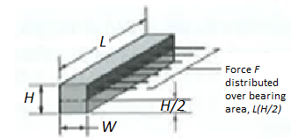
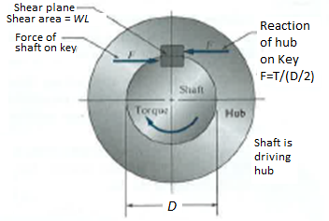
Simplified mechanical stresses equations for shear and compression
Tangential Force at shaft diameter: F= T/(D/2) = 2T/D
Average shear stress τ in Key, should not exceed allowable shear stress τ_{w} =τ_{yp}/N_{fs}
τ = F/(W*L) < τ_{yp}/N_{fs}
or, F/(W*L) < σ_{yp}/(2N_{fs}) ………..(1)
Average bearing (compressive) stress σ in Key, should not exceed compressive stress σ_{w} =σ_{yp}/N_{fs}
σ = F/[(H/2)*L] < σ_{yp}/N_{fs}
or, σ = F/(H*L) < σ_{yp}/(2N_{fs})……..(2)
For square key, W=H, Equation (1) and (2) are essentially same, i.e., shear or bearing stress will produce the same key length.

Slide 7
Stress concentration

Slide 8
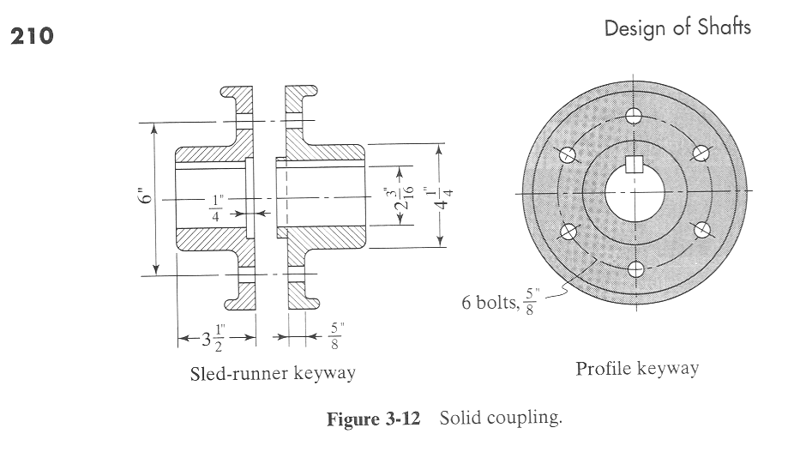
Coupling

Slide 9
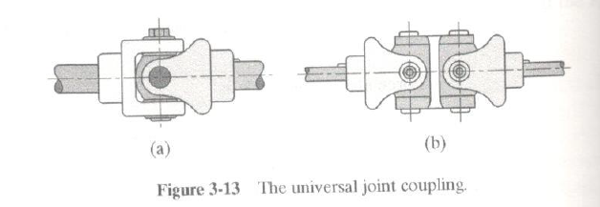
Universal Joint Coupling

