Slide 1
Deep learning architectures
Usman Roshan
NJIT
Figures from
https://www.jeremyjordan.me/convnet-architectures/
https://medium.com/@sidereal/cnns-architectures-lenet-alexnet-vgg-googlenet-resnet-and-more-666091488df5

Slide 2
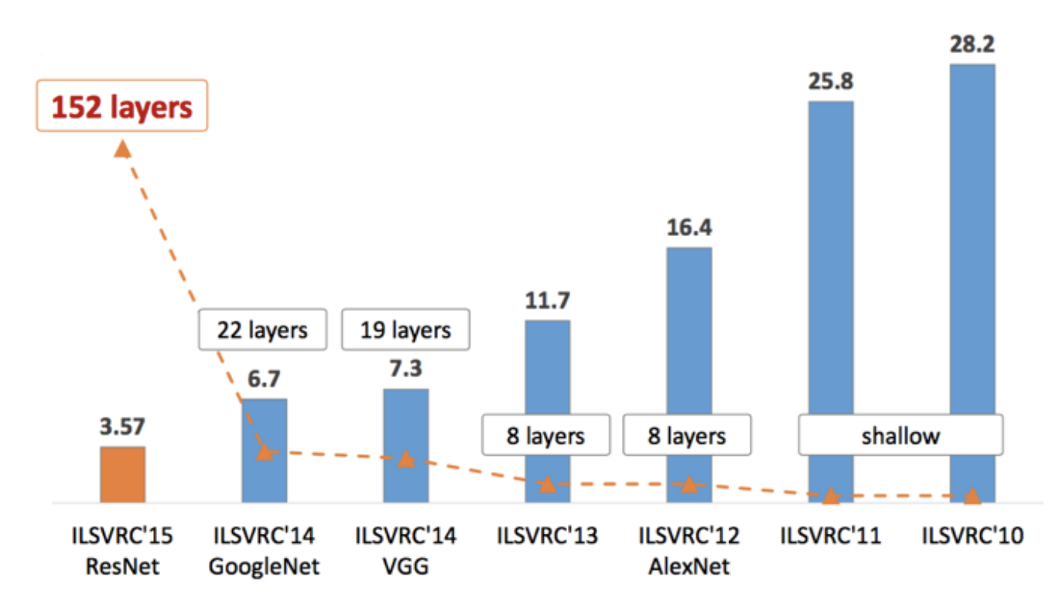
Evolution of networks

Slide 3
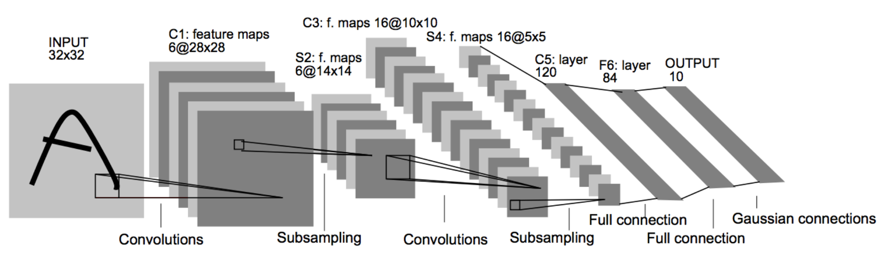
LeNet
Deep learner by Yann LeCunn in 1998 to train on MNIST

Slide 4
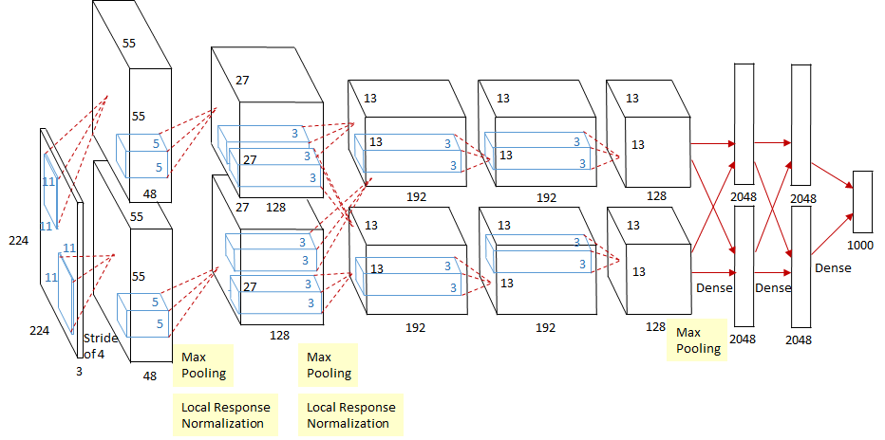
AlexNet
Won ImageNet in 2012

Slide 5
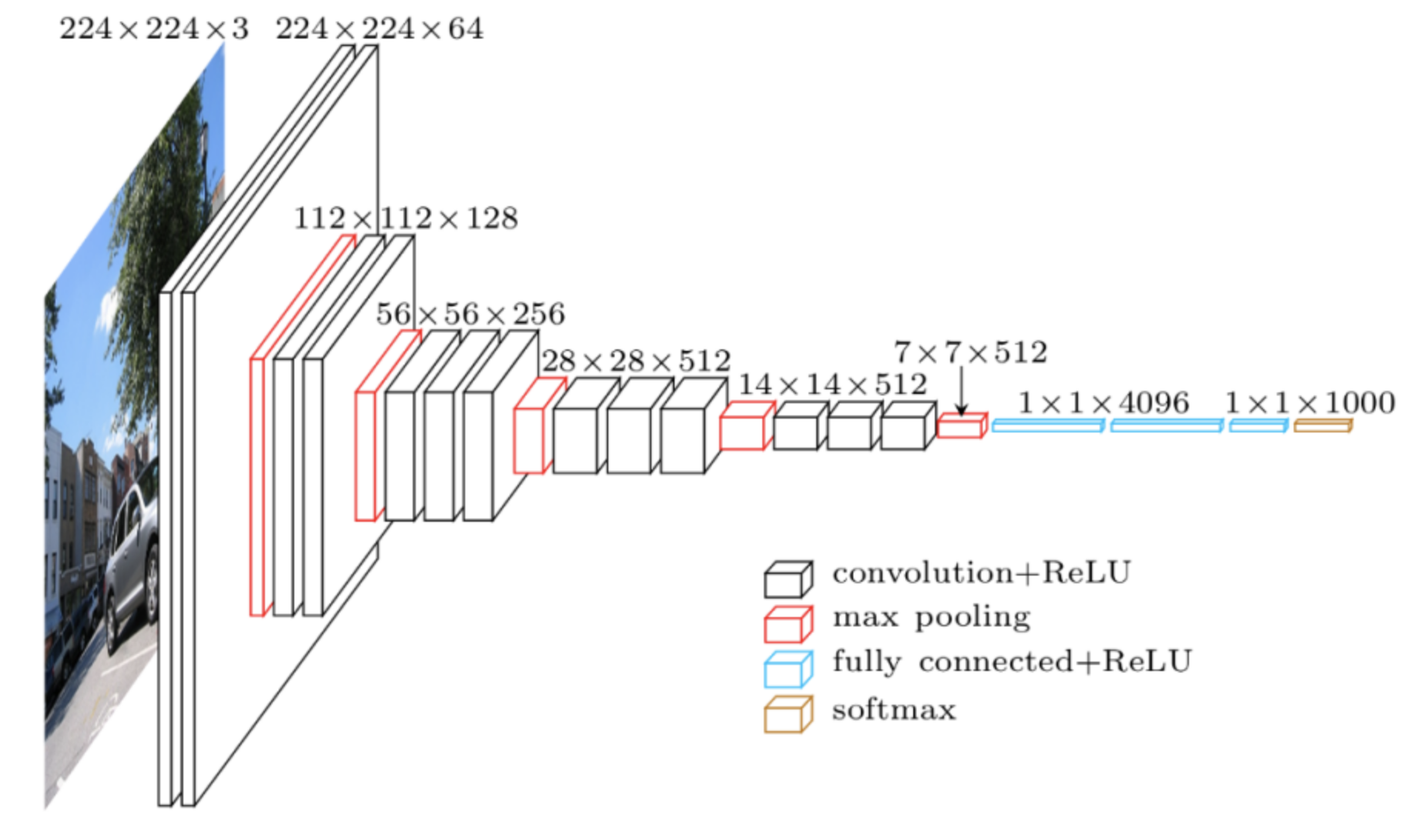
VGG16
Introduced in 2014 by Oxford, won ImageNet classification plus localization

Slide 6
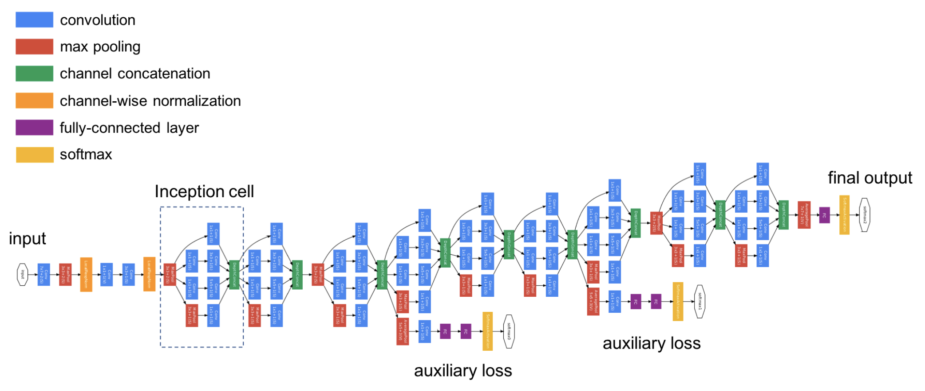
Inception (GoogLeNet) I
Introduced in 2014 by Google, won ImageNet classification only

Slide 7
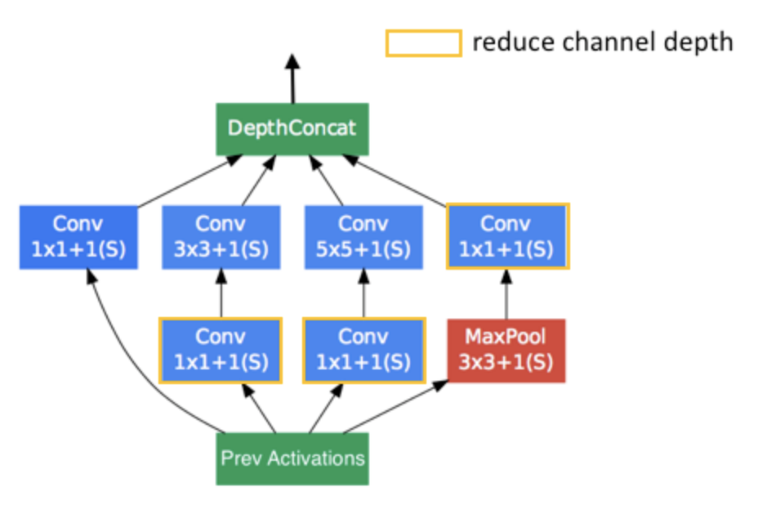
Inception II (Inception cell)
Basic unit of inception

Slide 8
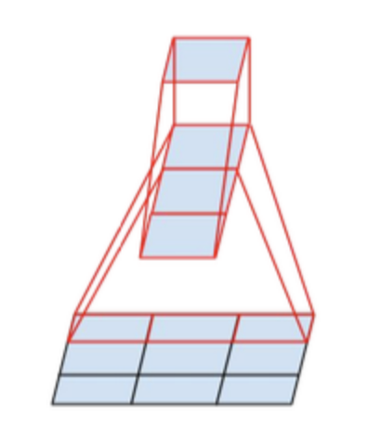
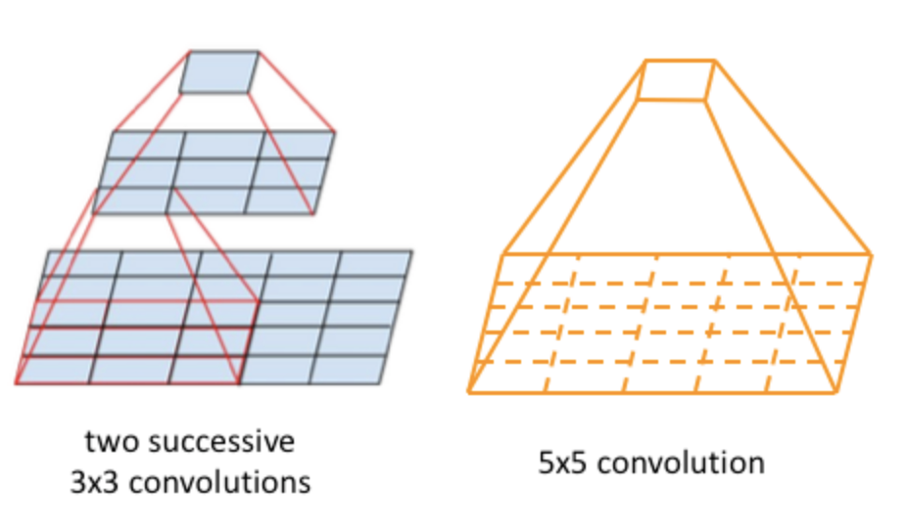
Inception III (efficient large kernel width)
Two stacked 3x3 kernels have a similar
effect of a single 5x5 kernel with fewer
parameters.
Do a 3x3 kernel with successive 1x3
and 3x1 convolutions

Slide 9
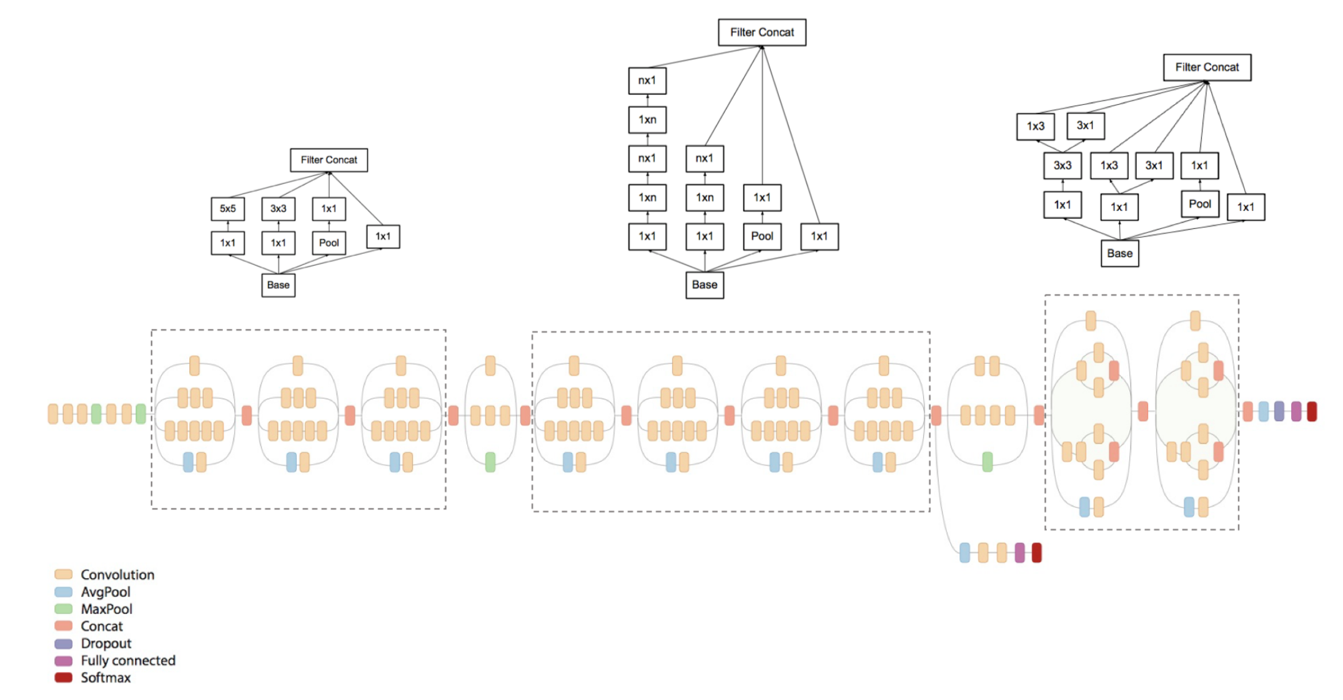
Inception IV

Slide 10
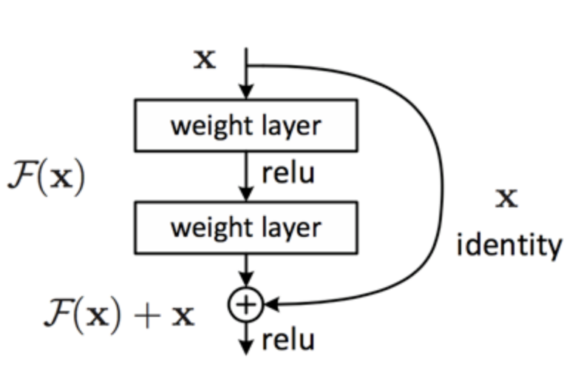
Residual networks
Deep(er) networks suffer from degradation: high error than shallow networks. One reason is vanishing gradients
Residual connections introduced in 2015 to alleviate this problem (won ImageNet the same year)

Slide 11
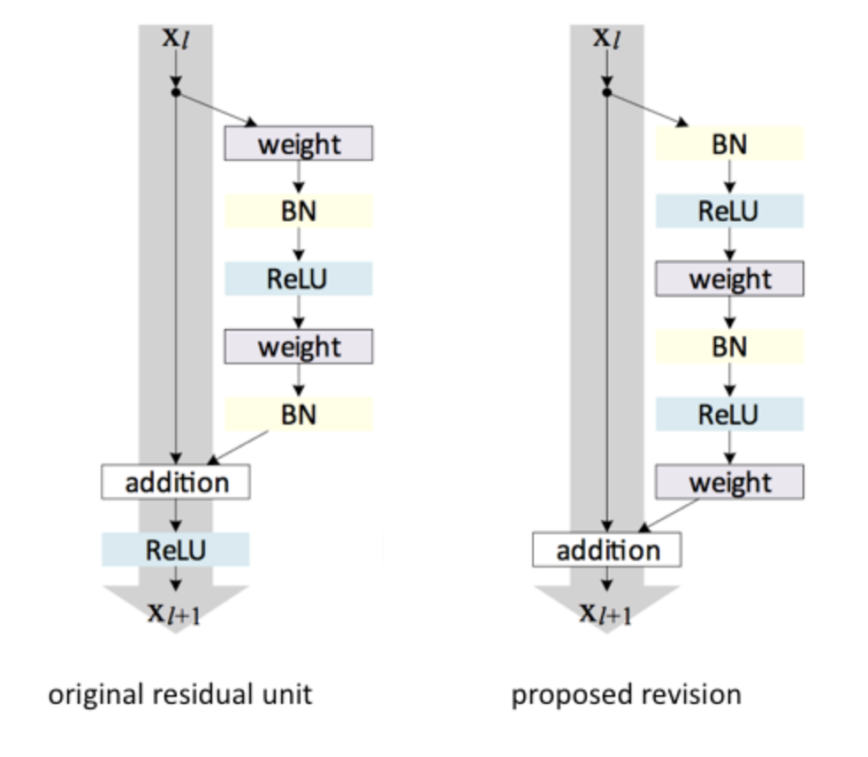
Residual networks II
Relu before residual addition gives better results than after

Slide 12
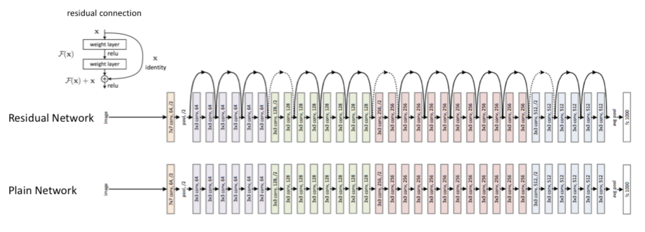
Residual networks

Slide 13
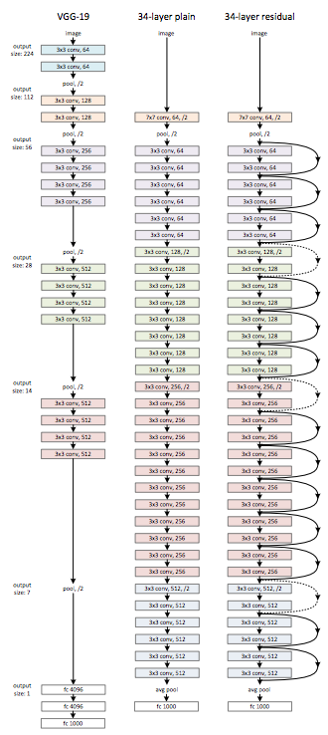
Residual networks

Slide 14
Deep vs. wide networks
Deep: few nodes per layer, many layers
Wide: few layers, many nodes per layer
Turns out that a 3-layer can express functions that a 2-layer network would require exponential nodes (The Power of Depth for Feedforward Neural Networks, Eldan and Shamir, COLT 16)

Slide 15
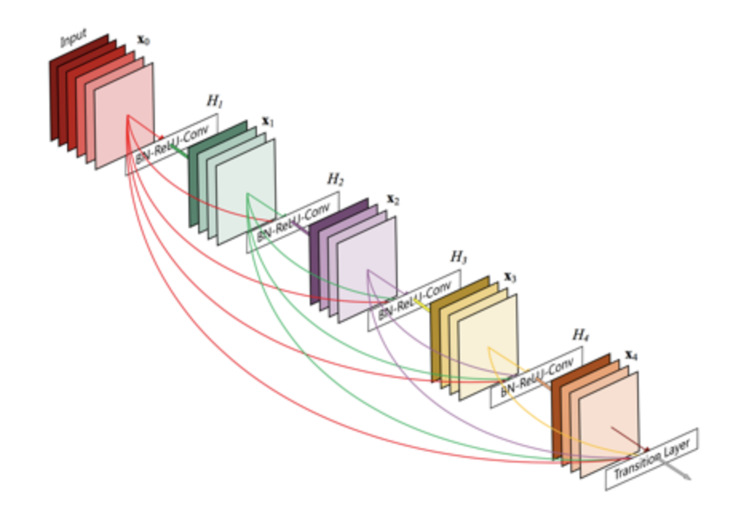
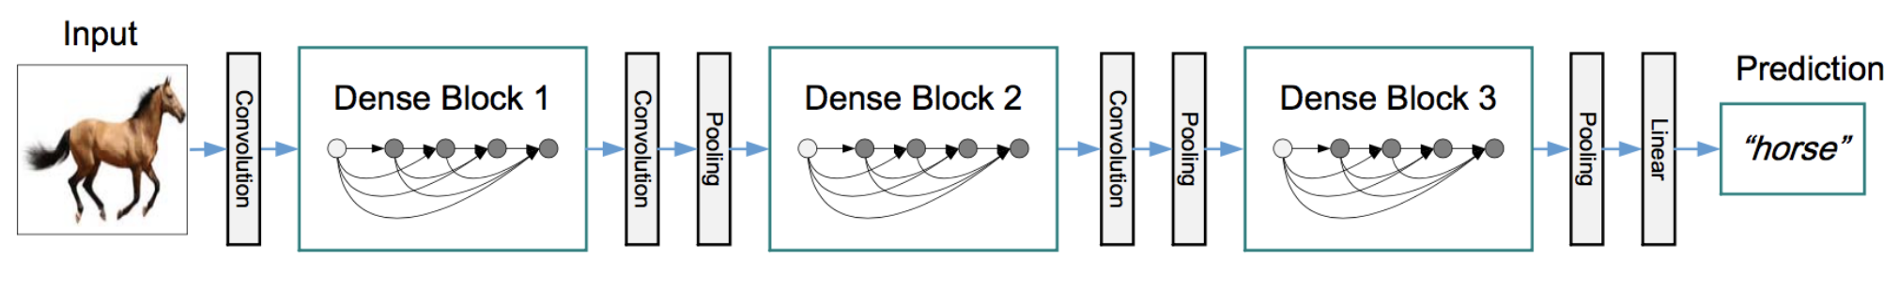
DenseNet
Concatenate output of a layer to all successive layers

Slide 16
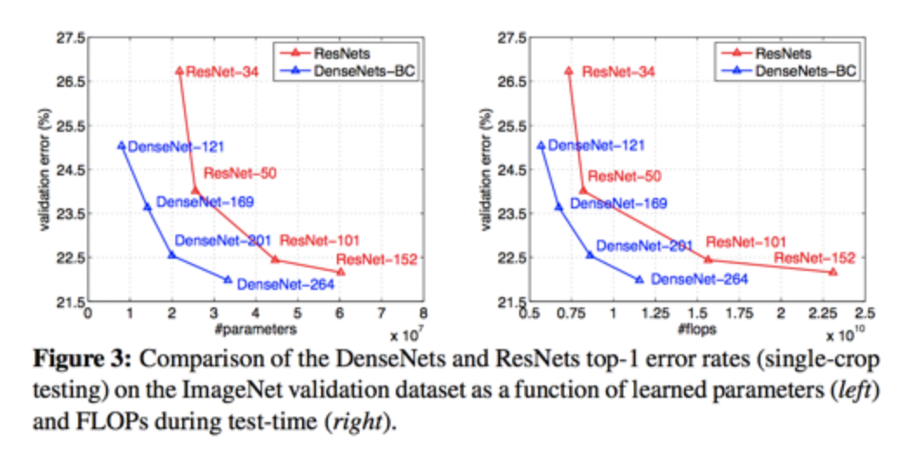
DenseNet vs. ResNet

