Slide 1
Optimizing deep networks
Usman Roshan
Figures from “An overview of gradient descent optimization algorithms” by Sebastian Ruder on arxiv.

Slide 2
Overview
Gradient descent is the standard algorithm

Slide 3
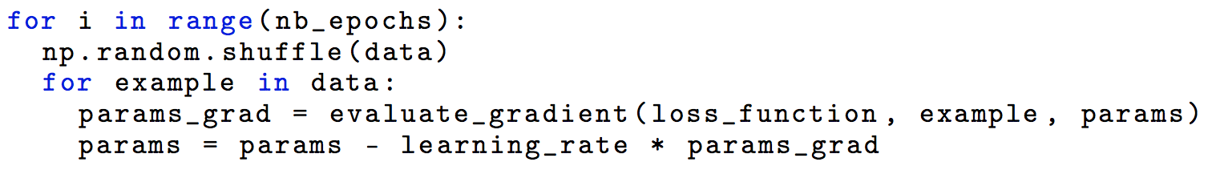
Variants of gradient descent
Stochastic gradient descent

Slide 4
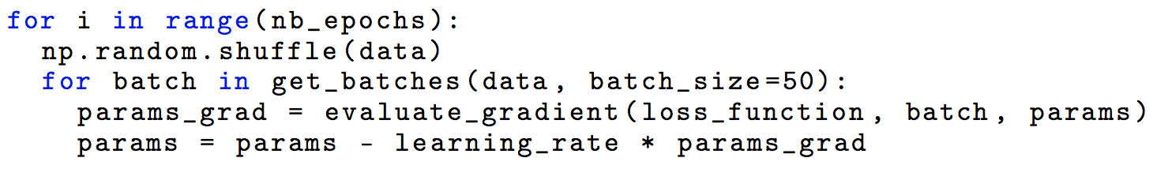
Variants of gradient descent
Mini batch SGD

Slide 5
Challenges
Learning rates
Local minima
We will look at methods to deal with the above issues

Slide 6
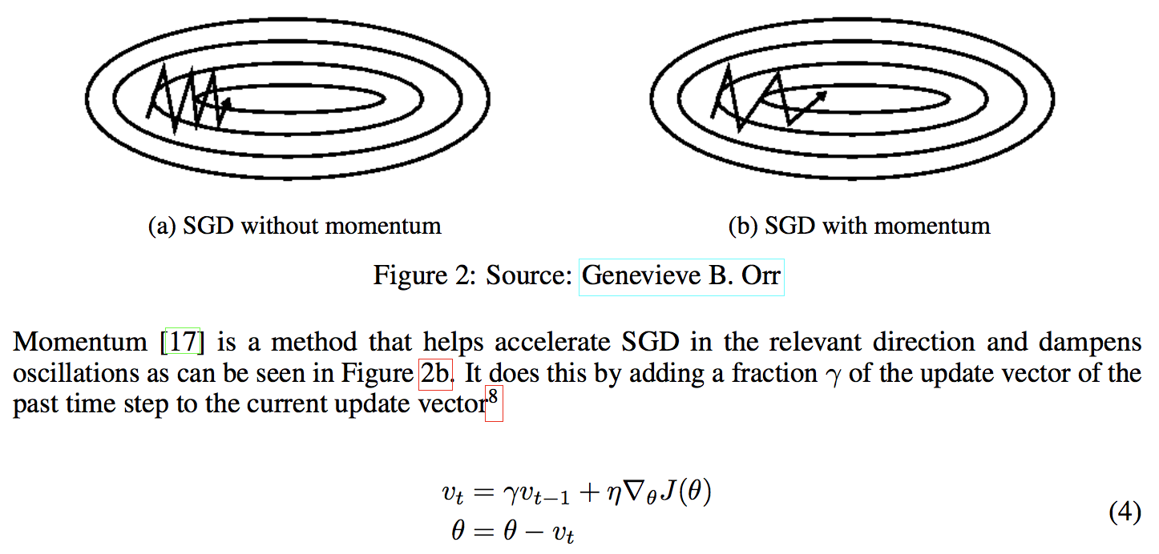
Momentum

Slide 7
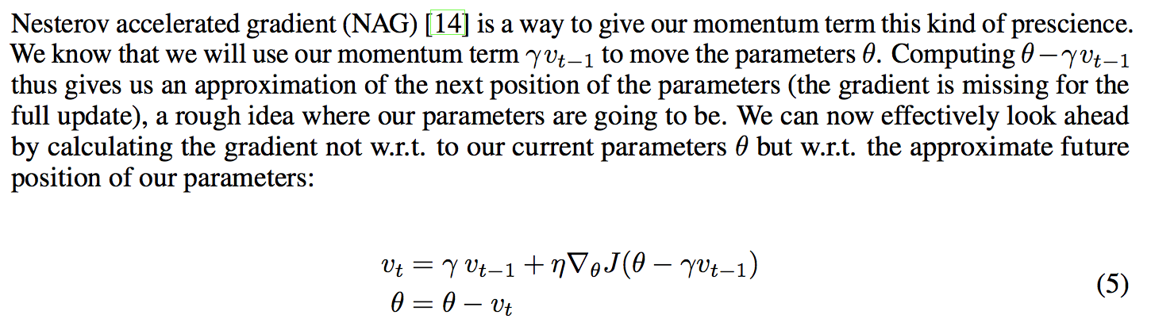
Nesterov momentum

Slide 8
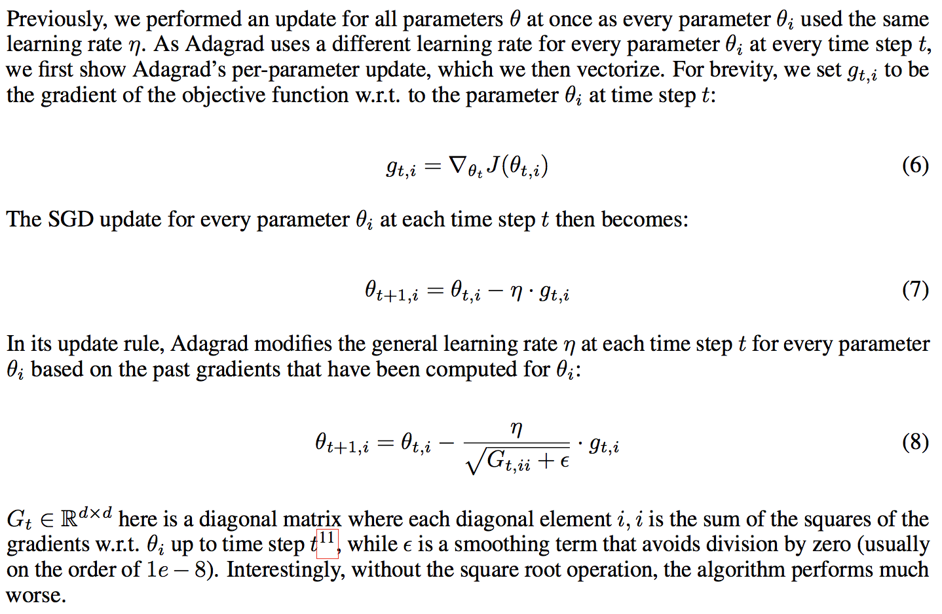
Adagrad

Slide 9
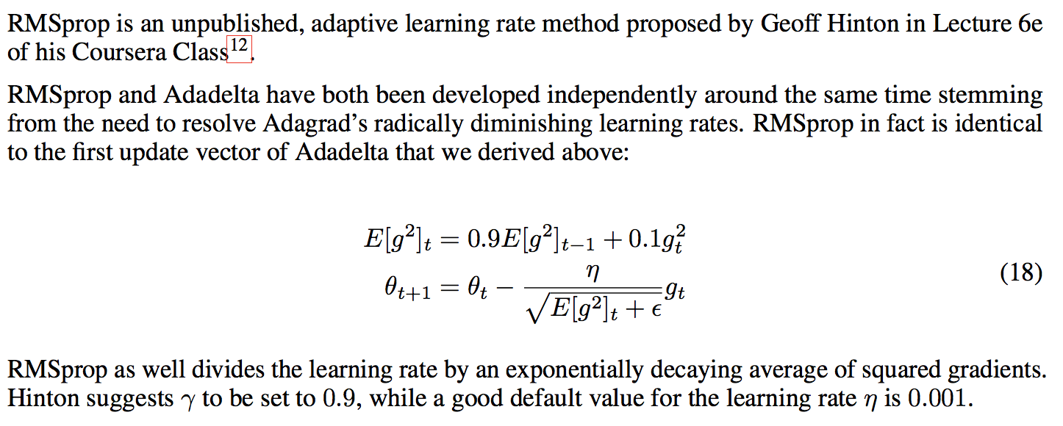
RMS prop

Slide 10
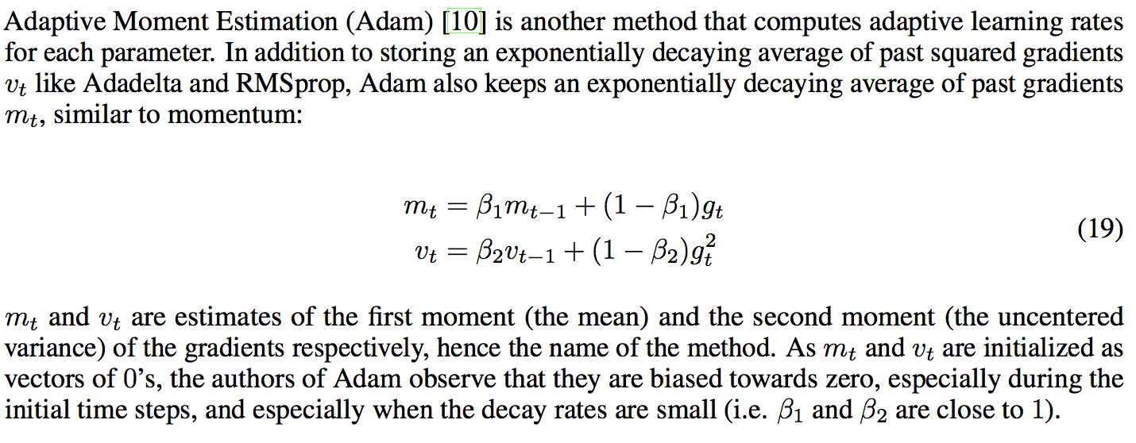
Adam

Slide 11
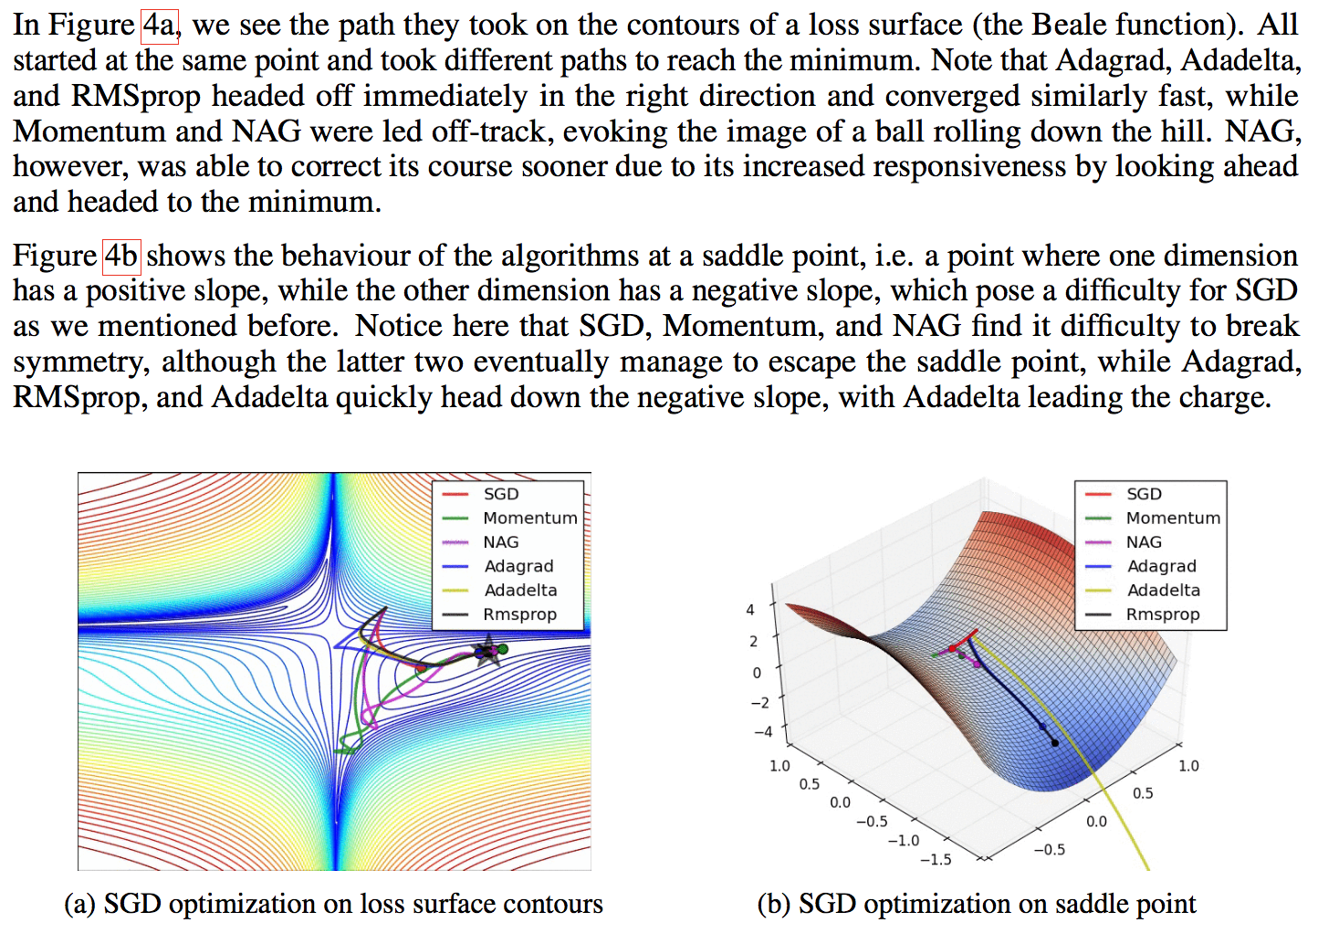
Visualization

Slide 12
Parallelizing SGD
Basic mini-batch SGD is straightforward to parallelize on multiple CPU cores

Slide 13
Additional strategies for SGD
Shuffling order of datapoints in SGD
Batch normalization
Early stopping
Gradient noise

