Slide 1
Multi-layer perceptron
Usman Roshan

Slide 2
Non-linear classification with many hyperplanes
Least squares will solve linear classification problems like AND and OR functions but won’t solve non-linear problems like XOR

Slide 3
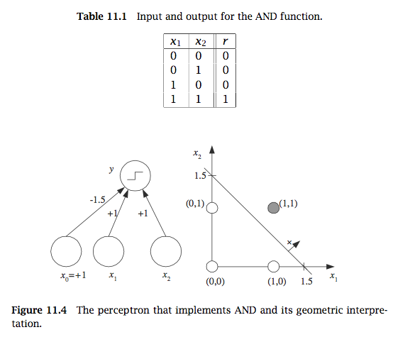
Solving AND with perceptron

Slide 4
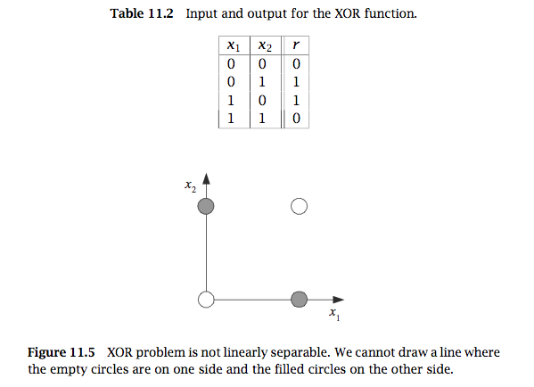
XOR with perceptron

Slide 5
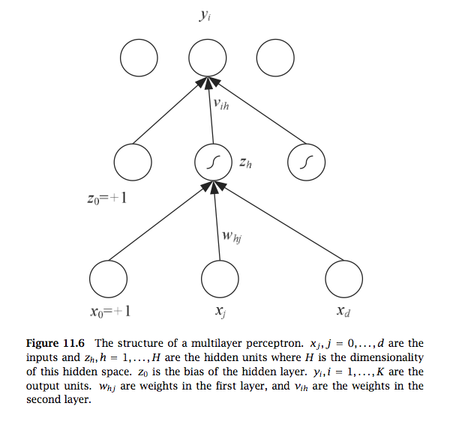
Multilayer perceptrons
Many perceptrons with hidden layer
Can solve XOR and model non-linear functions
Leads to non-convex optimization problem solved by back propagation

Slide 6
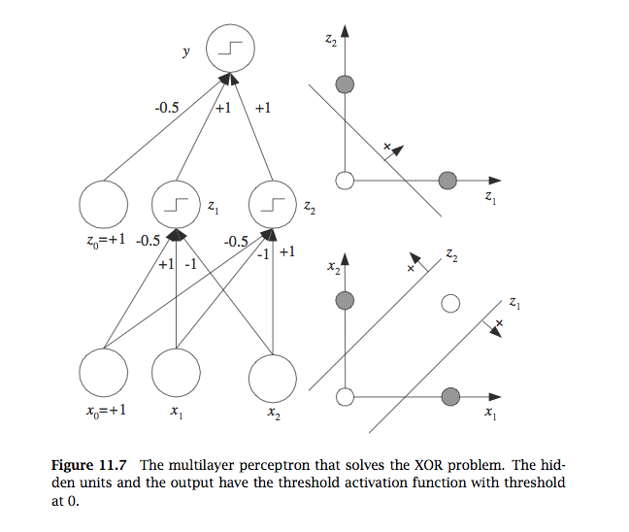
Solving XOR with multi-layer perceptron
z₁ = s(x₁ – x₂ - .5)
z₂ = s(x₂ – x₁ - .5)
y = s(z₁ + z₂ - .5)

Slide 7
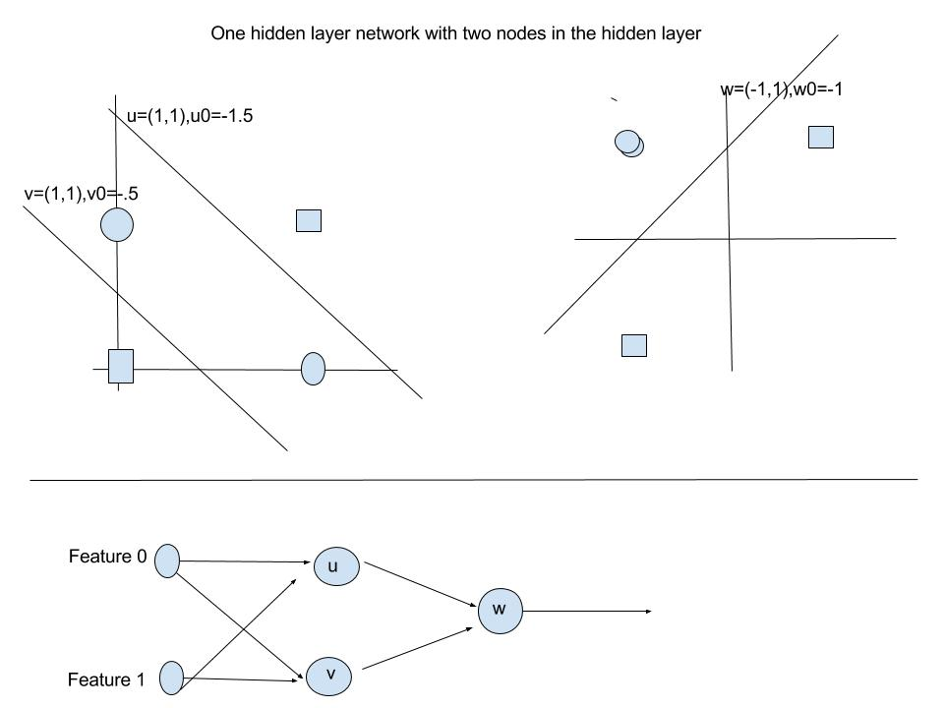
Solving XOR with a single layer and two nodes

Slide 8
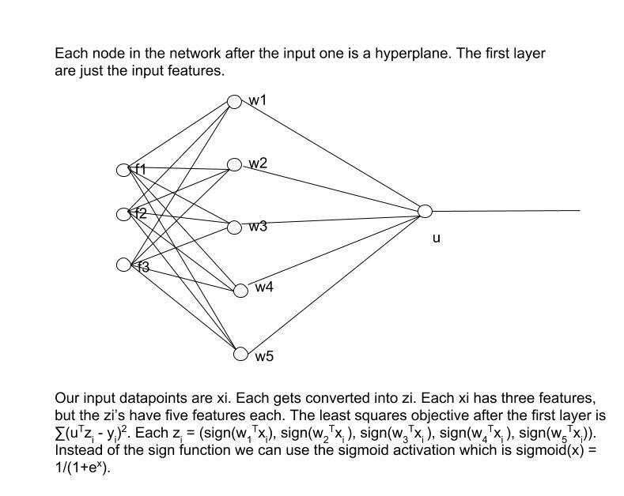

Slide 9
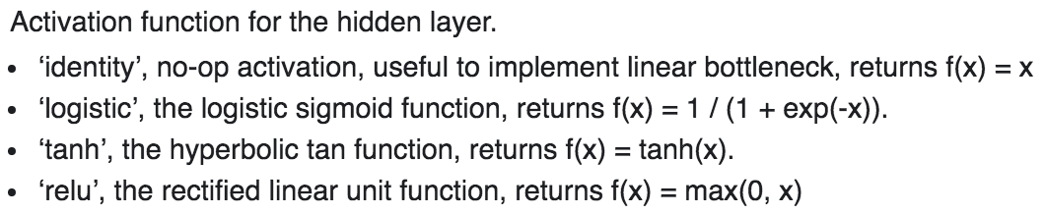
Activation functions
Without this a neural network is just another linear classifier (can you prove it?)
Some typical activations (sign not shown)

Slide 10
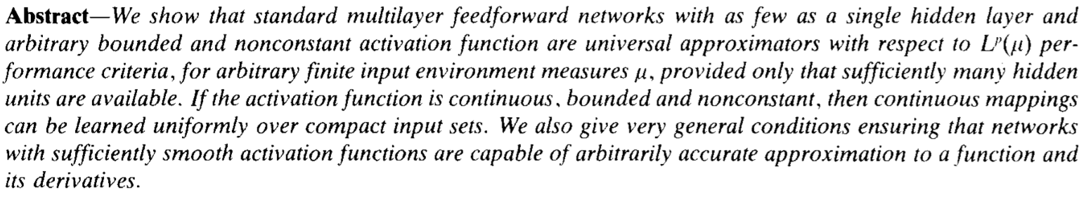
Theorems on neural networks
Any continuous function can be approximated by a single layer neural network within epsilon error (Hornik et. al. 1991)

Slide 11
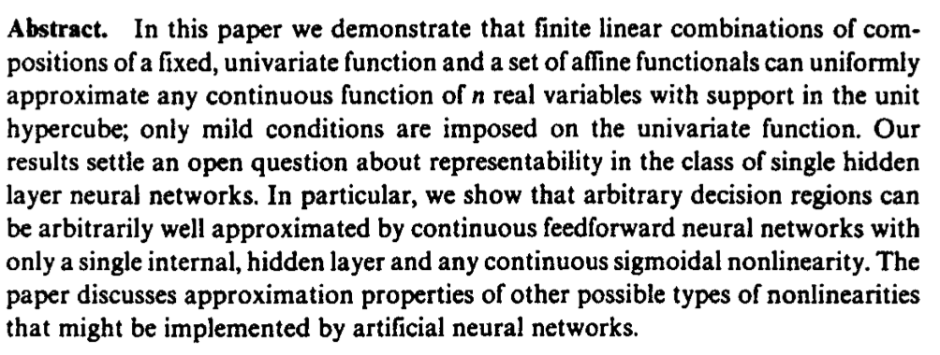
Theorems on neural networks
An earlier result on approximation capabilities of neural networks (Cybenko 1989)

Slide 12
How do we optimize neural net parameters?
First let’s look at the least squares objective again
Let our datapoints x_{i} be in a matrix form X = [x₀,x₁,…,x_{n-1}] and let y = [y₀,y₁,…,y_{n-1}] be the output labels.
Then the perceptron output can be viewed as w^{T}X = y^{T} where w is the perceptron.
And so the perceptron problem can be posed as

Slide 13
Multilayer perceptron
For a multilayer perceptron with one hidden layer we can think of the hidden layer as a new set of features obtained by a linear transformation of each feature.
Let our datapoints x_{i} be in a matrix form X = [x₀,x₁,…,x_{n-1}],y = [y₀,y₁,…,y_{n-1}] be the output labels, and Z = [z₀,z₁,…,z_{n-1}] be the new feature representation of our data.
In a single hidden layer perceptron we have perform k linear transformations W = [w₁,w₂,…,w_{k}] of our data where each w_{i} is a vector.
Thus the output of the first layer can be written as

Slide 14
Multilayer perceptrons
We convert the output of the hidden layer into a non-linear function. Otherwise we would only obtain another linear function (since a linear combination of linear functions is also linear)
The intermediate layer is then given a final linear transformation u to match the output labels y. In other words u^{T}nonlinear(Z) = y’^{T}. For example nonlinear(x)=sign(x) or nolinear(x)=sigmoid(x).
Thus the single layer objective can be written as
Regularized version would be
The back propagation algorithm solves this with gradient descent but coordinate descent can also be applied.

Slide 15
Gradient descent
Recall the objective from above
We differentiate this w.r.t. each weight to obtain the gradient
Alternatively we can take a stepwise approach called back-propagation.
In this method we use the chain rule to calculate partial derivatives and perform the update for each node

Slide 16
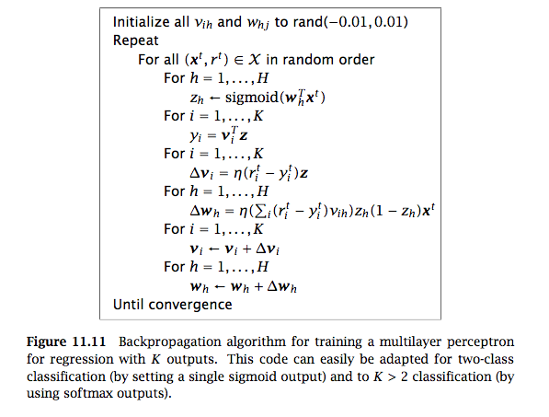
Back propagation
Ilustration of back propagation
  http://home.agh.edu.pl/~vlsi/AI/backp_t_en/backprop.html
Derivation: https://en.wikipedia.org/wiki/Backpropagation#Intuition

Slide 17
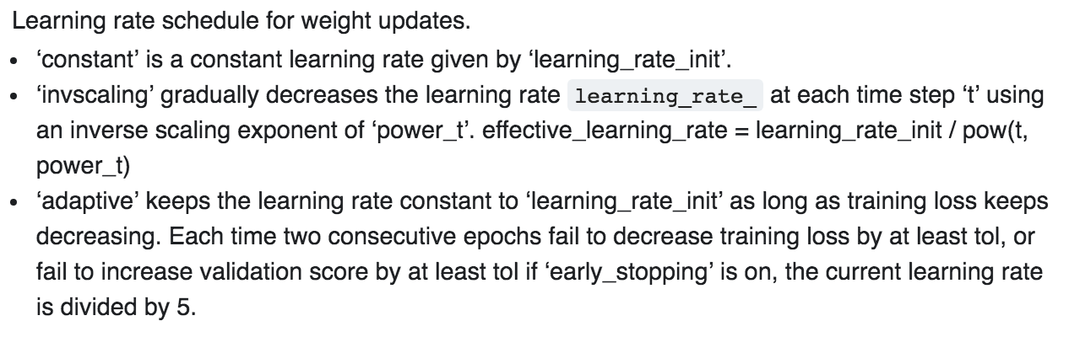
Training issues for multilayer perceptrons
Adaptive learning rate
Overfitting (a big problem in neural networks)

Slide 18
Training issues for multilayer perceptrons
Overfitting (a big problem in neural networks)
New methods employing randomness are highly effective
  Dropout (ignore weights for randomly chosen nodes during training)
  Use different subsets of the input data across iterations
  Data augmentation (used for images)

