Slide 1
Trees, bagging, boosting, and stacking
Usman Roshan

Slide 2
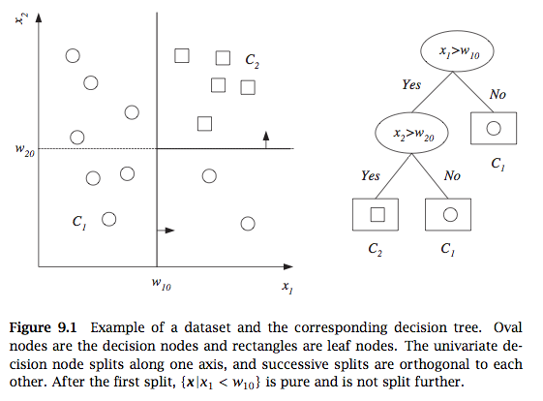
Decision tree
From Alpaydin, 2010

Slide 3
Decision tree

Slide 4
Decision tree construction
For a given dataset there are many trees with no error
Finding the tree with no error and fewest nodes is NP-complete
Finding split in one column
Goodness of split given by entropy, gini index, or misclassification error.
Binary classification: Let p be the proportion of instances in class 0.
Find split that minimizes weighted sum of impurities of child nodes:
Misclassification error: 1 – max(p,1-p)
Entropy: plog(p) – (1-p)log(1-p)
Gini index: 2p(1-p)
Similar approach for regression – (regression trees)

Slide 5
Decision tree splits
Example: consider the simple one dimensional data shown below. Points from class 0 have label x and from class 1 have label o.
x x x o o x x x
Consider split 1 which is just before the first x (trivial split). Consider split 2 which is between the third x and first o.
For split 1
Classification error impurity = 0 + (1)2/8
Gini impurity = 0 + (1)6/8(2/8) = 12/64
For split 2
Classification error impurity = 3/8(0) + 5/8(2/5) = 2/8
Gini impurity = 3/8(0) + 5/8(3/5)(2/5) = 6/40
Thus Gini selects the second split while for misclassification impurity there is a tie

Slide 6
CART algorithm - Training
Recurse(data):
Find column with minimum classification error
If error < threshold then stop
Bipartition the space with the split. Let data_{neg} and data_{pos} be the set of points with negative and positive predicted labels.
Recurse(data_{neg})
Recurse(data_{pos})

Slide 7
CART algorithm - Testing
The training procedure gives us a decision tree.
We classify a given dataset by testing feature values at each node
Example

Slide 8
Multivariate decision trees

Slide 9
Bagging
Randomly sample training data
Determine classifier C_{i} on sampled data
Goto step 1 and repeat m times
For final classifier output the majority vote
Popular example: random forest
Similar to tree bagging
Compute decision trees on bootstrapped datasets
Return majority vote

Slide 10
Bootstrap
The probability of picking one row out of n is 1/n.
Therefore the probability of not picking it is 1-(1/n)
After n trials the probability of not picking it is (1-(1/n))^{n}
As n approaches infinity (1-(1/n))^{n} becomes e⁻¹=0.368. Therefore approximately 63.2% of datapoints are uniquely selected in a bootstrap

Slide 11
Variance reduction by voting
What is the variance of the output of k classifiers?
Thus we want classifiers to be independent to minimize variance
Given independent binary classifiers each with accuracy > ½ the majority vote accuracy increases as we increase the number of classifiers (Hansen and Salamon, IEEE Transactions of Pattern Analysis and Machine Intelligence, 1990)

Slide 12
Random forest
In addition to sampling datapoints (feature vectors) we also sample features (to increase independence among classifiers)
Compute many decision trees and output majority vote
Can also rank features
Comparison against SVM feature selection in genomic data
Alternative to bagging is to select datapoints with different probabilities that change in the algorithm

Slide 13
Bagging vs. random forest

Slide 14
Boosting
Main idea:
Assign equal probabilities to training data
Randomly sample from training data and classify
Redo probabilities by assigning lower values to correctly classified points and higher to misclassified points
Go to step 2 and repeat
Perform final classification with weighted combination of classifiers

Slide 15
Ada-boost
From Alpaydin, 2010

Slide 16
AdaBoost

Slide 17
AdaBoost

Slide 18
AdaBoost

Slide 19
AdaBoost

Slide 20
AdaBoost

Slide 21
Empirical performance
37 random UCI datasets
Number of rows ranges from 99 to 7352
Number of columns ranges from 4 to 1300
Datasets include biological, medical, robotics, business, and social networks
Compared optimized linear SVM program liblinear to fest
Mean liblinear error: 12%
Mean boosted (100) trees error: 10.2%
Mean decision tree error: 14.6%

Slide 22
Stacking

