Slide 1
Clustering
Usman Roshan
Department of Data Science
NJIT

Slide 2
Clustering
Suppose we want to cluster n vectors in R^{d} into two groups. Define C₁ and C₂ as the two groups.
Our objective is to find C₁ and C₂ that minimize
where m_{i} is the mean of class C_{i}

Slide 3
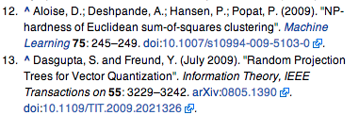

Clustering
NP hard even for 2-means
NP hard even on plane
K-means heuristic
  Popular and hard to beat
  Introduced in 1950s and 1960s

Slide 4
K-means algorithm for two clusters
Input:
Algorithm:
  Initialize: assign x_{i} to C₁ or C₂ with equal probability and compute means:
  Recompute clusters: assign x_{i} to C₁ if ||x_{i}-m₁||<||x_{i}-m₂||, otherwise assign to C₂
  Recompute means m₁ and m₂
  Compute objective
  Compute objective of new clustering. If difference is smaller than then stop, otherwise go to step 2.

Slide 5
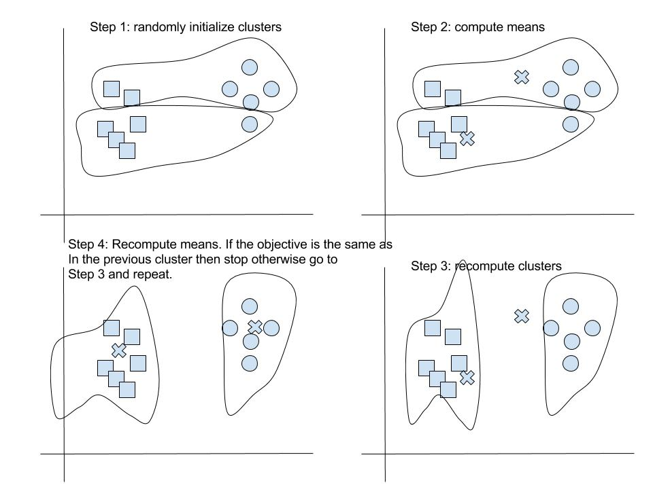
K-means example

Slide 6
K-means
Is it guaranteed to find the clustering which optimizes the objective?
It is guaranteed to find a local optimal
We can prove that the objective decreases with subsequence iterations

Slide 7
Proof sketch of convergence of k-means
Justification of first inequality: by assigning x_{j} to the closest mean the objective decreases or stays the same
Justification of second inequality: for a given cluster its mean minimizes squared error loss

Slide 8
K-means clustering
K-means is the Expected-Maximization solution if we assume data is generated by Gaussian distribution
  EM: Find clustering of data that maximizes likelihood
  Unsupervised means no parameters given. Thus we iterate between estimating expected and actual values of parameters
PCA gives relaxed solution to k-means clustering. Sketch of proof:
  Cast k-means clustering as maximization problem
  Relax cluster indicator variables to be continuous and solution is given by PCA

Slide 9
K-means clustering
K-medians variant:
  Select cluster center that is the median
  Has the effect of minimizing L1 error
K-medoid
  Cluster center is an actual datapoint (not same as k-medians)
Algorithms similar to k-means
Similar local minima problems to k-means

Slide 10
Other clustering algorithms
Spherical k-means
  Normalize each datapoint (set length to 1)
  Clustering by finding center with minimum cosine angle to cluster points
  Similar iterative algorithm to Euclidean k-means
  Converges with similar proofs.

Slide 11
Other clustering algorithms
Hierarchical clustering
  Initialize n clusters where each datapoint is in its own cluster
  Merge two nearest clusters into one
  Update distances of new cluster to existing ones
  Repeat step 2 until k clusters are formed.

Slide 12
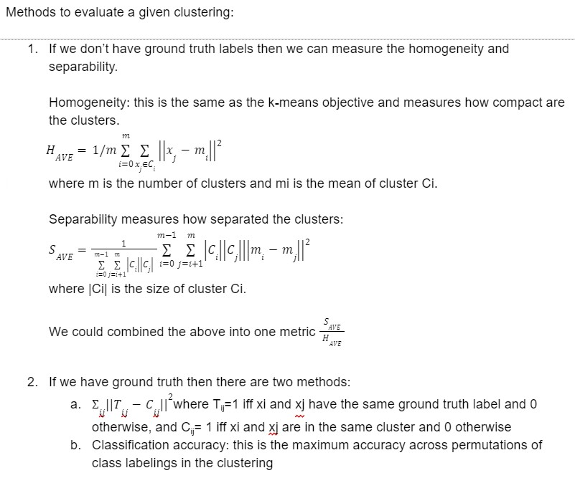

Slide 13
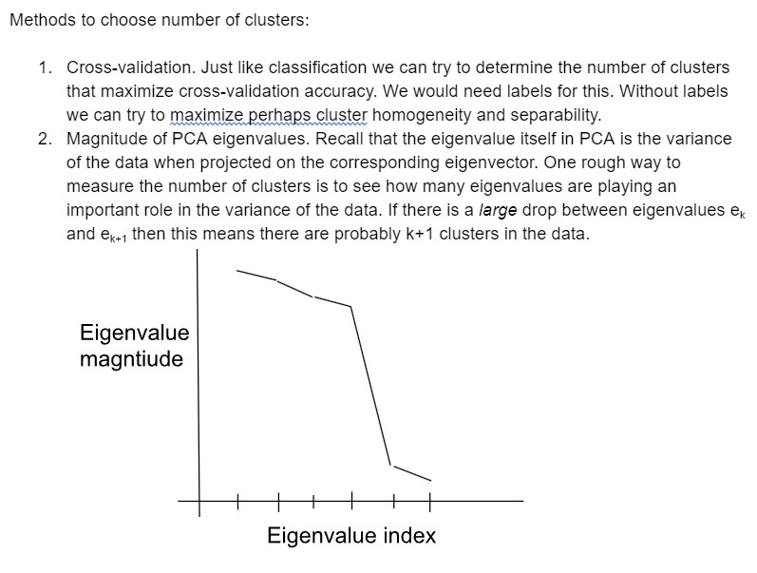

Slide 14
Graph clustering
Graph Laplacians widely used in spectral clustering (see tutorial on course website)
Weights C_{ij} may be obtained via
  Epsilon neighborhood graph
  K-nearest neighbor graph
  Fully connected graph
Allows semi-supervised analysis (where test data is available but not labels)

Slide 15
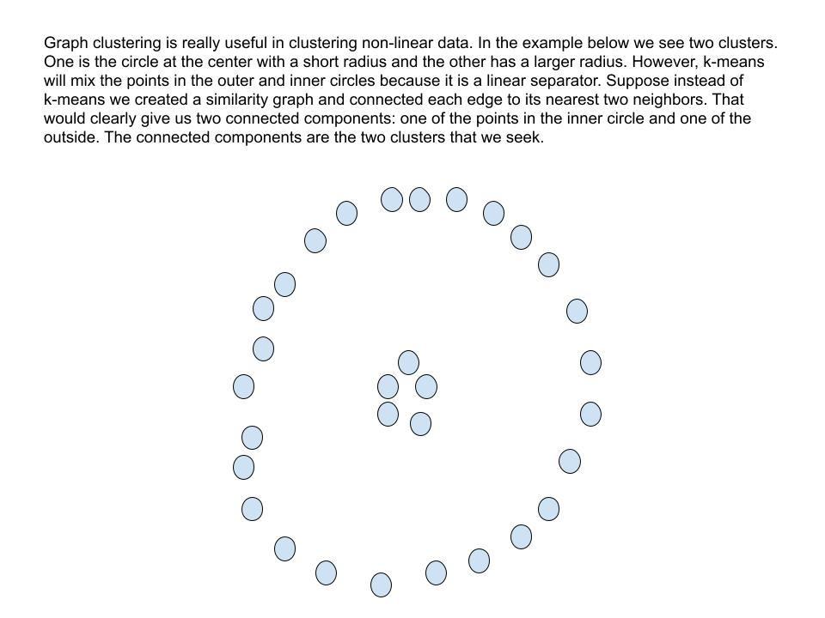
Graph clustering for non-linear data

Slide 16
Graph clustering
We can cluster data using the mincut problem
Balanced version is NP-hard
We can rewrite balanced mincut problem with graph Laplacians. Still NP-hard because solution is allowed only discrete values
By relaxing to allow real values we obtain spectral clustering.

Slide 17
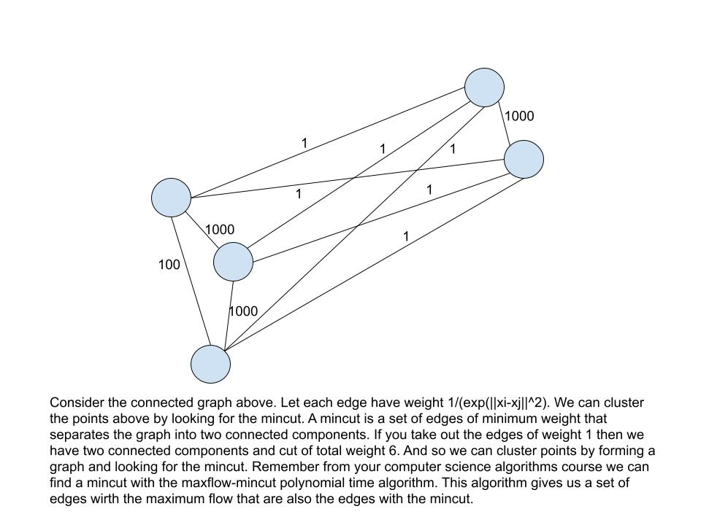
Min cut graph clustering

Slide 18
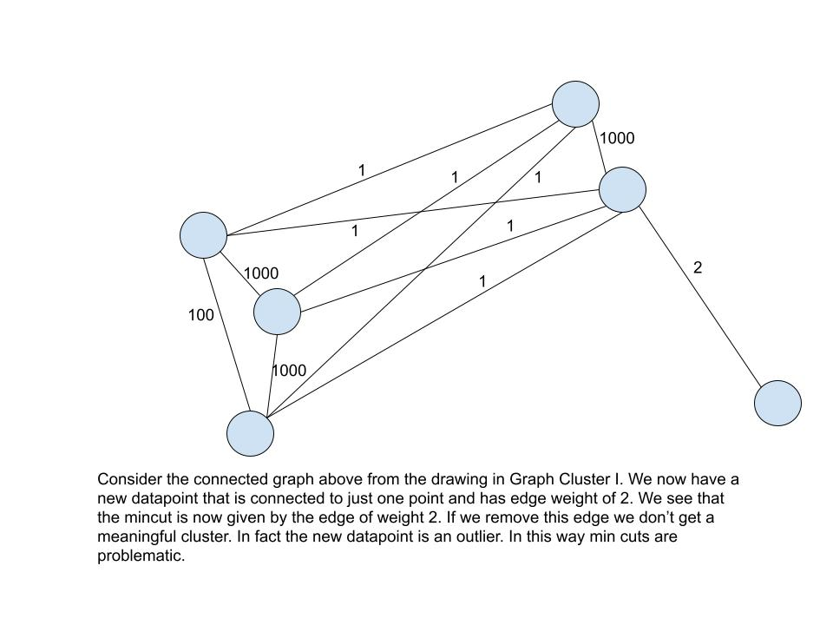
Drawback of min cut approach

Slide 19
Graph clustering
We can cluster data using the mincut problem
Balanced version is NP-hard
We can rewrite balanced mincut problem with graph Laplacians. Still NP-hard because solution is allowed only discrete values
By relaxing to allow real values we obtain spectral clustering.

Slide 20
Graph Laplacians
We can perform clustering with the Laplacian L = D – C where D_{ii} = Σ_{j}C_{ij}
Basic algorithm for k clusters:
  Compute first k eigenvectors v_{i} of Laplacian matrix
  Let V = [v₁, v₂, …, v_{k}]
  Cluster rows of V (using k-means)

Slide 21
Graph clustering
Why does it work?
Relaxation of NP-hard clustering
What is relaxation: changing the hard objective into an easier one that will yield real (as opposed to discrete) solutions and be at most the true objective
Can a relaxed solution give optimal discrete solution? No guarantees

Slide 22
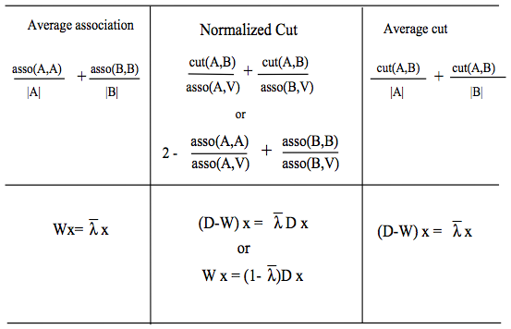
Graph clustering
Cut problems are NP-hard.
We obtain relaxed solutions via eigenvectors of original weight matrix and its Laplacian.
From Shi and Malik,
IEEE Pattern Analysis and
Machine Intelligence, 2000

Slide 23
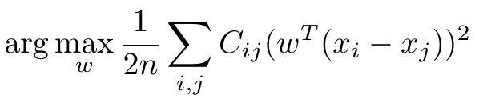

Graph Laplacians and cuts
Recall from earlier the WMV dimensionality reduction criterion
WMV is also given by
where X = [x₁, x₂, …, x_{n}] contains each x_{i} as a column and L is the
graph Laplacian.
Thus

Slide 24
Graph Laplacians and cuts
For a graph with arbitrary edge weights if we define input vectors x in a certain way then the WMV criterion gives us the ratio cut.
For proof see page 9 of tutorial (also give in next slide)

Slide 25
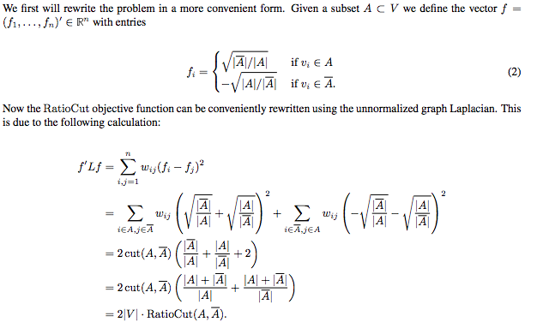
Graph Laplacians and cuts
From Spectral clustering tutorial by Ulrike von Luxborg

Slide 26
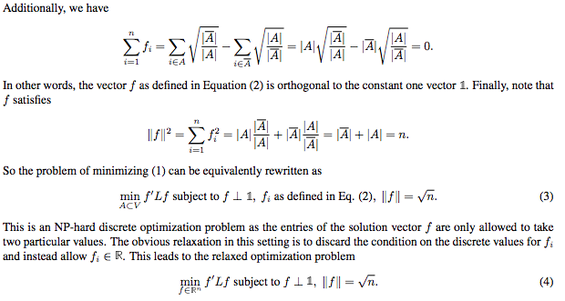
Graph Laplacians and cuts
From Spectral clustering tutorial by Ulrike von Luxborg

Slide 27
Application on population structure data
Data are vectors x_{i} where each feature takes on values 0, 1, and 2 to denote number of alleles of a particular single nucleotide polymorphism (SNP)
Output y_{i} is an integer indicating the population group a vector belongs to

Slide 28
Publicly available real data
Datasets (Noah Rosenberg’s lab):
  East Asian admixture: 10 individuals from Cambodia, 15 from Siberia, 49 from China, and 16 from Japan; 459,188 SNPs
  African admixture: 32 Biaka Pygmy individuals, 15 Mbuti Pygmy, 24 Mandenka, 25 Yoruba, 7 San from Namibia, 8 Bantu of South Africa, and 12 Bantu of Kenya; 454,732 SNPs
  Middle Eastern admixture: contains 43 Druze from Israil-Carmel, 47 Bedouins from Israel-Negev, 26 Palestinians from Israel-Central, and 30 Mozabite from Algeria-Mzab; 438,596 SNPs

Slide 29
East Asian populations

Slide 30
African populations

Slide 31
Middle Eastern populations

Slide 32
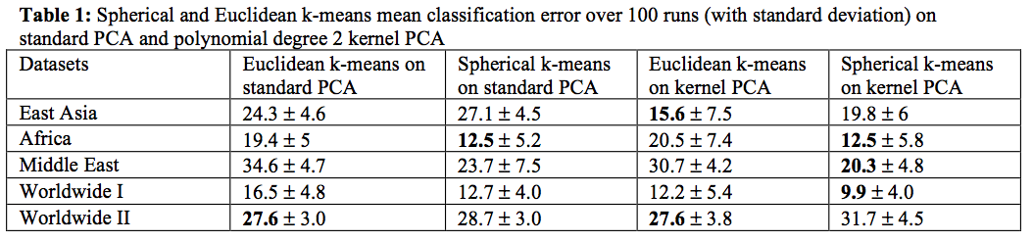
K-means applied to PCA data
PCA and kernel PCA (poly degree 2)
K-means and spherical k-means
Number of clusters set to true value

