Slide 1
Convolutional neural network
Usman Roshan

Slide 2
Convolutions
Now that we understand convolutions let us look at a convolutional neural network
The key is to remember that convolutions give us a new representation of an image
Can we try to optimize the parameters of a convolutional network for image classification?
First let us see a typical convolutional neural network

Slide 3
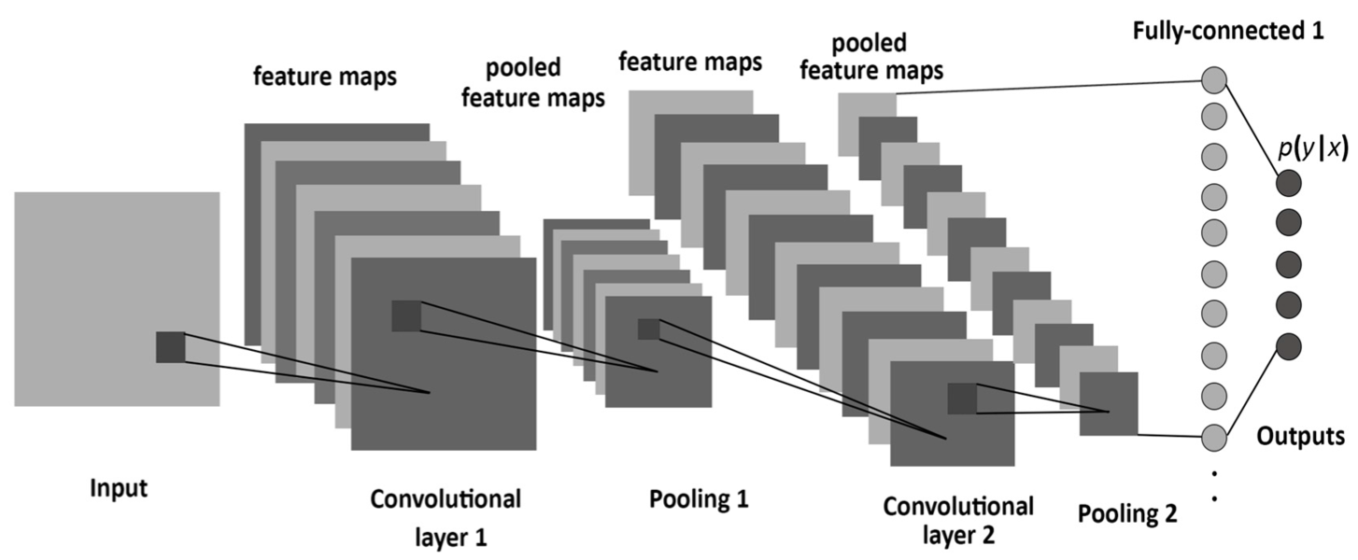
Convolutional neural network
Below we see a typical convolutional neural network.

Slide 4
Convolutional neural network (CNN)
We see that a CNN has two main components: convolutions and pooling
Convolutions serve to partition the image and look at local regions instead of the entire image as given
Pooling reduces dimensionality which helps in the optimization of parameters

Slide 5
CNN training
We train a CNN with stochastic gradient descent as we do in neural networks
Main ideas:
  Back propagation to determine convolutional parameters (see https://becominghuman.ai/back-propagation-in-convolutional-neural-networks-intuition-and-code-714ef1c38199 for a simple example)
  Dropout (see http://jmlr.org/papers/v15/srivastava14a.html)
  Stochastic gradient descent (see https://leon.bottou.org/publications/pdf/compstat-2010.pdf)
  Data augmentation

Slide 6
CNN training
For a typical network we have many parameters that take long to train
To speed this up the training is performed on GPUs by parallelizing dot products for example
Libraries to train CNNs:
  Keras (easy to use front end but slow)
  Pytorch (not hard to use and allows fast development)
  Tensorflow (hardest to use but also the fastest, new version may have a Keras interface)
We will train a simple CNN for the flower image dataset

