Slide 1
Convolutional filters
Usman Roshan

Slide 2
Convolutional filter
Mathematically speaking a convolution is defined as an integral of two functions f and g after one is reversed and shifted
We can think of a convolution as the product of two functions over a moving interval
Used in various fields like electrical engineering (signal processing) and image processing

Slide 3
Convolutional filters on images
A convolutional kernel for images is given by a k x k convolutional kernel and stride s. We apply the kernel starting from the top left of the image and shift it by s pixels to the right.
Once we have reached crossed the image we then move the kernel down by s rows and repeat.
If the stride takes the kernel outside the image we pad the missing data with zeros.

Slide 4
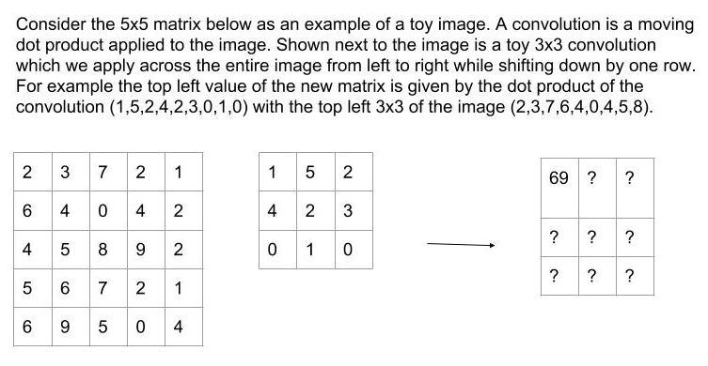
Convolutional filters on images

Slide 5
Convolutions in practice
Convolutions are used to perform operations on images such as edge detection, sharpening, blurring, etc.
These are custom convolutions designed to obtain specific effects
We see several examples of convolution kernels here https://en.wikipedia.org/wiki/Kernel_(image_processing)

Slide 6
Interpretation of convolutions
In our machine learning framework data are feature vectors. So how do convolutions fit into this framework?
We can think of a convolution as linear classifier since it is performing a dot product
But the vector space is the space of patches of images instead of the entire image
To understand this better let us look at a toy example

Slide 7
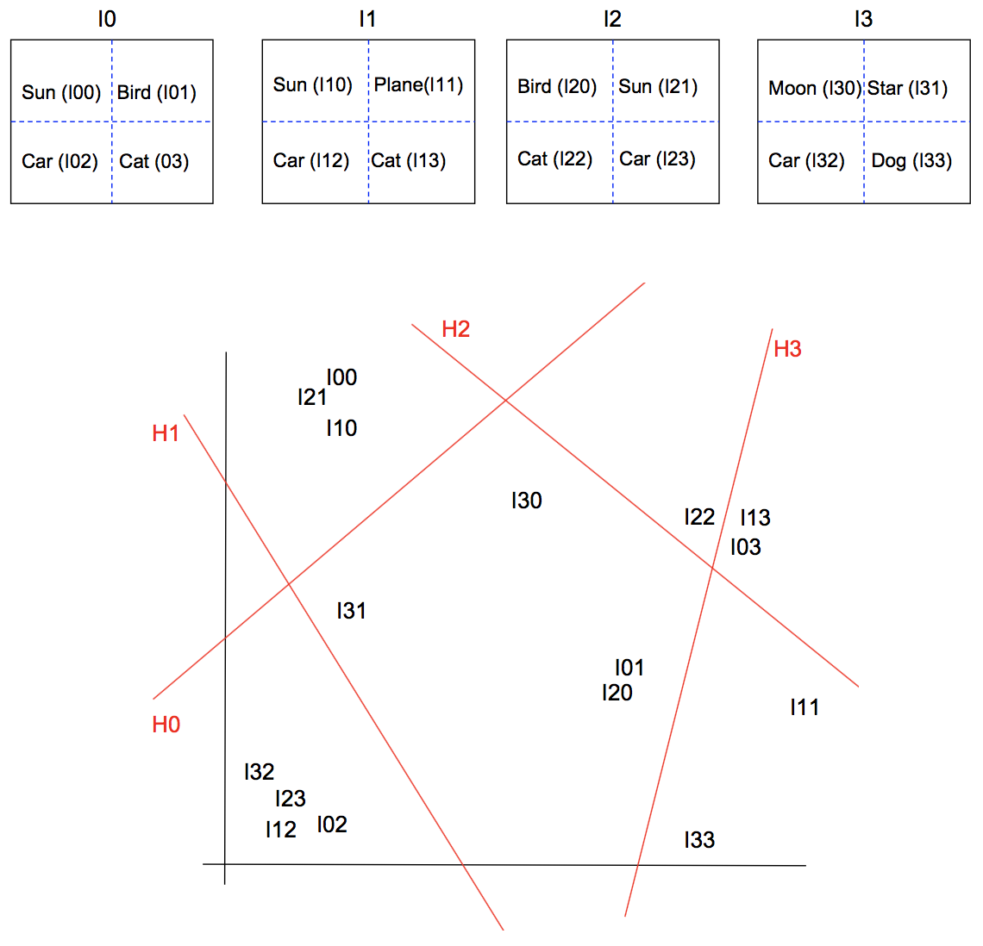
Understanding convolutions
Consider four toy images on the right containing various objects.
Let us divide each image into four quadrants and imagine we plot each quadrant as shown in the graph.
We intentionally place the same object in each image in the same vicinity since they are likely to be similar (at least we assume so)
In red we see four hyperplanes of the same dimensions as each quadrant
Each hyperplane can by thought of as a convolution of half the dimension of the images and a large stride.
The output of a convolution filter can be thought of as the classification given by the hyperplane

Slide 8
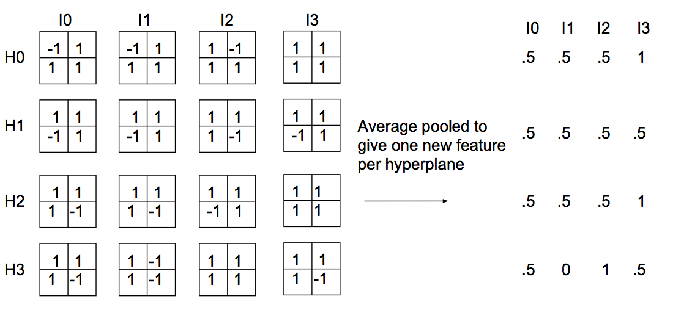
Understanding convolutions
For each image we have four parts. Thus we represent each image as the output of each part given by the red hyperplanes (or convolutions) shown previously
Are the images more similar as feature vectors?
Indeed they are if we simply average the outputs given by each convolution and consider each convolution as a new coordinate to represent the image

Slide 9
Image classification with machine learning and classifications
We will classify images with the linear support vector machine
We will then perform convolutions and redo the classification to see if there is any improvement

