Slide 1
Gradient free optimization for deep learning
Usman Roshan
NJIT

Slide 2
Derivative free optimization
Pros:
  Can handle any activation function (for example sign)
  Free from vanishing and exploding gradient problems
Cons:
  May take longer than gradient search
Does it work for deep learning and what do we know there?

Slide 3
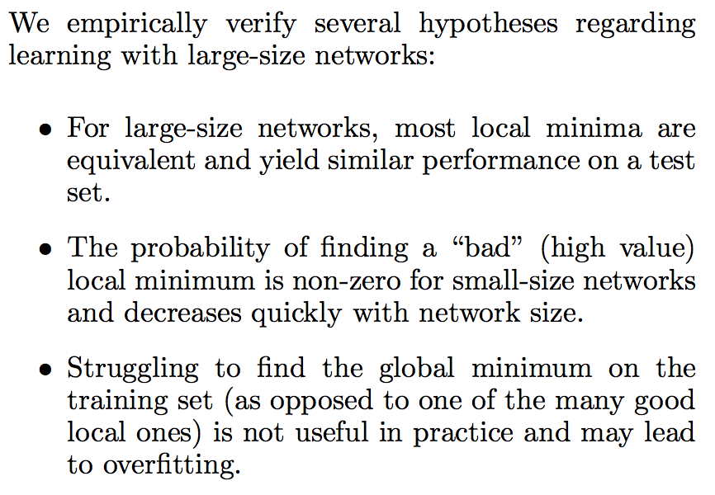
What do we know about the search space of deep networks?
From “The Loss Surfaces of Multilayer Networks”, AISTATS 2014

Slide 4
Other methods for deep learning optimization
Ant colony optimization
Simulated annealing
Both report minor improvements
Previous studies show the importance of architecture
Even gradient descent is a bit of an overkill. For example random weights will go a long way in deep learning. Dropout zeros out many nodes. Perhaps even simpler training methods may be better on large datasets

