Slide 1
Batch normalization in deep learning
Usman Roshan

Slide 2
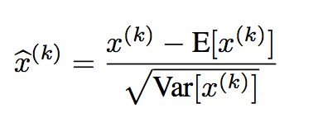
What is batch normalization?
Subtract mean and divide by variance
Alternatively set input Euclidean length to 1
Speeds up training of deep networks
Improves accuracy
From Ioffe and Szegedy https://arxiv.org/abs/1502.03167

Slide 3
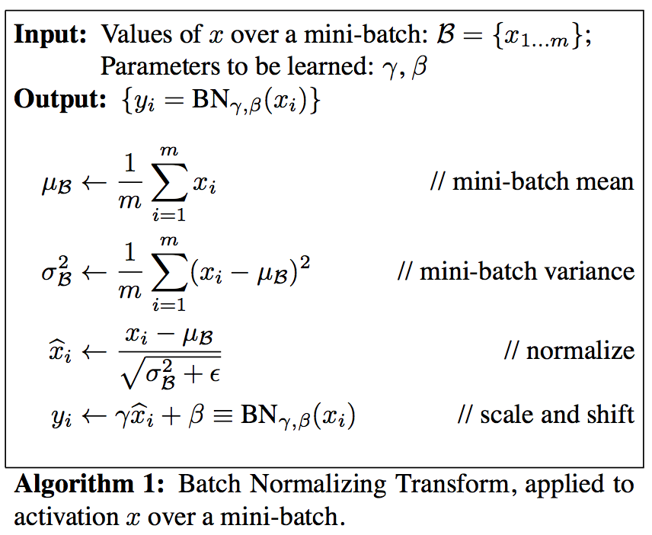
Batch normalization
From Ioffe and Szegedy https://arxiv.org/abs/1502.03167

Slide 4
Batch normalization
Why does it work?
Conjecture: reduces internal covariate shift (ICS)
ICS is the change in distribution of layer inputs caused by updates to previous layers
Recent study challenges this conjecture with empirical results

Slide 5
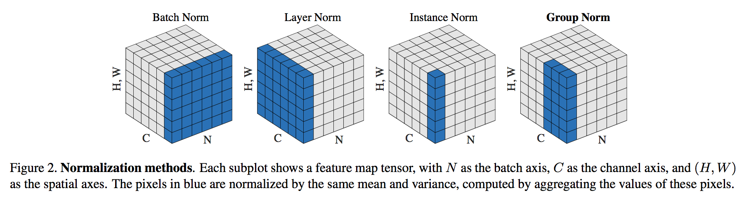
Group normalization
Four types of normalization:
From Ioffe and Szegedy https://arxiv.org/abs/1502.03167

