Slide 1
René Bastón, Executive Director
Kathy McKeown, PI
Coordinated by Columbia University

Slide 2
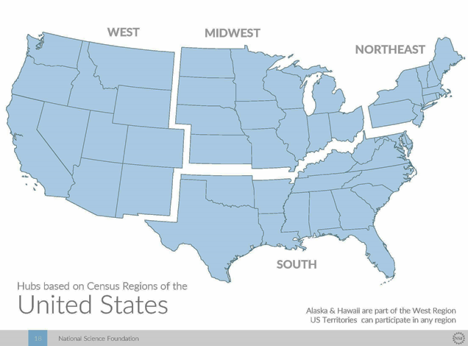
Regional Data Innovation Hubs
History
2012: White House “Big Data Research and Development Initiative” → $200 million
2015: NSF → $6 million to four Hubs and set to award another $10 million to the Spokes, this year.

Slide 3
The NSF Big Data Portfolio
Within the broader NSF portfolio, BD Hubs and BD Spokes
focuses on building partnerships around Big Data
RESEARCH
Critical Techniques & Technologies for … Big Data (BIGDATA)
INFRASTRUCTURE
Data Infrastructure Building Blocks (DIBBS)
EDUCATION
National Research Traineeship (NRT)
PARTNERSHIPS
Big Data Regional Innovation Hubs: Spokes (BD Hubs & Spokes)

Slide 4

How is the BDHubs Program different?
BDHubs is not your typical NSF research program
MULTIPHASE
Partners can use networking activities to determine what future priority areas to take on. Activities around these areas will be funded in later phases
NETWORKING
NSF is funding the staff & networking activities between partners, not research.
COLLABORATION NOT COMPETITION
NSF required only one proposal per region describing general consensus around Hub activities. Host institution is only a logistics facilitator for the Hub.
DYNAMIC
Hubs are dynamic and grow over time to accommodate more interested participants

Slide 5
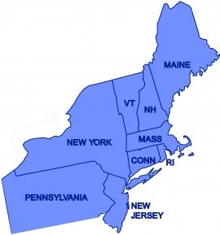
NE Regional Big Data Innovation Hub
Mission
Build public-private, multi-sector partnerships to address high-priority challenges with data-driven innovations
NORTHEAST
250 Personnel
100+ Organizations
9 States
Columbia (PI)

Slide 6
Priority Areas
Data Literacy
Data Sharing
Big Data in
Education
Finance
Cities &
Regions
Discovery
Science
Health
Energy
Ethics
Privacy & Security

Slide 7
Early Activities
Events/Projects
  Delivered
    NE Hub All Hands Meeting
    Health: Data Science Applications to Biomedical & Health Sciences
    Enabling Seamless Data Sharing in Industry & Academia
  Planned
    Cross-Organization Big Data Cyber Attack Awareness (CROSSBAR)
    Health: IBM Connected Medical Device Hackathon
    AAAI Fall Symposium – Accelerating Science; a Grand Challenge for AI
  Proposed Workshops on:
    Cities & Regions
    Privacy & Security
    Data Driven Energy Workshop
    Data Ethics Workshop
  Executive Education Initiative
    Bridging the Big Data Knowledge Gap
      A short course targeted at Executives
      Goal: Help decision-makers understand how to effectively use data-driven tools for decision support

Slide 8
Early Activities
Governance
  Steering Committee in Place
  Bylaws Drafted
Northeast Road Trip
  Discovering Stakeholder Needs
  Identifying Data Resources in the NE
  Developing Corporate Membership/Partnership Models
Funding / In-Kind Contributions
  Computing Community Consortium Early Career Data Scientist Grant
  Microsoft Azure Cloud Services
  Spoke Projects
Data Set Access
  DOT
  Census
  Others including Industry, Government, Academic and Non-Profit sources
Cross Hub Coordination
  National Big Data Infrastructure
  NSF Directorate and Federal Agency Outreach

Slide 9
Spoke Awards
7 NSF Spoke Awards totaling $3.3 million
  “Partnerships for Energy Cycle Innovation through Big Data”
  “Cross-Organization Big Data Cyber Attack Awareness”
  “Planning for Privacy and Security in Big Data”
  “Big Data Literacy: Building Capacity for Regional Collaboration in Closing the Big Data Divide”
  “A Licensing Model and Ecosystem for Data Sharing”
  “Grand Challenges for Data-Driven Education”
  “Integration of Environmental Factors and Causal Reasoning Approaches for Large-Scale Observational Health Research”

Slide 10
A data warehouse to enable causal modeling of environmental influences in clinical outcomes
Chirag J Patel (Harvard), Noémie Elhadad (Columbia), Vasant Honavar (Penn State), Greg Cooper (University of Pittsburgh)

Slide 11
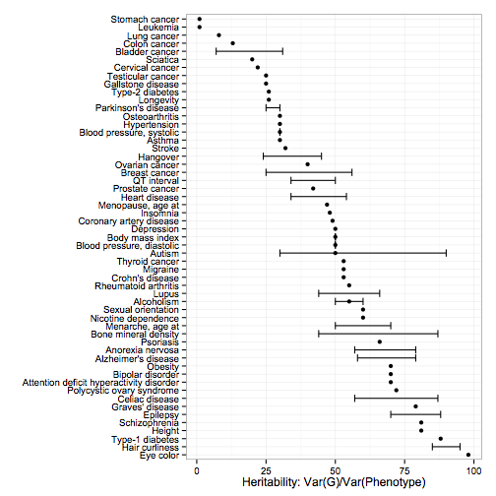





Elusive phenotypic variation:
Opportunity for exposome discovery in clinical big data streams
σ²E : Exposome!
Environmental
Risk
Assessment
Source: SNPedia.com

Slide 12
The Tapestry of Potentially High-Value Information Sources That May Be Linked to an Individual for Use in Healthcare
Weber, Mandl, Kohane, JAMA 2014

Slide 13


Multiple sources of external exposome datasets — both public and private — ripe for clinical data integration.
  Geological
    NASA - Cloud and Atmosphere Profiles
    NOAA Climate Data
  Pollution
    EPA Air Quality Surveillance Data Mart, or AirData,
  Socio-Economic
    US Census American Community Survey (ACS)
  Epidemiological
    CDC Wonder, USDA Food Atlas

Slide 14
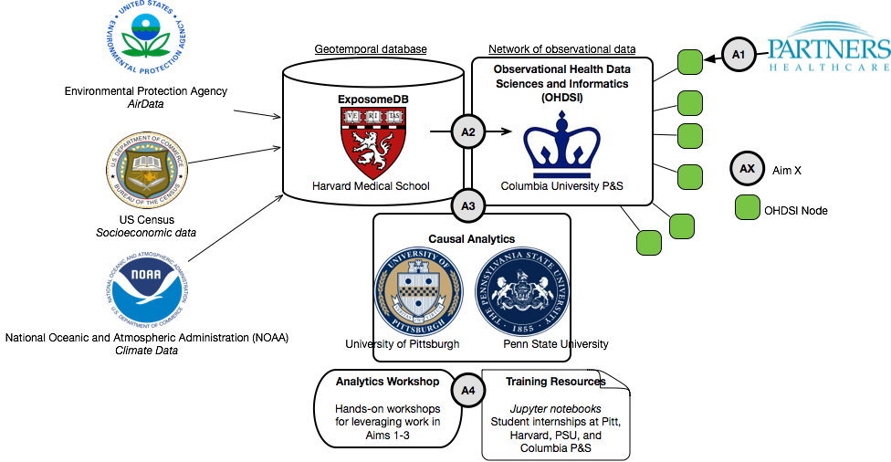
Integrating the ExposomeDB with OHDSI
and causal modeling tools to drive and demonstrate discovery

Slide 15
For More Information
Visit our website:
nebigdatahub.org
Email us:
contact@nebigdatahub.org
Follow us on Twitter:
@NEbigdatahub

