Slide 1
Ari Brooks, MD Cancer Surgeon, Big Data End User
39 year old woman with a 2cm left breast cancer
Family History: mother and maternal aunt breast CA
GYN History: menarche age 12 G3P2 age 1st birth 32
Imaging: Mammogram, Ultrasound, MRI
Pathology: Invasive Ductal Cancer ER+ PR+ Her2-
Surgical Options: Lumpectomy, Mastectomy (or two)
Radiation: Yes, type of delivery and dose
Chemotherapy: Oncotype (precision medicine?)
Hormone therapy: Yes, type?
Surveillance: blood? Imaging? Exams

Slide 2
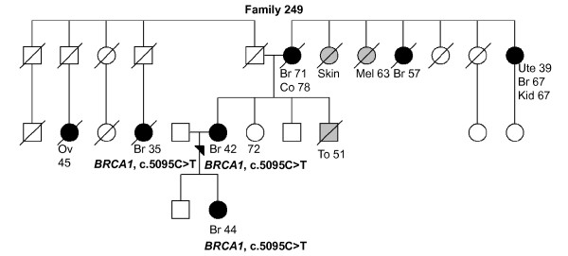
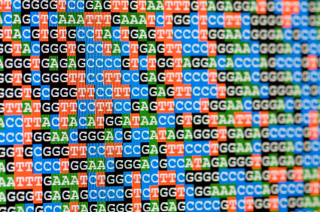
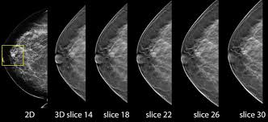
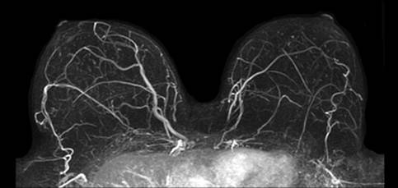
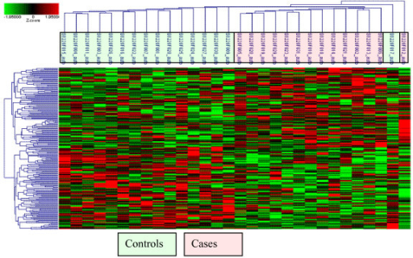
Complexity Map
Age Gender Race Site Geography Time
Family History Pedigree Somatic Genome
GYN History Medical History Medication History
Imaging: Mammo 9GB MRI 2GB
Tumor size morphology invasion nodes Tumor Genome Gene expression
Treatment: Surgery Radiation Chemotherapy Molecular therapy Hormone
Follow up type time local recurrence metastasis time death of disease time

