Slide 1
Symposium on Data Science for Healthcare (DaSH)
Sponsor: Leir Charitable Foundations
Host: Leir Retreat Center
Supporter: New Jersey Institute of Technology

Slide 2
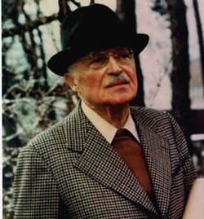
Thank You
The Leir Charitable Foundations

Slide 3
Thank You
Margot Gibis
Program manager, Leir Retreat Center
Jack Fong
Director, The Leir Retreat Center

Slide 4
Thank You
Dr. Joel S. Bloom President, NJIT
Dr. Fadi Deek Provost and Senior Executive Vice President, NJIT
Dr. Reggie J. Caudill Dean, Tuchman School Of Management NJIT

Slide 5
Advisory Board
Susan Davidson,
Founding Co-Director, Center for Bioinformatics, Weiss Professor, Computer & Info. Science, UPenn. Chair, Board of Directors, CRA.
Kathy Grise
Senior Program Director, Big Data Initiatives, Future Directions, IEEE
Bradford Hesse,
Chief, Health Communications & Informatics Research
National Cancer Institute, National Institute of Health
Cheickna Sylla
Professor, Associate Dean, Tuchman School of Management, NJIT

Slide 6
Opening Remarks Dr. Jack Fong Director, The Leir Retreat Center

Slide 7
Opening Remarks Dr. Joel S. Bloom President, NJIT

Slide 8
Symposium on Data Science for Healthcare (DaSH)
Sponsor: Leir Charitable Foundations
Host: Leir Retreat Center
Supporter: New Jersey Institute of Technology

Slide 9
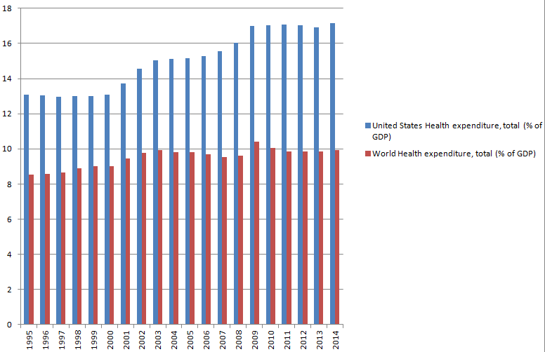
The Status of Healthcare in US -1
Health Spending as a share of GDP

Slide 10
The Status of Healthcare in US -2
OECD Health at a Glance 2015

Slide 11
Big Data Success in Business
Worldwide digital healthcare data was estimated to be 500 PB, and is expected to reach 25,000 PB in 2020.
A Big-Data Revolution in Healthcare

Slide 12
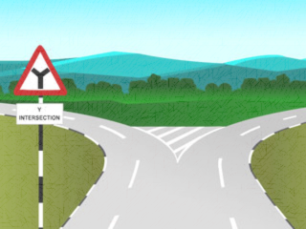
The Goal of DaSH Symposium
HealthCare
HealthCare
Big Data
DaSH
Re-active
Pro-active
Improve outcomes
Lower Costs

Slide 13
The Objectives of the DaSH Symposium
1
Identifying challenges
2
Recommending priorities and directions
3
Building communities and collaboration
4
Making an impact

Slide 14
Inaugural Event, Sept 24-25, 2015
CRA
Pro. Assoc.
IEEE
ACS
Rippel Foundation
Agencies
NIH
NSF
Boehringer Ingelheim
Anthem
Industry
Kaiser
Inovalon
Quest Diagnostics
BIDMC
Drexel
ASU
J&J
Merck
Geisinger
CUNY
Academia
Rutgers
Columbia
Harvard
UMaryland
UPenn
NJIT
CS
Engineering
Life Science
Pharm.
Medical
Statistics
Business

Slide 15
Summary of DaSH 2015
Technology advances for processing EHR, social media, sensor data, images, lab and biomedical experiment data
Applications
Assistance to Physician
Pharmacovigilance
Epidemiology
Smart clinic trials
Challenges
Data sharing and integration
Data availability and privacy
System usability
Analytics

Slide 16
DaSH 2016 Theme: Data Sharing
Lifestyles
Symptoms
Genetics
Bio-signature
Bio-
feedback
Socioeconomic
Status
Treatment
Social
network
Cost
Environment

Slide 17
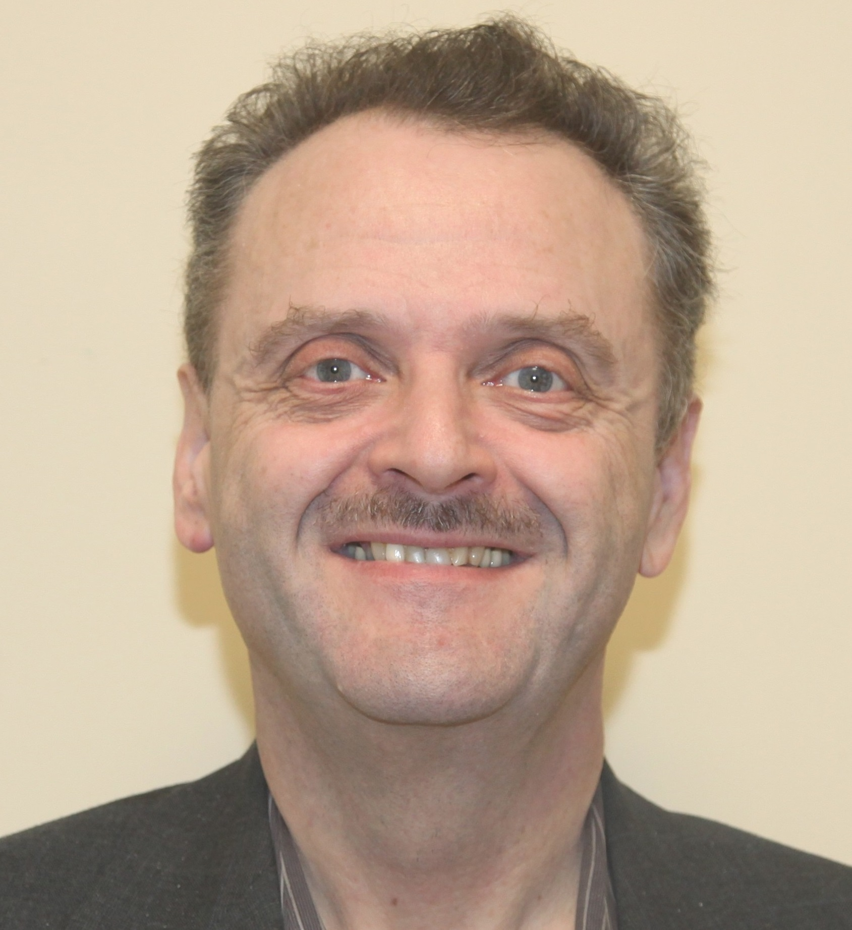
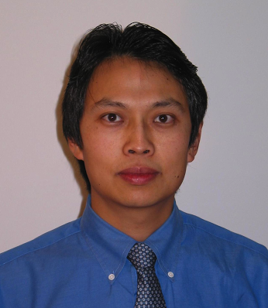
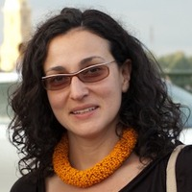
Data Sharing: The Art, Science and Ethics
Encourage Sharing
Facilitate Sharing
Responsible Sharing
James Geller
Dantong Yu
Julia Stoyanovich

Slide 18
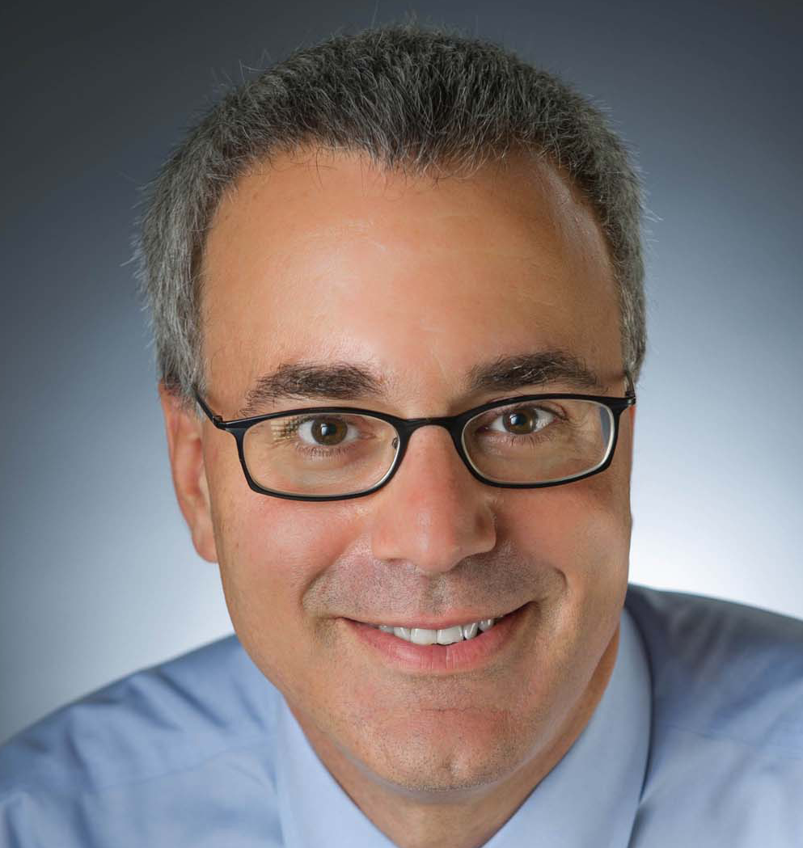
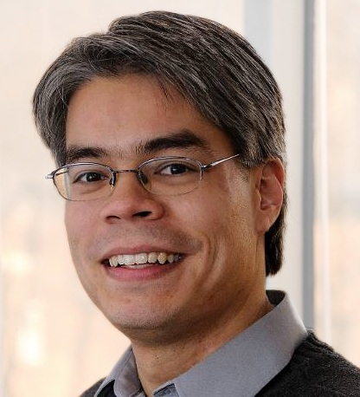
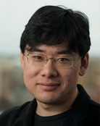
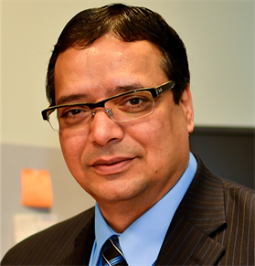
Technologies Advances
Standardization
and analytics
Data integration
and linking
Data privacy
Point-of-Care Technology
George Hripcsak
Zachary Ives
Nan
Zhang
Atam Dhawan

Slide 19
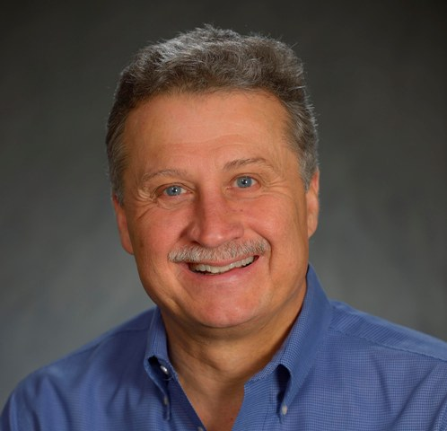
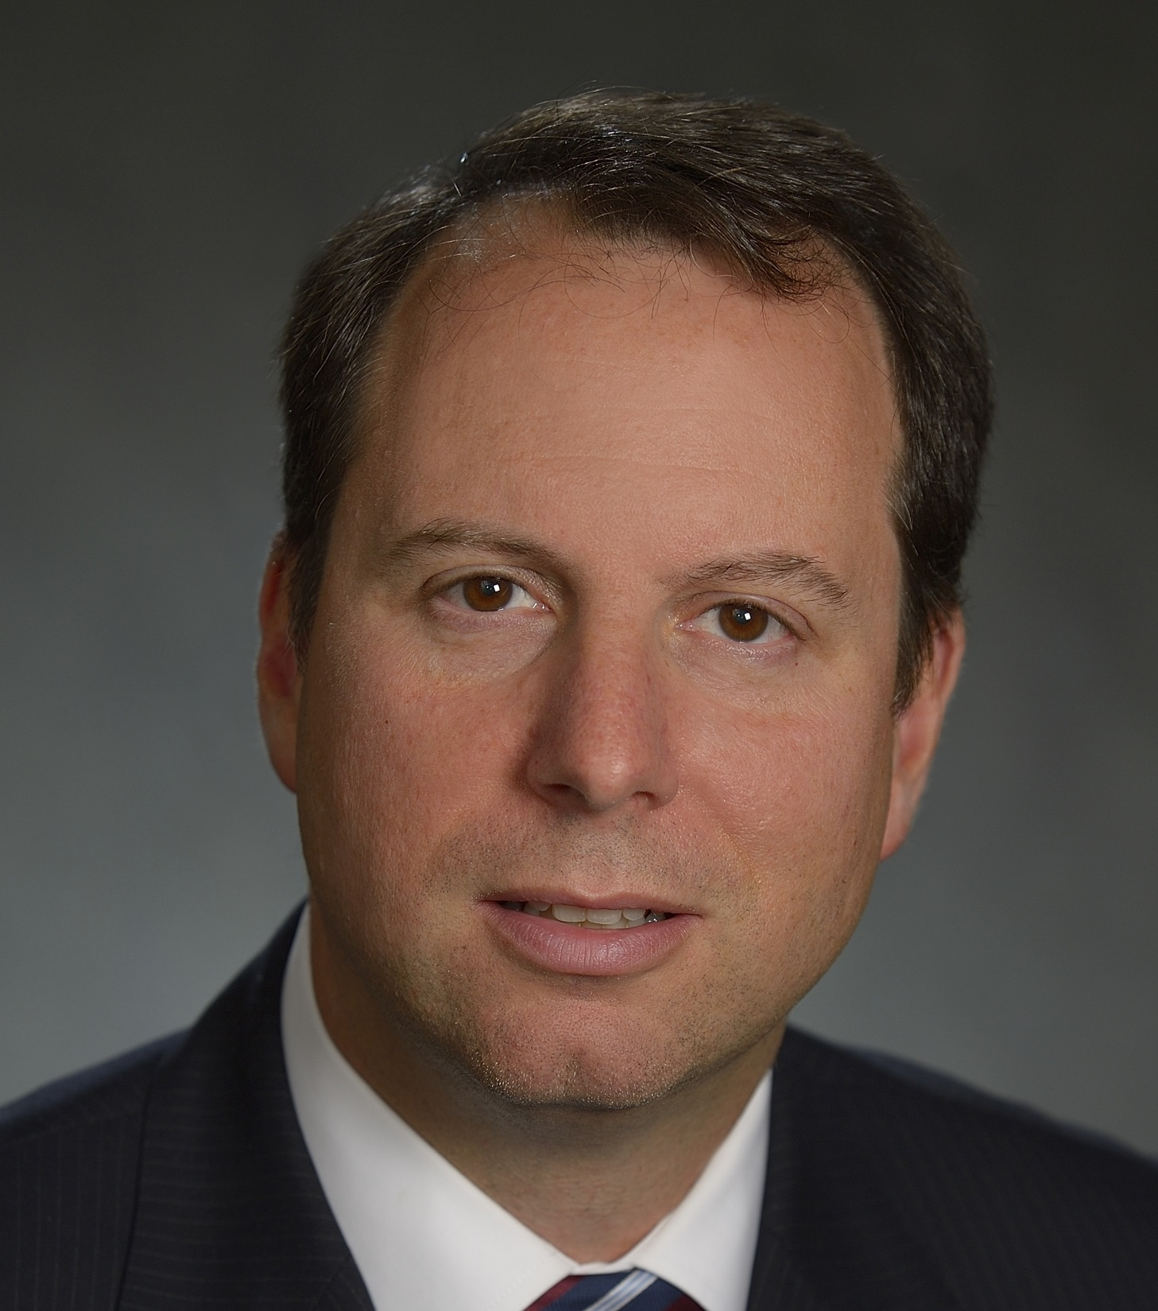
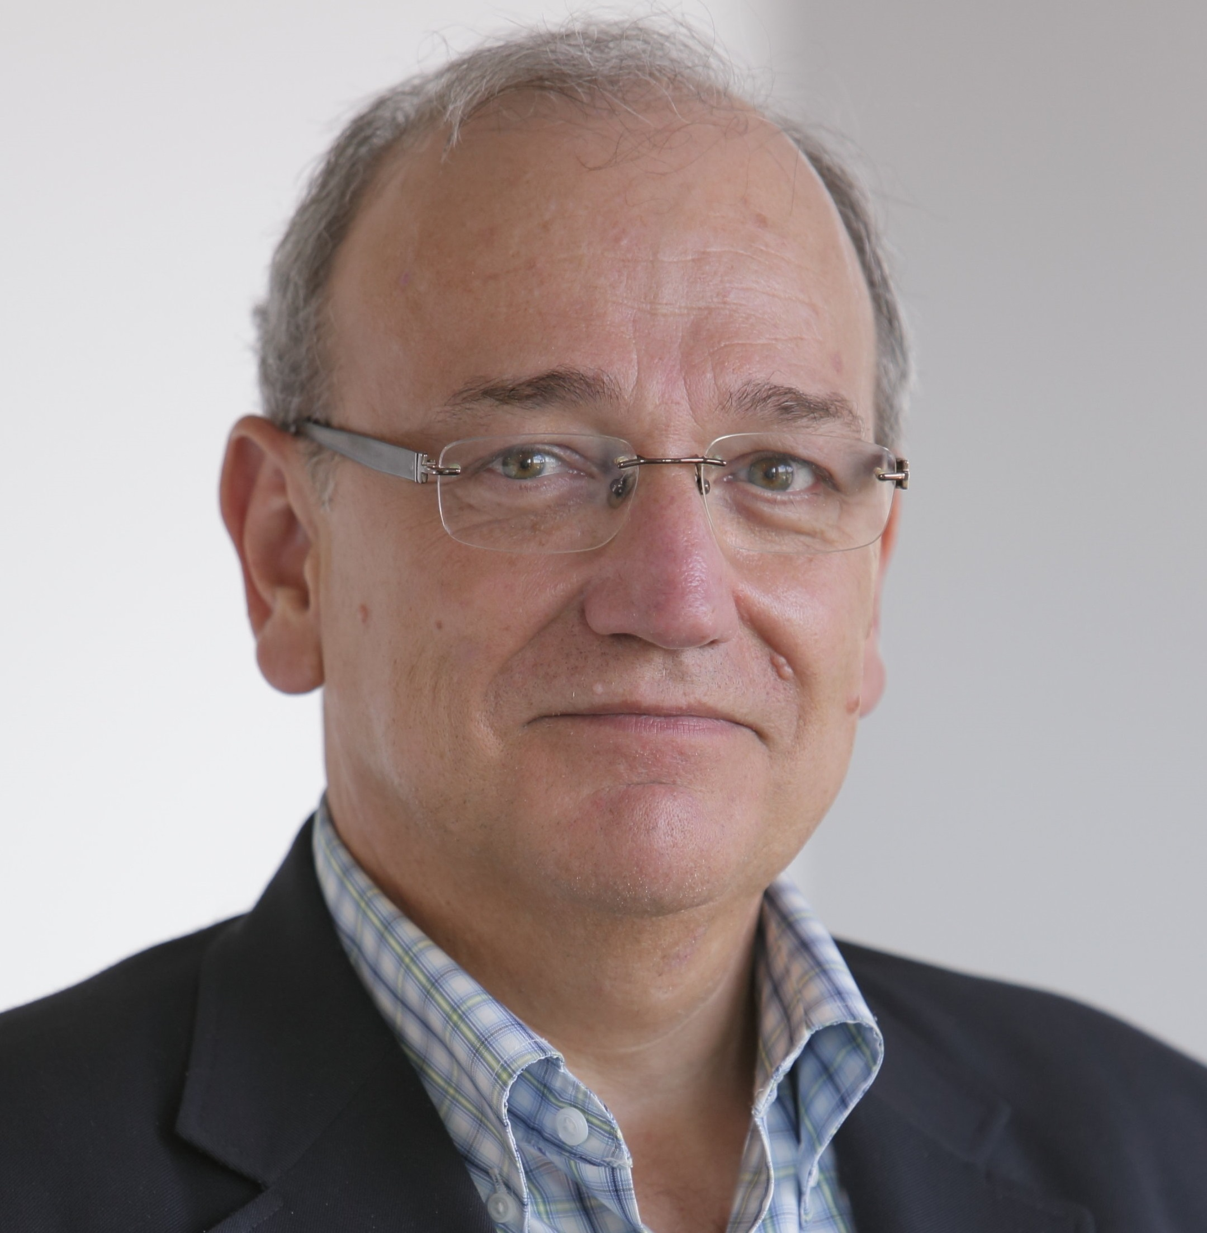
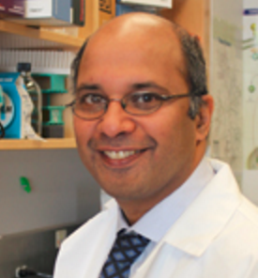
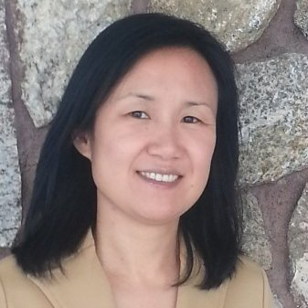
Healthcare Problem: Cancer MoonShot
"I am not a researcher. I am not an oncologist. I am not a geneticist. I am a Vice President of the United States.
But I've been on the other end of the need."
-- Vice President Biden, January 12, 2016
Reynold Panettieri
Ari
Brooks
Bradford Hesse
Shridar
Ganesan
Jianying Hu

Slide 20
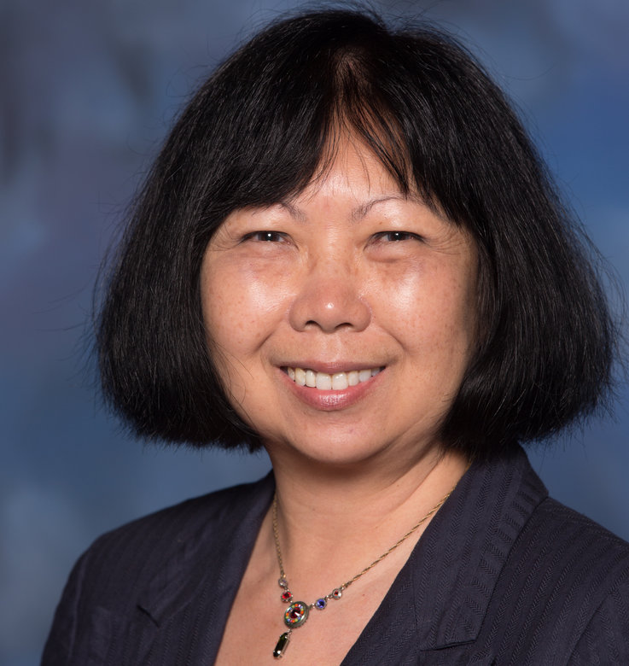
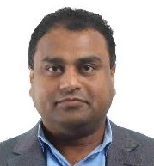
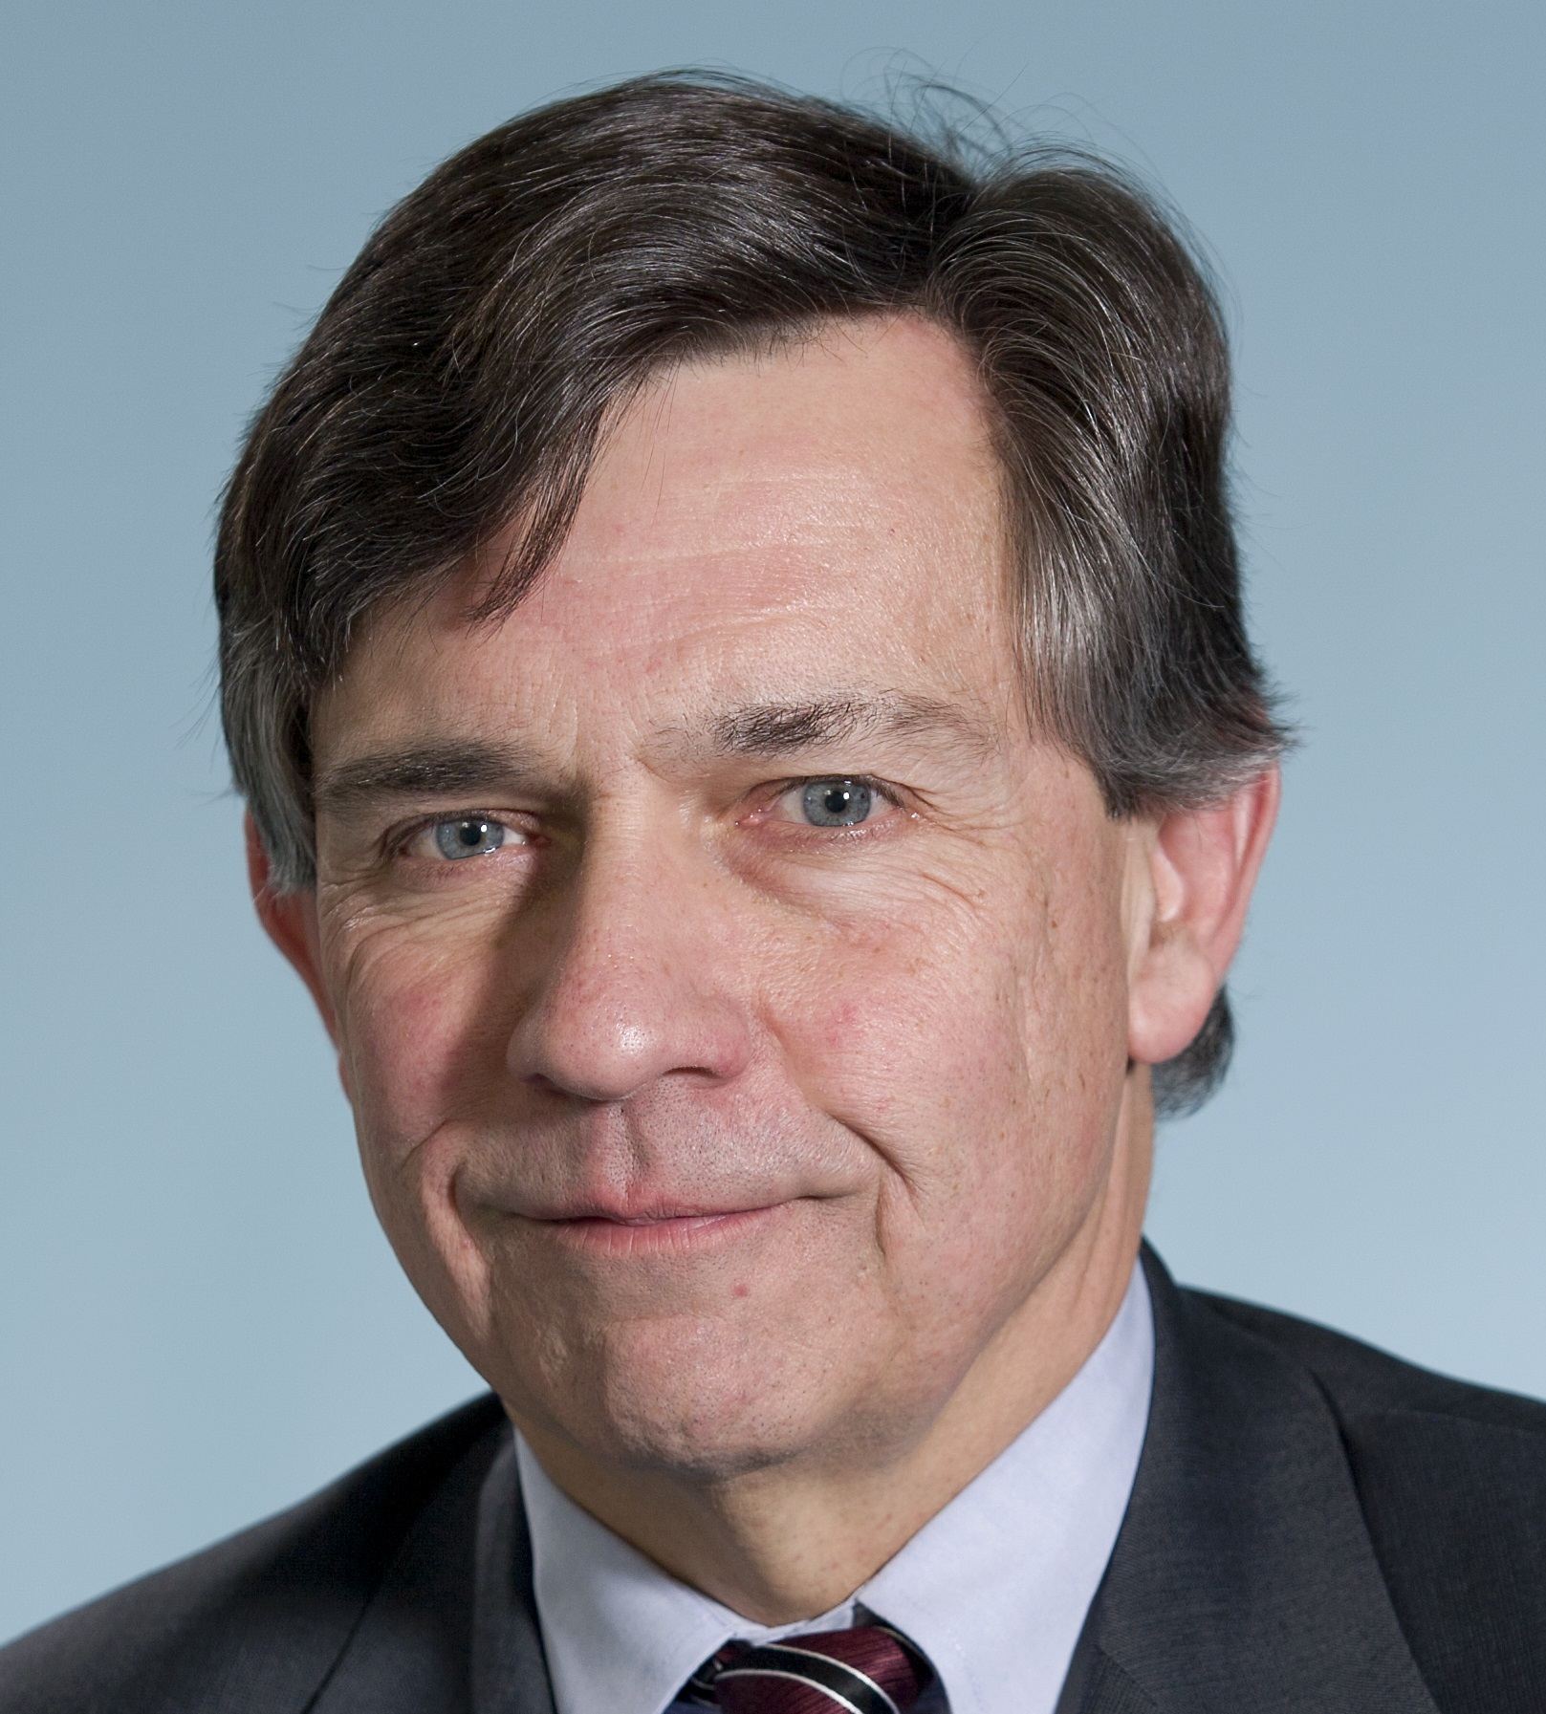
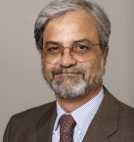
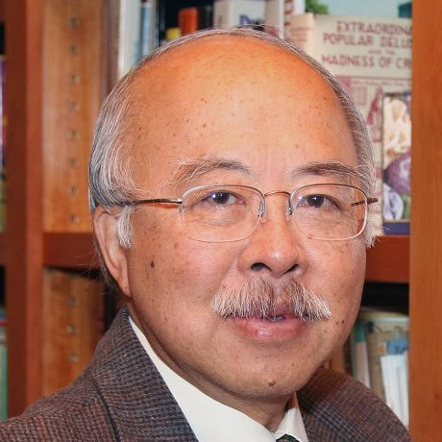
Healthcare Problem: US Health Reform
Voting on Health Reform in the 2016 Election
Kathy Grise
Ashok
Chennuru
James Gomes
Ram Ramesh
Jack Fong

Slide 21
