Slide 1
Morphology,
Anatomy
Natural History, Response to Treatment

Slide 2
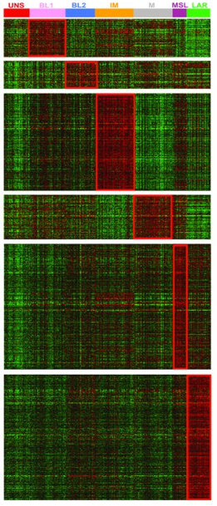
Gene expression,
Proteomics, etc
Morphology,
Anatomy
Natural History, Response to Treatment

Slide 3
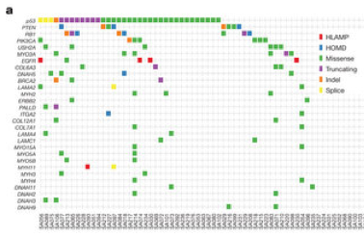
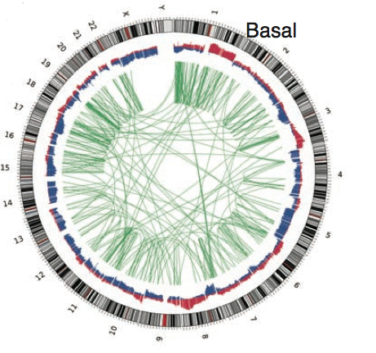
Cell of Origin
Genomic Changes
Shat et al, Nature 2012
Gene expression,
Proteomics, etc
Morphology,
Anatomy
Natural History, Response to Treatment

Slide 4
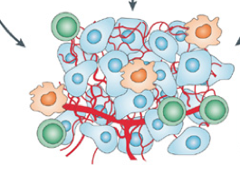
Cell of Origin
Genomic Changes
Tumor Microenvironment
Fibroblasts
Macrophages
Lymphocytes
Endothelial cells
Shat et al, Nature 2012
Gene expression,
Proteomics, etc
Morphology,
Anatomy
Natural History, Response to Treatment

Slide 5
Cell of Origin
Genomic Changes
Tumor Microenvironment
Host Factors
Fibroblasts
Macrophages
Lymphocytes
Endothelial cells
Shat et al, Nature 2012
Gene expression,
Proteomics, etc
Morphology,
Anatomy
Natural History, Response to Treatment

Slide 6
Precision Oncology
Cell of Origin
Genomic Changes
Tumor Microenvironment
Host Factors
Fibroblasts
Macrophages
Lymphocytes
Endothelial cells
Shat et al, Nature 2012
Gene expression,
Proteomics, etc
Morphology,
Anatomy
Natural History, Response to Treatment
Chemotherapy (DNA repair/checkpoint/cell death)
Biological therapy (growth signaling pathways)
Immune Therapy (tumor/host factors)

Slide 7
Precision Oncology
Cell of Origin
Genomic Changes
Tumor Microenvironment
Host Factors
Fibroblasts
Macrophages
Lymphocytes
Endothelial cells
Shat et al, Nature 2012
Gene expression,
Proteomics, etc
Morphology,
Anatomy
Histology guided
clincial trials
Natural History, Response to Treatment
Chemotherapy (DNA repair/checkpoint/cell death)
Biological therapy (growth signaling pathways)
Immune Therapy (tumor/host factors)

Slide 8
Precision Oncology
Cell of Origin
Genomic Changes
Tumor Microenvironment
Host Factors
Fibroblasts
Macrophages
Lymphocytes
Endothelial cells
Shat et al, Nature 2012
Gene expression,
Proteomics, etc
Morphology,
Anatomy
BIG DATA??
Genomically informed
Clinical trials
Histology guided
clincial trials
Natural History, Response to Treatment
Chemotherapy (DNA repair/checkpoint/cell death)
Biological therapy (growth signaling pathways)
Immune Therapy (tumor/host factors)

Slide 9
Precision Oncology
Cell of Origin
Genomic Changes
Tumor Microenvironment
Host Factors
Fibroblasts
Macrophages
Lymphocytes
Endothelial cells
Shat et al, Nature 2012
Gene expression,
Proteomics, etc
Morphology,
Anatomy
BIG DATA??
Genomically informed
Clinical trials
Histology guided
clincial trials
Natural History, Response to Treatment
Shridar Ganesan, MD, Phd
Assoc. Dir. Transl. Science
Chief, Sec. Molecular Oncology
Rutgers -CINJ
Chemotherapy (DNA repair/checkpoint/cell death)
Biological therapy (growth signaling pathways)
Immune Therapy (tumor/host factors)

