Slide 1
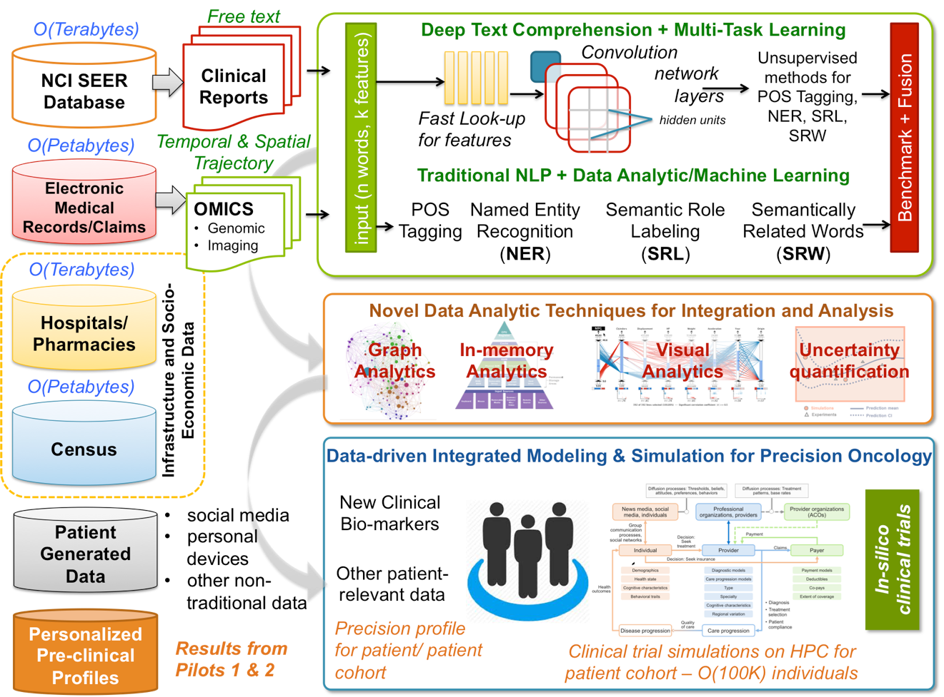
Population Information Integration, Analysis and Modeling
Pilot 3 – Exascale/Big Data Intersection
Notes:
Technical Slide: Since clinical text has tremendous variability of writing style and expression, algorithmic development will focus on advanced machine learning and deep learning in particular.
By using traditional text understanding methods, we can extract relevant features from the clinical reports. However, there is tremendous variability in writing styles and expression, which also contributes to significant heterogeneity in the way reports are interpreted. Hence, we will develop feature agnostic techniques such as deep learning (DL) that will automatically enable the understanding of the innate variability across these clinical reports. The challenging aspects of this process is that it needs (a) tremendous amounts of data and (b) deep learning algorithms are computationally expensive. Therefore, we propose to develop novel DL algorithms that will work well even when the training data sets are not large and extensively benchmark them with the different clinical reports. We will also scale DL approaches to CORAL and exascale architectures that will enable easy scaling when collections of these datasets increase. In addition, we will develop multi-task learning approaches that will integrate the “best-of –the-two-worlds” approach – by combining features from traditional text understanding approaches with DL and ultimately deliver scalable DL tools that will enable comprehensive text understanding.
The long term value of this project is that the machine learning approaches developed are not specific to text data, but can be leveraged with other modalities including genomic data, imaging, electronic medical records, and claims.
The obtained datasets and “features” will be combined with scalable analytics approaches to discover new clinical bio-markers. Further, we also will develop patient-specific “profiles” that incorporate diverse information from the exposome, including socioeconomic, environmental, lifestyle, care delivery, and community infrastructure factors. These profiles will be used to complement existing and newer modeling and simulation toolkits to model patient-specific outcomes and health trajectories.
We will initially plan to use the NCI SEER database where clinical reports are currently stored. First, we plan to examine clinical pathology reports from the top 5 cancer sites and use this as starting point for developing and testing our DL algorithms for text comprehension. Simultaneously, we will develop scalable approaches to host, access and visualize these datasets across various sites. Once these approaches are benchmarked, we will then scale our implementation of DL and other data analytic approaches (for Exascale). The modeling and simulation approaches will be iteratively incorporated into each dataset examined and integrated, to ensure that the models developed are reliable and are clearly representative of the patient–specific data points that are relevant for this pilot.

