Slide 1
Observational Health Data Sciences and Informatics (OHDSI)
Data Science for Healthcare (DaSH)
Oct 5, 2016

Slide 2
Observational Health Data Sciences and Informatics (OHDSI, as “Odyssey”)
Mission: To improve health, by empowering a community to collaboratively generate the evidence that promotes better health decisions and better care
A multi-stakeholder, interdisciplinary, international collaborative with a coordinating center at Columbia University
Aiming for 1,000,000,000 patient data network
http://ohdsi.org

Slide 3
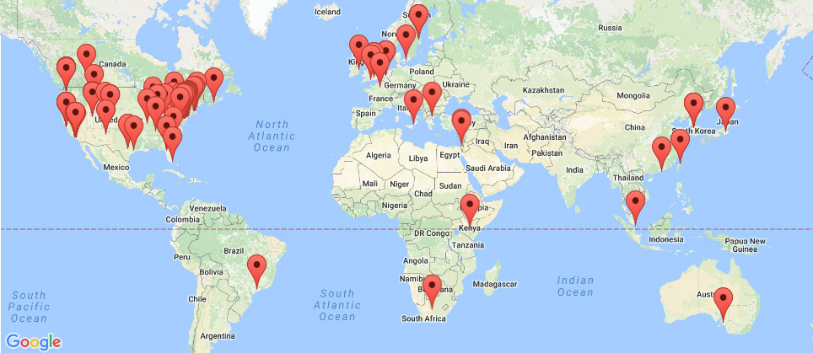
OHDSI’s global research community
>140 collaborators from 20 different countries
Experts in informatics, statistics, epidemiology, clinical sciences
Active participation from academia, government, industry, providers
Currently 600 million patient records in 52 databases
http://ohdsi.org/who-we-are/collaborators/

Slide 4
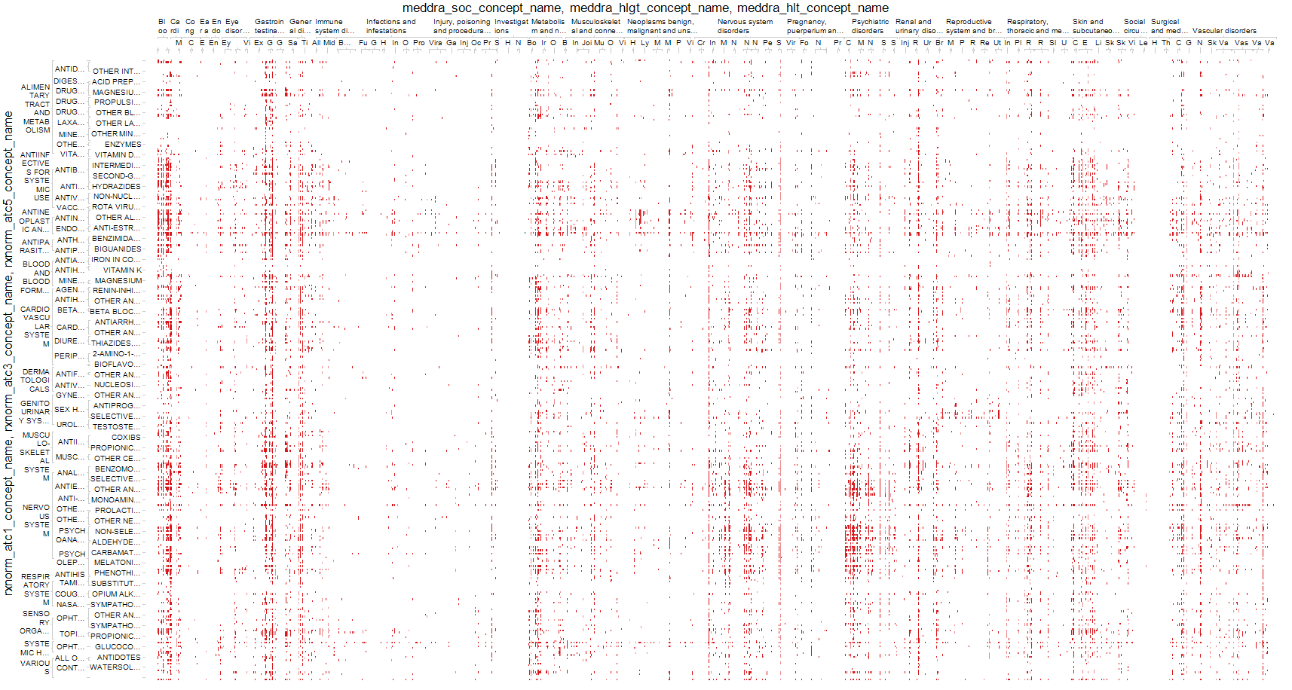
Why large-scale analysis is needed in healthcare
All health outcomes of interest
All drugs

Slide 5

Patient-level predictions for personalized evidence requires big data
2 million patients seem excessive or unnecessary?
Imagine a provider wants to compare her patient with other patients with the same gender (50%), in the same 10-year age group (10%), and with the same comorbidity of Type 2 diabetes (5%)
Imagine the patient is concerned about the risk of ketoacidosis (0.5%) associated with two alternative treatments they are considering
With 2 million patients, you’d only expect to observe 25 similar patients with the event, and would only be powered to observe a relative risk > 2.0
Aggregated data across a health system of 1,000 providers may contain 2,000,000 patients

Slide 6
Evidence OHDSI seeks to generate from observational data
Clinical characterization
  Natural history: Who has diabetes, and who takes metformin?
  Quality improvement: What proportion of patients with diabetes experience complications?
Population-level estimation
  Safety surveillance: Does metformin cause lactic acidosis?
  Comparative effectiveness: Does metformin cause lactic acidosis more than glyburide?
Patient-level prediction
  Precision medicine: Given everything you know about me, if I take metformin, what is the chance I will get lactic acidosis?
  Disease interception: Given everything you know about me, what is the chance I will develop diabetes?

Slide 7
OHDSI’s approach to open science
Open science
Generate evidence
Data + Analytics + Domain expertise
Open source software
Enable users to do something
Open science is about sharing the journey to evidence generation
Open-source software can be part of the journey, but it’s not a final destination
Open processes can enhance the journey through improved reproducibility of research and expanded adoption of scientific best practices

Slide 8
Standardizing workflows to enable reproducible research
Open science
Population-level estimation for comparative effectiveness research:
Is <intervention X> better than <intervention Y> in reducing the risk of <condition Z>?
Generate evidence
Database summary
Cohort definition
Cohort summary
Compare cohorts
Exposure-outcome summary
Effect estimation & calibration
Compare databases
Defined inputs:
Target exposure
Comparator group
Outcome
Time-at-risk
Model specification
Consistent outputs:
analysis specifications for transparency and reproducibility (protocol + source code)
only aggregate summary statistics
(no patient-level data)
model diagnostics to evaluate accuracy
results as evidence to be disseminated
  static for reporting (e.g. via publication)
  interactive for exploration (e.g. via app)

Slide 9
OHDSI Distinguishing Features
International effort (size & coverage)
  43 sources terminologies from around the world
Open science (depth)
  Infrastructure serves the science
  Stack: Terminology, CDM, ETL, QA, Visualization, Novel analytic methods, Clinical research
Full information model

Slide 10

How OHDSI Works
OHDSI Coordinating Center
Source data warehouse, with identifiable patient-level data
Standardized, de-identified patient-level database (OMOP CDM v5)
Data network support
Analytics development and testing
Research and education
ETL
Standardized large-scale analytics
Summary statistics results repository
OHDSI.org
Consistency
Temporality
Strength
Plausibility
Experiment
Coherence
Biological gradient
Specificity
Analogy
Comparative effectiveness
Predictive modeling
Analysis results
OHDSI Data Partners

Slide 11
Deep information model
OMOP CDM v5.0.1
Standardized clinical data
Person
Observation_period
Standardized health system data
Standardized meta-data
Location
Care_site
CDM_source
Specimen
Provider
Death
Concept
Payer_plan_period
Standardized health economics
Vocabulary
Standardized vocabularies
Visit_occurrence
Domain
Procedure_occurrence
Concept_class
Cost
Drug_exposure
Concept_relationship
Relationship
Device_exposure
Concept_synonym
Cohort
Standardized derived elements
Condition_occurrence
Concept_ancestor
Cohort_attribute
Source_to_concept_map
Measurement
Condition_era
Drug_strength
Note
Drug_era
Cohort_definition
Observation
Dose_era
Attribute_definition
Fact_relationship

Slide 12
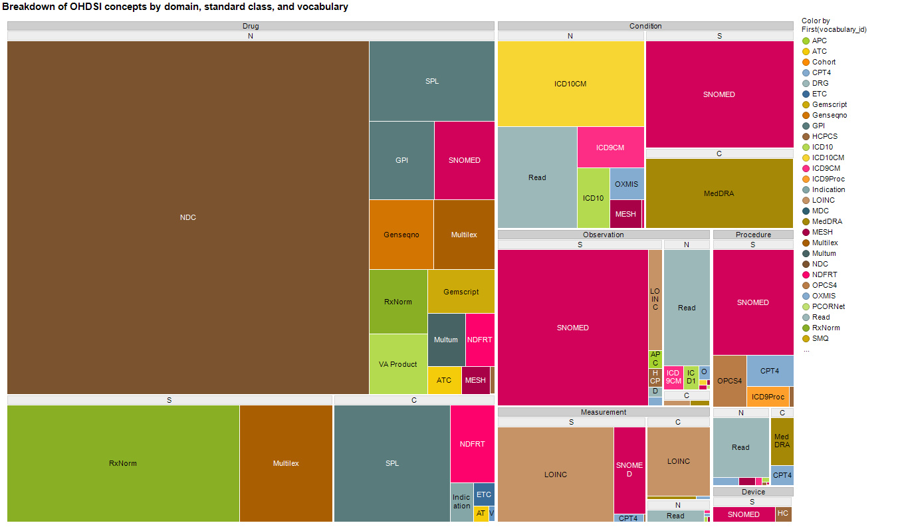
Extensive vocabularies

Slide 13
Preparing your data for analysis
Patient-level data in source system/ schema
Patient-level data in
OMOP CDM
ETL
design
ETL implement
ETL test
OHDSI tools built to help
WhiteRabbit: profile your source data
ATHENA:
standardized vocabularies for all CDM domains
CDM:
DDL, index, constraints for Oracle, SQL Server, PostgresQL;
Vocabulary tables with loading scripts
ACHILLES:
profile your CDM data; review data quality assessment; explore population-level summaries
RabbitInAHat: map your source structure to CDM tables and fields
Usagi:
map your source codes to CDM vocabulary
OHDSI Forums:
Public discussions for OMOP CDM Implementers/developers
http://github.com/OHDSI

Slide 14
Step 1: What is in your dataset?
WhiteRabbit
WhiteRabbit, a tool that lets you
  Scans your dataset
  Extracts summary information on the contents
  Produces a file that can be consumed for ETL planning

Slide 15
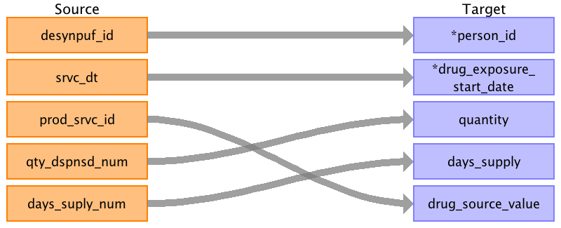
Step 2: Map Your Dataset to CDM
Rabbit In a Hat
Rabbit-In-a-Hat is a tool that uses the WhiteRabbit output and lets you match up your dataset with the CDM model

Slide 16
OHDSI Has Extensive Vocabulary Maps
1 | SNOMED | Systematic Nomenclature of Medicine - Clinical Terms (IHDSTO)
2 | ICD9CM | International Classification of Diseases, Ninth Revision, Clinical Modification, Volume 1 and 2 (NCHS)
3 | ICD9Proc | International Classification of Diseases, Ninth Revision, Clinical Modification, Volume 3 (NCHS)
4 | CPT4 | Current Procedural Terminology version 4 (AMA)
5 | HCPCS | Healthcare Common Procedure Coding System (CMS)
6 | LOINC | Logical Observation Identifiers Names and Codes (Regenstrief Institute)
7 | NDFRT | National Drug File - Reference Terminology (VA)
8 | RxNorm | RxNorm (NLM)
9 | NDC | National Drug Code (FDA and manufacturers)
10 | GPI | Medi-Span Generic Product Identifier (Wolters Kluwer Health)
11 | UCUM | Unified Code for Units of Measure (Regenstrief Institute)
12 | Gender | OMOP Gender
13 | Race | Race and Ethnicity Code Set (USBC)
14 | Place of Service | Place of Service Codes for Professional Claims (CMS)
15 | MedDRA | Medical Dictionary for Regulatory Activities (MSSO)
16 | Multum | Cerner Multum (Cerner)
17 | Read | NHS UK Read Codes Version 2 (HSCIC)
18 | OXMIS | Oxford Medical Information System (OCHP)
19 | Indication | Indications and Contraindications (FDB)
20 | ETC | Enhanced Therapeutic Classification (FDB)
21 | ATC | WHO Anatomic Therapeutic Chemical Classification
22 | Multilex | Multilex (FDB)
28 | VA Product | VA National Drug File Product (VA)
31 | SMQ | Standardised MedDRA Queries (MSSO)
32 | VA Class | VA National Drug File Class (VA)
33 | Cohort | Legacy OMOP HOI or DOI cohort
34 | ICD10 | International Classification of Diseases, 10th Revision, (WHO)
35 | ICD10PCS | ICD-10 Procedure Coding System (CMS)
40 | DRG | Diagnosis-related group (CMS)
41 | MDC | Major Diagnostic Categories (CMS)
42 | APC | Ambulatory Payment Classification (CMS)
43 | Revenue Code | UB04/CMS1450 Revenue Codes (CMS)
44 | Ethnicity | OMOP Ethnicity
46 | MeSH | Medical Subject Headings (NLM)
47 | NUCC | National Uniform Claim Committee Health Care Provider Taxonomy Code Set (NUCC)
48 | Specialty | Medicare provider/supplier specialty codes (CMS)
50 | SPL | Structured Product Labeling (FDA)
53 | Genseqno | Generic sequence number (FDB)
54 | CCS | Clinical Classifications Software for ICD-9-CM (HCUP)
55 | OPCS4 | OPCS Classification of Interventions and Procedures version 4 (NHS)
56 | Gemscript | Gemscript NHS dictionary of medicine and devices (NHS)
57 | HES Specialty | Hospital Episode Statistics Specialty (NHS)
60 | PCORNet | National Patient-Centered Clinical Research Network (PCORI)
65 | Currency | International Currency Symbol (ISO 4217)
70 | ICD10CM | International Classification of Diseases, 10th Revision, Clinical Modification (NCHS)
72 | CIEL | Columbia International eHealth Laboratory (Columbia University)
Athena

Slide 17
Additional Vocabulary Support
If you use non-standard vocabularies, you can also utilize our vocabulary mapper tool Usagi

Slide 18
Step 3: Turn the Crank
Write the SQL using the generated ETL doc as you guide
Get help on the forums from the many folks who have done it before
We provide tools to explore and analyze your data and data quality as you go along so you can iterate as needed

Slide 19
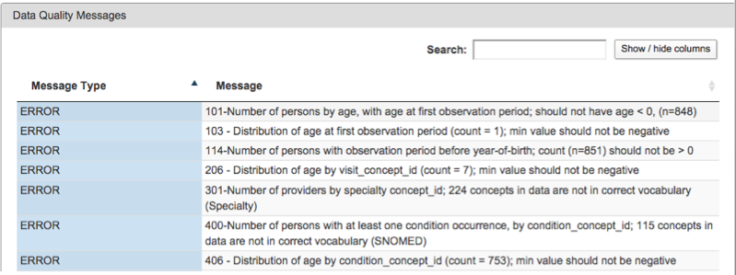
ACHILLES Heel Helps You Validate
Your Data Quality

Slide 20
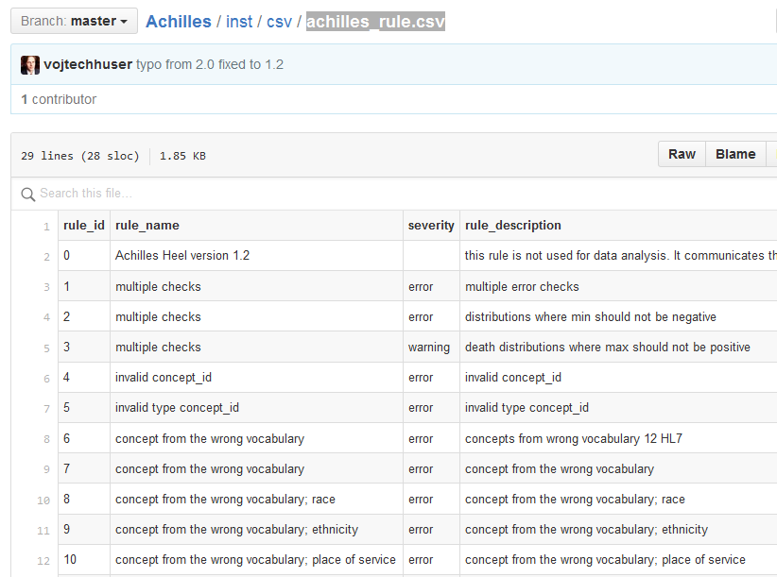
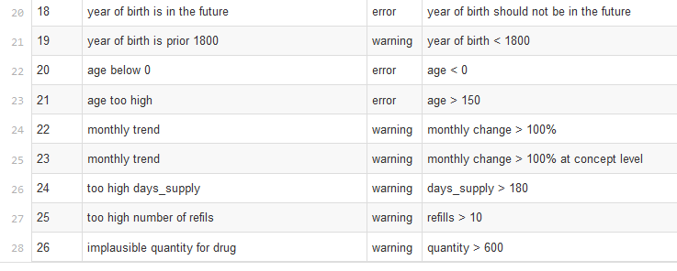

Slide 21
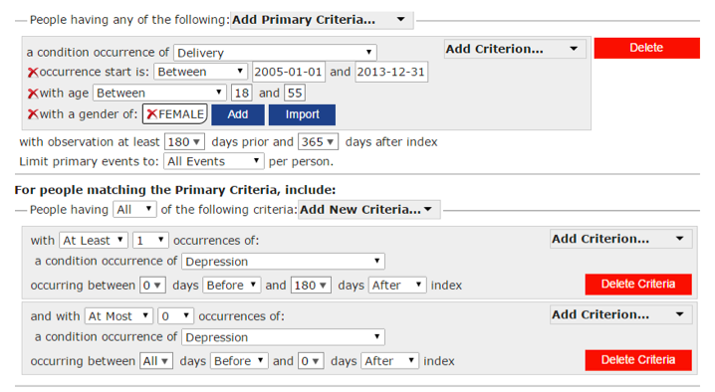
ATLAS to build, visualize, and analyze cohorts

Slide 22
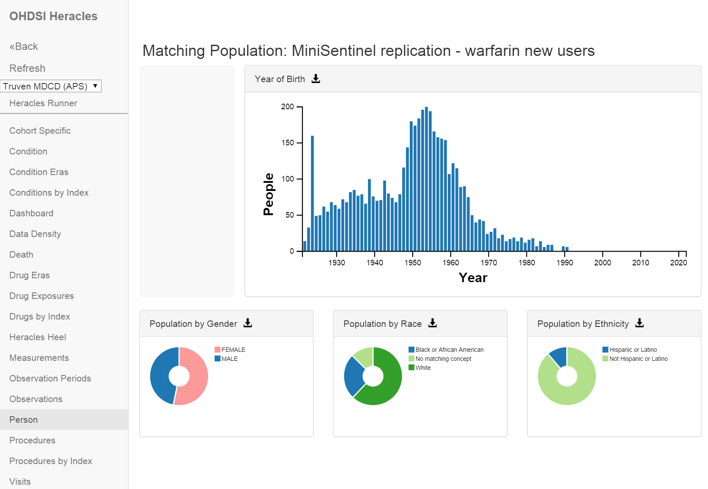
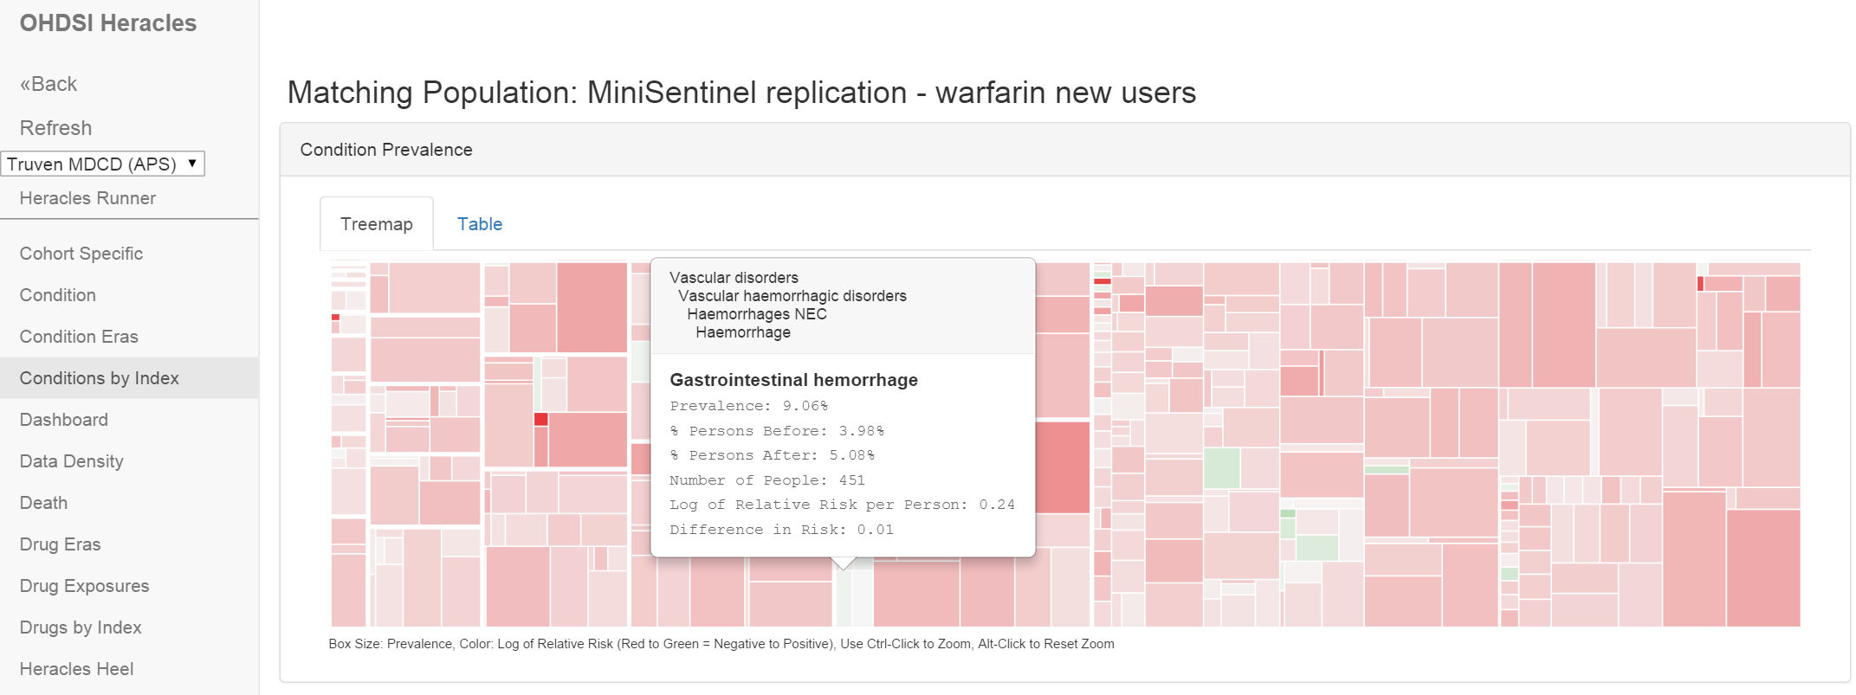
Characterize the cohorts of interest

Slide 23
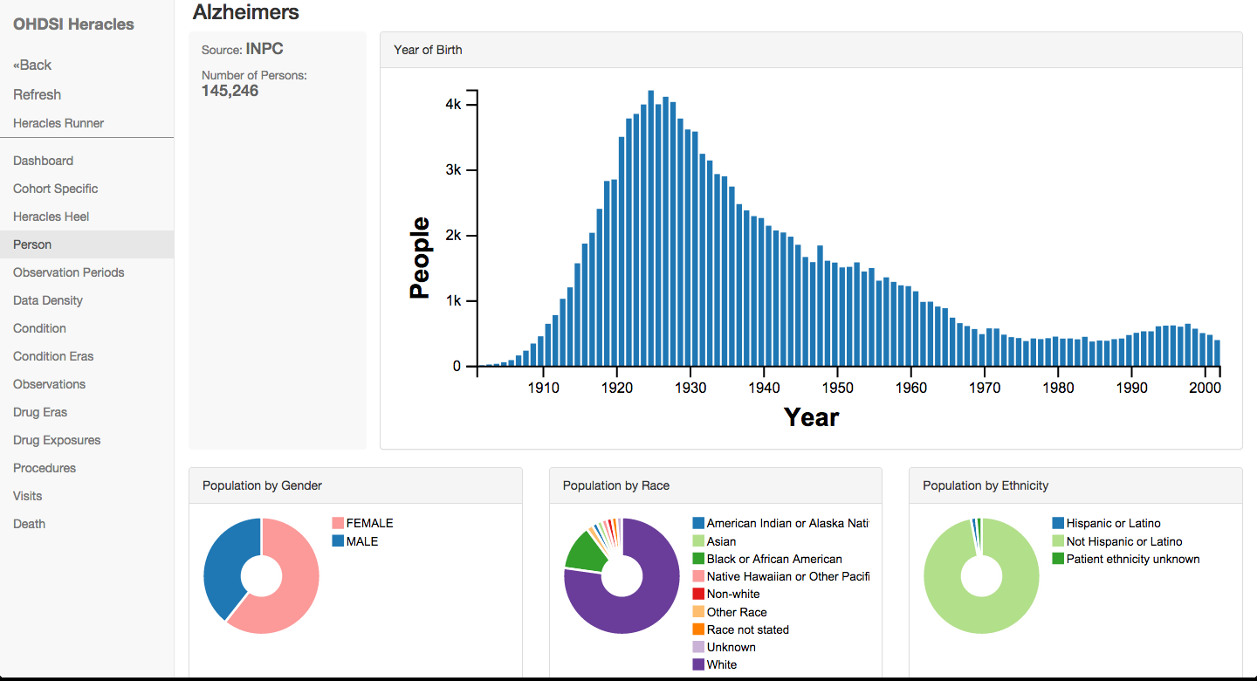

Slide 24
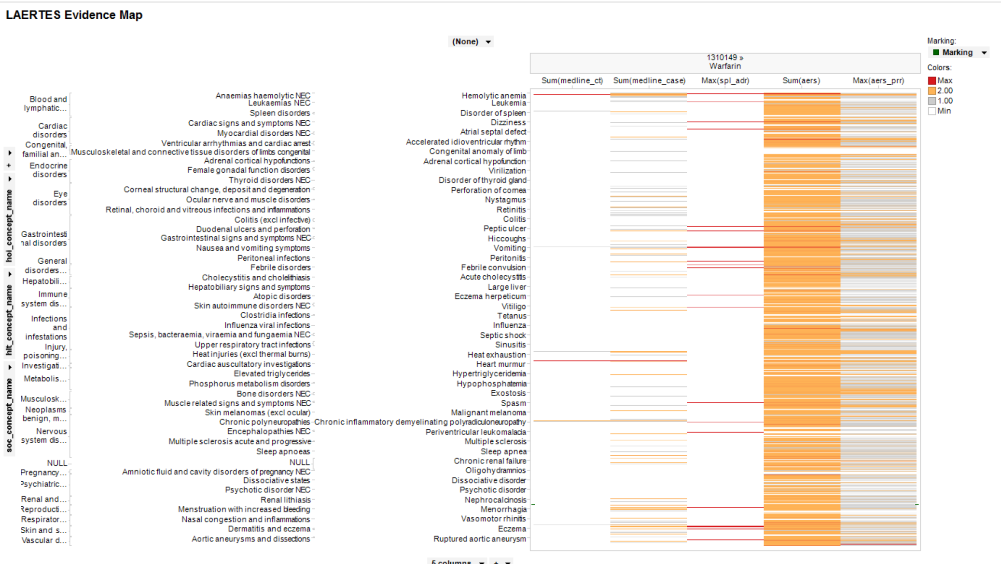
LAERTES: Summarizing evidence from existing data sources: literature, labeling, spontaneous reporting

Slide 25
OHDSI in Action
Generate evidence
  Randomized trial is the gold standard
  Observational research seen as supporting

Slide 26
Characterization
Today we carry out RCTs without clear knowledge of actual practice
There will be no RCTs without an observational precursor
  It will be required to characterize a population using large-scale observational data before designing an RCT
  Disease burden
  Actual treatment practice
  Time on therapy
  Course and complication rate
  Done now somewhat through literature and pilot studies

Slide 27
Treatment Pathways
Global stakeholders
Conduits
Public
Social media
Local stakeholders
Evidence
Family
RCT, Obs
Lay press
Academics
Literature
Patient
Industry
Guidelines
Advertising
Clinician
Regulator
Formulary
Consultant
Labels
Inputs
Indication
Feasibility
Cost
Preference

Slide 28
Network process
Join the collaborative
Propose a study to the open collaborative
Write protocol
  http://www.ohdsi.org/web/wiki/doku.php?id=research:studies
Code it, run it locally, debug it (minimize others’ work)
Publish it: https://github.com/ohdsi
Each node voluntarily executes on their CDM
Centrally share results
Collaboratively explore results and jointly publish findings

Slide 29
OHDSI in action:
Chronic disease treatment pathways
Conceived at AMIA
Protocol written, code written and tested at 2 sites
Analysis submitted to OHDSI network
Results submitted for 7 databases
15Nov2014
30Nov2014
2Dec2014
5Dec2014

Slide 30
OHDSI participating data partners
Abbre-viation | Name | Description | Population, millions
AUSOM | Ajou University School of Medicine | South Korea; inpatient hospital EHR | 2
CCAE | MarketScan Commercial Claims and Encounters | US private-payer claims | 119
CPRD | UK Clinical Practice Research Datalink | UK; EHR from general practice | 11
CUMC | Columbia University Medical Center | US; inpatient EHR | 4
GE | GE Centricity | US; outpatient EHR | 33
INPC | Regenstrief Institute, Indiana Network for Patient Care | US; integrated health exchange | 15
JMDC | Japan Medical Data Center | Japan; private-payer claims | 3
MDCD | MarketScan Medicaid Multi-State | US; public-payer claims | 17
MDCR | MarketScan Medicare Supplemental and Coordination of Benefits | US; private and public-payer claims | 9
OPTUM | Optum ClinFormatics | US; private-payer claims | 40
STRIDE | Stanford Translational Research Integrated Database Environment | US; inpatient EHR | 2
HKU | Hong Kong University | Hong Kong; EHR | 1

Slide 31
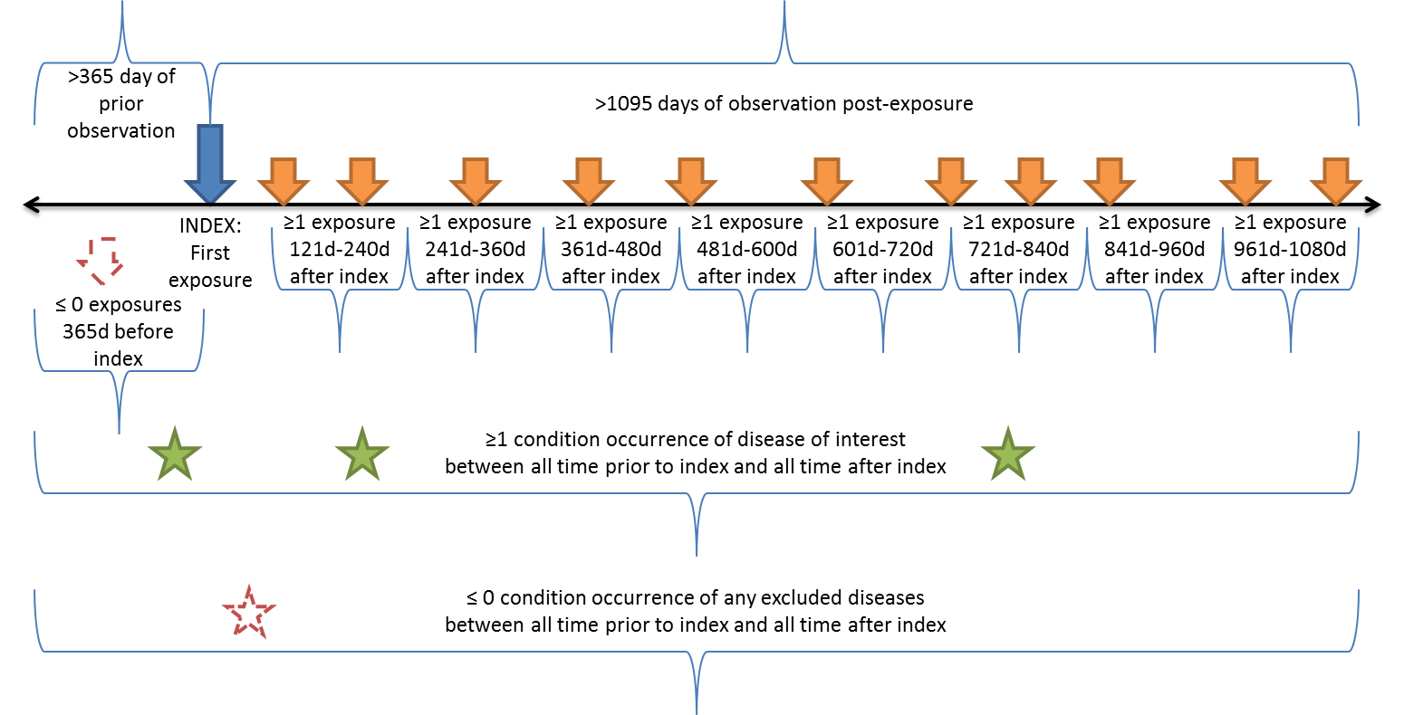
Treatment pathway event flow

Slide 32
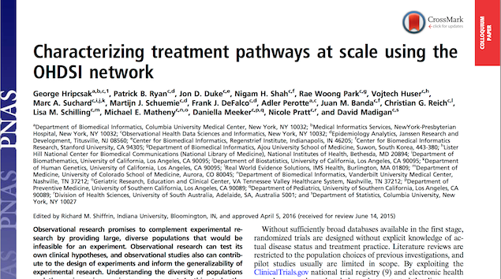
Proceedings of the National Academy of Sciences, 2016

Slide 33
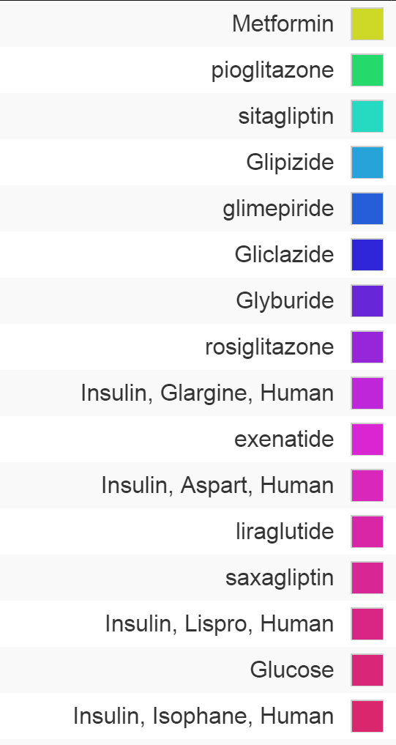
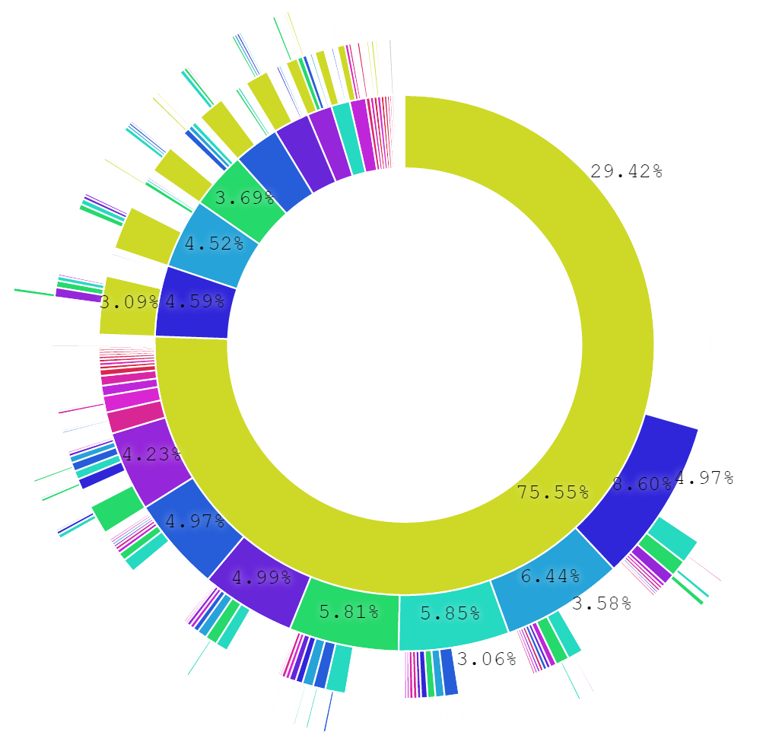
Treatment pathways for diabetes
T2DM : All databases
Only drug
First drug
Second drug

Slide 34
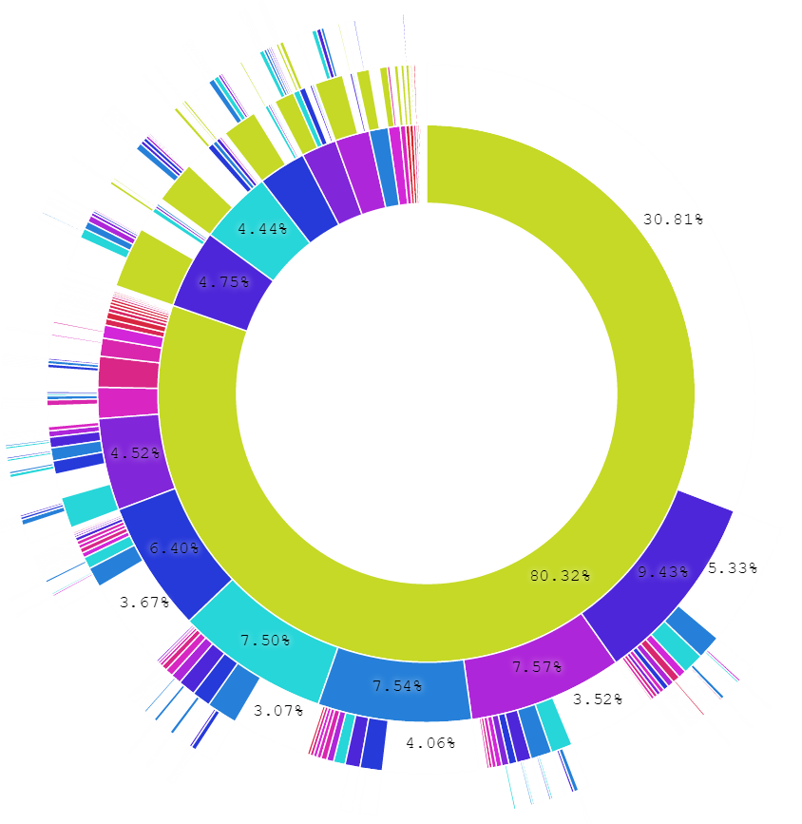
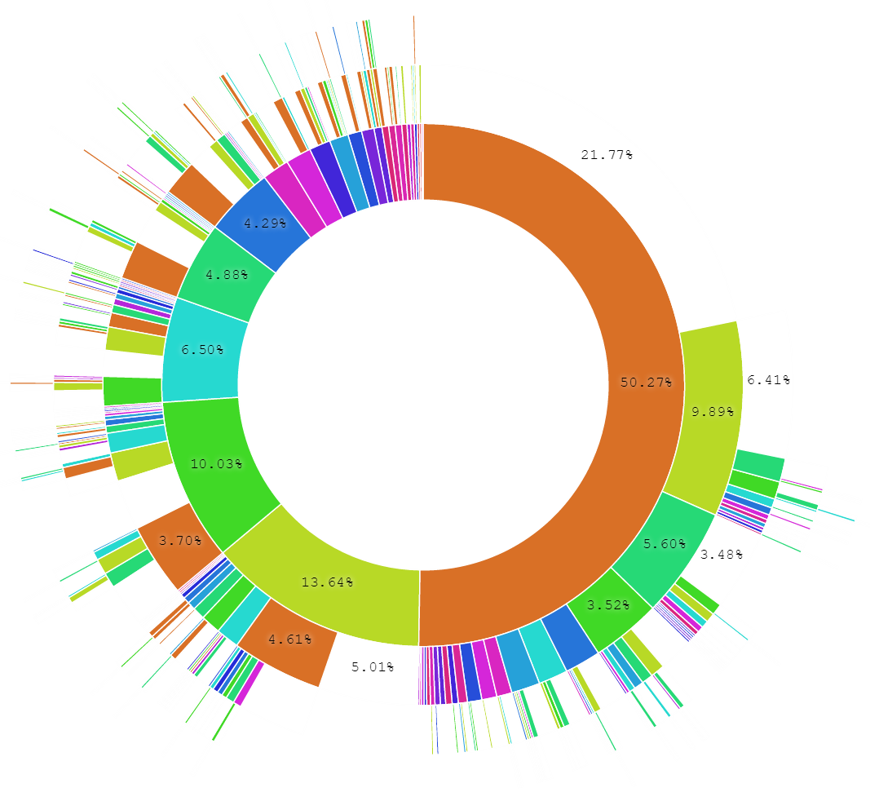
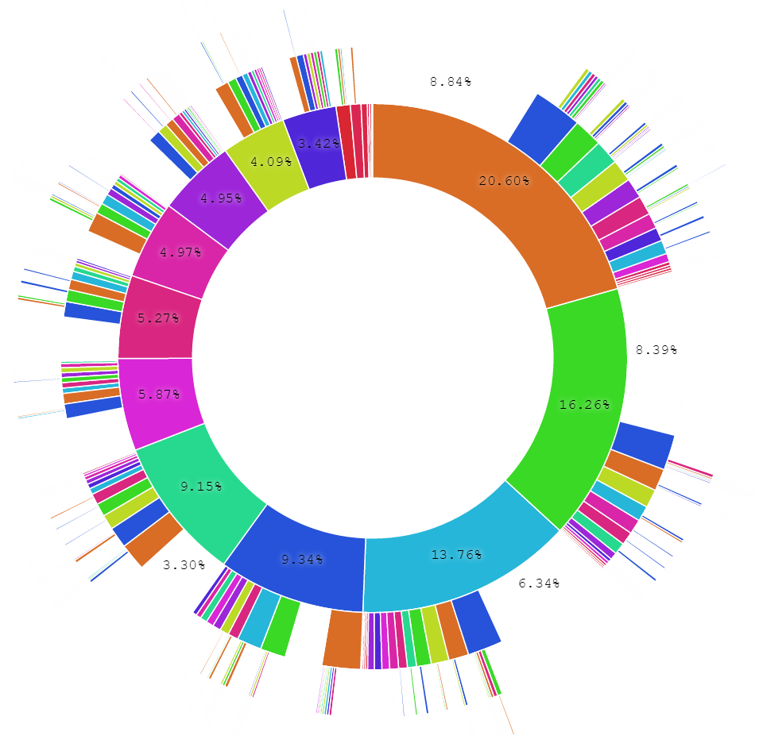
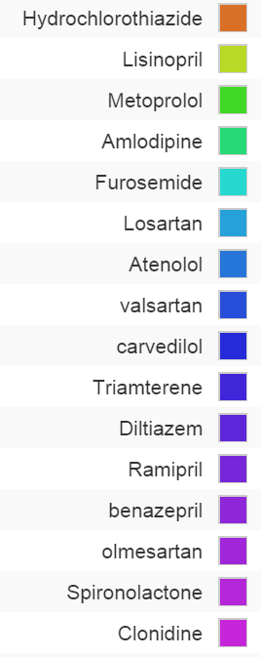
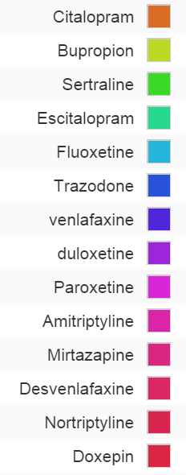
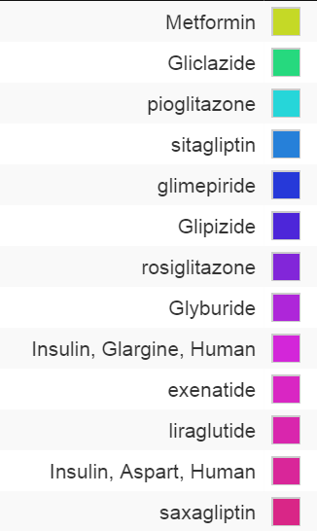
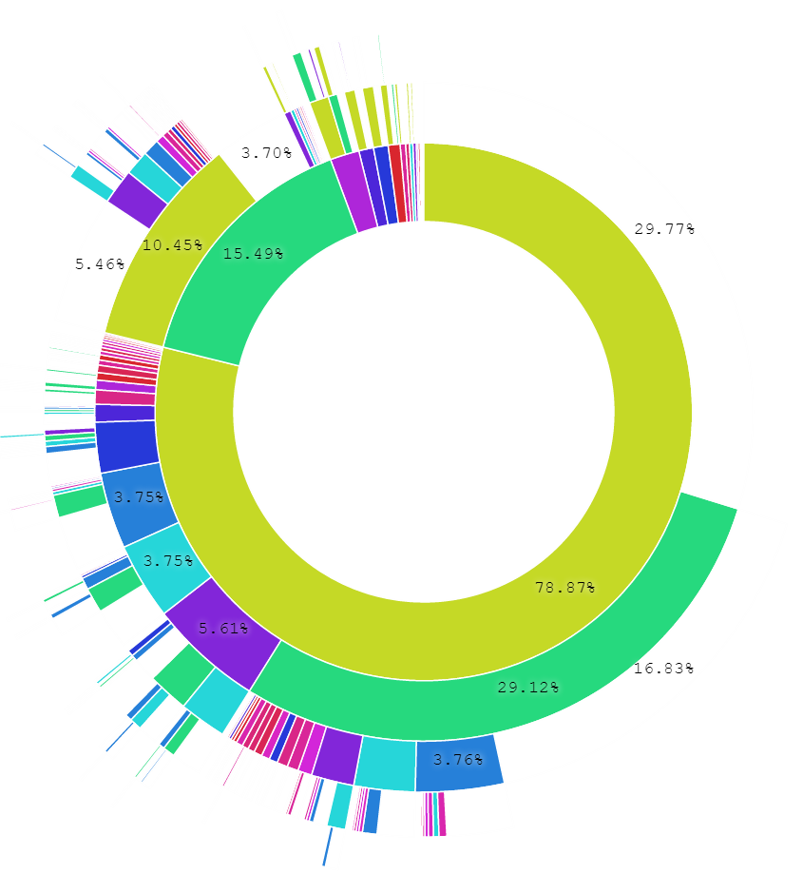
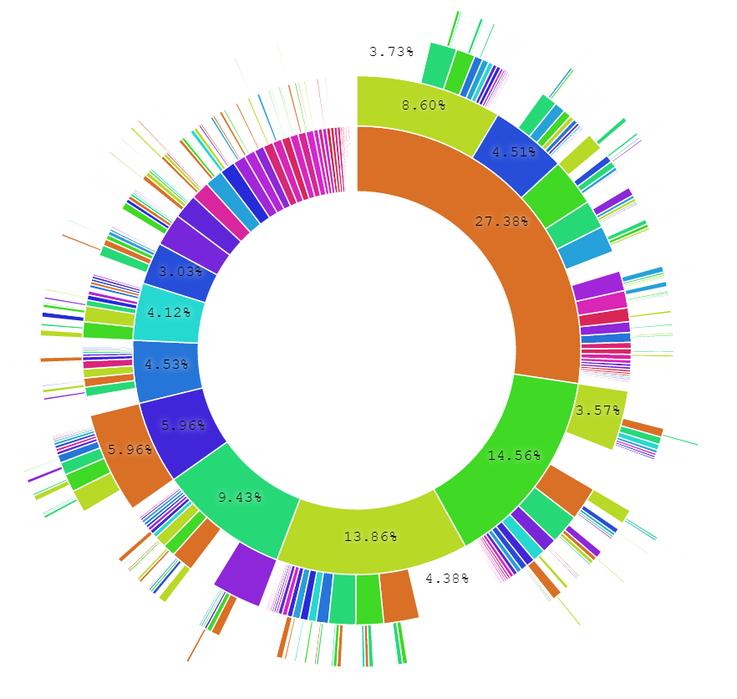
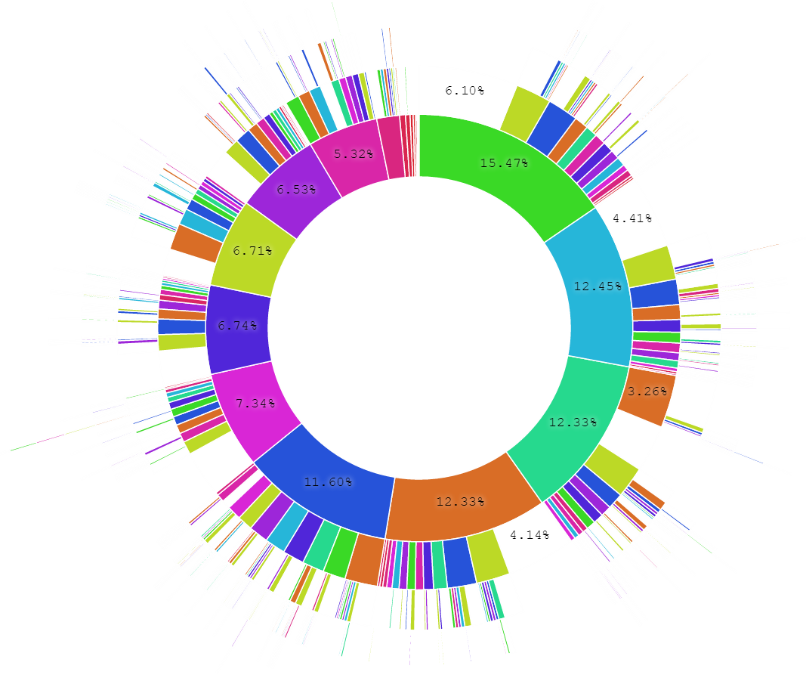
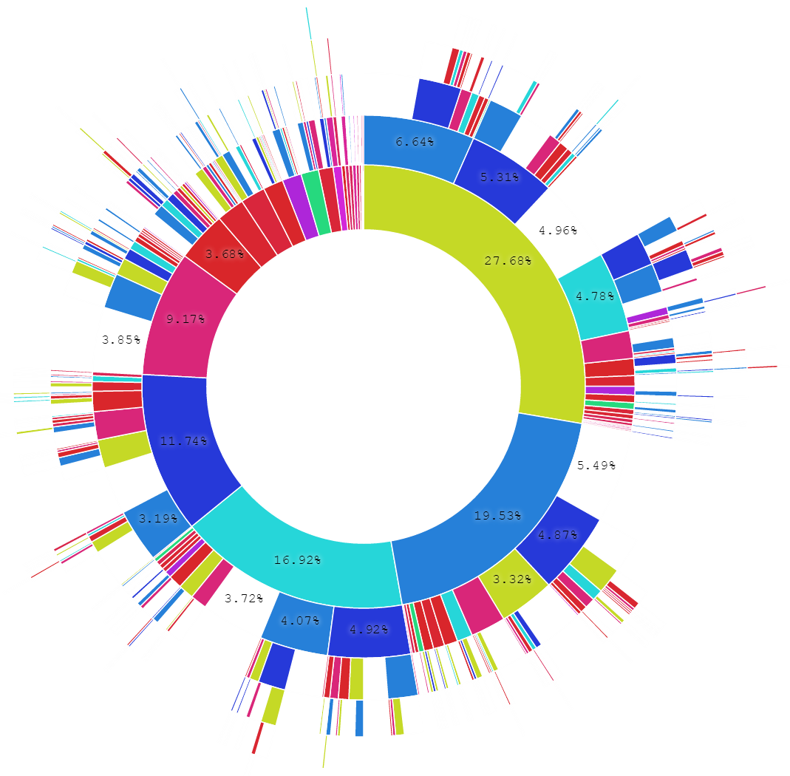
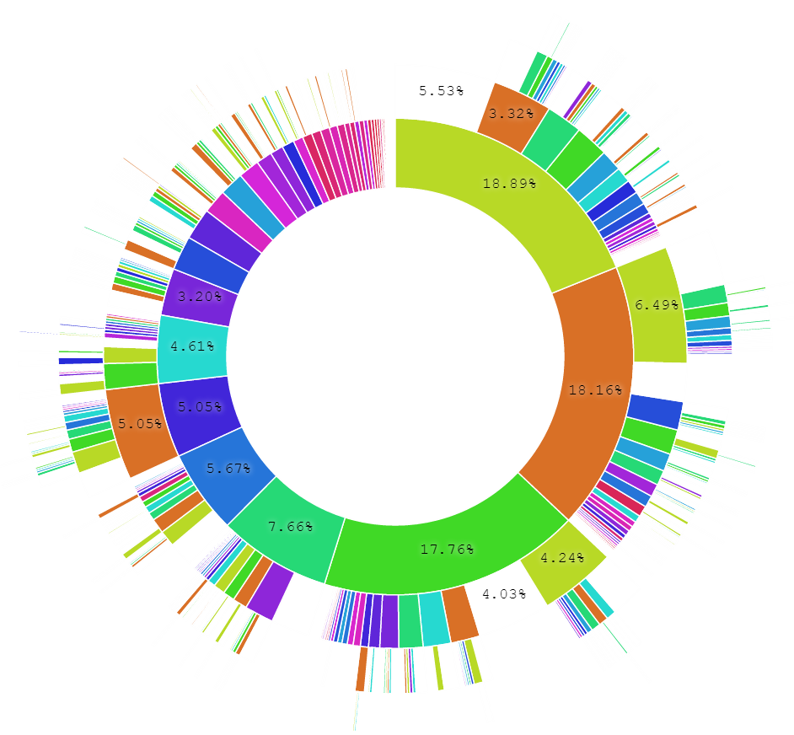
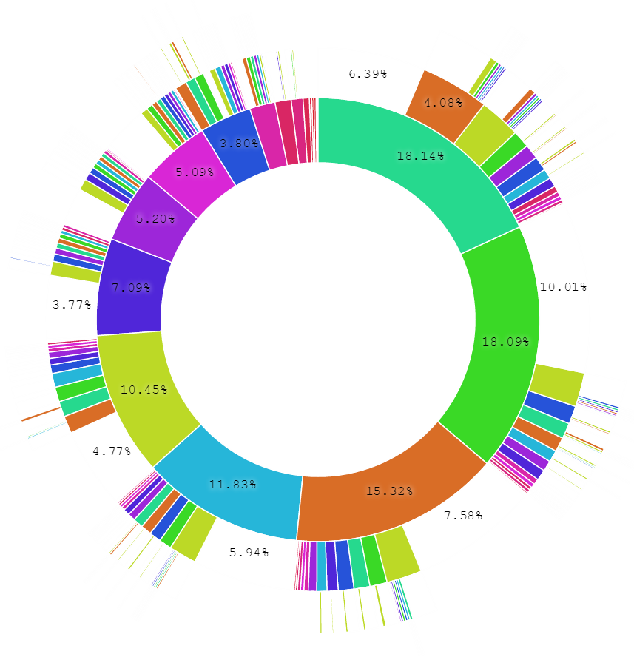
Population-level heterogeneity across systems, and patient-level heterogeneity within systems
Type 2 Diabetes Mellitus
CCAE
Hypertension
CUMC
Depression
MDCD
CPRD
INPC
GE
JMDC
MDCR
OPTUM

Slide 35
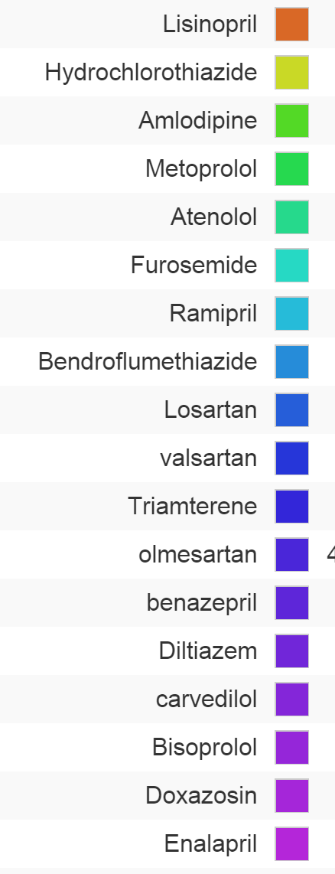
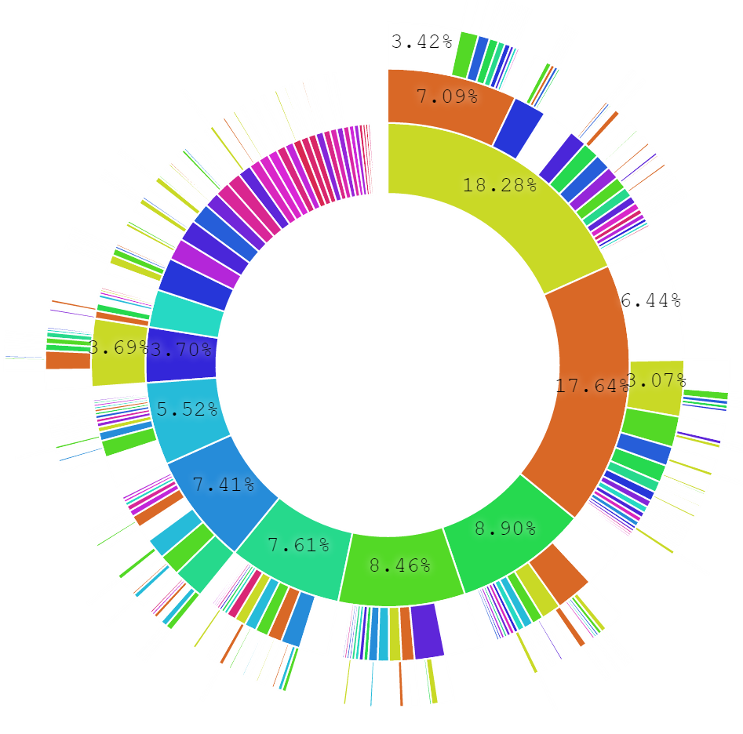
Patient-level heterogeneity
HTN: All databases
25% of HTN patients (10% of others) have a unique path despite 250M pop

Slide 36
Monotherapy – diabetes
General upward trend in monotherapy

Slide 37
Monotherapy – HTN
Academic medical centers differ from general practices

Slide 38
Monotherapy – diabetes
General practices, whether EHR or claims, have similar profiles

Slide 39
Conclusions: Treatment pathways
General progress toward more consistent therapy over time and across locations
Differ by country
Differ by practice type
Not differ so much by data type (claims, EHR)
Differ by disease
  Even before guidelines published
  Disease differences and literature
Huge proportion of unique pathways

Slide 40
Conclusions: Network research
It is feasible to encode the world population in a single data model
  Over 600,000,000 records by voluntary effort (682,000,000)
Generating evidence is feasible
Stakeholders willing to share results
Able to accommodate vast differences in privacy and research regulation

Slide 41
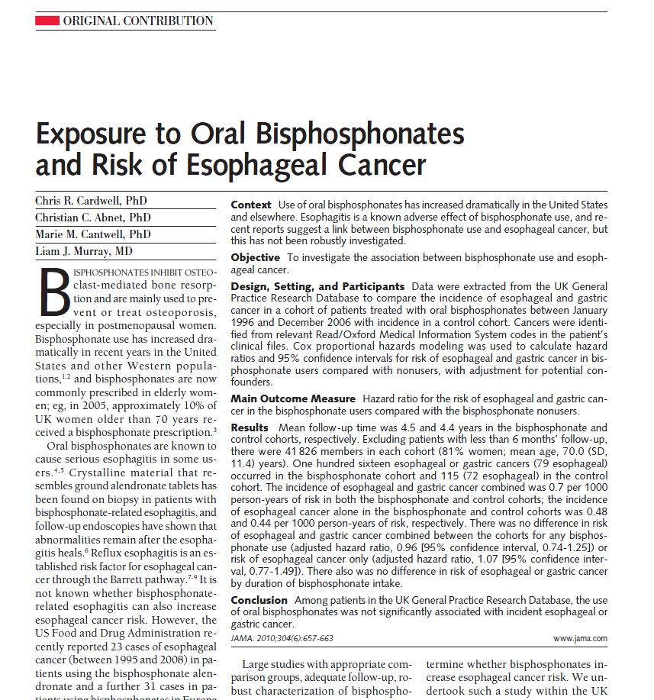
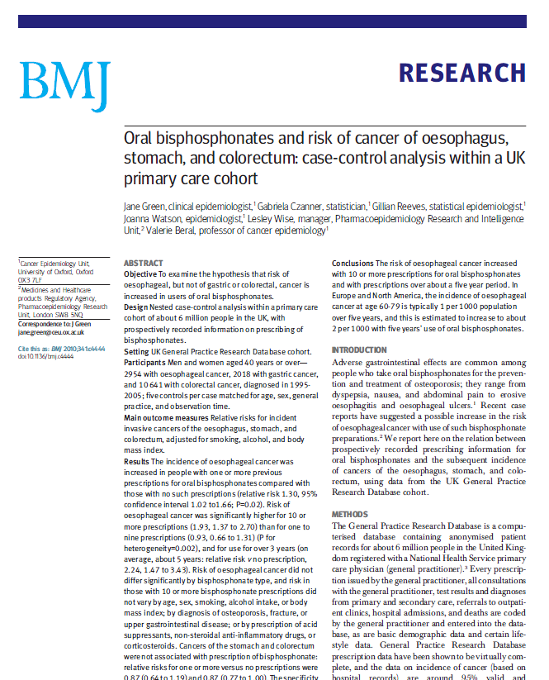

What is the quality of the current evidence from observational analyses?
August2010: “Among patients in the UK General Practice Research Database, the use of oral bisphosphonates was not significantly associated with incident esophageal or gastric cancer”
Sept2010: “In this large nested case-control study within a UK cohort [General Practice Research Database], we found a significantly increased risk of oesophageal cancer in people with previous prescriptions for oral bisphosphonates”

Slide 42
Distribution of possible results for one hypothesis
Stat signif > 1
OR
Databases
Methods

Slide 43
Distribution of possible results for one hypothesis
Stat signif > 1
OR
Databases
Methods

Slide 44
Distribution of possible results for one hypothesis
Stat signif > 1
Stat signif < 1
Databases
Methods

Slide 45
Distribution of possible results for one hypothesis
JAMA
BMJ
Databases
Methods
Study #3

Slide 46
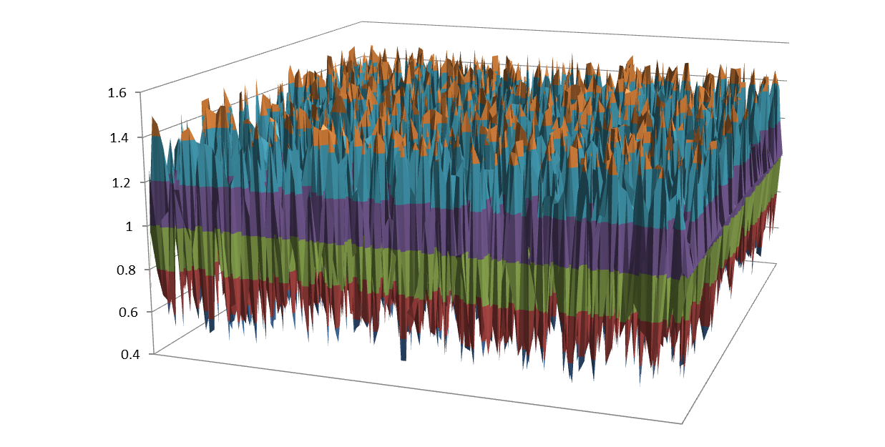
Distribution of possible results for one hypothesis
OR
Databases
Methods

Slide 47
Take a scientific approach to science
Database heterogeneity:
Holding analysis constant, different data may yield different estimates
Parameter sensitivity:
Holding data constant, different analytic design choices may yield different estimates
Empirical performance:
Most observational methods do not have nominal statistical operating characteristics
Empirical calibration can help restore interpretation of study findings
Madigan D, Ryan PB, Schuemie MJ et al, American Journal of Epidemiology, 2013
“Evaluating the Impact of Database Heterogeneity on Observational Study Results”
Madigan D, Ryan PB, Schuemie MJ, Therapeutic Advances in Drug Safety, 2013: “Does design matter? Systematic evaluation of the impact of analytical choices on effect estimates in observational studies”
Ryan PB, Stang PE, Overhage JM et al, Drug Safety, 2013:
“A Comparison of the Empirical Performance of Methods for a Risk Identification System”
Schuemie MJ, Ryan PB, DuMouchel W, et al, Statistics in Medicine, 2013:
“Interpreting observational studies: why empirical calibration is needed to correct p-values”

Slide 48
Open science
Admit that there is a problem
Study it scientifically
  Define that surface and differentiate true variation from confounding …
Total description of every study
Research into new methods

Slide 49
Columbia Data Sharing Approach
Cornell, NYP, NYU, Sinai, Einstein, …
New York City CDRN
Columbia
PCORnet
NYC CDRN (OMOP)
i2b2
NYC CDRN (OMOP)
OHDSI OMOP
EHR
OHDSI OMOP
i2b2
SCILHS (Boston)
SHRINE
OHDSI
i2b2

Slide 50
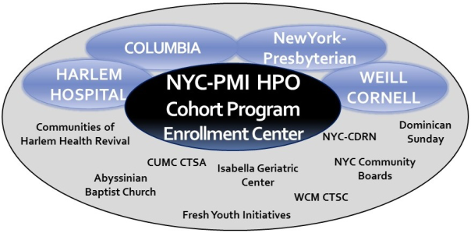
National
Precision Medicine Initiative

Slide 51
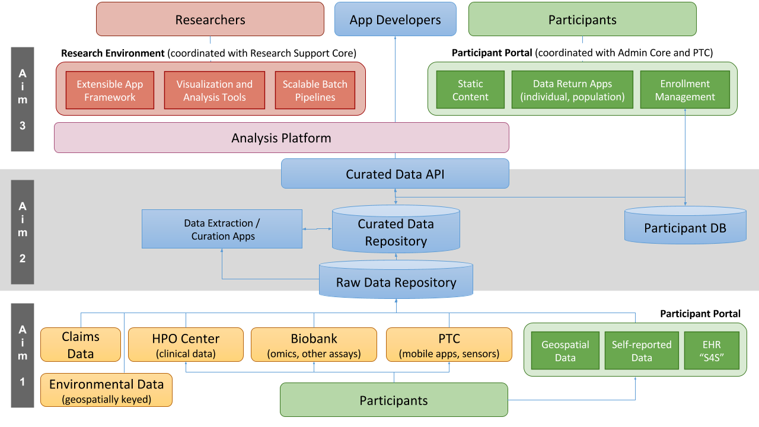
PMI Data and
Research support Center

Slide 52
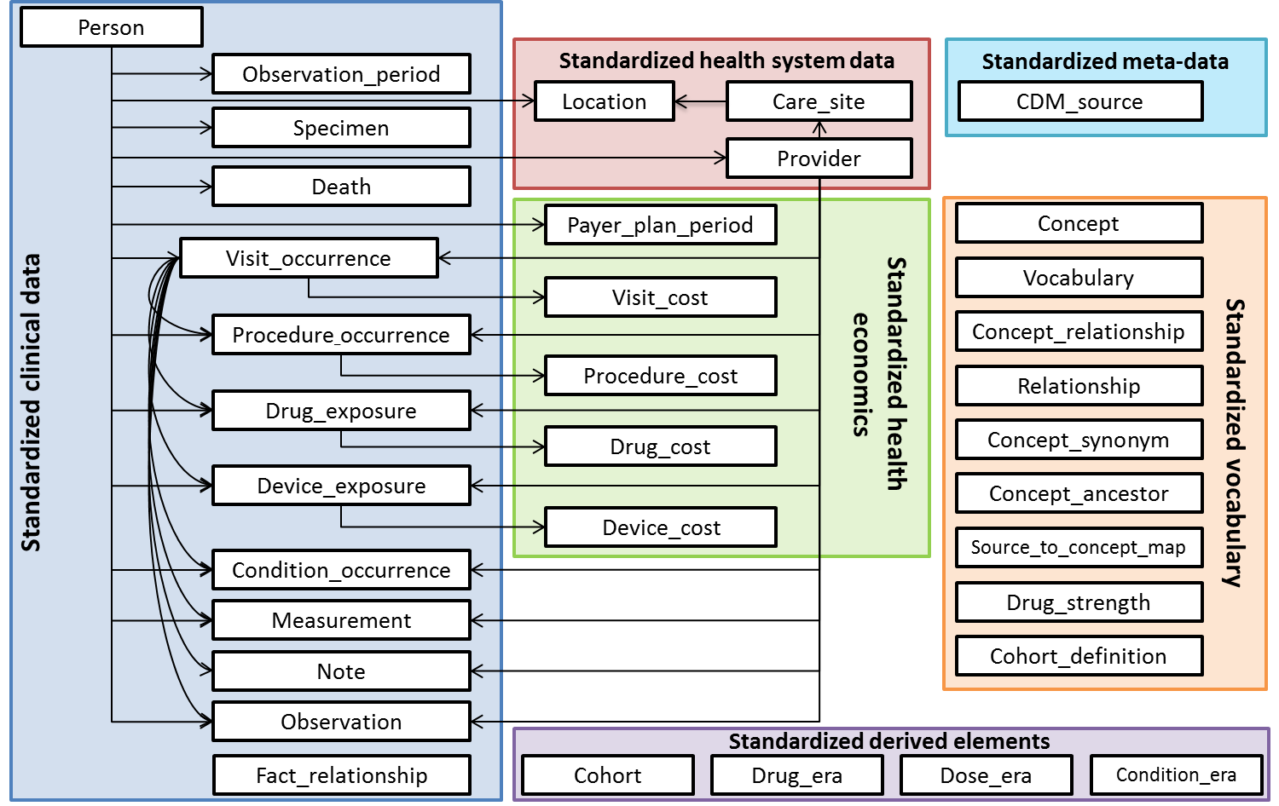
Decide the data model for the national initiative

Slide 53
Quality assurance for the nationally collected data

Slide 54
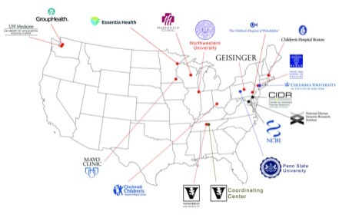
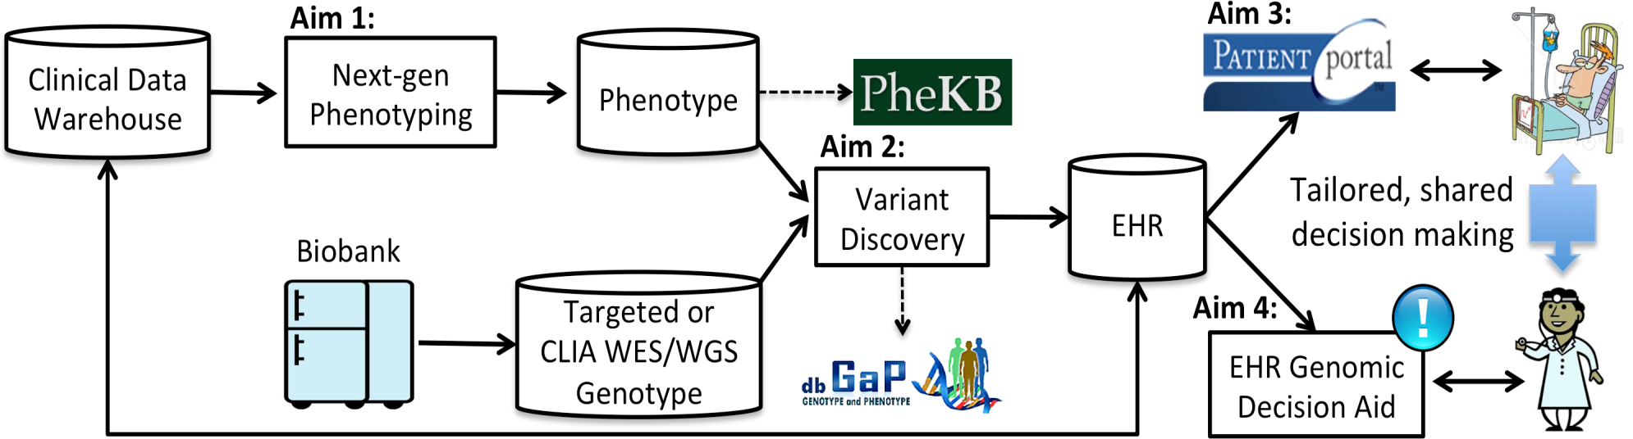
eMERGE
Aim 1: Advance next-generation phenotyping
Aim 2: Perform genetic association studies of rare variants
Aim 3: Develop practical, scalable learning mechanisms for returning results
Aim 4: Provide genomic decision support
Aim 5: Disseminate data and algorithms

Slide 55
Join the journey
http://ohdsi.org

