Slide 1
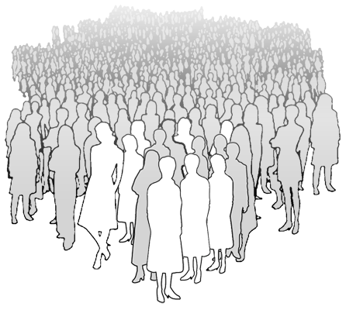
Data-Drive Analytics for Precision Medicine
Clinical
Pattern
Extraction
Insight
Generation
Personalized
Intervention
Diagnostics
Lab
Preprocessing
Scalable Platform
Med.
Decision Support
Genomic
Feature Engineering
Precision Cohort
Sensor
Behavior Profiling
Diet
Personalized Models
Activities
Feature Selection
Patient Centric Measures
Job
Interpretable Insights
Social
Envir.
...
Machine Learning Data Mining Visual Analytics Decision Science
Notes:
> 1m patients in the Precision medicine initiative ($130m)
molecular, genomic, cellular, clinical, behavioral, physiological, environmental

